Slide 1
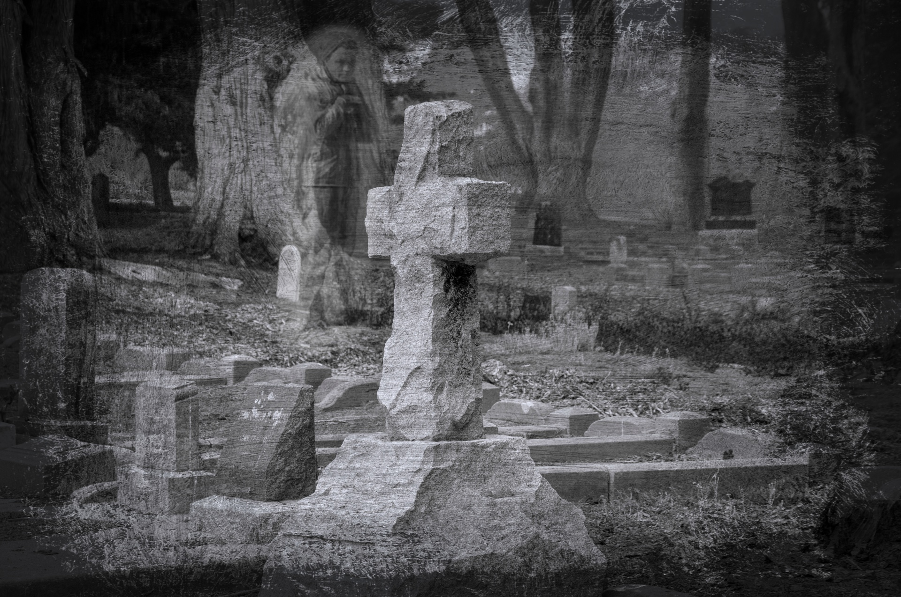
THE DEAD SEASON
MKCW

Slide 2
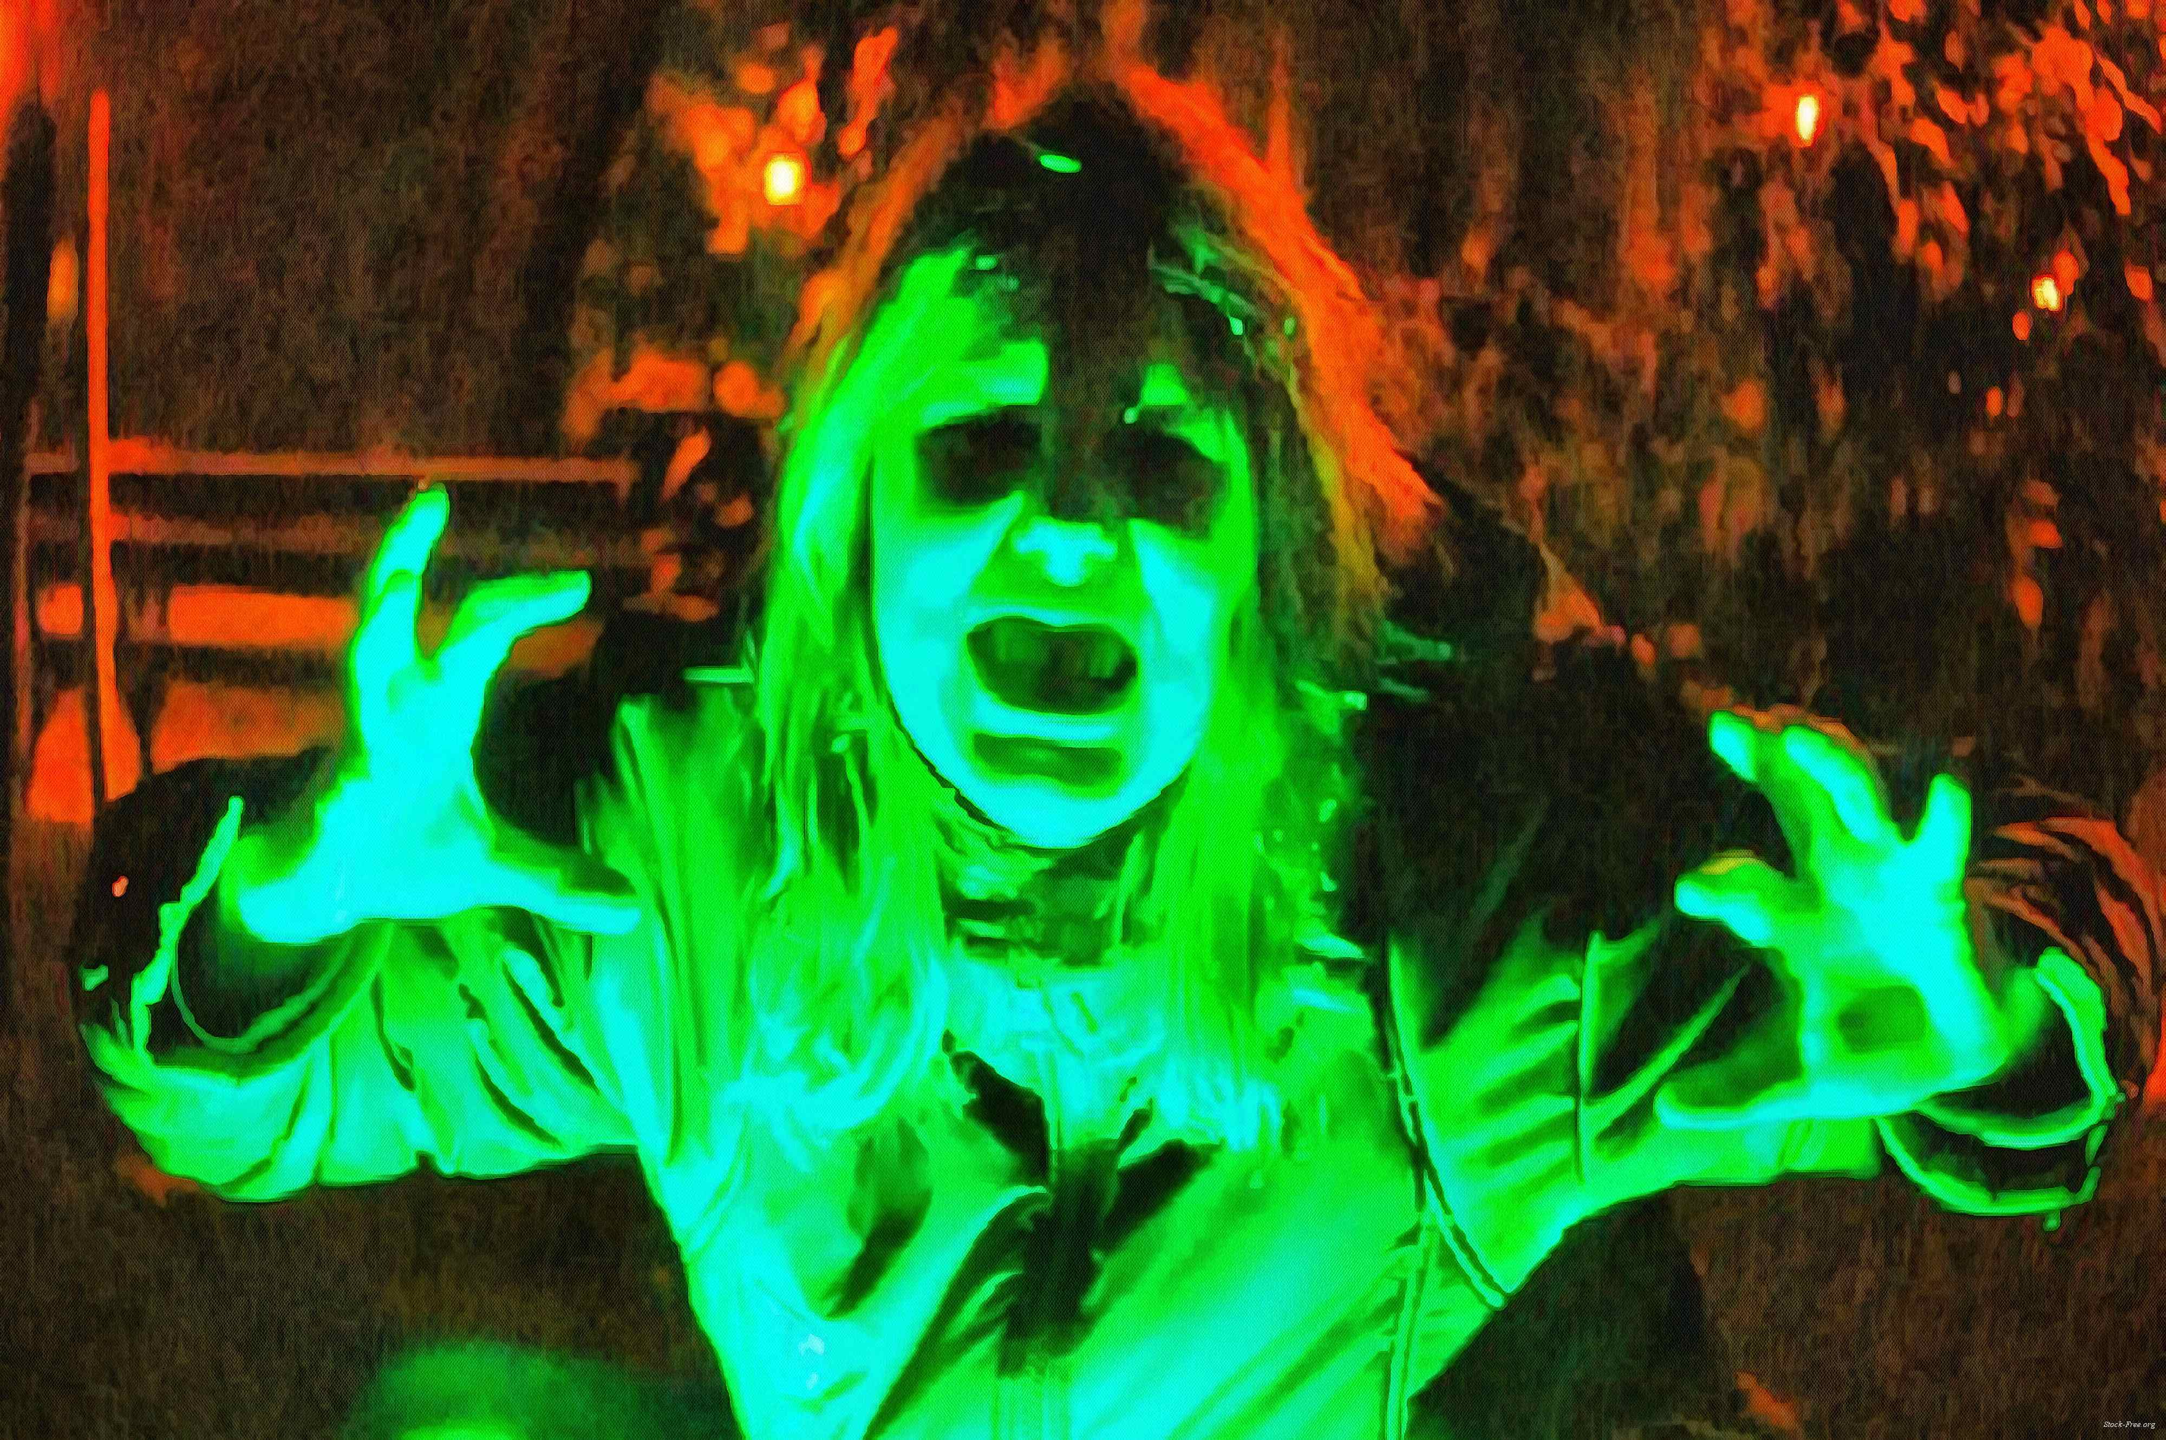
COURSE CONTENT
Week 1 Introduction
Week 2 Complete a Ghost Story
Week 3 Planning a Horror novel
Week 4 Working in Fantasy
Week 5 Writing Suspense
Week 6 Publishing Review

Slide 3
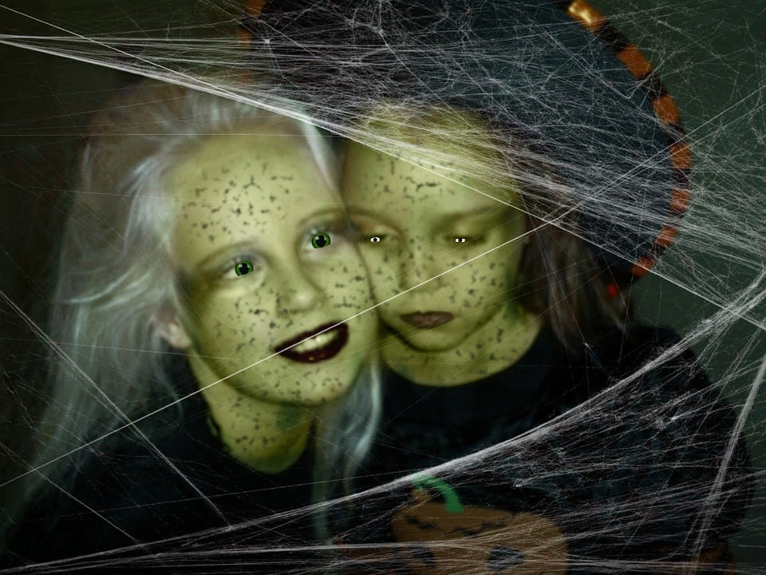
COURSE CONTENT
What makes a Ghost Story?
Structures
Types
Action
Character
Fear

Slide 4

COURSE CONTENT
How to Plan a Horror Novel?
CONCEPTS
VISUALS
USE OF TIME & PLACE
OTHER ODDITIES

Slide 5
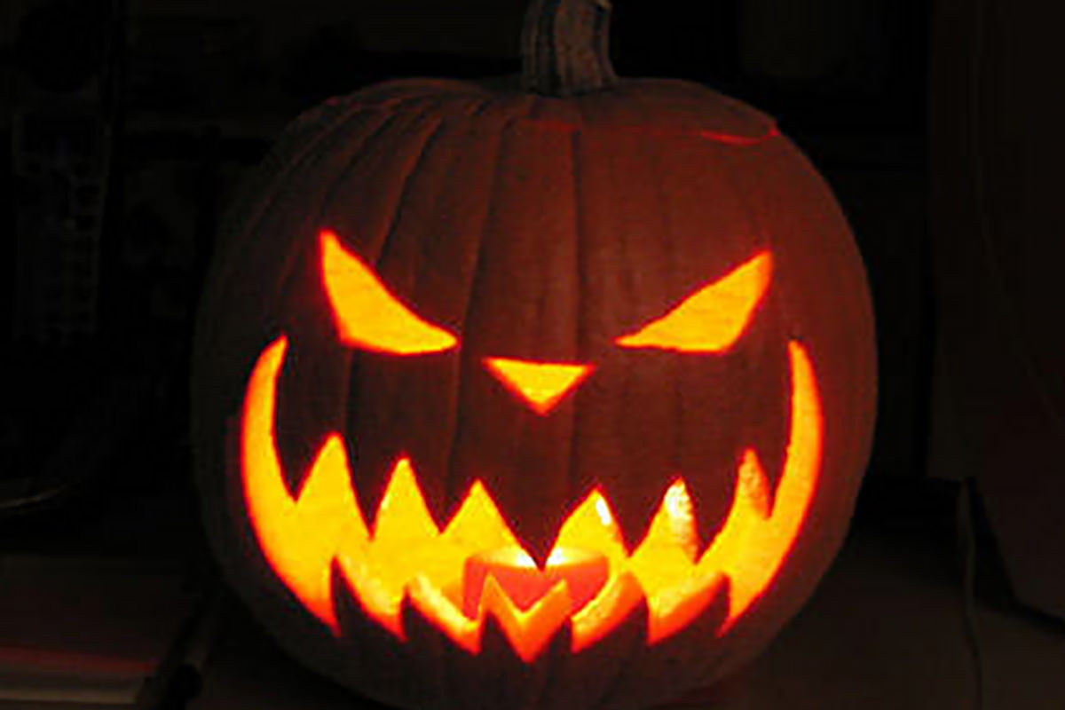
COURSE CONTENT
HOW TO USE FANTASY FOR FEAR?
WHAT IS FANTASY?
WEIRDENSS IN WRITING
UNCANNY
ABSURD
This Photo by Unknown Author is licensed under CC BY-NC-ND

Slide 6
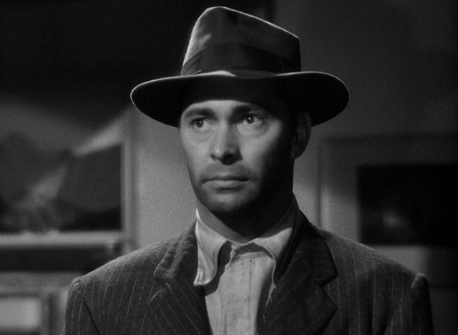
COURSE CONTENT
NON-SCARY FEAR
EDGY WRITING
TECHNIQUES OF SUSPNESE
MURDER VALLEYS AND PEAKS

Slide 7

COURSE CONTENT
PUBLISHING SHORT HORROR
PUBLISHING A HORROR NOVEL
FANATSY & SUSPENSE
COMPLETING A PROJECT

Slide 8
THE DEAD SEASON
MKCW
www.martinkeaveney.com 2023
Not registered? BOOK HERE

