Slide 1
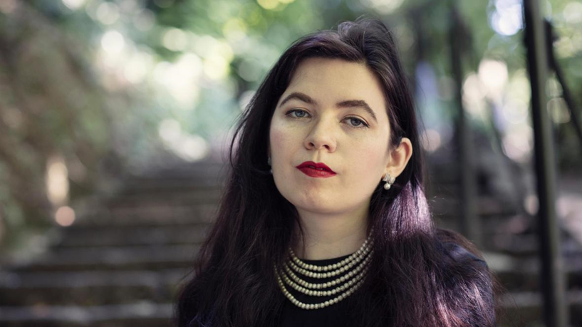
IRISH LITERATURE
TEXT IN CONTEXT
Dr Martin Keaveney
Week 8 ‘Snowflakes’ - Naoise Dolan

Slide 2


EXCITING TIMES
First Published 2020,
Weidenfeld & Nicholson.
2020 W&N Edition
for page references
Debut Novel

Slide 3

MAIN CHARACTERS
Ava
Julian
Edith
Miles
Tom
)

Slide 4
EXCITING TIMES
Part 1 ‘JULIAN’ (3-88)
‘July 2016’ (3)
Ava (22) and Julian (29) live in Hong Kong
Ava TEFL teacher, Julian Banker
Christmas
)

Slide 5
EXCITING TIMES
Part II ‘EDITH’ (91-199)
Chapters 18-38)
Julian leaves for UK.
Ava meets Edith. They start relationship.
Julian comes back.
)

Slide 6
EXCITING TIMES
Part III ‘EDITH and JULIAN’ (91-199)
Chapters 39-50 (203-275)
Edith meets Julian in Hong Kong
Julian gets transfer to Frankfurt.
Julian invites Ava to join him, she leaves Hong Kong and Edith.
)

Slide 7

HONG KONG
‘The Hong Kong dollar was pegged to the US dollar..’ (255-256).

Slide 8
POWER
‘I wish Julian were married. It would make me a powerful person who could ruin his life’ (26).

Slide 9
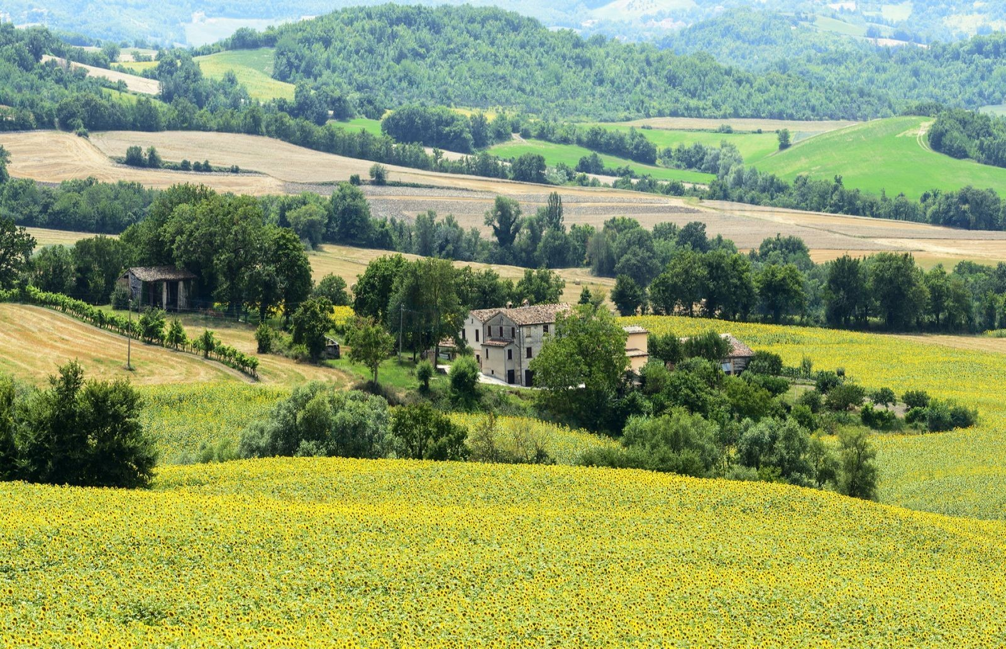
FATHER/FATHERHOOD/MEN
‘”Grand stretch in the evenings now?” [Father](211)
‘Mam’s dad died when I was six. Like any number of men in our family, he’d been an alcoholic’ (211)

Slide 10
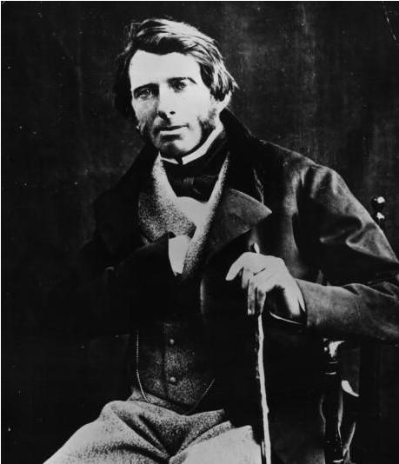
ART
John Ruskin
‘[…]I’d always had that exact fear about anyone seeing me naked’ (29).

Slide 11


CULTURE
‘When an American MD wanted something on their desk tomorrow morning, they said they wanted it on their desk tomorrow morning. When a British one did, they said it wasn’t urgent, tomorrow morning would do.’ (47)

Slide 12
LANGUAGE
‘A Lick-arse’ (100)
‘Ar Meisce is the Irish Irish’ (133)
‘You formed phrases by mirroring patterns from sentences you’d heard in the past’ (227)
‘I suppose it’s like how Irish has all those different words for seaweed’ (253-254).
‘If you work was an intransitive verb then that meant your trust fund subsidised it’ (257). [Created]

Slide 13
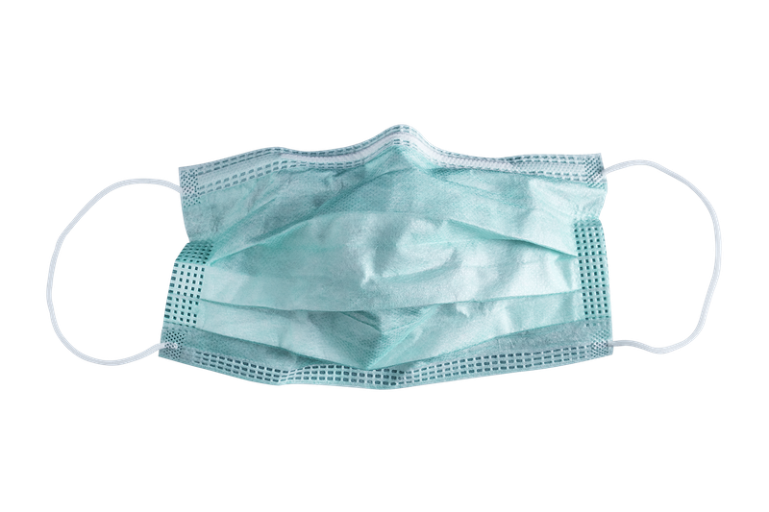
PROPHETIC?
‘Next day at work I had a cough that cut off all my sentences. Joan gave me a mint-green face mask. I said I didn’t need one and she said if parents saw me coughing without it, they’d worry I’d infect their kid. (180)

Slide 14

MEN AND WOMEN
‘[…] so never let anyone tell you men are not complex’ (83).
‘Afterwards we compared our bodies, and I realised that I had never felt calm doing it before’ (145).

Slide 15
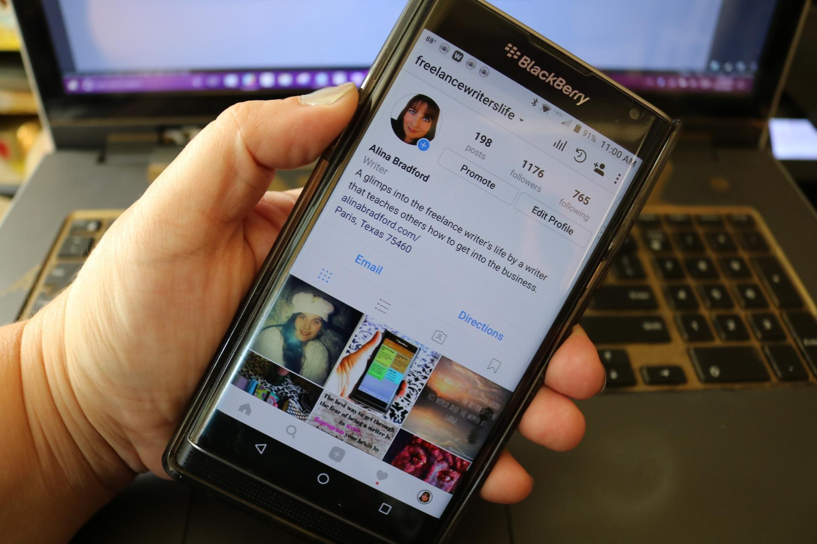
MODERN COMMUNCIATION
‘I decided to write one of my therapeutic drafts’ ‘ (190)
‘Edith hadn’t opened my Instagram stories since our break-up a month ago’ (238).

Slide 16

IRELAND’S POSTCOLONIAL HISTORY
‘Julian said: “Isn’t it that independence was a waste of time because the free state hasn’t yet transitioned to full communism?’ (53).

Slide 17
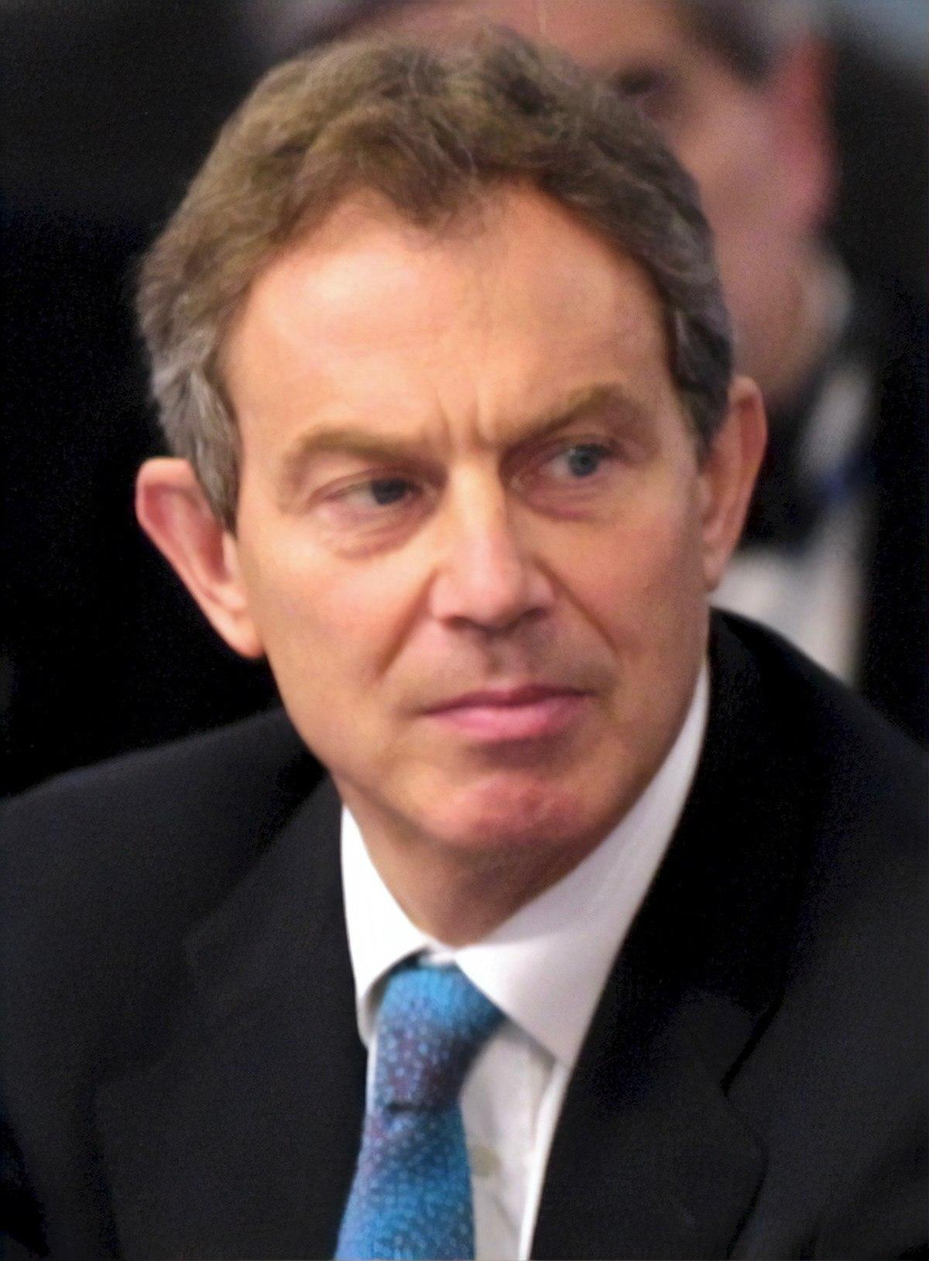
BRITISH POLITICS
‘Or why, if you followed the narrative late-twenties Blairites often held of having graduated into centrism, then he matured to loving a Tory,….’ (246)
This Photo by Unknown Author is licensed under CC BY-SA

Slide 18
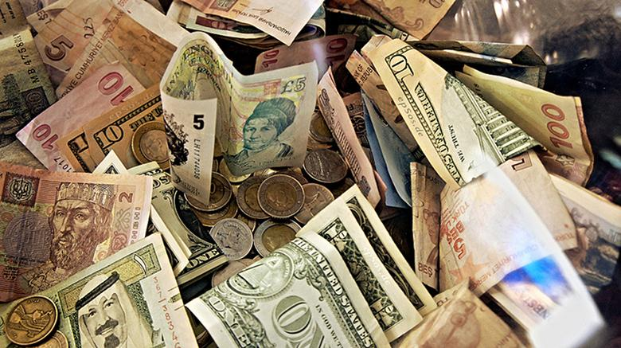

ECONOMICS & RELATIONSHIPS
‘ “I suppose my credit cards are yours as well. Since your definition of owning something is that you use it and don’t pay me back’ (69).

Slide 19
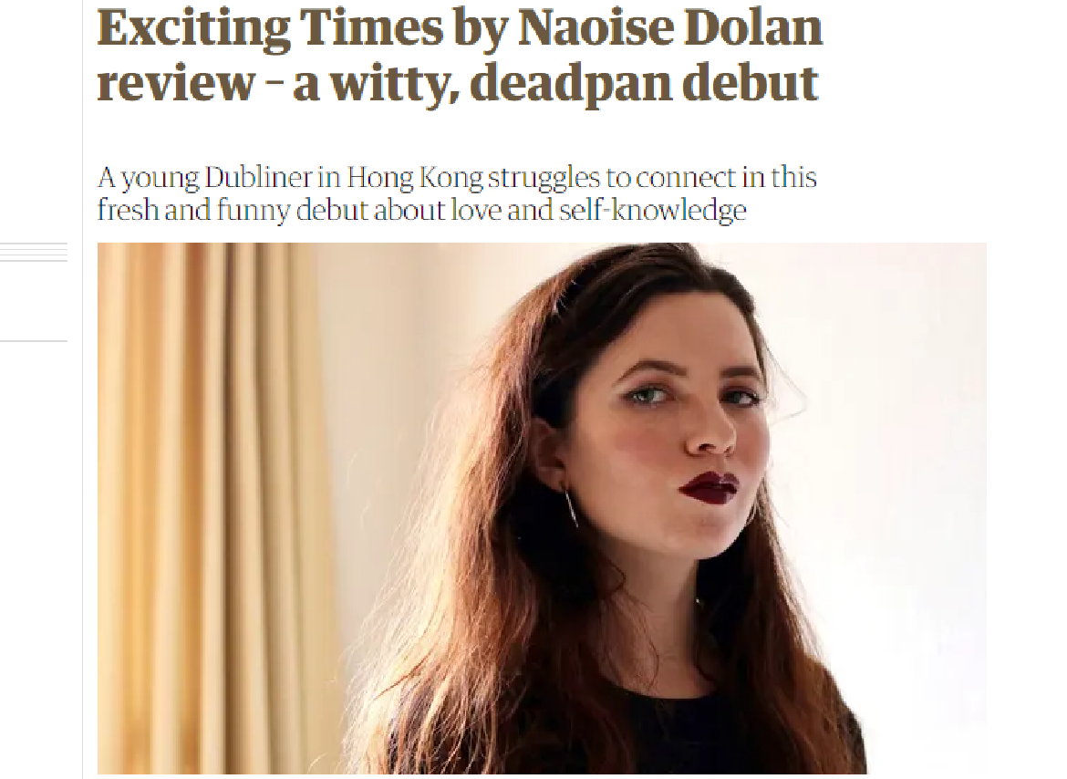
REVIEW
‘[A] brilliantly concise summation of her take on relationships, which she sees as a power game, an “ultimately shallow emotional transaction” in which the greatest potential benefit might be that you get to move into an apartment better than anything you can afford on your own’
Carrie O'Grady, The Guardian, Fri 17 Apr 2020

Slide 20
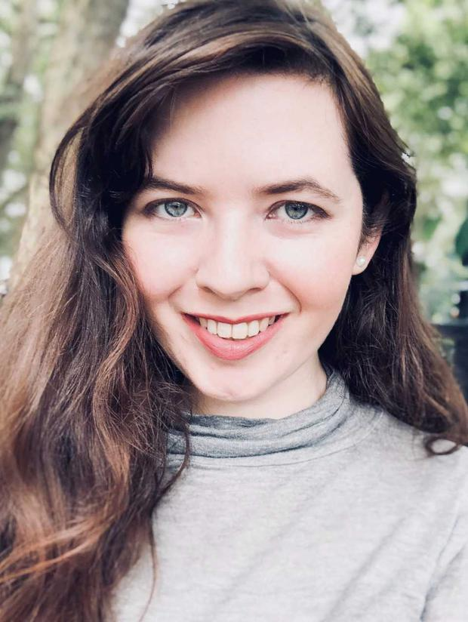
NAOISE DOLAN
Naoise Dolan
Born 14 April, 1992.
.

Slide 21
BIOGRAPHY
Studied at Trinity College
Master’s in Victorian literature at Oxford.
Journalism for The London Review of Books, The Guardian and Vogue.
Shortlisted and longlisted for
The Women’s Prize for Fiction, the Dylan Thomas Prize and The Sunday Times Young Writer of the Year Award.
The Happy Couple (2023)

Slide 22
CONGRATULATIONS!
FINAL ESSAYS – SEND BY NOVEMBER 1st FOR RESPONSE BEFORE CHRISTMAS 2023
FOLLOW-ON – Discuss with Tutor – Several Options available in this weekly slot
Potential further routes of study in new module:
Temporal: Choose 1880-1900, 1900-1950, 1950-1990, 1990-2023
Author: Focus on one of the authors
Language: Focus on evolving styles
Arts - Sociological
Arts- Political
Arts- Historical
Arts - Anthropological
Other combinations or variations possible, discuss with tutor.
FEEDBACK - LET US KNOW ON FEEDBACK FORM!
Great wishes in further study!
www.martinkeaveney.com 2023

Slide 23

MEDIA
https://www.youtube.com/watch?v=3CIyZ6Fku4s

Slide 24

READING
This Photo by Unknown Author is licensed under CC BY-SA-NC

