Slide 1
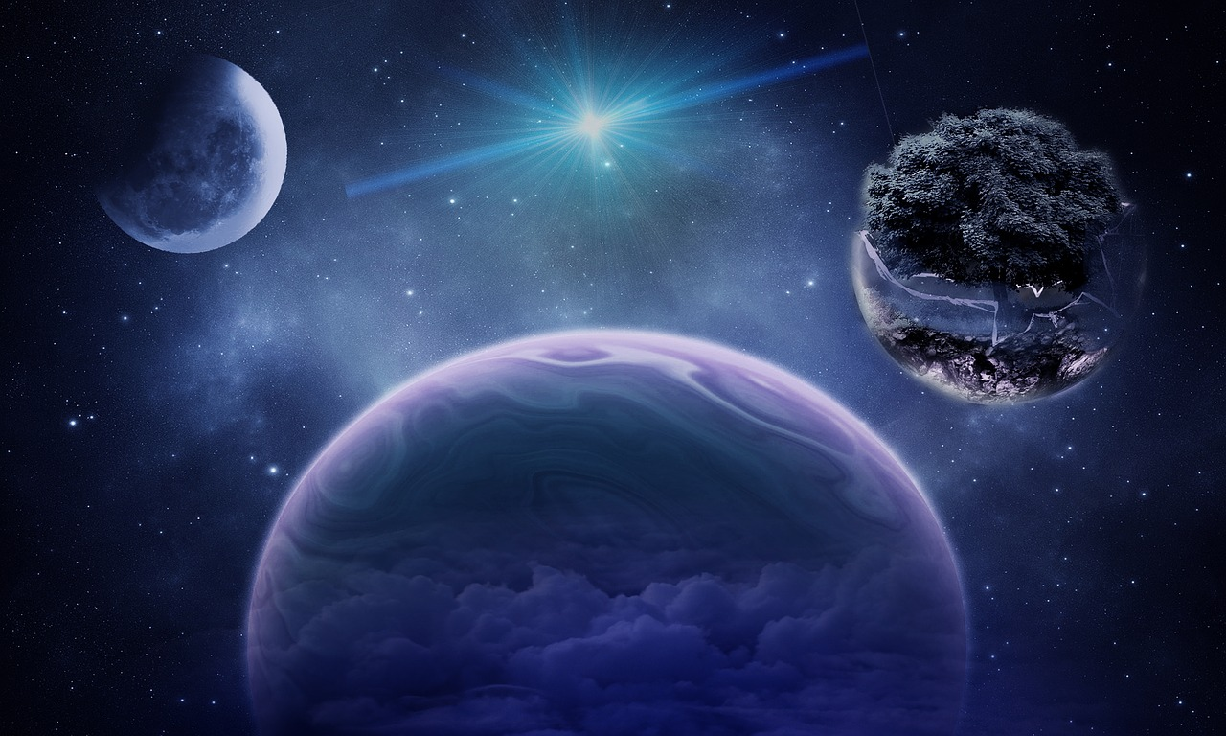
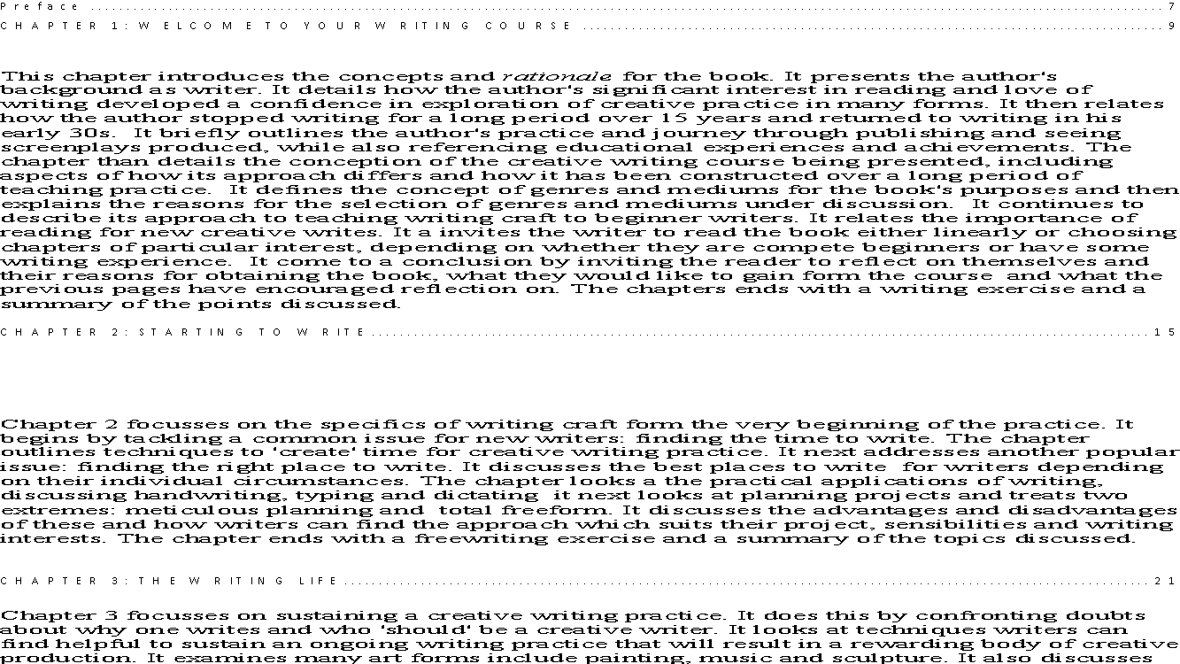

Wonder World
Specialist Course
Week 5 The World to Come
MKCW
This Photo by Unknown Author is licensed under CC BY-NC-ND

Slide 2
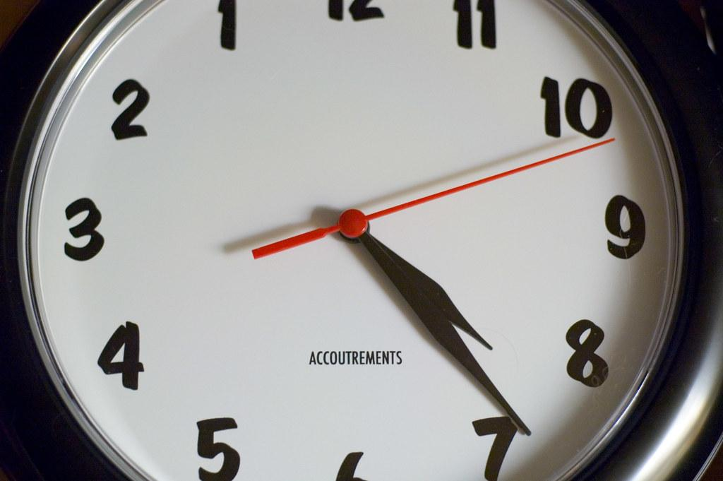
Future Time Zones
2100 AD
3000 AD
30000 AD
300000 AD

Slide 3

Near Futures
2025
2035
2050
2075

Slide 4
Writing Futures
Hypothetical Language
Anticipations
Apocalyptic Outcomes
Technologies
Healthcares

Slide 5

Technology

Slide 6

Hypothetical

Slide 7
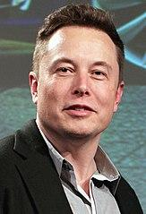
New Frontiers

Slide 8

The Road

Slide 9

Writing

Slide 10
This week
Write a scene in the future based on the writing exercise.
Next Week – Publishing
          www.martinkeaveney.com. 2023

