Slide 1
MKCW
SCREENWRITING: INTRODUCTION
WEEK 7: TREATMENTS

Slide 2
BLUEPRINT
Outline
Include only relevant information
Include all details
In drafting, treatments typically double in size

Slide 3
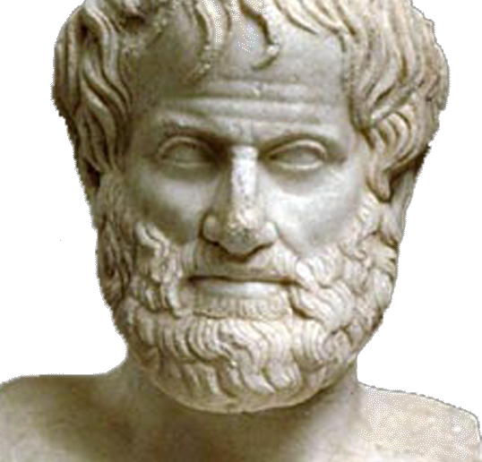
3 Act Structure
Incite
Sustain
Satisfy
Detail Ending

Slide 4

Details
Beats Precisely Dictated

Slide 5
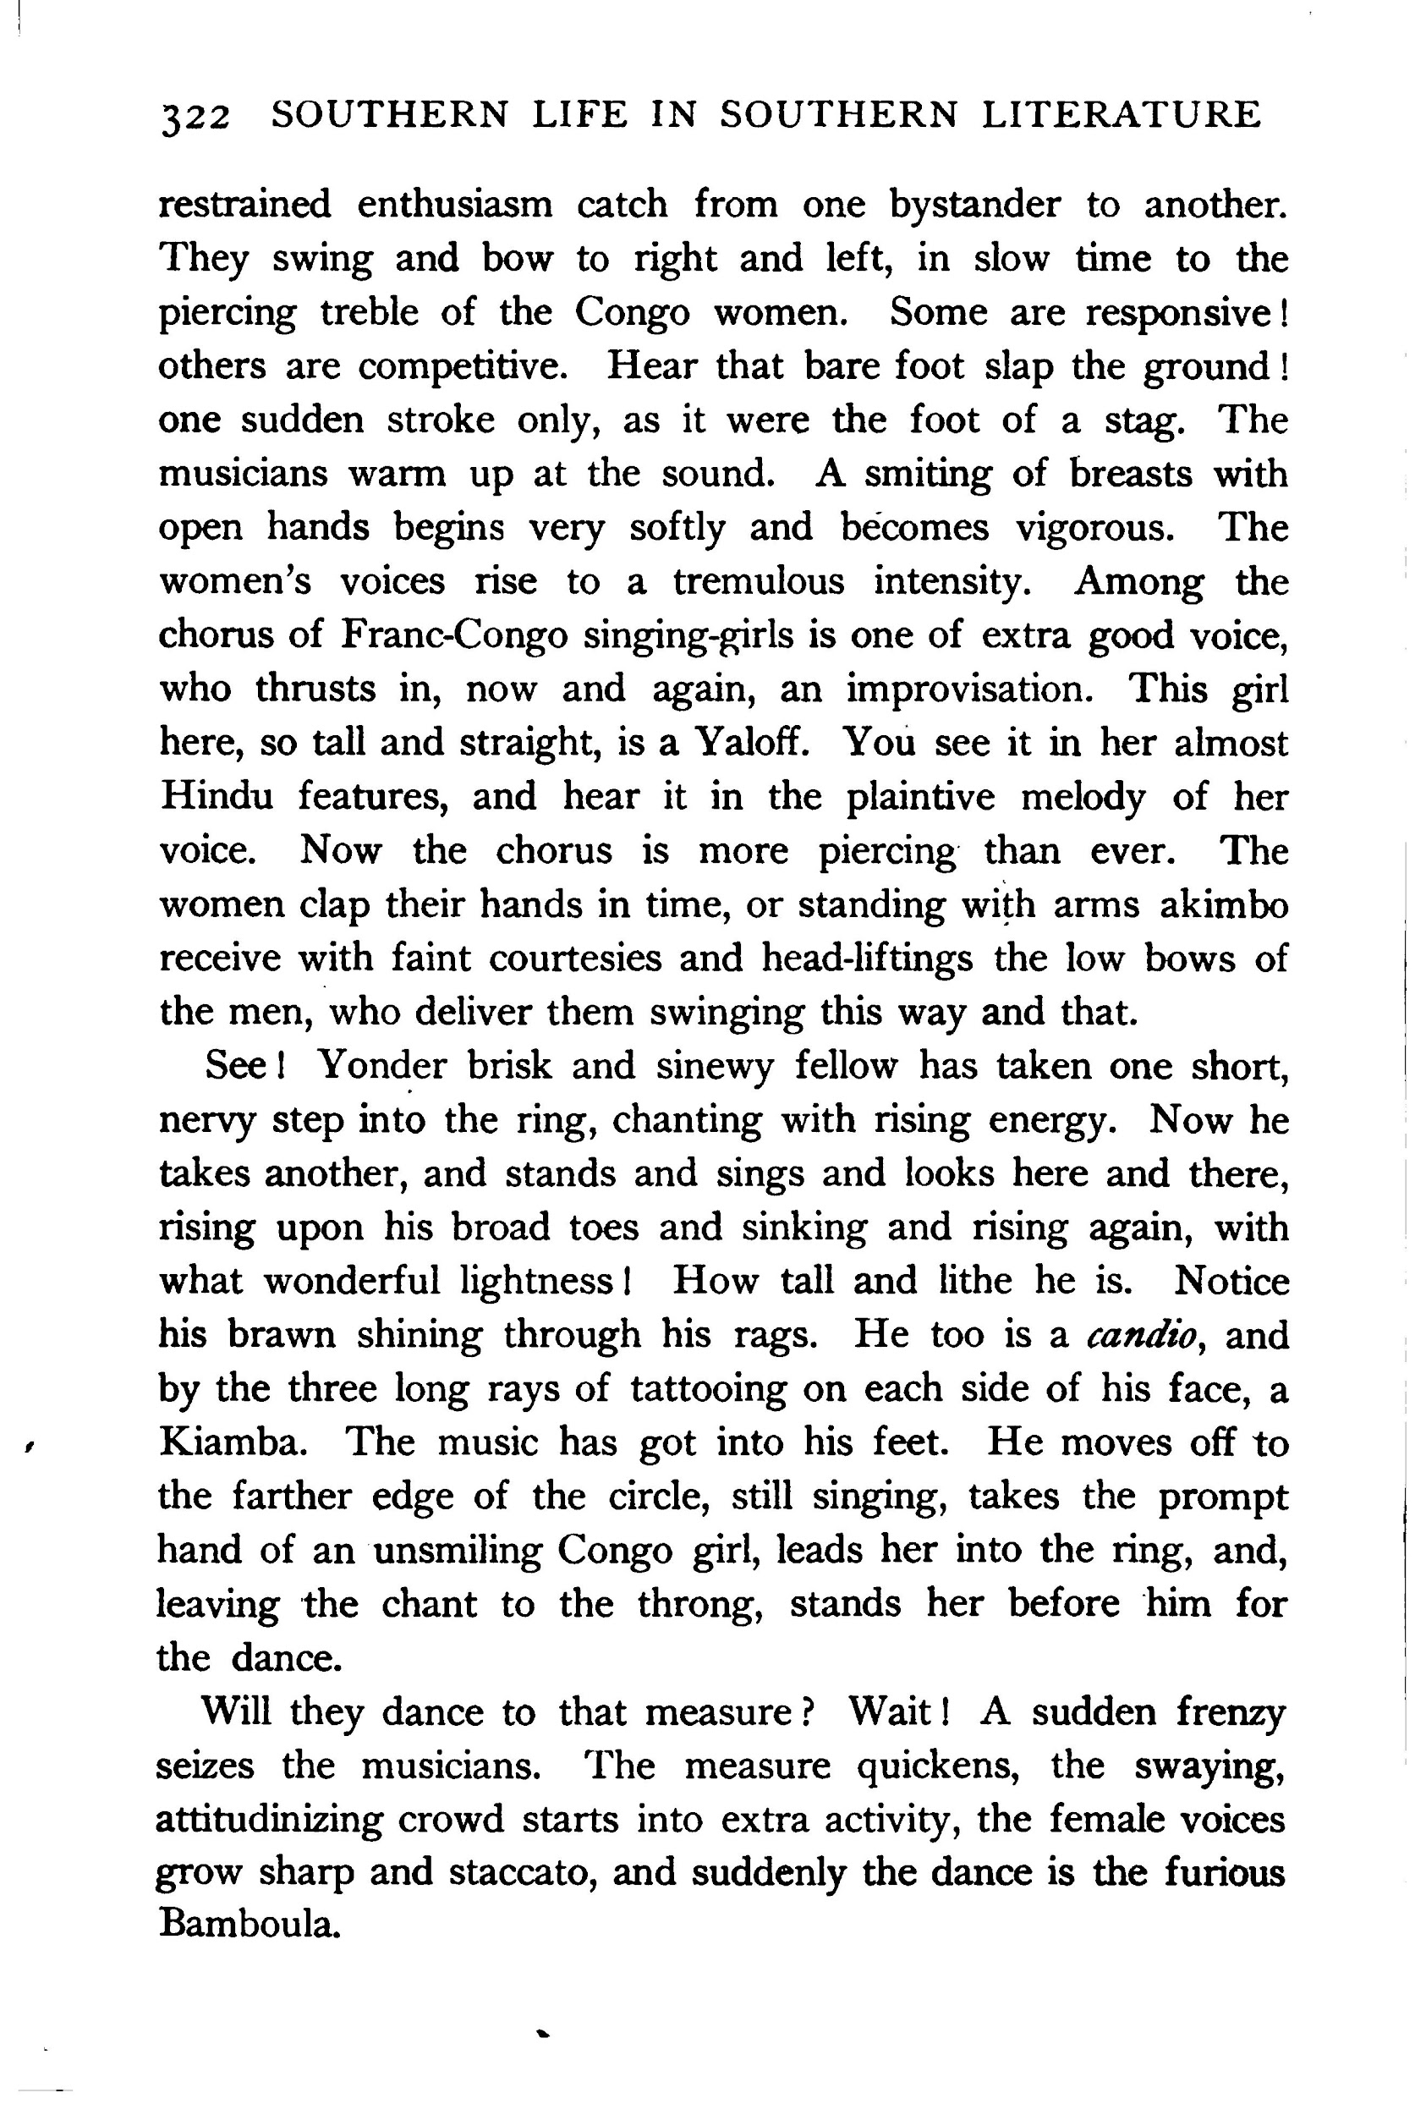
Presentation
Clarity
Present Tense
3rd Person
Conventional Length guideline
120 pages screenplay = 12 pages treatment (2000-3000 words)

Slide 6
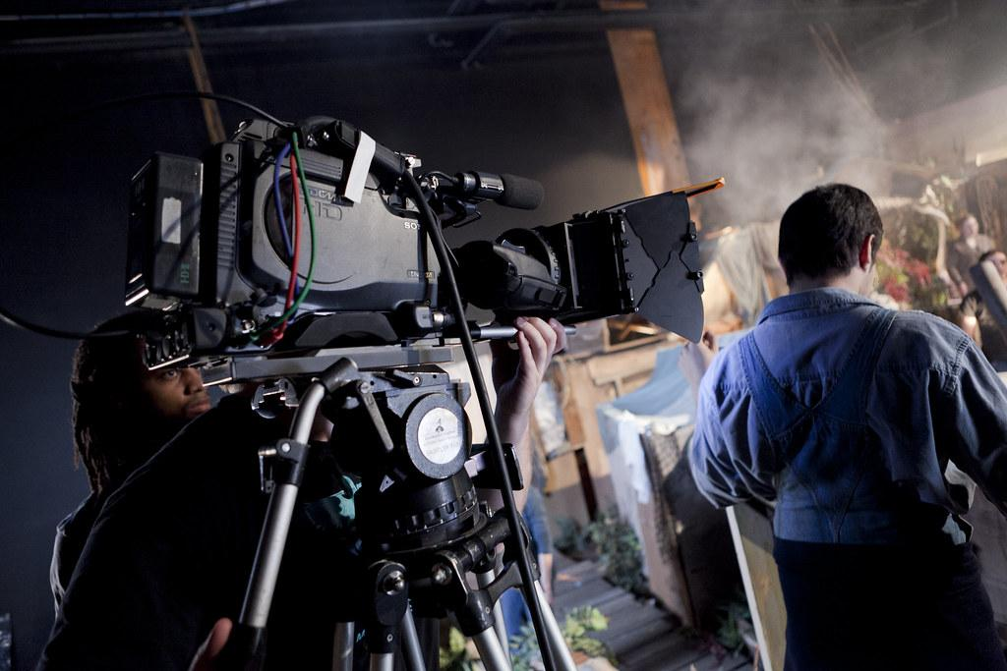
Production
Evolves in Production

Slide 7
EXERCISE
Watch this scene
https://www.youtube.com/watch?v=9TaWiq_-2Dc
Describe precisely what happens in it.

Slide 8
THIS WEEK:
Write a treatment of a short film a this site
https://filminute.com/festival/
.Or write a treatment of one of your short films.
Next week: Formatting

