Slide 1
MKCW
SCREENWRITING: INTRODUCTION
WEEK 5: REWRITES

Slide 2

REVISIONS
Macro Revisions - Story
Macro Revisions - Sequence
Micro Revisions - Scenes
Character Revisions
Cuts
Additions

Slide 3
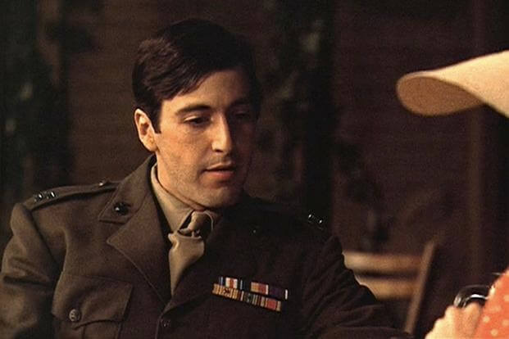
Macro Revisions - Story
Logic
Journey
Alternatives
Treatment of Character & Plot
Character example
Character state full clip
Character Changes 3.00-3.325

Slide 4
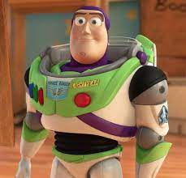
Macro Revisions - Sequence
Key Events
Value for Events
Foreshadows & Links
Foreshadow part 1 0.50-1.52
Foreshadow part 2 2.00 - 2.38

Slide 5
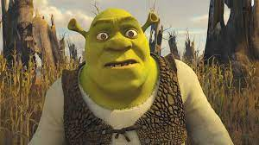
Micro Revisions - Scenes
Incite, Sustain, Satisfy
Motive through Action
Conflict
Scene error example 2.25 - 2.50

Slide 6
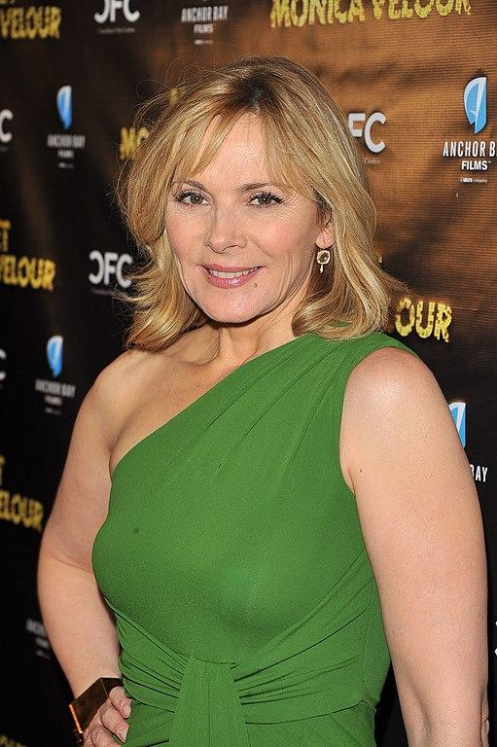
Character Revisions
Basis of Character
Character Arc / Journey
Character Voice / Tone
Character 0.00 - 1.00
Character 0.00 - 1.00

Slide 7
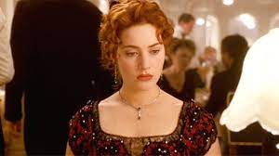
Cuts
Non-contributing scenes
Non-contributing characters
Non-contributing lines
Deleted Scene example 0.18 - 1.18

Slide 8
Additions
Push story further
Push scenes further
Push characters further
Push lines further

Slide 9
EXERCISE
Write a scene
Cut the original scene in half
Double the original scene length
Change the scene in another way

Slide 10
THIS WEEK:
Write a revised scene from your story (5 industry length pages).
Next week: Formatting

