Slide 1
MKCW
SCREENWRITING: INTRODUCTION
WEEK 4: SCREENWRITING

Slide 2
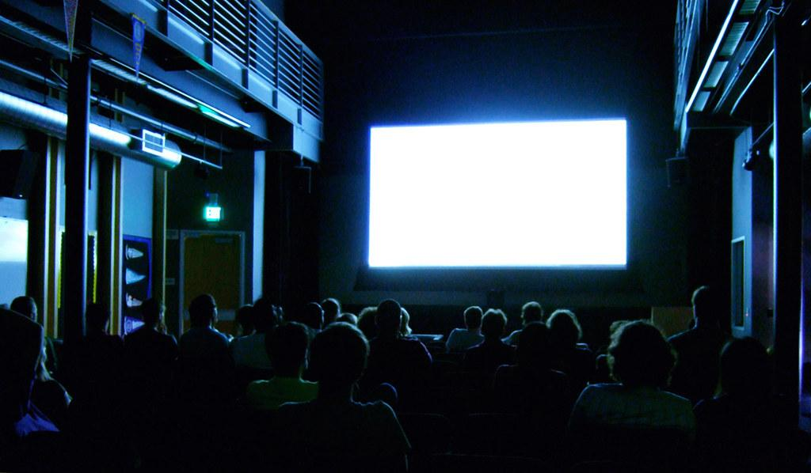
SCREEN AS MEDIUM
Visual
Pacing
Clarity

Slide 3

Visual Medium
Background
Colours
Characters

Slide 4

PACING
Scene Length
Dialogue
Action

Slide 5
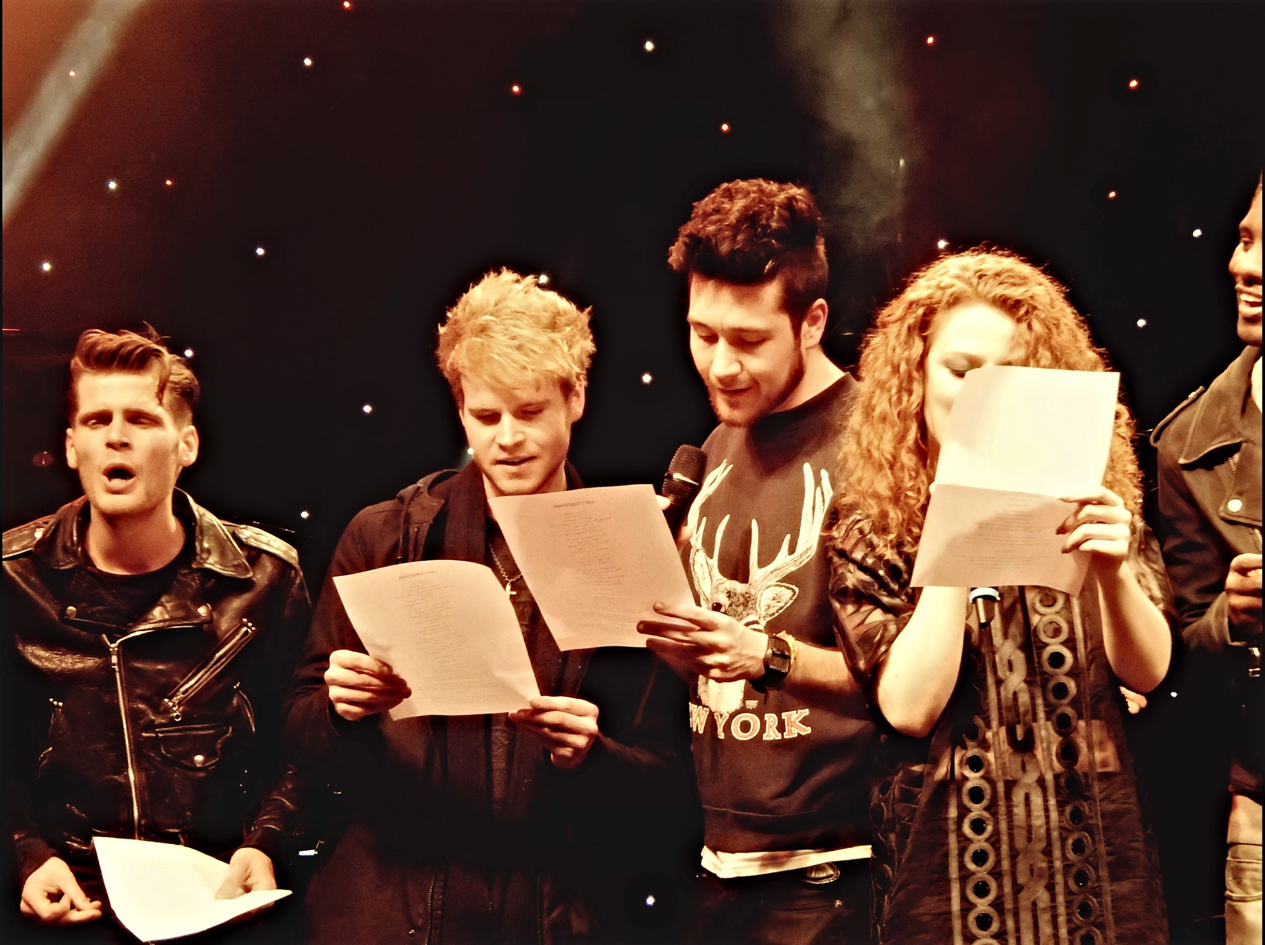
CLARITY
3rd Person
Motive through Action
Conflict

Slide 6
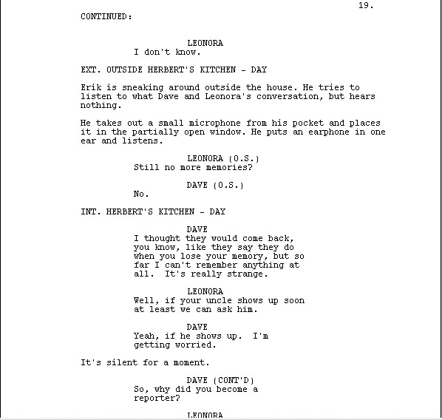
CONVENTIONS
Slug Lines
Character Names
Tense
Practical examples

Slide 7

CONVENTIONS
Courier New 12
Cover page
Project length

Slide 8

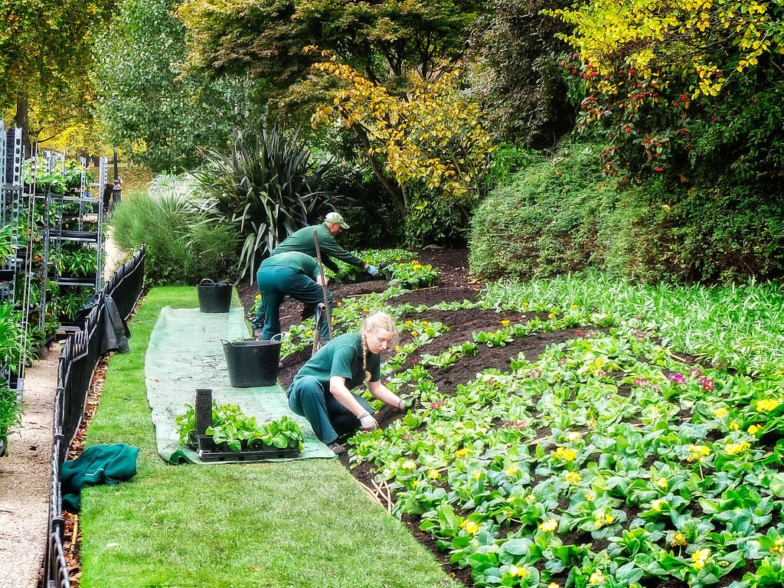
Writing
Approach from Story
Approach from Scene
Combinations

Slide 9
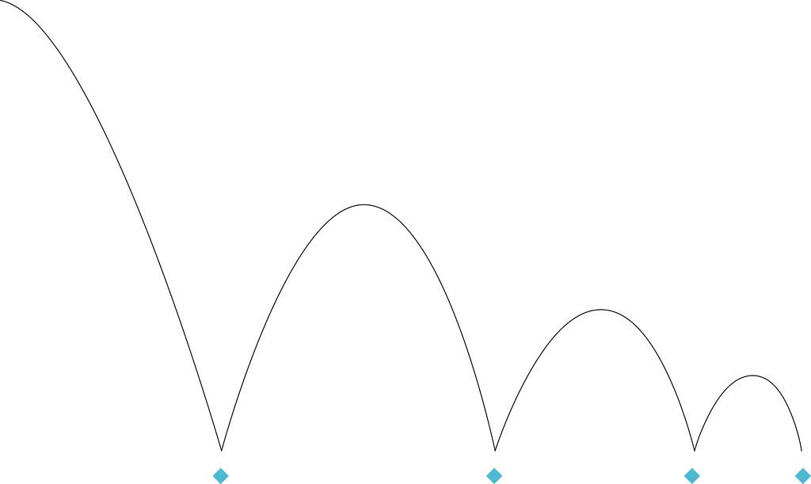
Sequencing
3 Act Structure in Conventional Forms
Others vary
Foreshadow
Reach expectation
Defy expectation
Rising Action
Peaks and Troughs

Slide 10
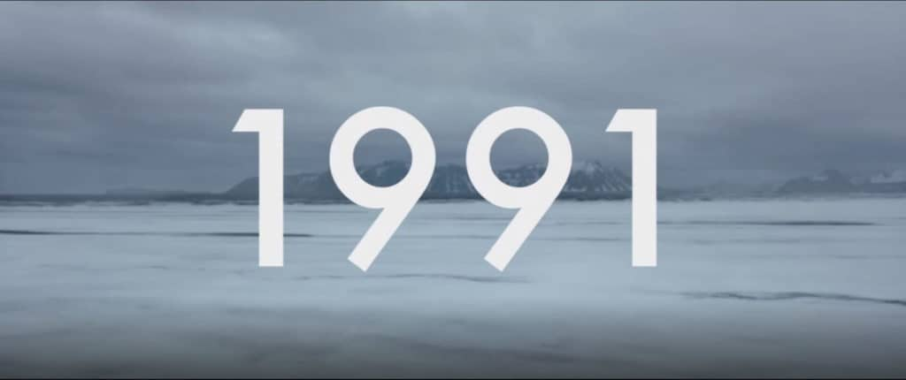
Other Aspects
Voiceovers
Off-screen
Super-impositions

Slide 11
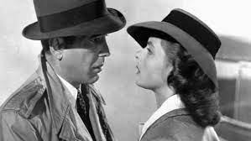
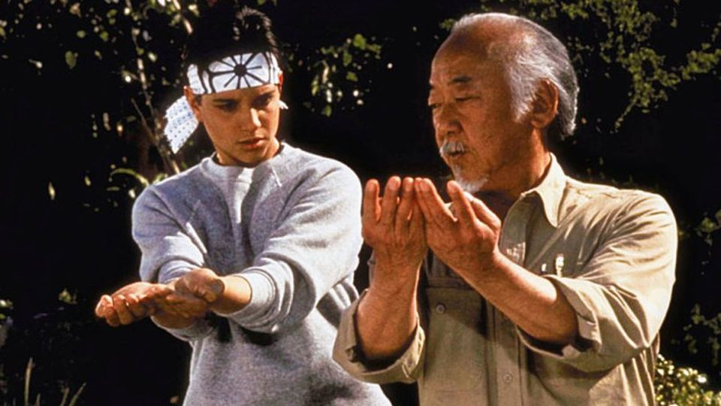
Sample Screenplays
The Karate Kid (1984)
Casablanca (1942)

Slide 12
SAMPLE
INT. - KITCHEN - DAY
John and Mary sit at the table.
JOHN
I see Paddy is open again.
MARY
He must have been closed 2 years.

Slide 13
EXERCISE
Write a short scene.

Slide 14
THIS WEEK:
Write a short scene from your story (5 industry length pages).
Next week: Rewrites

