Slide 1

Screenwriting
with Dr Lucie Brownlee

Slide 2
Screen versus Prose
“ If I had more time, I would have written a shorter letter”
(variously attributed to Blaise Pascal, Thoreau, Twain...)

Slide 3
Voice...voice...VOICE?
ASK YOURSELF...
Why is this a story only I can tell?
Why now?

Slide 4
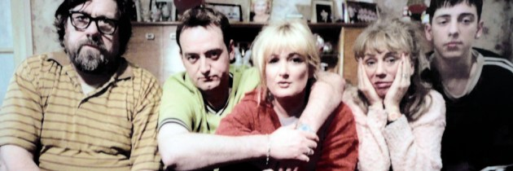

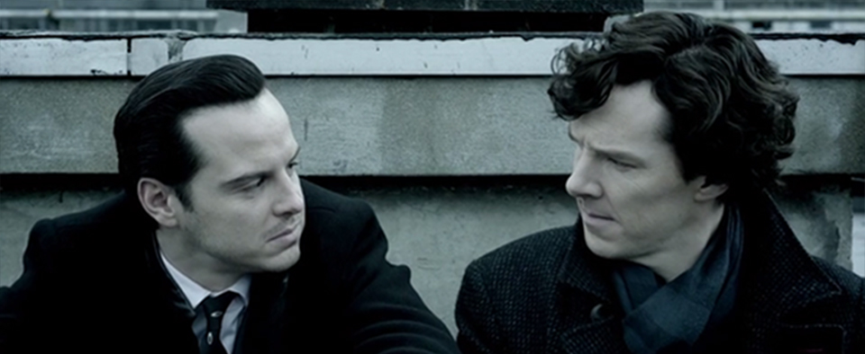
Character or Plot-Driven? Or a bit of both?

Slide 5
Structure
Alan Plater to his agent Peggy Ramsay: “What is this structure thing?”
Peggy: “Oh darling, it’s just two or three little surprises followed every now and again by a bigger surprise.”
Watch Matt Stone and Trey Parker talking about the importance of causation between beats:
https://www.youtube.com/watch?v=vGUNqq3jVLg

Slide 6
The Beat Sheet
A short exercise on beats using the work of our (OK, my) favourite Norwegians:
https://www.youtube.com/watch?v=djV11Xbc914

Slide 7
Sequence (collection of scenes leading to significant change)
Act (series of sequences that peaks in a climactic scene which causes a major reversal of values, more powerful in its impact than any previous sequence or scene.)
Story (master event)

Slide 8
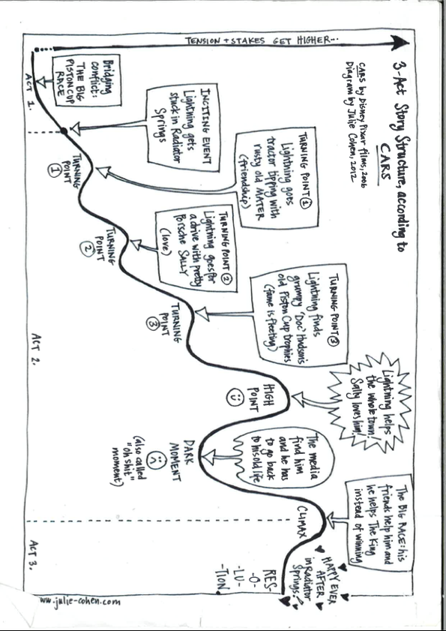

Slide 9

EXERCISE: WHAT’S AT STAKE?

Slide 10
GETTING DOWN TO IT
FIRST TEN PAGES
FLASHBACK = FLASH PRESENT https://www.youtube.com/watch?v=od9nlPsAa3E
ENTER LATE, GET OUT EARLY
SPEC SCRIPT
SHORT SYNOPSIS
TREATMENT
LOGLINE

Slide 11
THE DARK ART OF THE LOGLINE...
PROTAGONIST + PROTAGONIST GOAL/ACTION + CENTRAL CONFLICT/IRONY

Slide 12
GUESS THE FILM OR SHOW FROM THE LOGLINE...
1. The aging patriarch of an organized crime dynasty transfers control of his clandestine empire to his reluctant son.
2. Five women head out on a weekend of a lifetime to celebrate Zara's engagement only to be interrupted by the end of the world.
3. A young man is transported to the past, where he must reunite his parents before he and his future cease to exist.

Slide 13
A word on titles...
‘With enough time you can always get a good title. The hell of it is that you always have a lot that seem good and it takes time to tell which one is right.’
Hemingway to Arnaud Gingrich, 1933, from Selected Letters p386
Mr Cauliflower
Montauk
Six of One
Lenny, Penny and Kenny

Slide 14
NEXT STEPS
STOCK UP ON SPEC SCRIPTS
ENTER COMPETITIONS
SEARCH AND APPROACH AGENTS WHO REPRESENT YOUR KIND OF WRITING
WATCH TV SHOWS!
HOPEFULLY AN OPTION...THEN A COMMISSION...THEN A SHOW!

