Slide 1
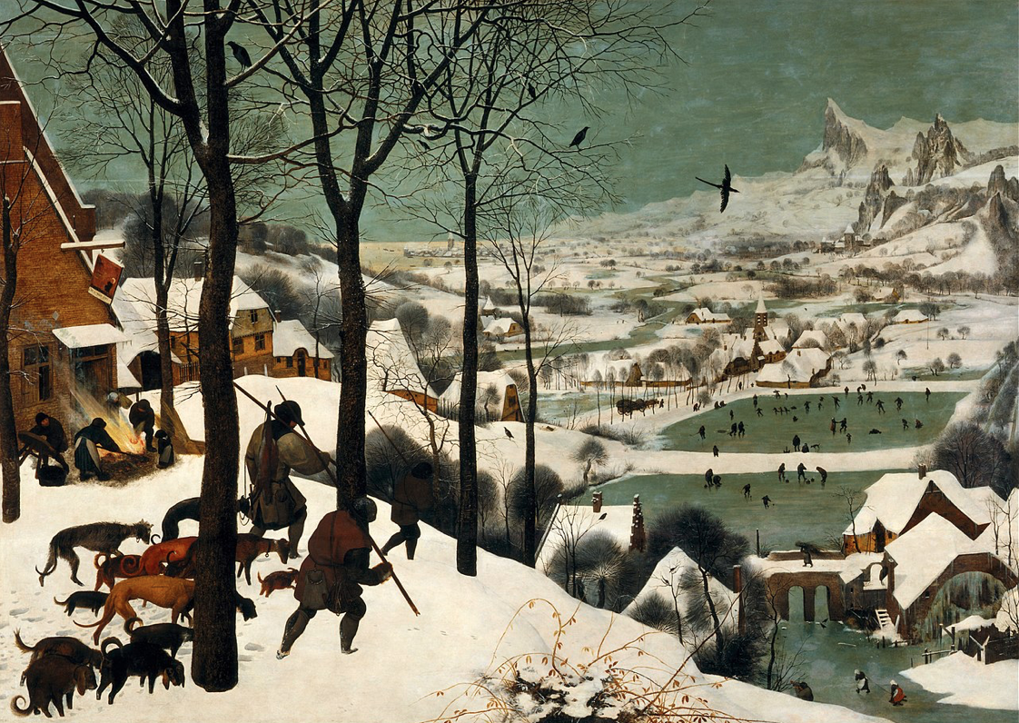
Ekphrastic Poetry - Art as Stimulus
Hunters in the Snow,
(Bruegel, 1565)
    Course Tutor: Sam Egelstaff Contact email: egelstaff@icloud.com

Slide 2
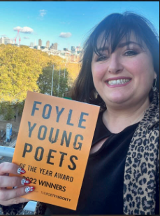
Sam Egelstaff
BA Hons - English, Language, Literature, TEFL, Creative Writing and Film Studies Northumbria University at Newcastle
MA Creative Writing Bangor University - poetry collection and prose fiction
PhD Education- Using poetry to improve wellbeing of learners in areas of high disadvantage and poverty
Teacher Trailblazer Award 2022 from The Poetry Society and Foyle Foundation
Lecturer in Creative Writing, Literature, Film and Media for 9 years
Teacher of Literature, Language, Theatre, Drama and Media- 22 years experience
Feature Writer, Photographer & Copy Editor for Trinity Mirror Press

Slide 3
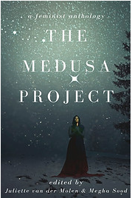

Published Works:
Sculpted and Hegel’s Child in ‘Counterpoints’ Responses to RS Thomas (Einion Press, 2014)
Knot in The Medusa Anthology (Mookychic, 2020 & SpaceEx Falcon Lunar Codex Mission & NASA Viper Rover Museum on the Moon, Lunar South Pole-to be launched July 2024)
We have become dysmorphic (Cape Magazine, 2021 & Sonnets for Shakespeare, 2020) and Gwenllian on a Payfreeze (Sonnets for Shakespeare, 2020 & Icefloe, 2021) Both performed at BritGrad Conference 2021.
We have become Plastic (Icefloe Press, 2022) Limpet (Ice Floe Press, 2022) Raw (Wildfire Words, 2022)
Pirate of Llandoger Trow (Frosted Fire, 2022)
Poetry performances across venues in the UK, including the R.S Thomas Literary Festival, BritGrad Festival 2020, Cheltenham Poetry Festival and Evesham Poetry Festival.

Slide 4
What is Ekphrasis?
Ekphrasis is the term for literature that is influenced from another form of art. This may include: a sculpture; a work of fine art; an artistic object; a textile or tapestry etc. Ekphrasis is a Greek term and it is used to describe a skill applied in vivid detail.
One of the earliest examples of Ekphrastic poetry can be read in Homer’s The Iliad, (7th Century BC) ’a great and massive shield, blazoning well-­‐wrought emblems all across its surface.’
In his epic poem, Homer creates a sense of heroic power by describing Achilles’ ornate shield in detail, through 150 lines of ekphrastic poetry.
Sometimes, poets may describe the effect the artwork may have had upon them, such as in John Keats’ Ode to a Grecian Urn (1819), or there may be a socio-political statement made, such as in Edwin Markham’s poem about ‘Man with a Hoe’ (1899) painted by Jean Francois Millet. Markham’s poetry highlights the cruel and labour intensive treatment of the American worker and his poetry is thought to have been instrumental in influencing amendments for workers’ rights.
Furthermore, using ekphrastic influences are a great way to end writer's block!
So, visit an art gallery; find an image or search for an artistic object and start writing!

Slide 5
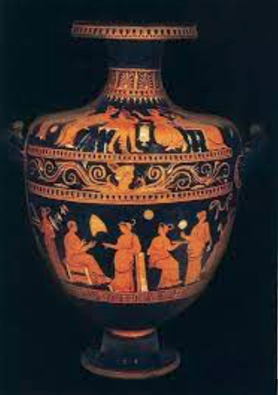
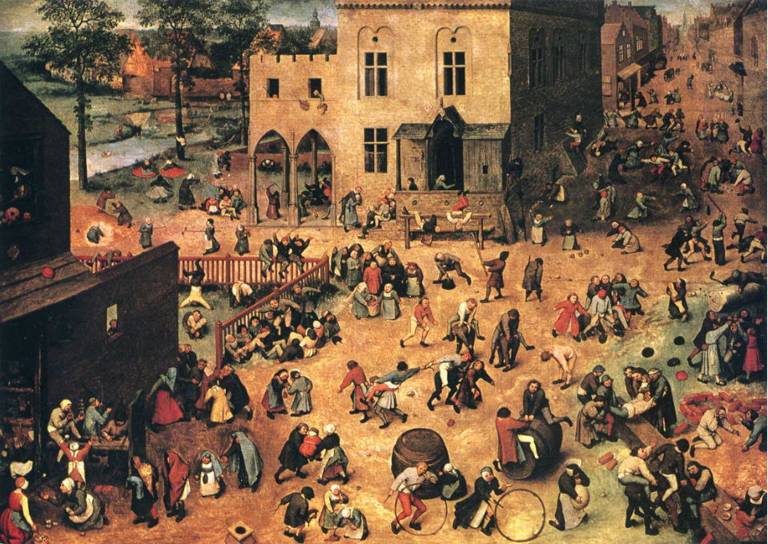
Starry Night, Van Gogh & Sexton
Ode to a Grecian Urn, Keats
Children’s Games, Breugel & Carlos Williams

Slide 6
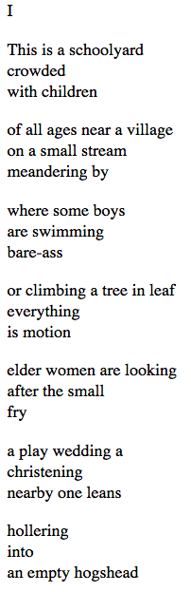
    Children’s Games, William Carlos Williams

Slide 7
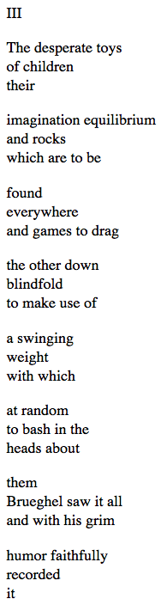
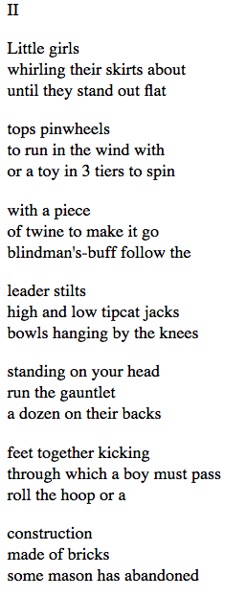

Slide 8
“To begin, begin.”
–William Wordsworth

Slide 9
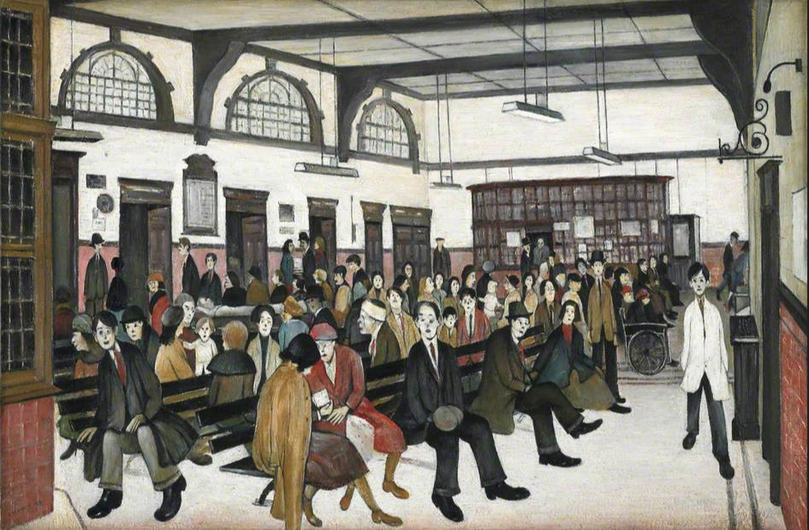
Free Writing Activity - Listing & Editing
Hunters in the Snow,
(Bruegel, 1565)Hunters in the Snow,
(Bruegel, 1565)
Hunters in the Snow,
(Breugel,1565)
Ancoats Hospital Outpatients’ Hall,
(Lowry, 1952)

Slide 10
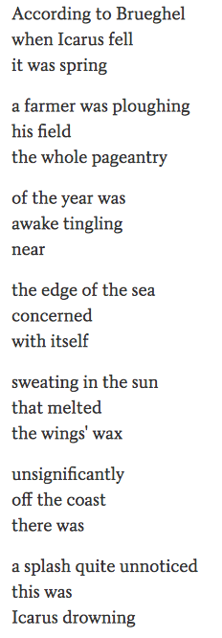
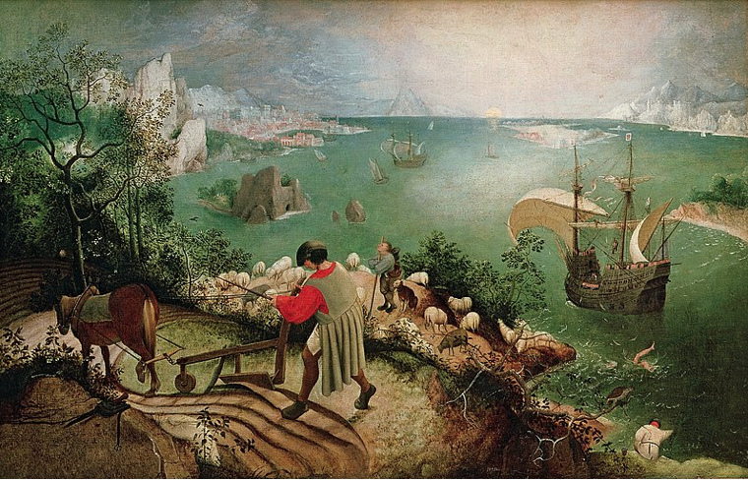
Landscape with the Fall of Icarus, (Breugel,1560 & Carlos Williams, (1883-1963) NB: His family name had an ‘h’ in it, but he personally dropped the ‘h’ and signed his paintings ‘Breugel.

Slide 11
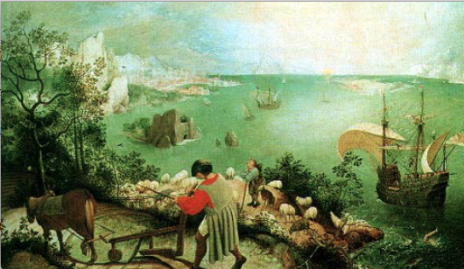
The Gallery or the Voyeur
Musee’ des beaux Arts, WH Auden
My Last Duchess, Robert Browning (Analysis)

Slide 12

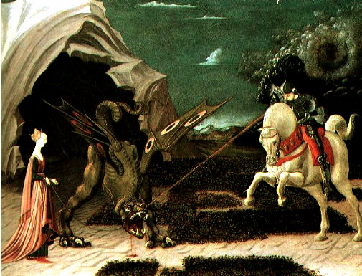
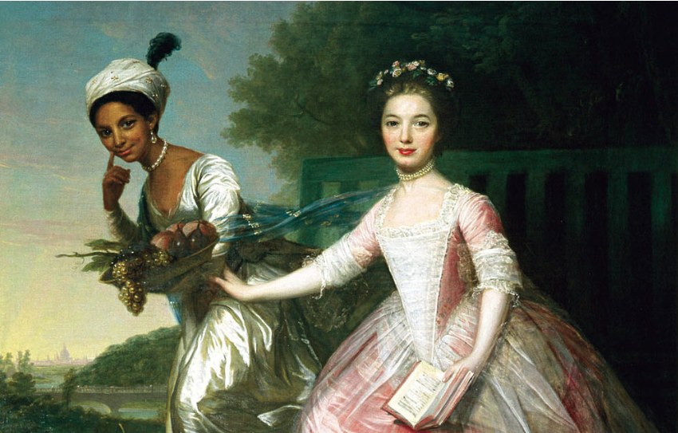
The Muse’s Voice
Paolo Uccello, St. George and the Dragon
Oil on canvas. National Gallery, London.
Not my best side, by UA Fanthorpe (1978)
Dido by Honoree Fannone Jeffers (2010)
Painted by David Martin in 1779. Dido was the great-niece of William Murray, First Earl of Mansfield; as Lord Chief Justice of the King's Bench, he is responsible for the Somerset ruling (1772), which essentially outlawed slavery in England, though not in the colonies.)

Slide 13
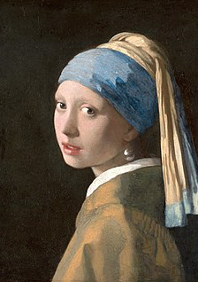
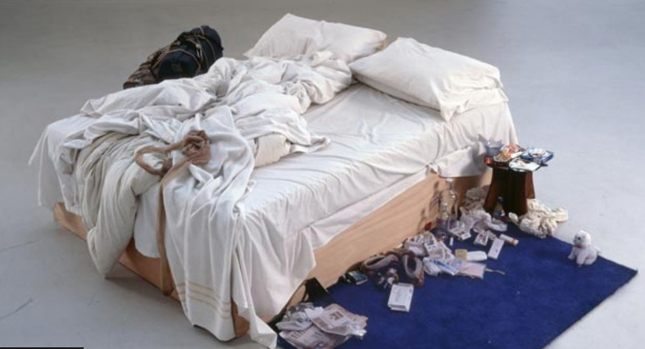
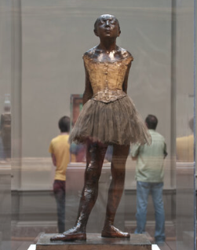
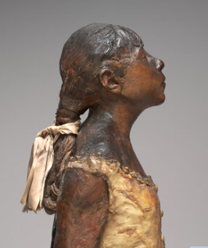
Choose to list your observations,
or write from the point of view of:
the artist, the muse or the gallery voyeur.
Tracey Emin’s Bed, 1999
Vermeer, 1665
Degas, Little Dancer, 1881

Slide 14
My Ekphrastic Poems
Leg of Mutton, Nude
A Dove Called Peace
Self, 1922-1914
Emptiness & Sentinels
All of the above are in your pre-reading pack.
Have fun reading and remember, ‘if you don’t have time to read, then you don’t have time to write.’ (Stephen King)

Slide 15
Texts for discussion
Readings and links have been/will be supplied. If you require hard copy please let Martin know.
Sexton, A. Starry Night, (1962)
Carlos Williams, W. Children’s Games (1962)
Carlos Williams, W. Landscape with the Fall of Icarus, (1960)
Fanthorpe, UA. Not My Best Side, (1978)
Jeffers, H. F. Dido, (2010)
Auden, W. H. Musee des Beaux Arts
Browning, R. My Last Duchess,
Egelstaff, S. The Muse/Leg of Mutton, Nude. (2019).
Egelstaff, S. A Dove Called Peace, (2020).
Egelstaff, S. Self 2022-1914, (2022).
Egelstaff, S. Emptiness & Sentinels (2023)

Slide 16
References
Bradford, Wade. Analysis of the Robert Browning's Poem 'My Last Duchess’. ThoughtCo, (2023). Site: thoughtco.com/analysis-of-my-last-duchess-2713679.
De Cola, Christina. Please You Sit and Look at Her: Art and Objectification- Mystics, Madmen, Prophets and Perverts, (2009)
Site: https://victorianweb.org/authors/rb/duchess/decola7.html
Fanthorpe, U. A. Selected Poems. Enitharmon Press, (2014) Used with permission from Dr R. V. Bailey. Site: https://www.poetrybyheart.org.uk/poems/not-my-best-side
Homer, The Iliad. Translated by Robert Fables. Penguin, New York, 1990.
Jeffer, H, D. Portrait of Dido, in: The Glory Gets, Wesleyan University Press, (2015).
Nash, William, R. Edwin Markham’s Life and Career.-A Concise Overview. Modern American Poetry. Site: http://www.english.illinois.edu/maps/poets/m_r/markham/life.htm
Petit, P. What the Water Game Me. Seren Books, (2010). Site: http://www.pascalepetit.co.uk/what-the-water-gave-me-poems-after-frida-kahlo/
Sexton, “The Starry Night” from The Complete Poems of Anne Sexton. Houghton Mifflin, Boston (1981).

Slide 17
Poetry to Pamphlet Workshops
7pm-9pm Thursday 28th Sept-14th Dec
Week 1- Guest Lecture- Ekphrastic Poetry
Week 2- Origins & Objects
Week 3- Space and Place
Week 4- Voices for Wellbeing
Week 5- Eco-Poetics
Week 6- Averting Writers' Block 'Lost and Found'
Week 7- Irony, Volta and Polysemy
Week 7- Structure- Haiku, Haibun and the Villanelle
Week 8- Structure - The Sonnet
Week 9- Creating a pamphlet - Thematic writing
Week 10- Poetry and Lyricism
Week 11- Finalising our pamphlet
Week 12- Spoken Word Showcase and Celebration

