Slide 1
‘The Living & The Dead’
James Joyce & ‘The Dead’
MKCW - Irish Literature – Text in Context – Week 3

Slide 2
Agenda
Introduction to James Joyce's 'The Dead'
The Morkans' Annual Dance
Character Dynamics: Gabriel and Lily
The Conroys at Home
Arrival of Key Characters
Gabriel and Miss Ivors
Key Scenes: Aunt Julia's Song & The Dinner
Discussion on Music & Gabriel's speech
Themes of the Story: Society, Class, Music, Nationalism, Life and Death
Freddy Malins: A Character Study

Slide 3

Introduction to James Joyce's 'The Dead'
Week 3: James Joyce/'The Dead' - Final Story in Dubliners
Dubliners published in 1914 - Edition for references: The O'Brien Press, 2012
'It was always a great affair, the Misses Morkans' annual dance' (198)

Slide 4
The Morkans' Annual Dance
The Misses Morkans' annual dance is described as a great affair.
The Morkans consist of Miss Kate, Miss Julia, Mary Jane (their niece), and Lily (the caretaker's daughter).
Gabriel and his wife arrive late to the dance, causing some concern.

Slide 5
Character Dynamics: Gabriel and Lily
Their conversation reveals Gabriel's internal conflicts regarding his Irish identity and the influence of his wife, Gretta.
Gabriel initially dismisses Lily's singing talent, but later realizes the depth of her emotions and experiences a moment of self-reflection.
Gabriel and Lily share interactions throughout the story, highlighting their contrasting perspectives and social positions.

Slide 6
The Conroys at Home
Events
Gabriel's responsibilities at home with Tom and Eva
Arrival of Freddy Malins and concerns about his intoxication
Arrival of Mr Browne and Miss Furlong
Arrival of Mr Bergin and Mr Kerrigan
Interaction between Mr Browne and Freddy Malins
Interaction between Gabriel and Miss Ivors
Aunt Julia's song: 'Arrayed for the Bridal'
The dinner
Discussion on music
Gabriel's speech
Late hours and events at the Gresham Hotel
Society, class, music, nationalism, life, and death
Characters
The Morkans: Miss Kate, Miss Julia, Mary Jane (their niece), Lily (the caretaker's daughter)
Gabriel and Gretta
Freddy Malins
Mr Browne and Miss Furlong
Mr Bergin and Mr Kerrigan
Mr Bartell D'Arcy

Slide 7

Arrival of Key Characters
The Morkans
'It was always a great affair, the Misses Morkans’ annual dance’ (198).
The Morkans:
- Miss Kate
- Miss Julia
- Mary Jane, their niece
- Lily, the caretaker’s daughter
Gabriel and Gretta Arrive Late
'And then it was long after ten o’clock and yet there was no sign of Gabriel and his wife’ (199).
‘[The Morkans] were dreadfully afraid that Freddy Malins might turn up screwed’ (199).
Gabriel and Gretta arrive late: ‘my wife takes three mortal hours to dress herself!’ (199).
Arrival of Other Characters
Arrival of Freddy: ‘” Slip down, Gabriel, like a good fellow and see if he’s alright, and don’t let him up if he’s screwed. I’m sure he’s screwed. I’m sure he is”’ [Julia] (205).
Arrival of Mr Browne and Miss Furlong (205).
Arrival of Mr Bergin and Mr Kerrigan (207).
Mr Bartell D’Arcy.
Mr Browne and Freddy Malins (209).
Gabriel and Miss Ivors (211-216).
Aunt Julia’s song: ‘Arrayed for the Bridal’ (217).

Slide 8

Gabriel and Miss Ivors
Gabriel
Miss Ivors
Gabriel is an important character in the story.
He attends the Misses Morkans' annual dance.
He arrives late with his wife, Gretta, complaining about her taking a long time to dress.
Gabriel and Lily have a conversation during the event.
Miss Ivors dances with gabriel
Miss Ivors taunts Gabriel
Miss Ivors calls Gabriel a ‘West Briton’.

Slide 9

Key Scenes: Aunt Julia's Song & The Dinner
Aunt Julia's Song
The Dinner
Aunt Julia performs the song 'Arrayed for the Bridal' (p. 217).
The song adds a touch of melancholy to the festivities.
The performance resonates with Gabriel and triggers a moment of reflection.
The dinner scene takes place from pages 221 to 223.
It is a time for lively conversation and discussion among the guests.
Topics such as music, society, class, nationalism, and life and death are explored.
Gabriel delivers a speech that leads to introspection and self-realization.

Slide 10
Discussion on Music & Gabriel's speech
Music plays a significant role in the story, reflecting the characters' emotions and creating a sense of atmosphere.
Gabriel's speech towards the end of the story is a pivotal moment that reveals his inner conflicts and self-realization.
The discussion on music and Gabriel's speech provides insights into the themes of society, class, nationalism, and life and death.

Slide 11
Themes of the Story: Society, Class, Music, Nationalism, Life and Death
Society
The story explores the impact of societal norms and expectations on the characters' lives.
Class
The theme of class is depicted through the interactions between characters from different social backgrounds.
Music, Nationalism, Life and Death
These themes are intertwined in the story, reflecting the cultural and political context of the time.

Slide 12
Freddy Malins: A Character Study
Freddy Malins is a character in 'The Dead' by James Joyce.
1
Freddy Malins plays a comedic role in the story, providing comic relief through his drunken antics.
2
He is known for his excessive drinking and unruly behavior.
3

Slide 13
BACKGROUND 1905
1
2
3
Stanilaus attended a concert of Plunket Greene, the Irish Baritone
Stanilaus was impressed by Greene's rendition of the second stanza, where the dead answer the living
One of the songs performed was Thomas Moore's Irish Melody called 'O, Ye Dead!'

Slide 14
CONTEXT
Great-Aunts Mrs Callanan and Mrs Lyons
Mrs Callanan's Daughter Mary Ellen
Annual Party at 15 Usher's Island
Joyce's hospitable great-aunts who were a part of the festive occasions
Mary Ellen, also known as Misses Morkans and Mary Jane, who was present at the parties
A party held every year where John Joyce carved the goose and made a speech

Slide 15
BACKGROUND ‘
Setting
Dublin and Galway
Michael 'Sonny' Bodkin and Nora Barnicle
The story began to take shape in Rome during spring 1907.
The story is mainly based on three generations of Joyce's family in Dublin, but also draws upon an incident in Galway.
Michael 'Sonny' Bodkin courted Nora Barnicle, but he contracted tuberculosis and had to be confined to his bed. Despite his illness, Bodkin stole out of his sickroom in the rainy weather to sing to Nora. He passed away shortly after. Nora was initially attracted to Joyce because he resembled Sonny Bodkin.

Slide 16
BACKGROUND 1907
Yeats' Advice
Aran Islands
Nationalistic Miss Ivors
Synge followed Yeats' advice to find inspiration in Irish folk.
Synge went to the Aran Islands, which served as a source of inspiration.
Miss Ivors, a nationalistic character, tried to persuade Gabriel to go to Aran.

Slide 17
CONTEXT
Mrs Callanan and Mrs Lyons
Mary Ellen and Misses Morkans
Freddy Malins and Barton McGluckin
Joyce's great-aunts, Mrs Callanan and Mrs Lyons, were known for their hospitality. They often hosted parties during festive occasions.
Mrs Callanan's daughter, Mary Ellen, and the Misses Morkans were regular attendees at the annual party held at 15 Usher's Island. John Joyce, Joyce's father, would carve the goose and make a speech during these gatherings.
Mrs Lyons had a son named Freddy, who was often present at the festivities. Barton McGluckin, also known as Bartell D'arcy, was a leading tenor in the Rosa Opera Company and a notable figure in the celebrations.

Slide 18
PUBLISHING
First Submission
Rejection by Richards
Rejection by Elkin
Dubliners was first submitted to Grant Richards on December 3, 1905, with the exception of 'The Dead' which had not been written yet. This submission is documented in Ellmann's biography on page 210.
In September 1907, Dubliners was ultimately rejected by Grant Richards. This rejection is mentioned in Ellmann's biography on page 231.
In November 1908, Dubliners was again rejected, this time by Elkin. This rejection is documented in Ellmann's biography on page 267.

Slide 19
JAMES JOYCE
Birthdate
Place of Birth
Place of Death
Zürich, Switzerland
February 2, 1882
Dublin, Ireland

Slide 20
JAMES JOYCE
Dubliners
A Portrait of the Artist as a Young Man
Exiles
Published in 1914
Published in 1916
Published in 1918
Ulysses
Finnegans Wake
Published in 1939
Published in 1922

Slide 21
MEDIA
This week, choose 1 question and write 1,000 words.
Based on the authors you have read so far, were Irish writers commenting on society or focussing on their art? Give one example from each author.
Problematize Joyce’s work in the context of early 20th century attitudes.
Isolate 2 passages in ‘The Dead’ that indicates Joyce’s personal style. Discuss how these succeed /fail to portray the period.

Slide 22
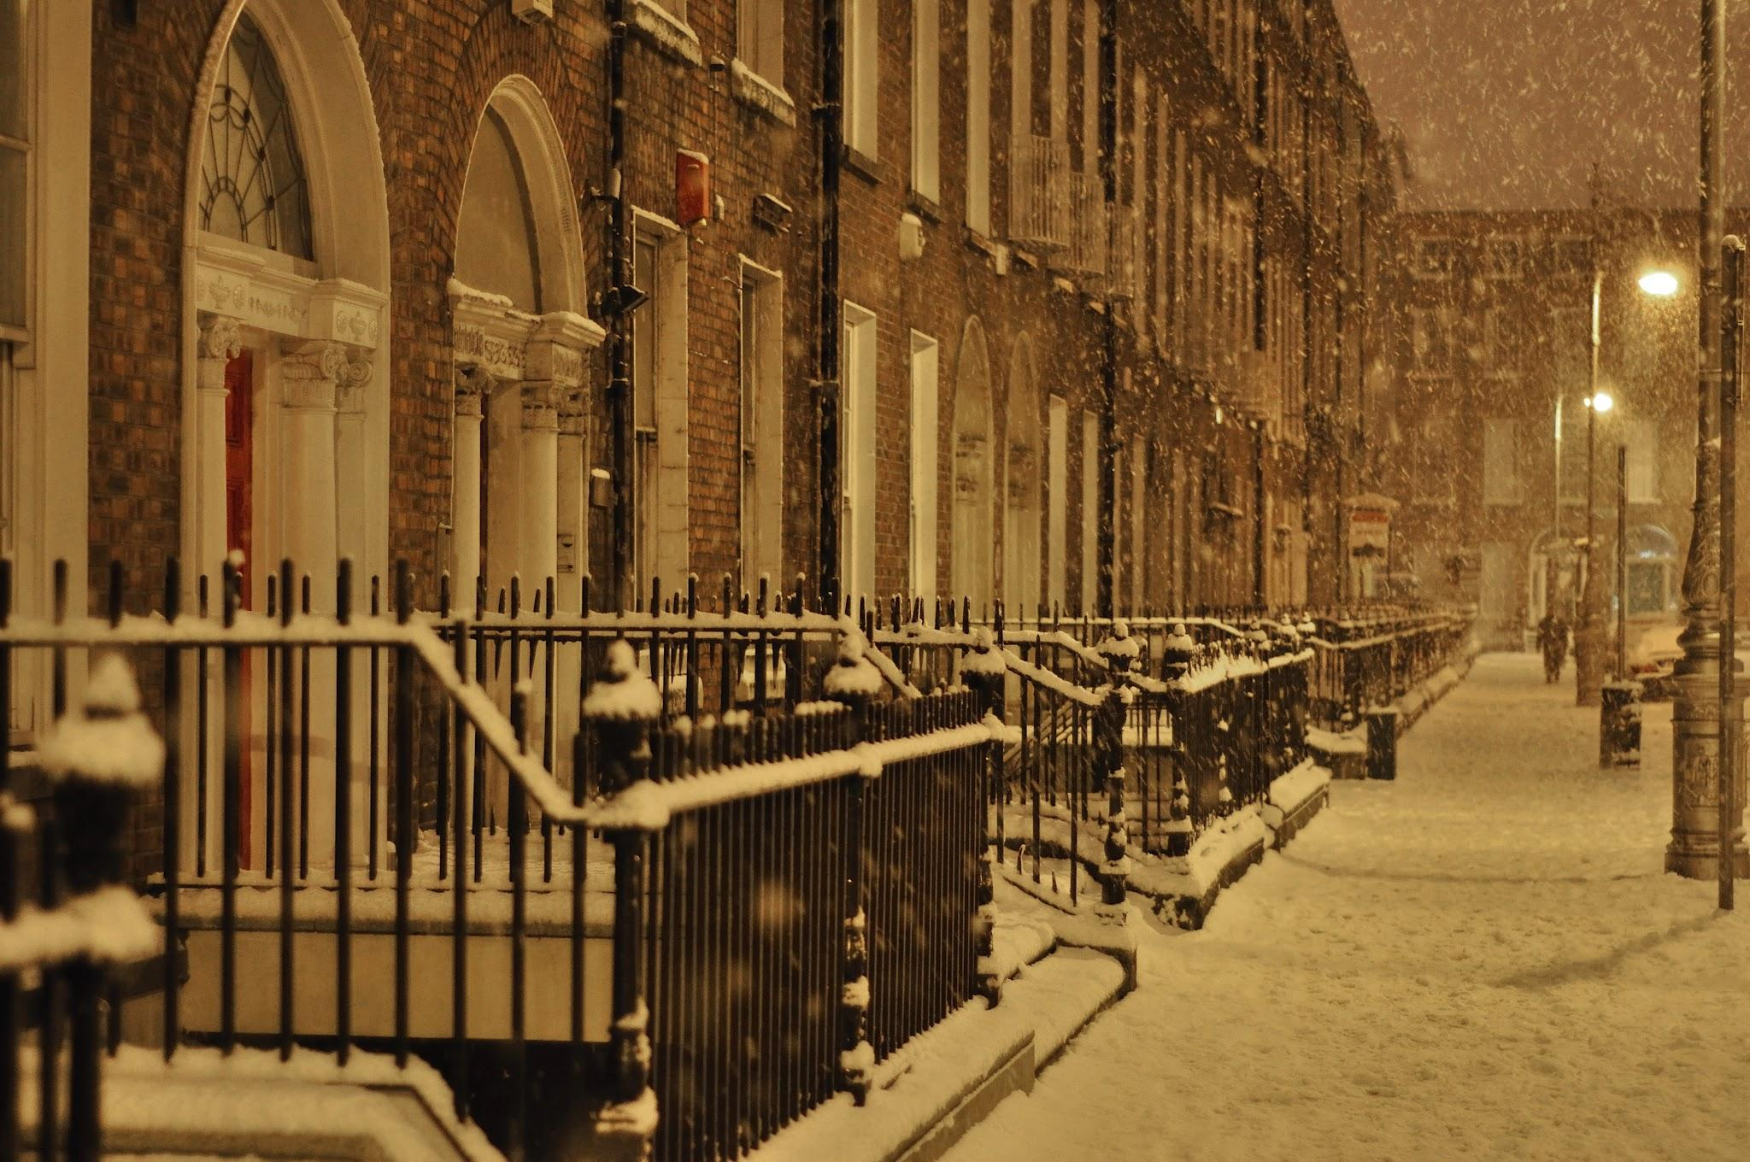
THIS WEEK
The Dead, dir. John Huston, 1987
https://www.youtube.com/watch?v=Rkos62UPwVk

Slide 23
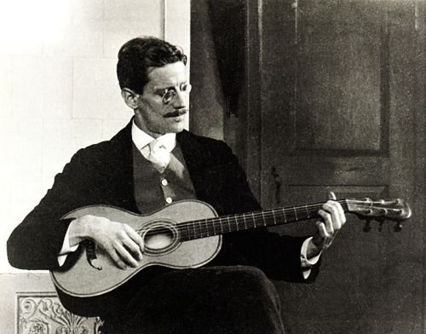
JAMES JOYCE TODAY

Slide 24
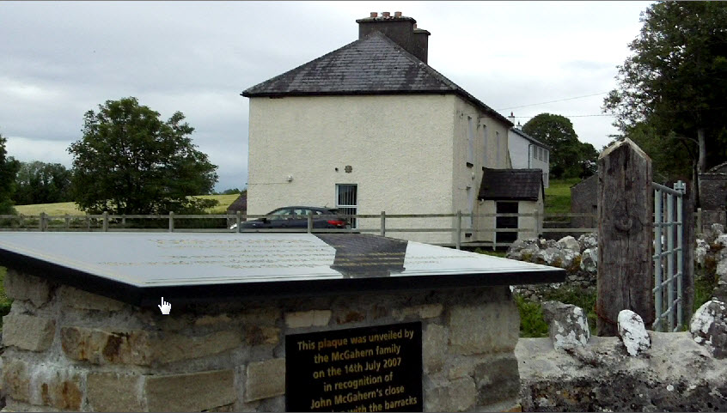
NEXT WEEK
Amongst Women/ John McGahern
www.martinkeaveney.com 2023

