Slide 1
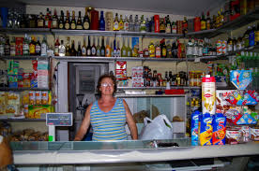
SHORT FICTION: INTRODUCTION
MKCW
DR MARTIN KEAVENEY
Class 2:
Real World

Slide 2

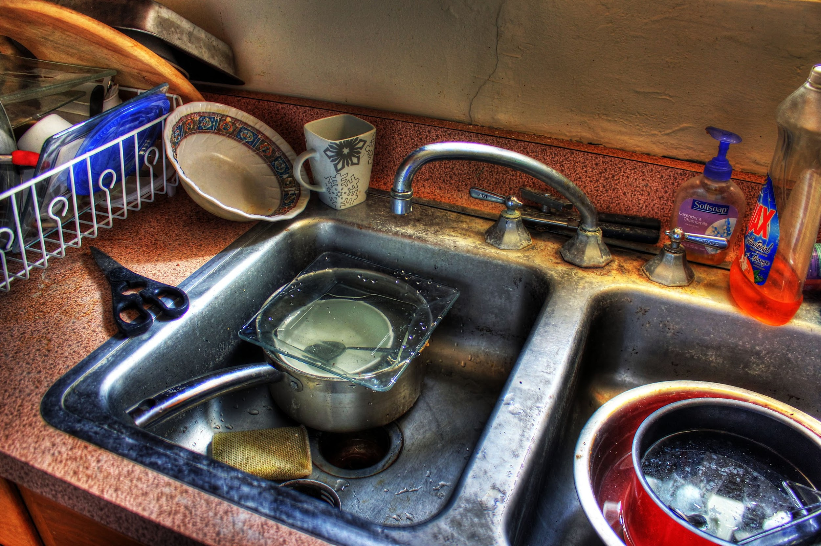
Craft – Micro Fiction
Genre – Real World

Slide 3
Words!
Sentences
Beats
Adjectives
Clauses

Slide 4
50 Word Stories
DEBORAH TAPPER: Snapshot
June 15, 2023
You find the undeveloped films while clearing her things. They’re decades old; you’re amazed they can still be processed. So you send them off. Cross your fingers, hoping she’s in every picture. And she is. Radiant, laughing, arms around another man.
A total stranger. But he has your son’s eyes.

Slide 5

WRITING EXERCISE

Slide 6
Planning
Outline v Writing Blind
Character biographies?
Plot-based narrative
Character-based narrative

Slide 7
Genre
‘Real World’
Observation

Slide 8
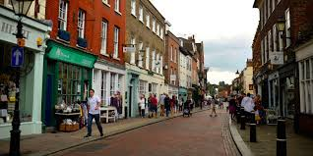
REALISM
‘The main artistic goal of the realist movement was the reliable depiction of daily motives, undertaken via the avoidance of both intricate technical conventions and any appeal to supernatural or exotic subjects.’
Falcato, Ana Christina, ‘Getting to the heart of the matter: Realism and Modernism in the novel’ Revista de Letras, Vol. 55, No. 1 (Janeiro/Junho 2015), pp. 9-24 (11)

Slide 9

WORKSHOP

Slide 10
FINAL PROJECT
Optional
2000 words
Developed from weekly assignments or elsewhere
Submit on Final Week
Extended editorial response with advice on how to proceed within three months
Short individual consultations available later in course

Slide 11
HOMEWORK
Please write 50 words of fiction set in the ‘Real World’ as we discussed. Work to complete a story.
Please email to peer group and info@martinkeaveney.com by agreed deadline if possible.

Slide 12
Class 3 :
Flash Fiction
Read Sci-fi story (TBS)
Submit piece written in ‘Real World’
www.martinkeaveney.com 2023

