Slide 1
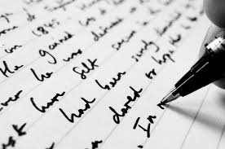
SHORT FICTION: INTRODUCTION
MKCW
DR MARTIN KEAVENEY
Week 1
Introduction

Slide 2


Welcome
Introduction

Slide 3
Course Objectives
Introduction to Short Fiction
Writing Craft
Critique
Develop writing practice for a hobby or a career

Slide 4
Seminar format
Short lecture on craft
Discussion on weekly reading
Workshop on submitted pieces
Short writing exercises

Slide 5
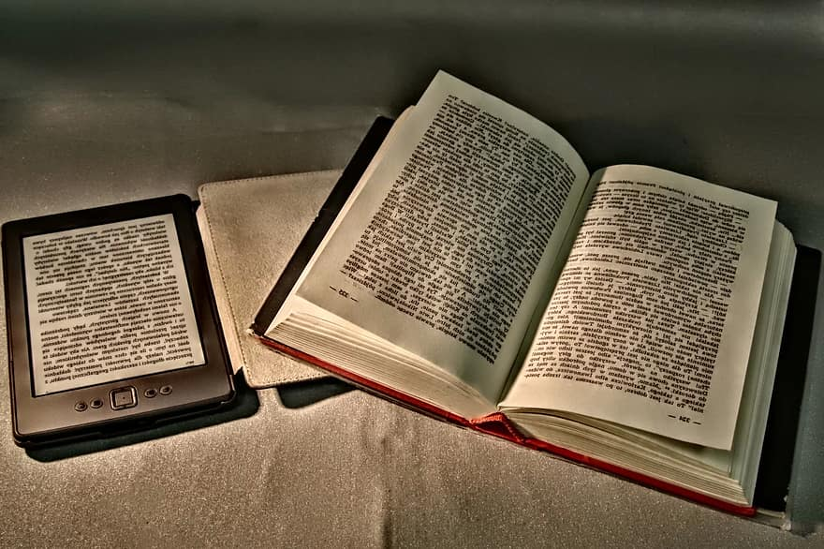
READING
Reading as a creative writer
Range of texts
Reading practice
Re-reading

Slide 6
Texts for discussion
Readings and links have been/will be supplied. If you require hard copy let Martin know. If desired, the following texts/items can be purchased in advance.

Slide 7
Course outline
Week 1 Intro to Short Form
Week 2
Realism/
Micro Fiction
Week 3
Sci-fi/Flash Fiction
Week 4
Crime/
Episodes
Week 5
Relationships/Prose-Poetry
Week 6
Horror/
Publishing
Week 7
Markets
Week 8
Short Form/Long Form
Week 9-12
Special Focus

Slide 8
FINAL PROJECT
Optional - more details to follow…

Slide 9
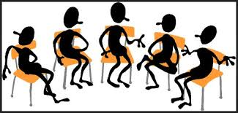
INTRODUCTIONS

Slide 10
Writing Exercise
Introduce
yourself!

Slide 11
Freewriting
‘Freewriting enables the writer to get past the conventional frame of work because it allows ideas to flow from the mind to the pen.’ (University of Lychburg.edu/drafting a document)
‘Producing writing is not so much like filling a basin or pool once, but rather getting water to keep flowing through finally it runs clear.’ (www.peterelbow.com)

Slide 12
PEER GROUPS
(Optional) Email submission by Saturday (for Wednesday class) at midnight to members of your group & to info@martinkeaveney.com
Put name and week in Subject title: example – ‘MARY – WEEK 1’
Please put your name in the document!
Name file with your name and week: example – ’MARY – WEEK 1’
Read other group members’ work before class
Please use .doc format and attach to email

Slide 13


Sample.

Slide 14

FOR NEXT TIME
Write a 500 word story. Use the class exercise, if you wish.

Slide 15
NEXT WEEK
This week’s slides will be emailed
Reading for next week will be emailed
Read the other work in your peer group and read the short story
Write your story!!
Any questions – email info@martinkeaveney.com

