Slide 1

Children’s Fiction
Special MODULE
AUTUMN 2022 at MKCW

Slide 2
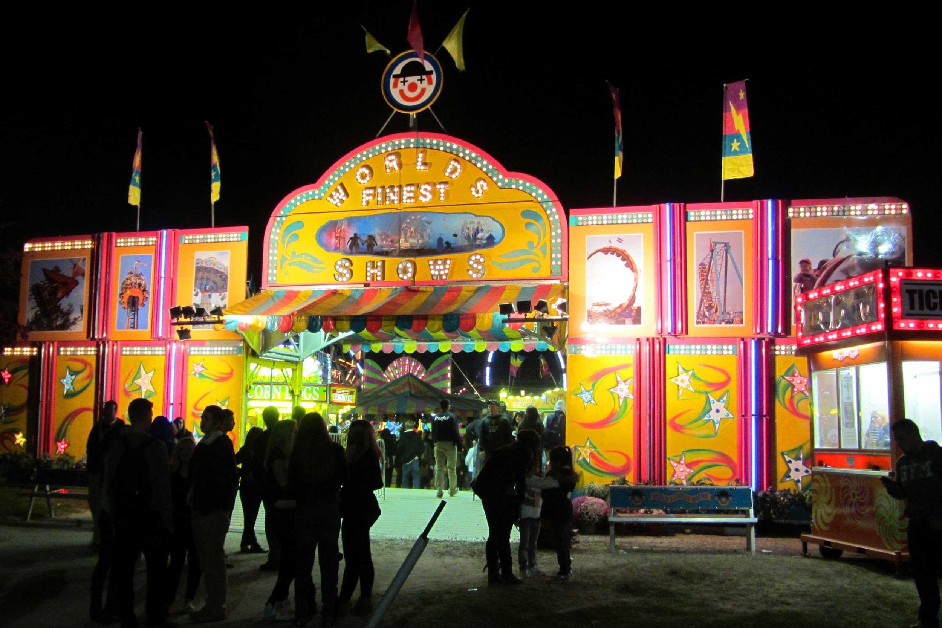
Week 8 - Screen & Other Mediums
Film
TV
Internet
Radio
Games
Poetry

Slide 3
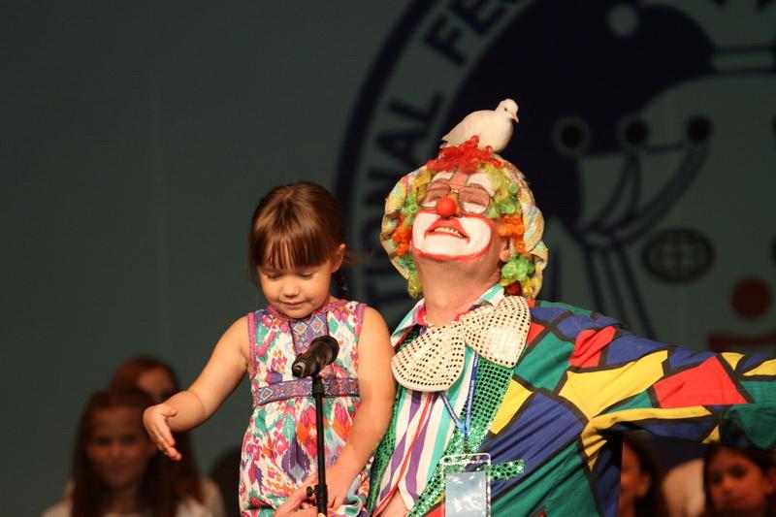
Film & TV
Scripts & Submissions

Slide 4
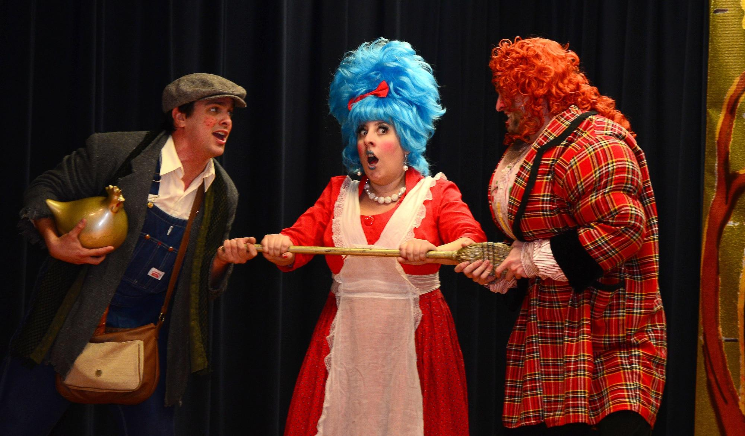
Internet
Accessibility & Targets

Slide 5
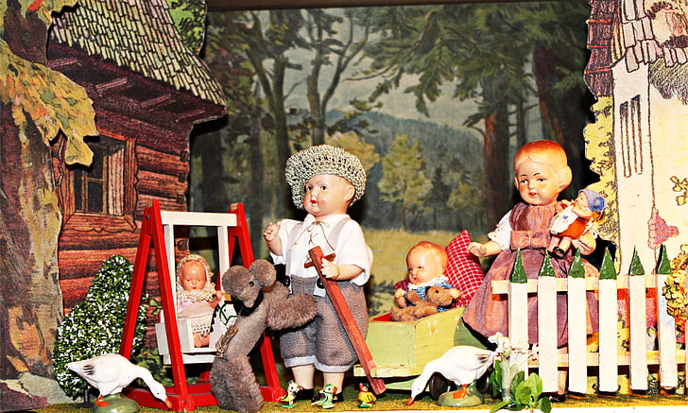
Radio
Sound & Visions

Slide 6
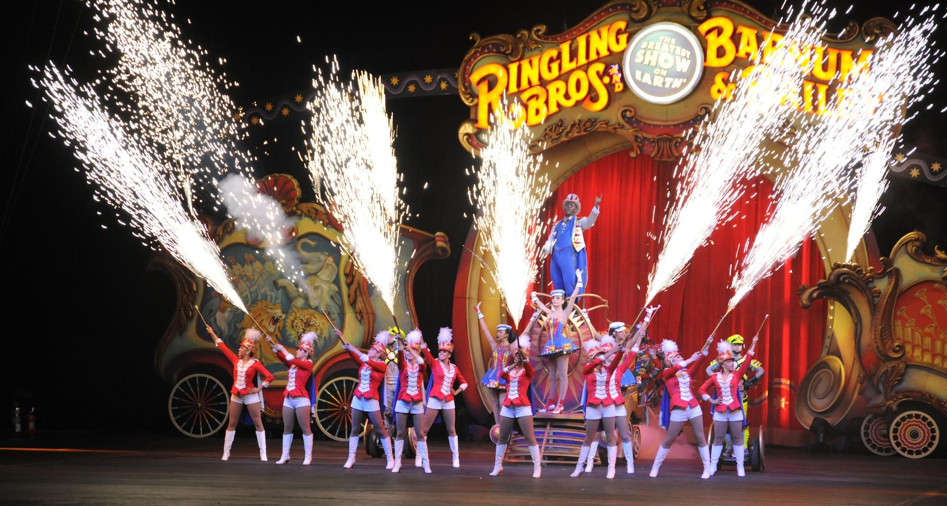
Games
Agency

Slide 7
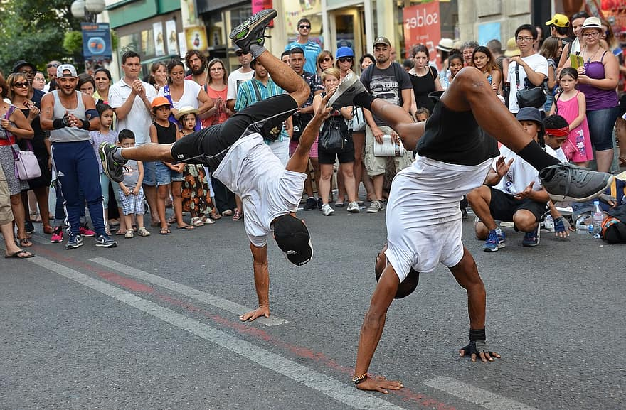
Poetry
Rhythms & Songs

Slide 8

Media
Screens

Slide 9
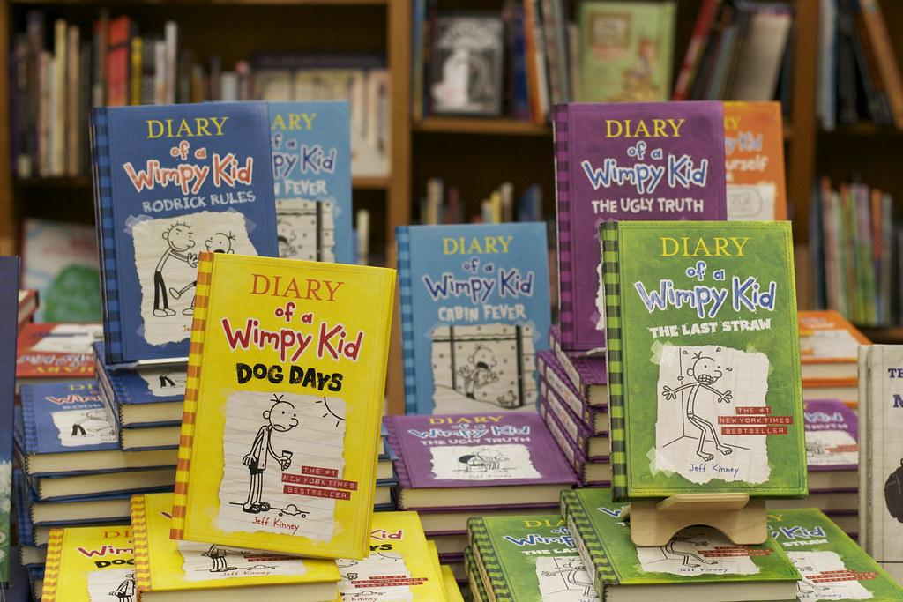
Diary of a Wimpy Kid Series
https://www.youtube.com/watch?v=1ghGImJ7qaQ
Jeff Kinney
2004-2022

Slide 10

Writing

Slide 11
Congratulations
Next….
Join a 12 week Children’s Single Project
          www.martinkeaveney.com. 2022

