Slide 1

Children’s Fiction
Special MODULE
AUTUMN 2022 at MKCW

Slide 2

Week 5 - Falling from Heaven
Shock Horror!
Cliques
Hierarchies
Lads & Ladies
Mischief
Humour

Slide 3
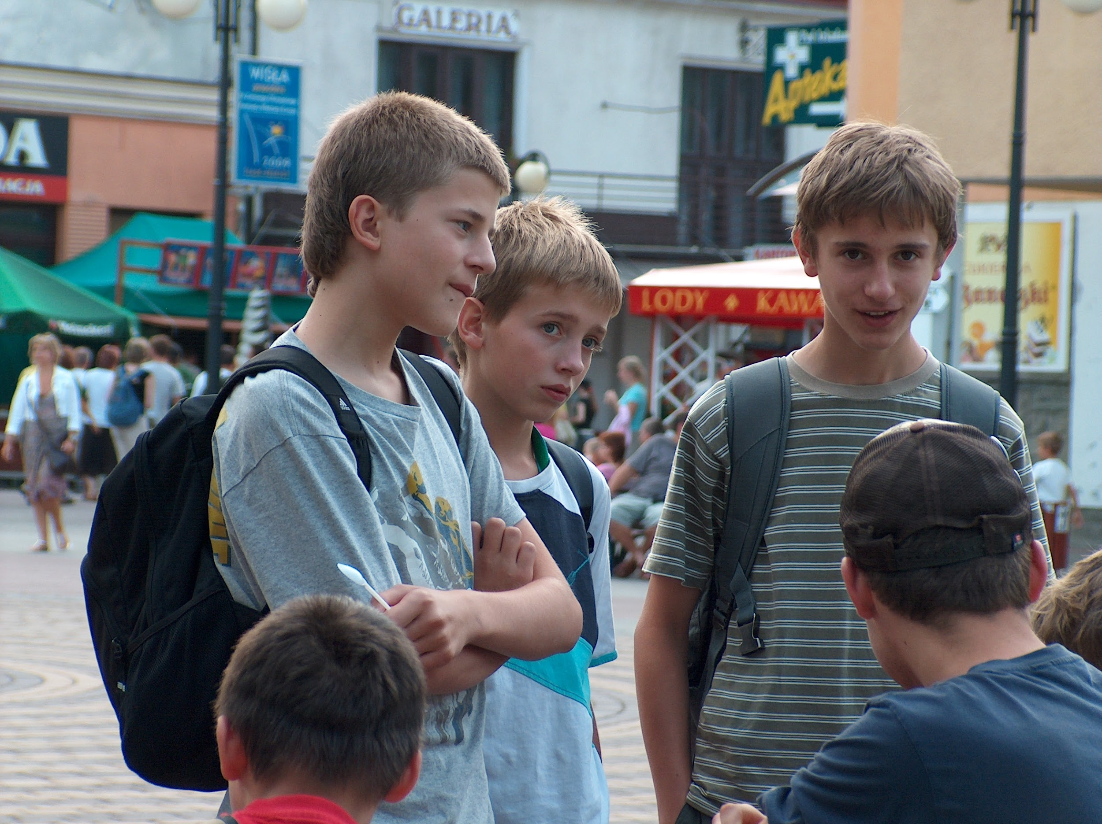
What is Teenage Fiction?
‘First, few if any of the good ones are easier reading than the average adult novel considered suitable for younger high school students. Writers for teenagers do not limit vocabulary, nor do they use a less complex style than they would in fiction for adults (except in the case of stories specifically produced for "slow readers," which are not really "novels" in the literary sense).’ (Enqdahl 51)
Enqdahl, Sylvia. Do Teenage Novels Fill a Need?
The English Journal 64. 2 (Feb., 1975), pp. 48-52

Slide 4

What is Teenage Fiction?
‘Novels of quality for teenagers do not preach. A writer who approaches young people in a condescending way receives short shrift from today's editors and reviewers. One can use a story to reflect one's views, just as an author of adult fiction can-but they must be views about life, not about how young people, as distinguished from other people, ought to look at it.
(Enqdahl 51)

Slide 5

What is Teenage Fiction?
‘Teenage novels, if good, are not devoid of concepts worth pondering and worth discussing. Although fiction for the young ordinarily stays within the bounds of good taste, its themes are confined neither to traditional ideas nor to fashionable new ones. Thus it can hardly be called uncontroversial’.
(Enqdahl 51)

Slide 6

Teenage Fiction
Stories

Slide 7
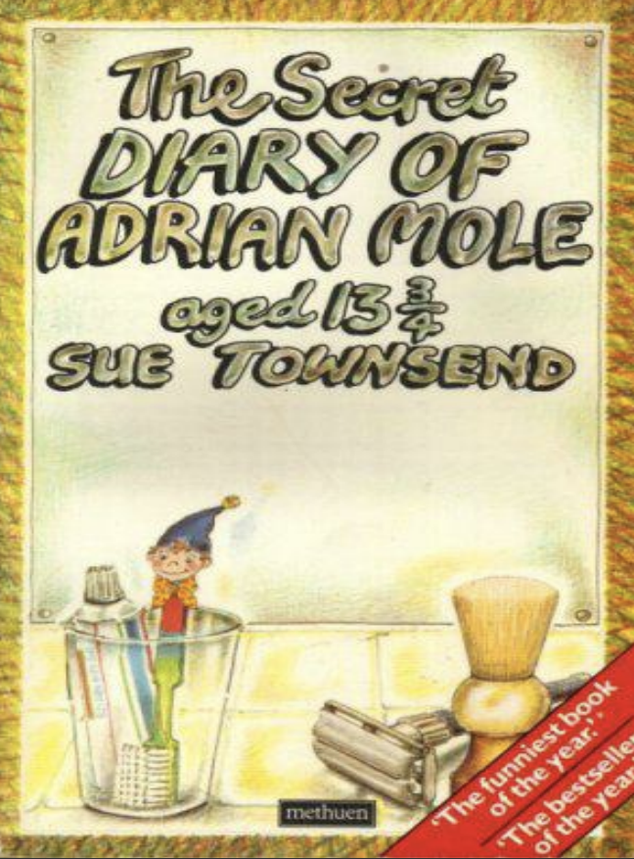
The Secret Diary of Adrian Mole Aged 13 3/4
by Sue Townsend.
Metheun, 1982.

Slide 8

Writing

Slide 9
This week
Please write a 2,000-word story for 11-14 year olds based on the writing exercise.
Next week – All Grown Up - Young Adult Fiction
          www.martinkeaveney.com. 2022

