Slide 1

Children’s Fiction
Special MODULE
AUTUMN 2022 at MKCW

Slide 2

Week 4 - New Kids on the Block
Awareness
Morals
Gender
Sarcasm

Slide 3

Awareness
‘It seems that for children between the ages of 5 and 10 years, the father's
influence becomes less important and the mother's more important. Family
influence on professional goals seems to decline, perhaps reflecting the
children's growing independence as well as the growth of role models and
sources of information outside of the family. Family orientation and profes-
sional orientation are no longer significantly correlated at age 10, perhaps
another indication of increasing individuation as well as of reality testing
and specificity of goals .’ (Seligman 178).
Seligman,Linda et al. ‘The Career Development of 10 year olds.’
Elementary School Guidance & Counseling 25. 3
(February 1991), pp. 172-181

Slide 4
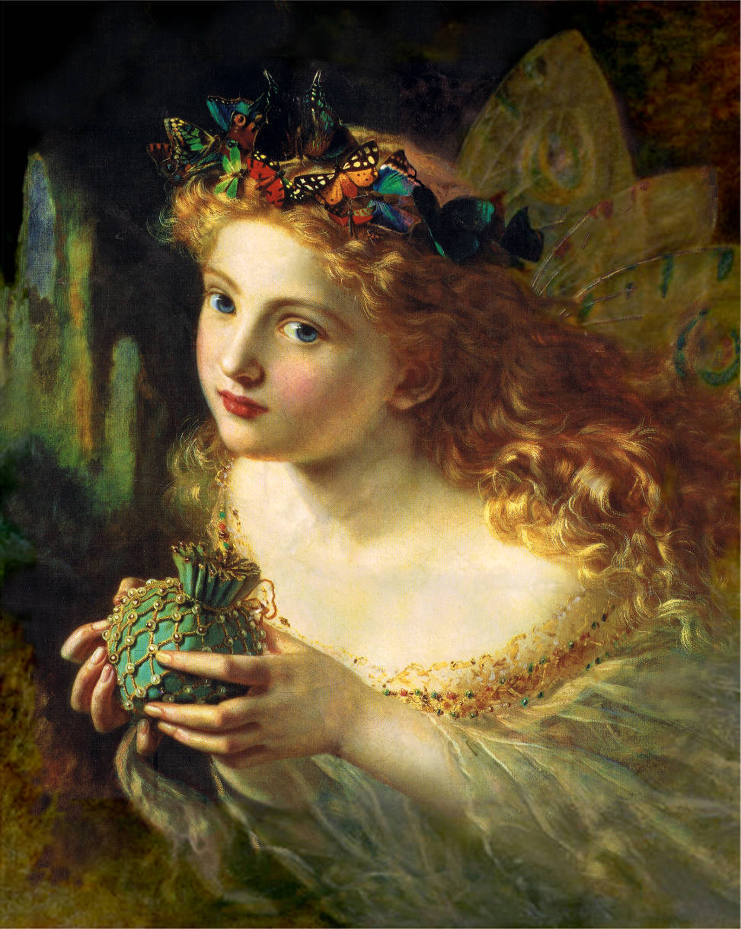
Stories
Children perceive and understand values, but not in the abstract manner of adult philosophy. Stories must seem real. Plots, characters, and settings must seem like actions, people, and places. If they do not, no amount of clever loading of the text with "intrinsic" values will satisfy young readers, who may not even get to the values at all.’ (Eisenberg, 77).
Eisenberg William D. ‘Morals, Morals Everywhere: Values in Children's Fiction’ The Elementary School Journal 72. 2 (Nov., 1971), pp. 76- 80

Slide 5

Birds and Bees
Children in the latency or preadolescent years tend to be less rigid and stereotyped in their thinking about appropriate sex role behavior than are both younger and older children, and this contributes to a broadening of occupational options and a receptivity to new ideas (Seligman, 1980)’.
(Seligman 172).

Slide 6
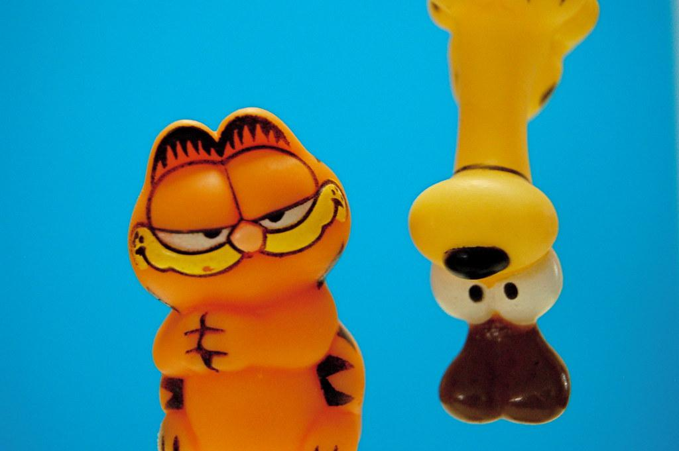
Sarcasm
‘It appears that children, especially younger ones, cannot make effective use of previous context in stories to help them infer the communicative intention behind sarcastic utterances.’ (Capelli 1836)
Children may first rely more heavily on intonation than the do on context’ (Capelli 1836)
Capelli, Carol A. et al. ‘How Children Understand Sarcasm: The Role of Context and Intonation’ Child Development 61. 6 (Dec., 1990), pp. 1824-1841

Slide 7

Girls and Boys’
books
Stories

Slide 8
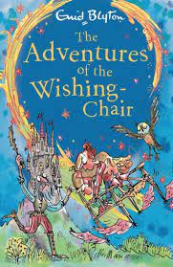
The Wishing Chair
by Enid Blyton.
George Newnes Limited, 1937.

Slide 9

Writing

Slide 10
This week
Please write a 1,000-word story for 7-11 year olds based on the writing exercise.
Next week – Falling From Heaven - 11-14 year olds
          www.martinkeaveney.com. 2022

