Slide 1
Writing for Well-Being
Dr Martin Keaveney
Offaly & Laois Libraries - Winter 2022
Session 1 - Introduction

Slide 2

WELCOME

Slide 3

COURSE OUTLINE
Tuesday 2/5 - Writing & Practice
Thursday 9/5 - Poetry & Language
Thursday 23/5 - Fiction & Formats
Thursday 30/5 - Plays & Film
11am-1pm
Room 1, Level 3, dlr LexIcon
Dul Laoghaire/Rathdown Libraries
NO CLASS MAY 15th

Slide 4

OBJECTIVES
Writing & Well-Being
Writing & Transferable Skills
Enhance Time Management
Increase Appreciation of Artistic Achievement
Enhance Productivity
Accomplish Rewarding Creative Projects
Share Achievements with Others

Slide 5

FORMAT
Seminar style (open forum)
Topic Discussion
Writing Exercises
Workshop of Weekly Writing

Slide 6

WRITING EXERCISE

Slide 7
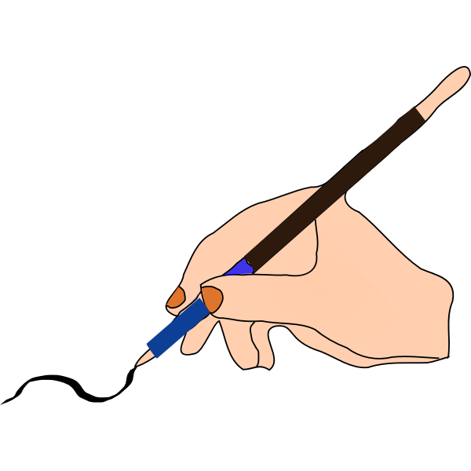
A WRITING PRACTICE
Disclaimer!
Time & Space
Methods
Starting to Write

Slide 8

A WRITING PRACTICE
Time Management
Timetables
Timeslot commitment
Prioritisation
Focus

Slide 9

A WRITING PRACTICE
Space
Silence & Sleep
Comfort

Slide 10
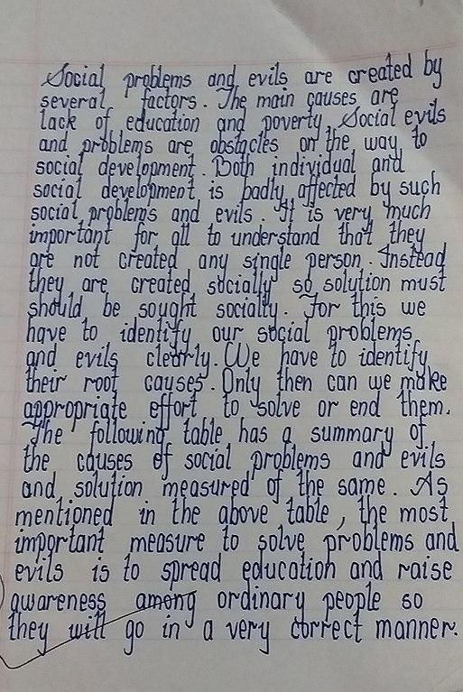
A WRITING PRACTICE
Handwriting
Type
Dictate
Images
Online Programs

Slide 11

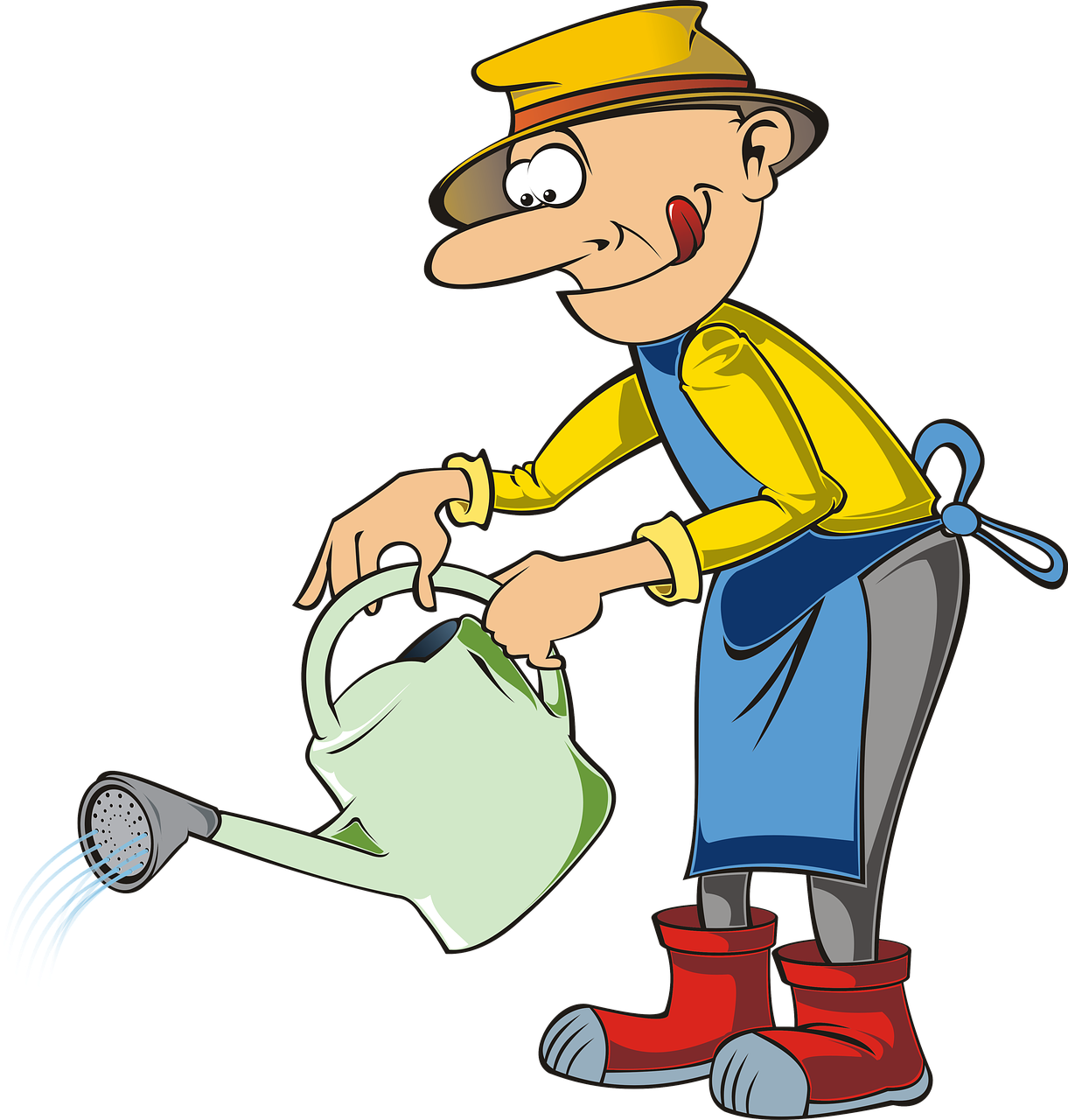
A WRITING PRACTICE
Planning
Architects & Gardeners
Plots & Characters

Slide 12
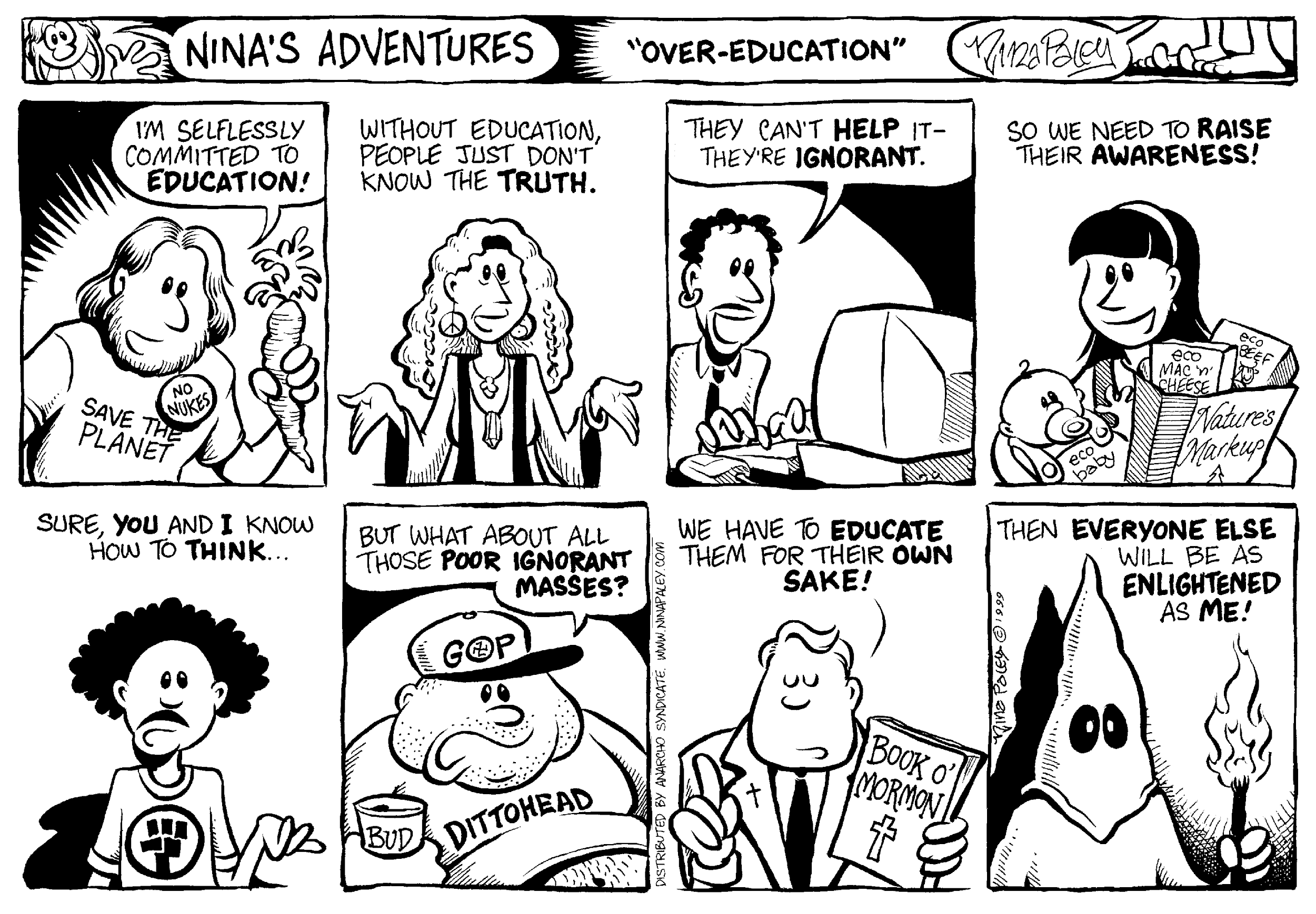
A WRITING PRACTICE
Turn off Editor
Comic Strip Approach
Progressive Competency
Interview by the Page

Slide 13

FREEDOM IN WRITING
Open to Change
Freewriting
Listening

Slide 14
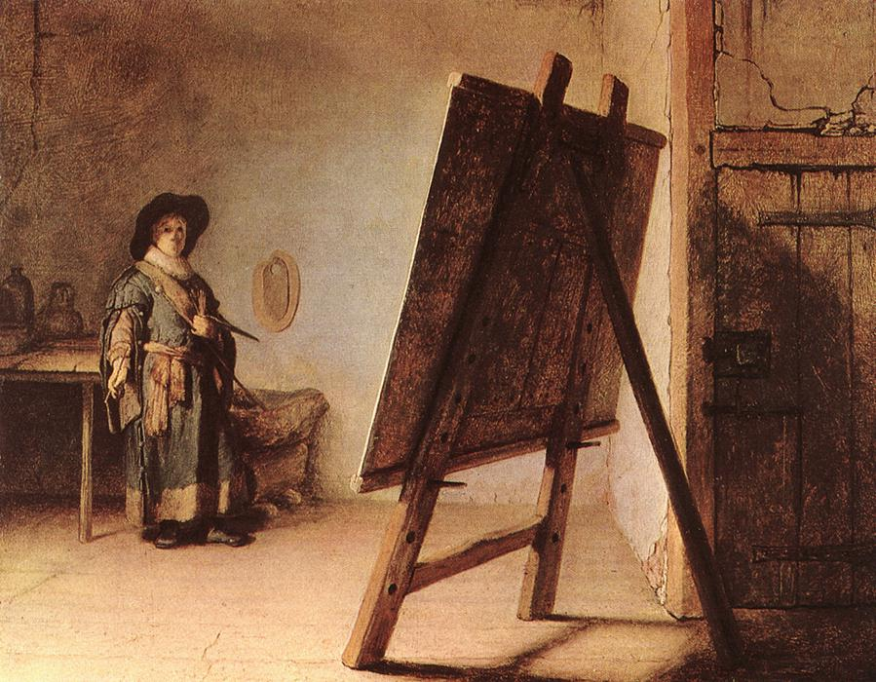
WRITER AS ARTIST
Why Write?
Will it be good enough?
Recognising our creative voice

Slide 15
WRITER AS ARTIST
Modern Visual Arts
Contemporary Music
Sculpture
Travel
Theatre
Cinema
Reading

Slide 16
WRITER’S TOOLBOX
Aural
Visual
Kinetic

Slide 17
WRITING AS THERAPY
Therapeutic writing & Creative Writing

Slide 18

WRITING EXERCISE

Slide 19
THIS WEEK
Please write a short piece of fiction of around 500 words. Send to your peer group and to info@martinkeaveney.com.
Good luck!
NEXT WEEK:
Poetry & Language
www.martinkeaveney.com 2023

