Slide 1
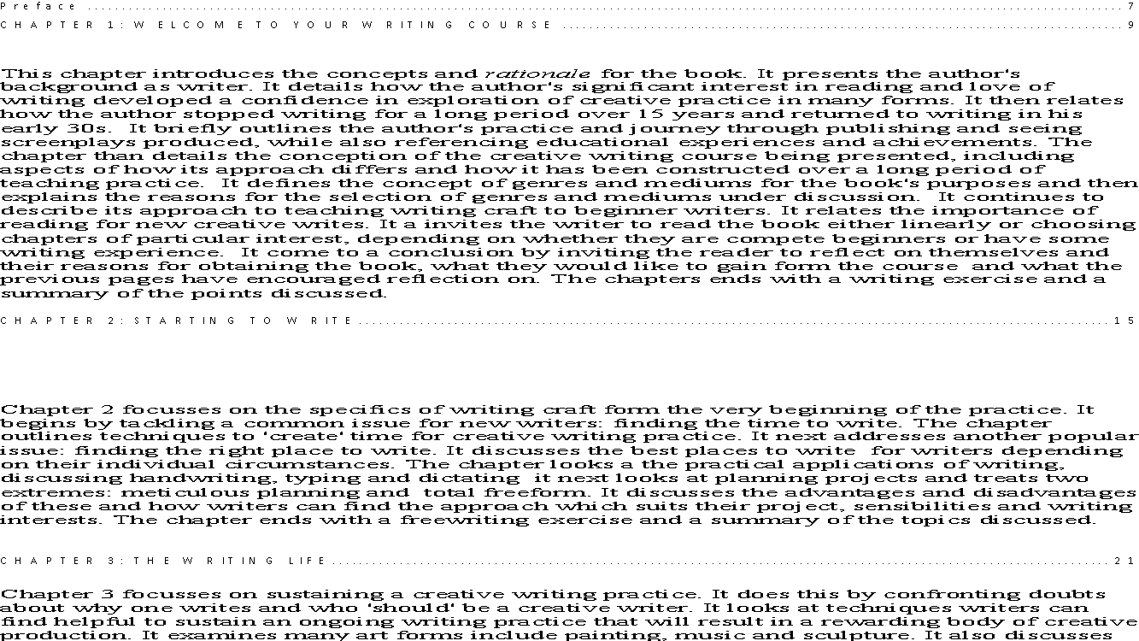
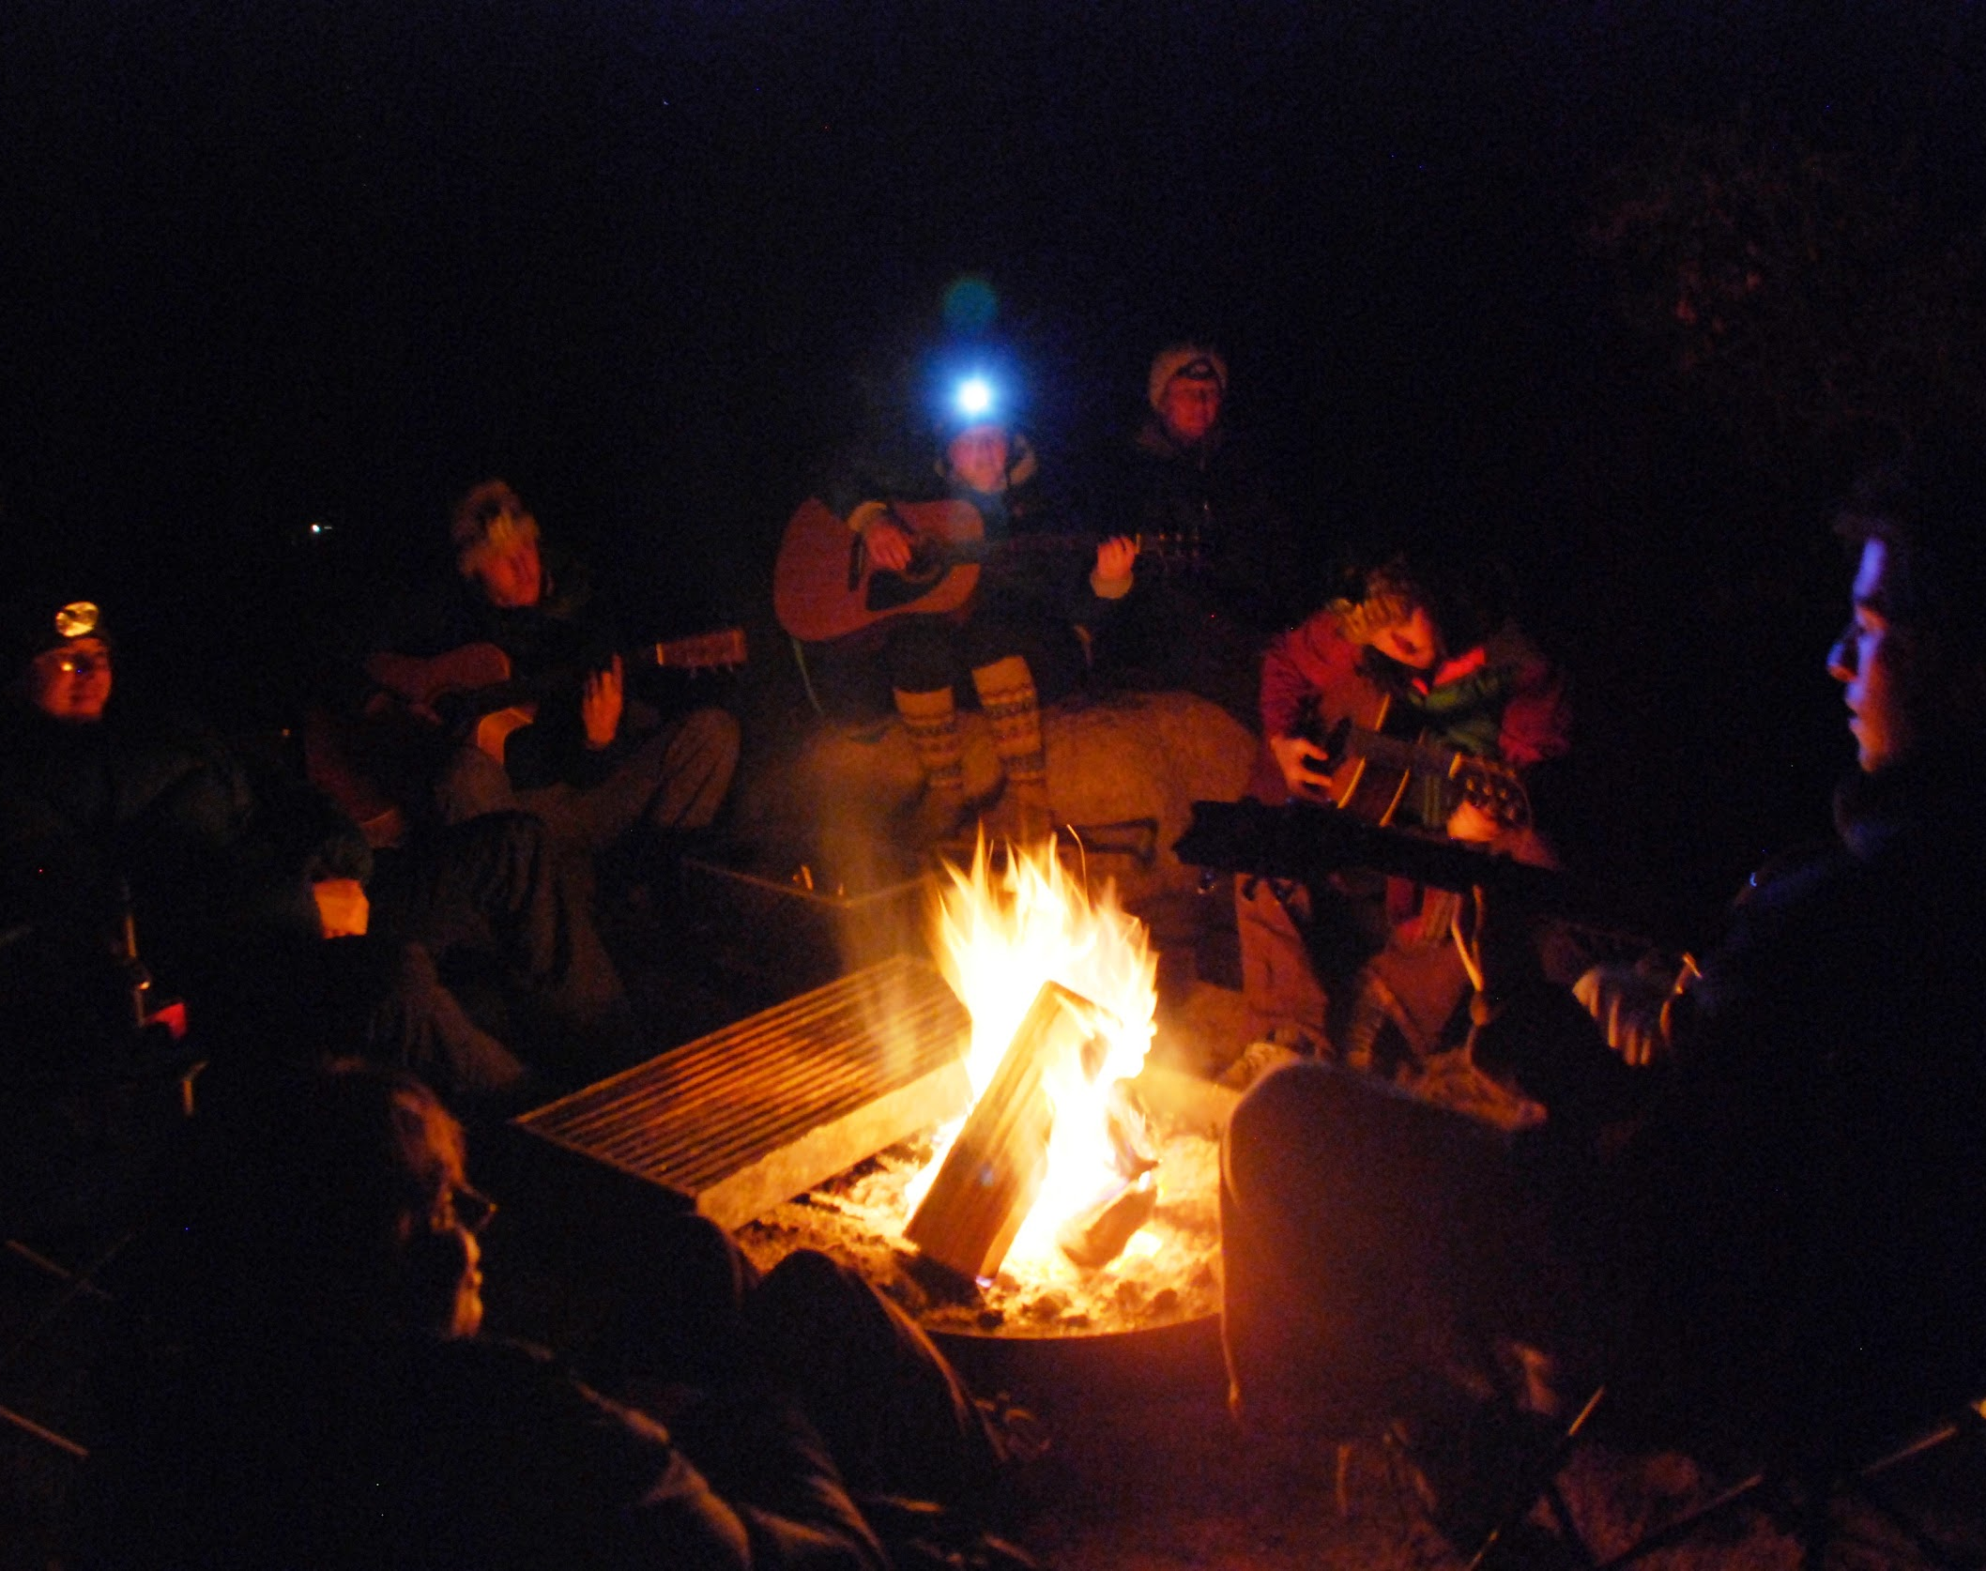
The World on Stage
Specialist Course
MKCW
This Photo by Unknown Author is licensed under CC BY-NC-ND

Slide 2
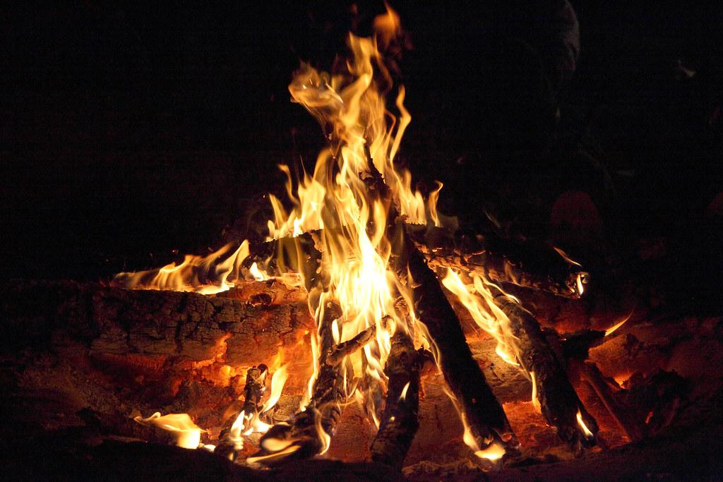
The Campfire
Language
Communication
Rhetoric
Conflict
Master/Slave

Slide 3

Language

Slide 4

Communication

Slide 5
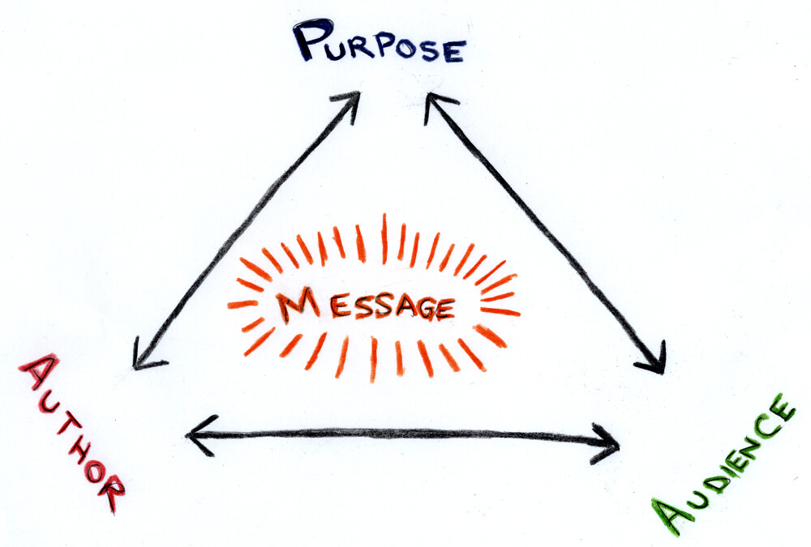
Rhetoric

Slide 6

Conflict

Slide 7

Master/Slave

Slide 8
Waiting for Godot

Slide 9

Writing

Slide 10
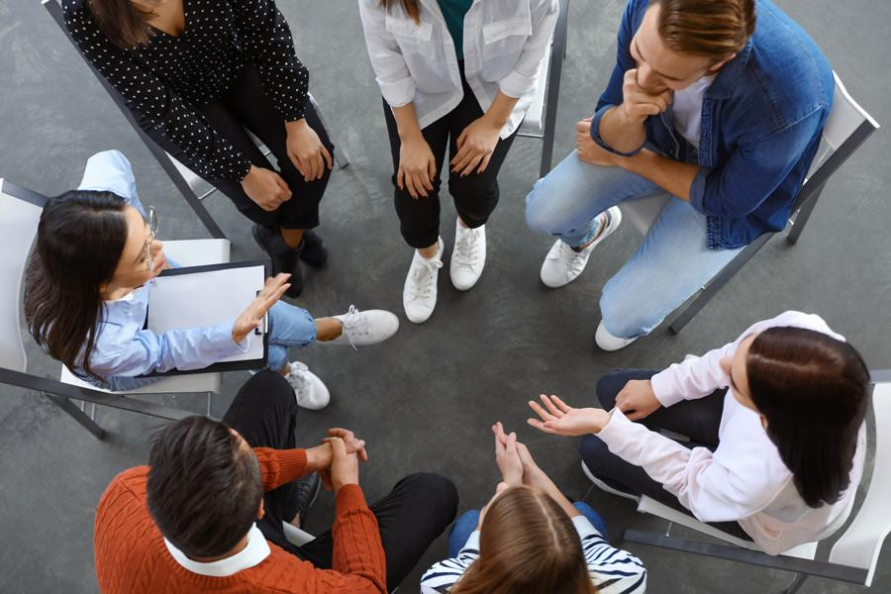
Peer group
Choose slot
Share work
Participate in Workshop
Change slot as needed

Slide 11

Livewrite
7am-9am
Mon-Fri
Excludes hols
Come and go as required

Slide 12
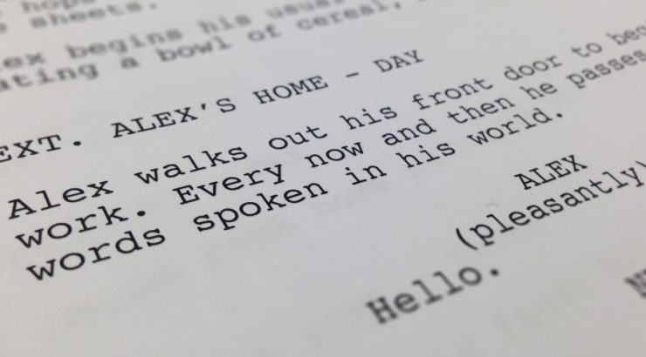
This week
Please write a 10-20 page script based on the writing exercise.
Next week – Greek Theatre
          www.martinkeaveney.com. 2023

