Slide 1
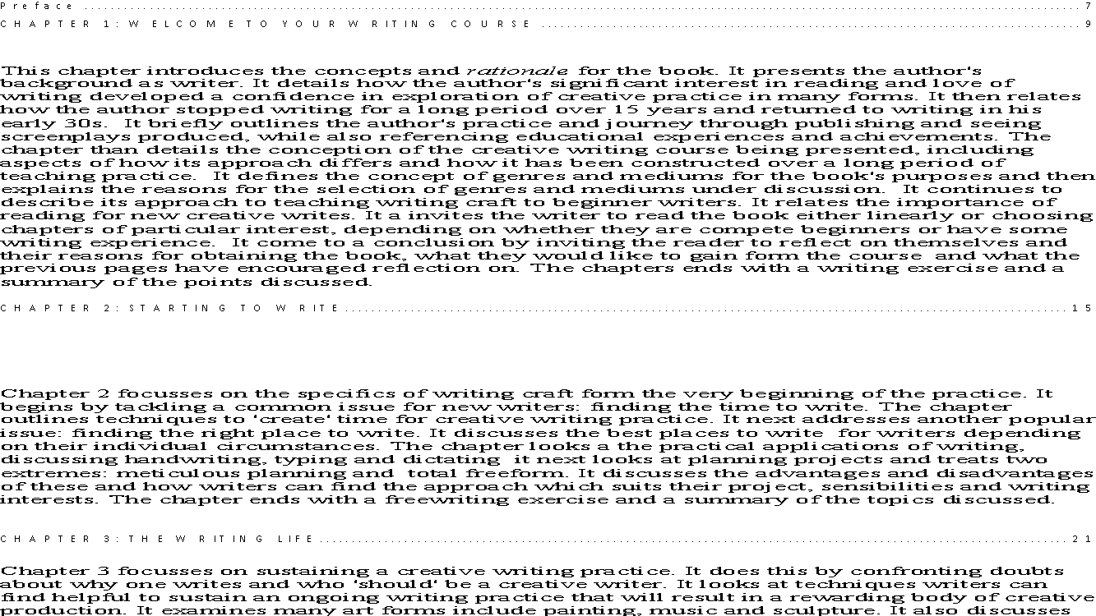
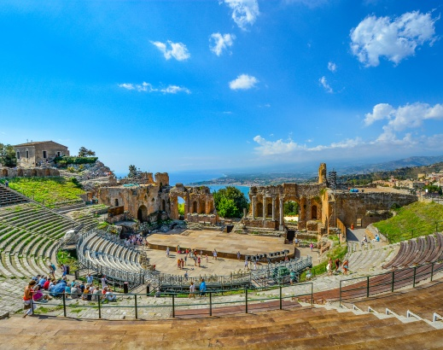
The World on Stage
Specialist Course
MKCW
This Photo by Unknown Author is licensed under CC BY-NC-ND

Slide 2
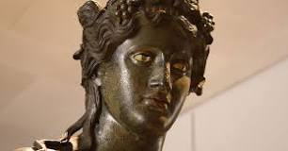
Dionysos - God of Theatre
Olympian god of wine, vegetation, pleasure, festivity, madness and wild frenzy
Trag - odia - Sacrifice of Goats – Wearing of Masks
Drinking Rites — Worshippers losing control – Acting
Chorus

Slide 3
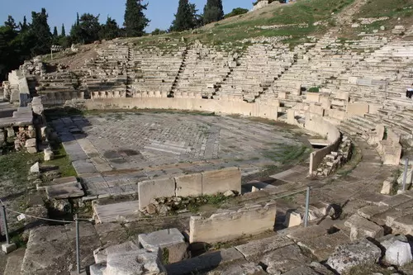
Greek Theatre
Tragedies
6th Century B.C.
Comedies
Sophocles
Euripides
Aristophanes

Slide 4
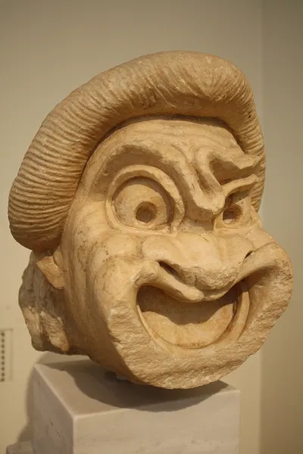
Early Tragedy Plays
5th century B.C.
Theatron
Plots inspired by Greek Mythology
Serious subject matter
No-win dilemmas
No violence
Death heard, not seen
Early stage - no comments or political comments

Slide 5
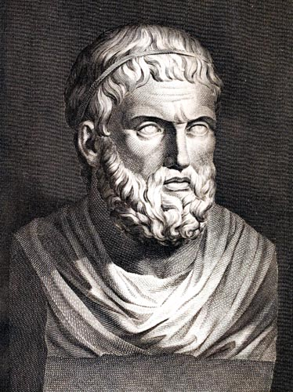
Oedipus Rex
Oedipus Rex, by Sophocles
First performed 429 B.C.
https://www.youtube.com/watch?v=bTQ-qK-m6mo
https://www.poetryintranslation.com/PITBR/Greek/Oedipus.php

Slide 6
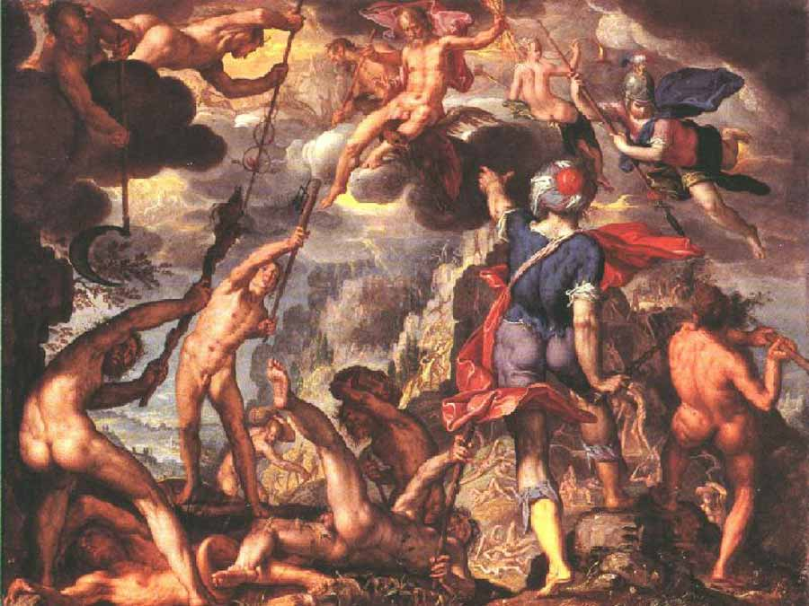
Writing
Hesiod’s Theogony: Clash of the Titans
The Battle Between the Gods and the Titansby Joachim Wtewael [Public domain]

Slide 7

Peer group
Choose slot
Share work
Participate in Workshop
Change slot as needed

Slide 8
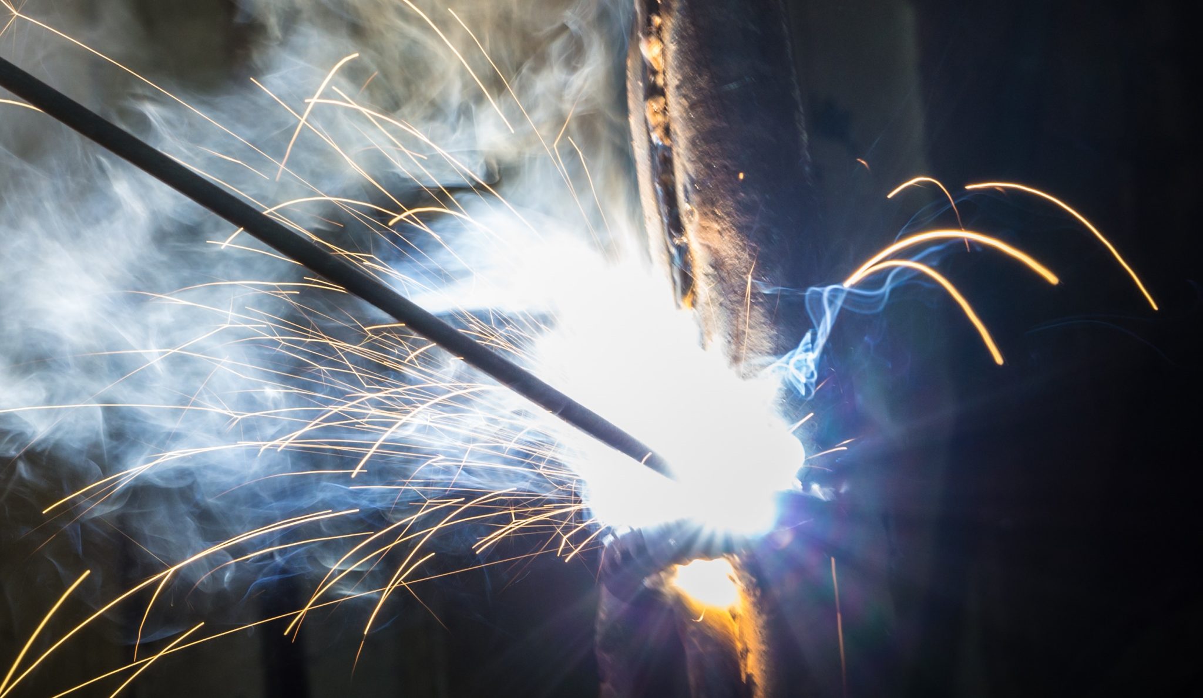
Livewrite
7am-9am
Mon-Fri
Excludes hols
Come and go as required

Slide 9
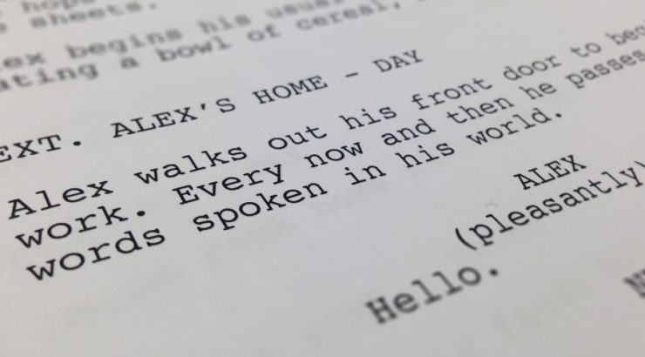
This week
Please write a 10-20 page script based on the writing exercise.
Next week – The Character
          www.martinkeaveney.com. 2023

