Slide 1
MKCW
PLAYWRITING: INTRODUCTION
WEEK 4: CHARACTER

Slide 2

OUTLINE

Slide 3

CHARACTER
Approaches
Meeting Your Character
Writing Exercise
Writing for this week

Slide 4
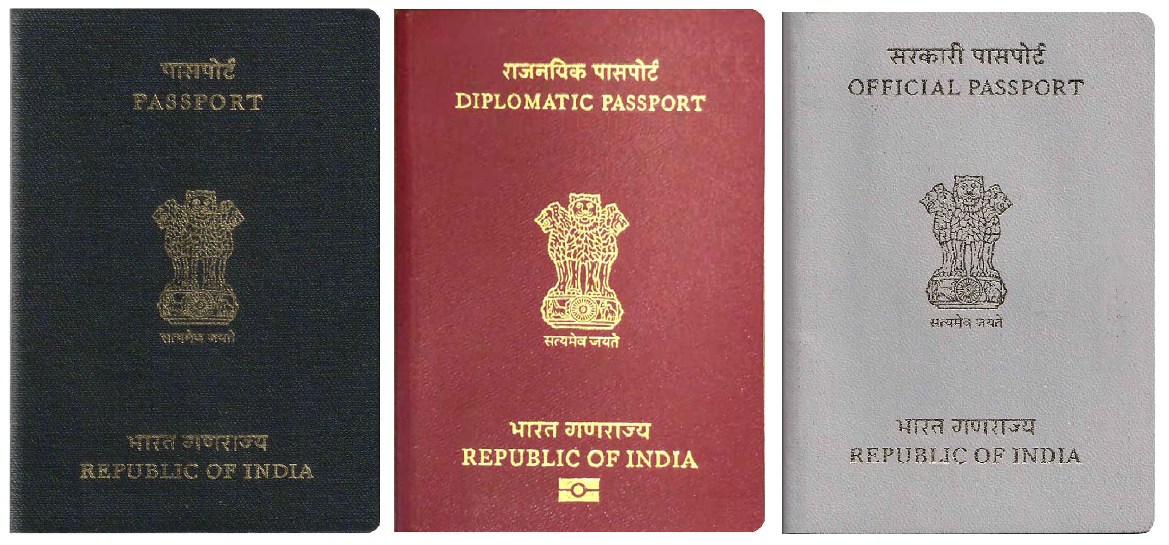
Meeting your character
Genre Characters (Fully formed)
Date of birth?
Education?
Work?
Family?

Slide 5
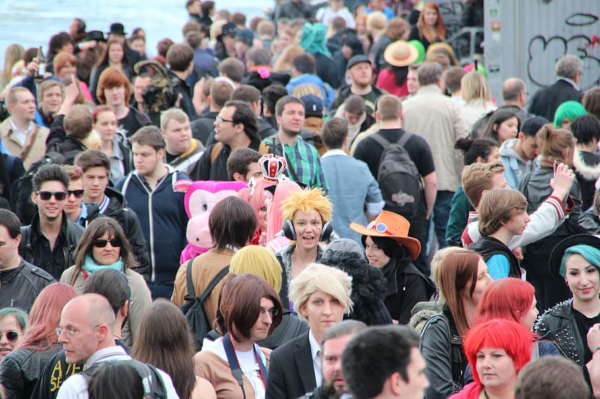
Meeting your character
Known associates?
Religion?
Convictions?
Finances?
Politics?

Slide 6
Meeting your character
Non-genre Characters (Partly formed)
Allow character to explain itself to you.
Answer questions later.

Slide 7
LISTEN, LISTEN, LISTEN!
What voice comes into your head?
Crystallise it on the page.

Slide 8
EXERCISE 1
Fill Sheet

Slide 9
EXERCISE 2
Now, choose a DIFFERENT CHARACTER
Spend 3 minutes waiting.
The listen to the character talking directly to you. Write everything they say for 3 minutes.

Slide 10
THIS WEEK:
Write a 500 word monologue of your character as they describe the most significant moment in their life.
Next week: Renaissance Theatre

