Slide 1

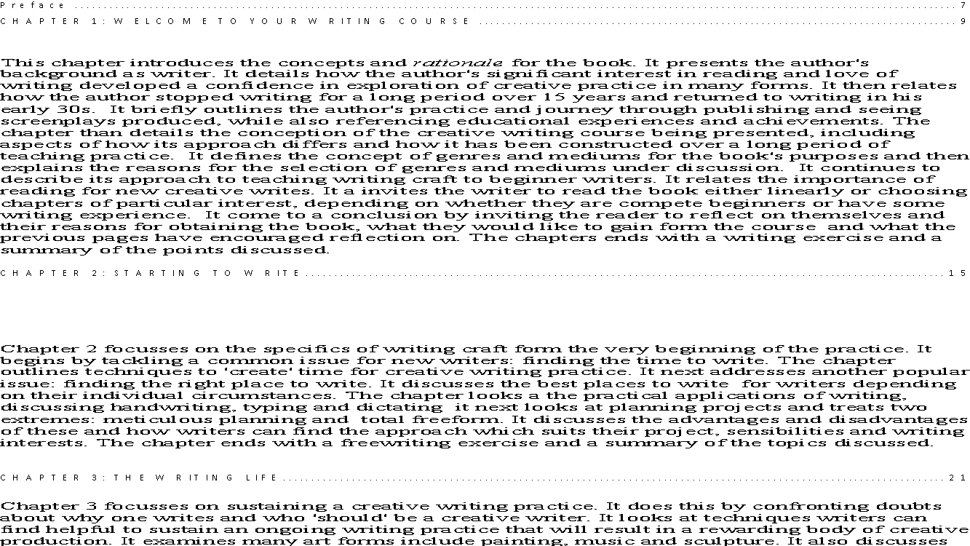
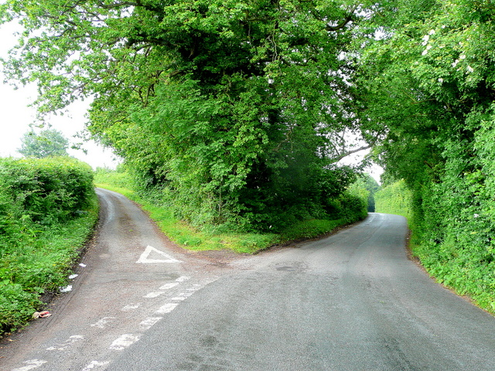
Wonder World
Specialist Course
Week 4 Alternative History
MKCW
This Photo by Unknown Author is licensed under CC BY-NC-ND

Slide 2
Alternative Histories
‘Historians [have] problems with [alternative histories]: with so much work to be done finding and writing the truth, why bother with something patently false? However, [alternative histories] have a very real use in the field of history: they foreground the notion of cause and effect that is so important to historians when they construct a narrative’ (Hellekson 16).
Hellekson, Karen. The Alternative History: Reconfiguring Historical Time
The Kent State University Press, London, 2001

Slide 3
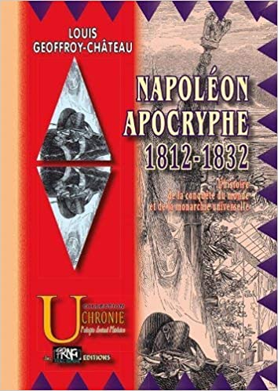
Early Alternative History
Napolean Apocryphe (1836) by Lous-Napolean Geoffroy-Chateau
(PRNG, 2013)

Slide 4

Historical Focus
Eschatalogical - Ultimate Destiny
Genetic - Origins, Development, Cause
Entropic - Disorder, Randomness
Teleological - Design, Purpose
(Hellekson)

Slide 5
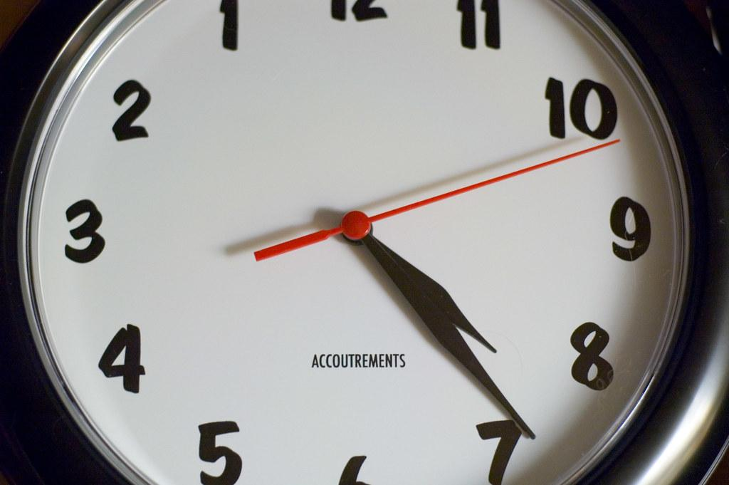
Eschatalogical
If we knew when the world would end….

Slide 6
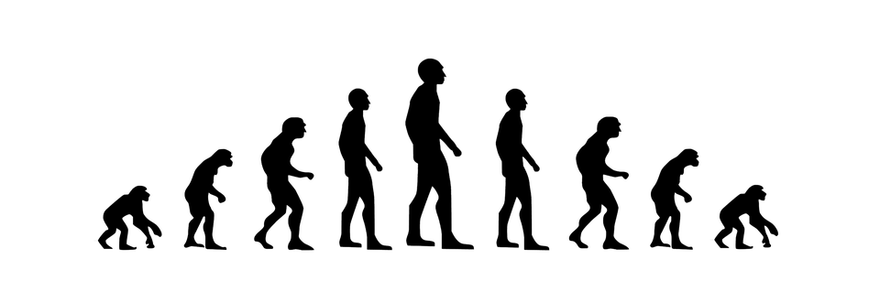
Genetic
If we had developed differently….

Slide 7
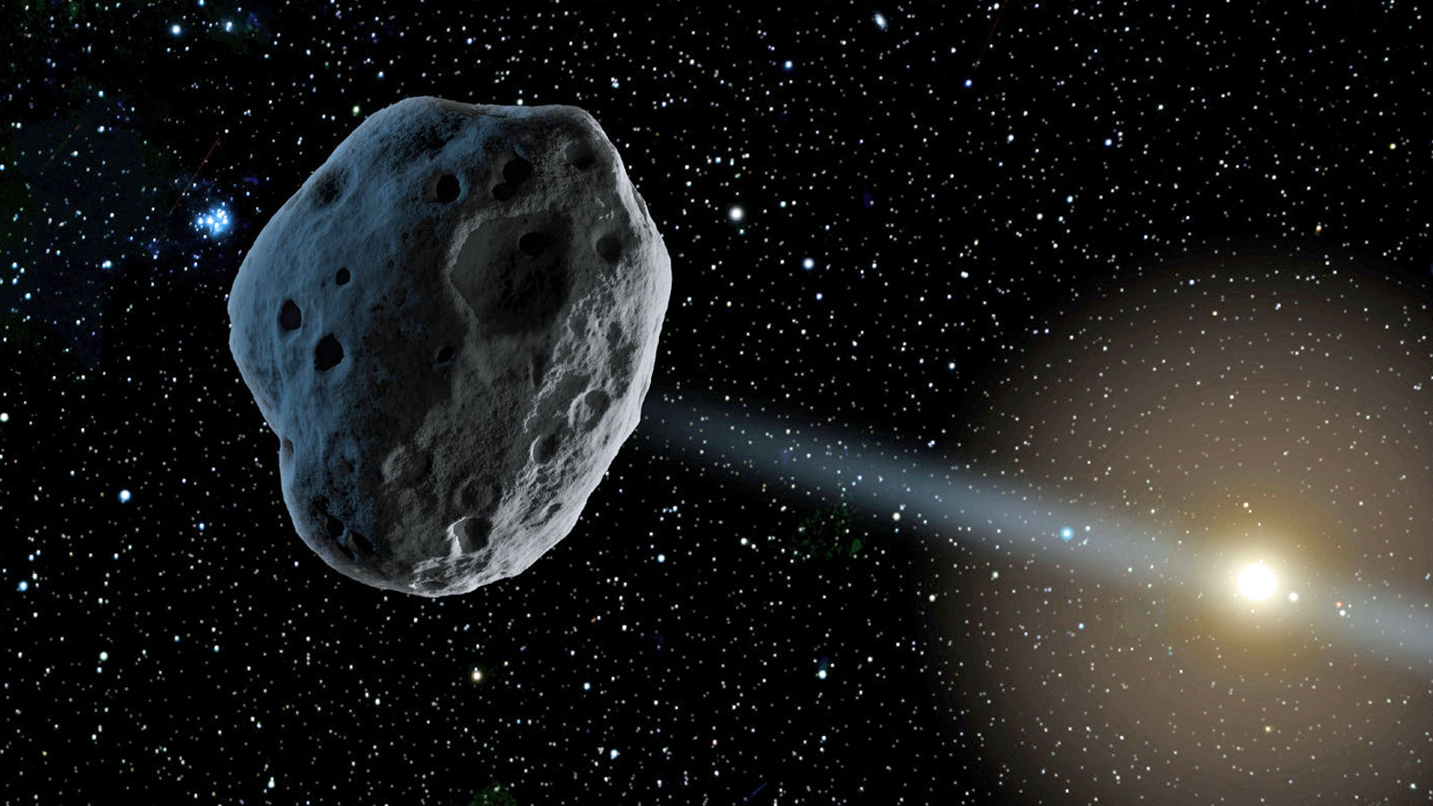
Entropic
If we had been hit with a random asteroid in the past….

Slide 8

Teleological
If Immoral forces won wars…

Slide 9
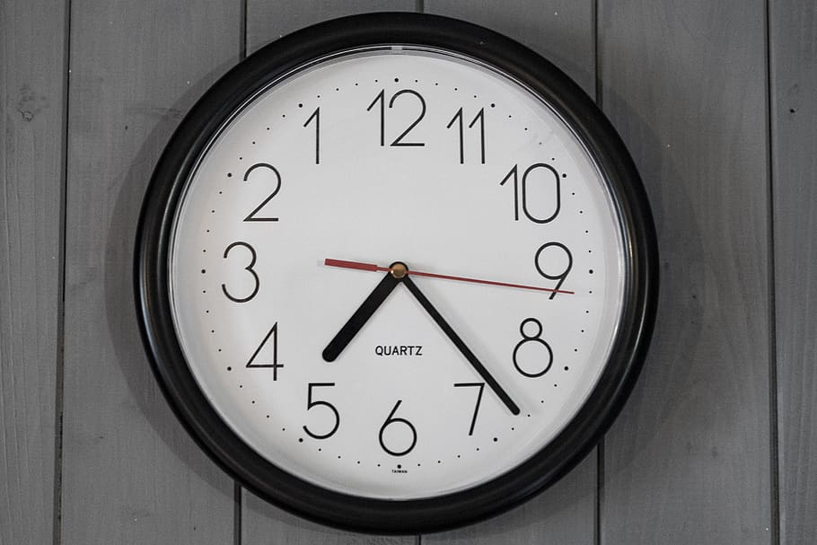
Time
Exploring Time in Fiction

Slide 10
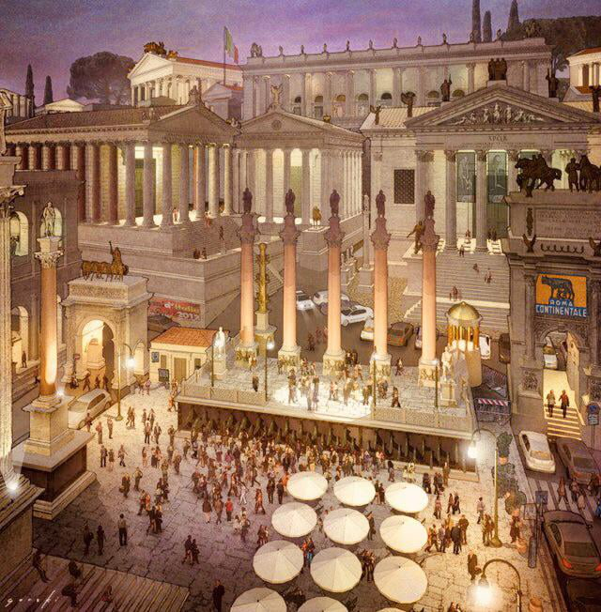
Macro-Scale

Slide 11
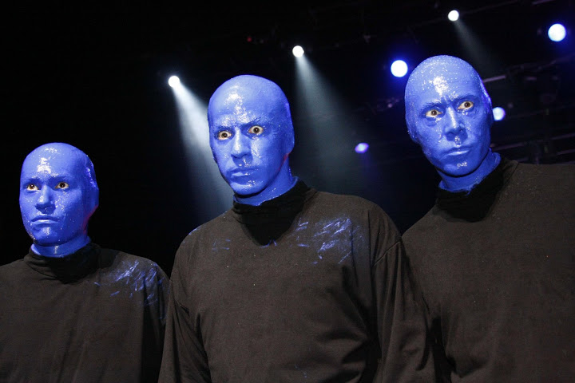
Micro-Scale

Slide 12
The Man in the High Castle
https://www.amazon.co.uk/Man-High-Castle-Philip-Dick/dp/0547572484?asin=B008DM2MGW&revisionId=892da4e5&format=1&depth=2
Read Sample at this link
Dick, Philip K. (1962) Mariner, 2012.
Publisher ‏ : ‎ Mariner Books; Reissue edition (24 Jan. 2012)
Language ‏ : ‎ English
Paperback ‏ : ‎ 288 pages

Slide 13

Writing

Slide 14
This week
Design an Alternative History based on the writing exercise.
Next Week – The World to Come
          www.martinkeaveney.com. 2023

