Slide 1

TEEN LIVES
APRIL IN PARIS
MKCW

Slide 2

Shock Horror!
Cliques
Hierarchies
Lads & Ladies
Mischief
Humour

Slide 3
‘First, few if any of the good ones are easier reading than the average adult novel considered suitable for younger high school students. Writers for teenagers do not limit vocabulary, nor do they use a less complex style than they would in fiction for adults (except in the case of stories specifically produced for "slow readers," which are not really "novels" in the literary sense).’ (Enqdahl 51)
Enqdahl, Sylvia. Do Teenage Novels Fill a Need?
The English Journal 64. 2 (Feb., 1975), pp. 48-52

Slide 4
‘Novels of quality for teenagers do not preach. A writer who approaches young people in a condescending way receives short shrift from today's editors and reviewers. One can use a story to reflect one's views, just as an author of adult fiction can-but they must be views about life, not about how young people, as distinguished from other people, ought to look at it.
(Enqdahl 51)

Slide 5
‘Teenage novels, if good, are not devoid of concepts worth pondering and worth discussing. Although fiction for the young ordinarily stays within the bounds of good taste, its themes are confined neither to traditional ideas nor to fashionable new ones. Thus it can hardly be called uncontroversial’.
(Enqdahl 51)

Slide 6
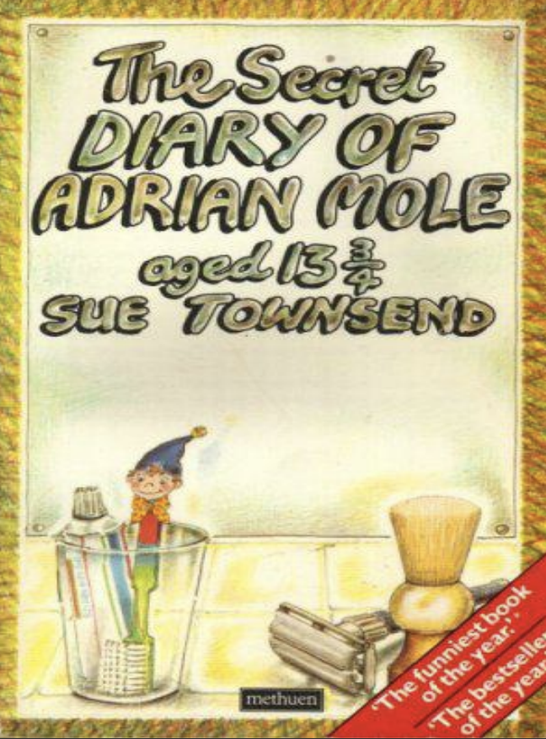
The Secret Diary of Adrian Mole Aged 13 3/4

Slide 7
THANK YOU FOR TAKING PART IN THIS SEMINAR
Please send questions to
info@martinkeaveney.com
APRIL IN PARIS 23 www.martinkeaveney.com 2023

