Slide 1
SHORT FICTION
APRIL IN PARIS 23
MKCW

Slide 2
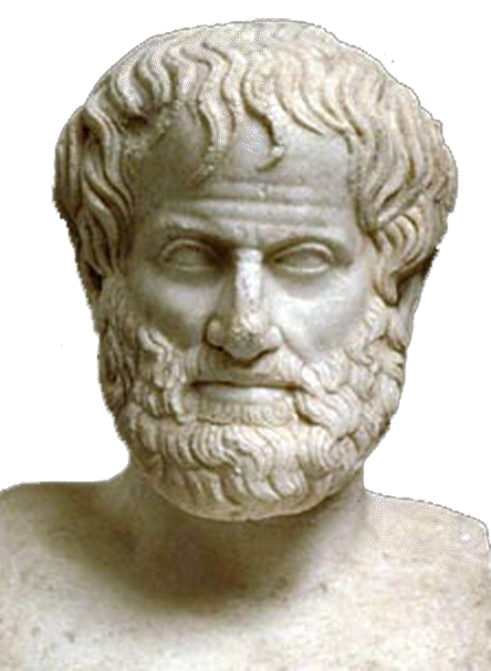
Incite Interest
Sustain Interest
Satisfy Interest
(Aristotle)

Slide 3

Incite Interest
Who is the character?
What do they want?

Slide 4

Sustain Interest
What does the character do to get what they want?
What stops the character getting what they want?

Slide 5
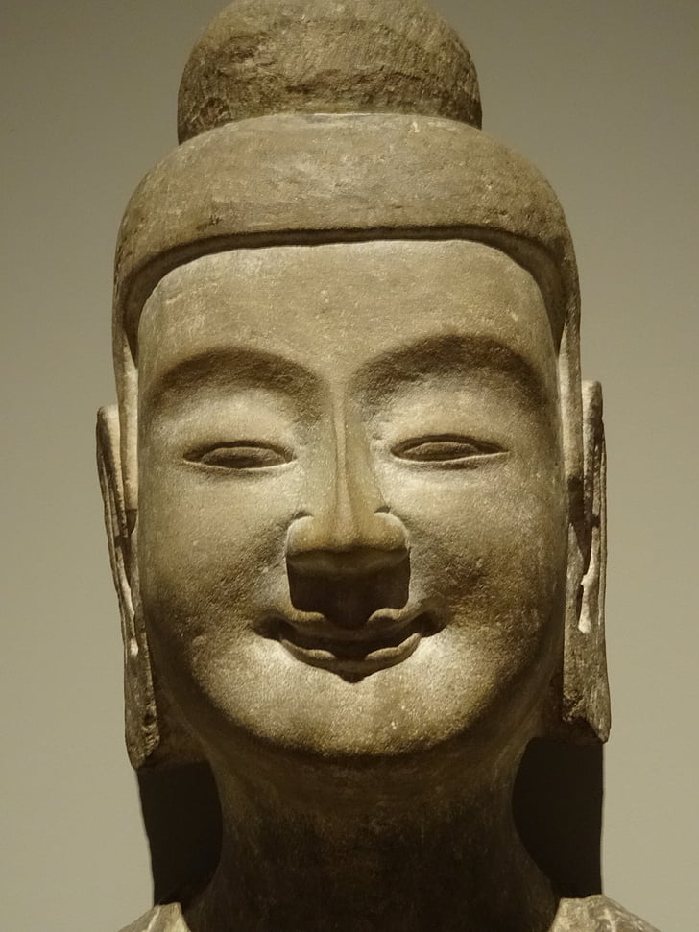
Satisfy Interest
Does the character get what they want?
If so, are they satisfied?
If not, what is the result of this?

Slide 6

Fantasy
Crime
Romance
Thriller
Historical Fiction
Others?

Slide 7
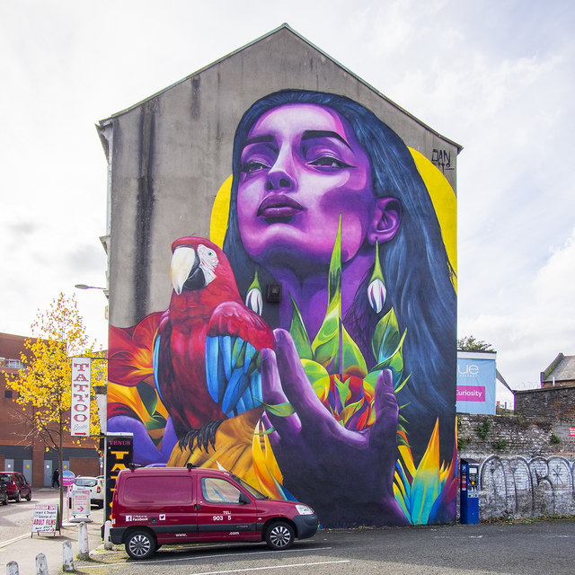
THE ART

Slide 8

The Image

Slide 9

The Sound

Slide 10
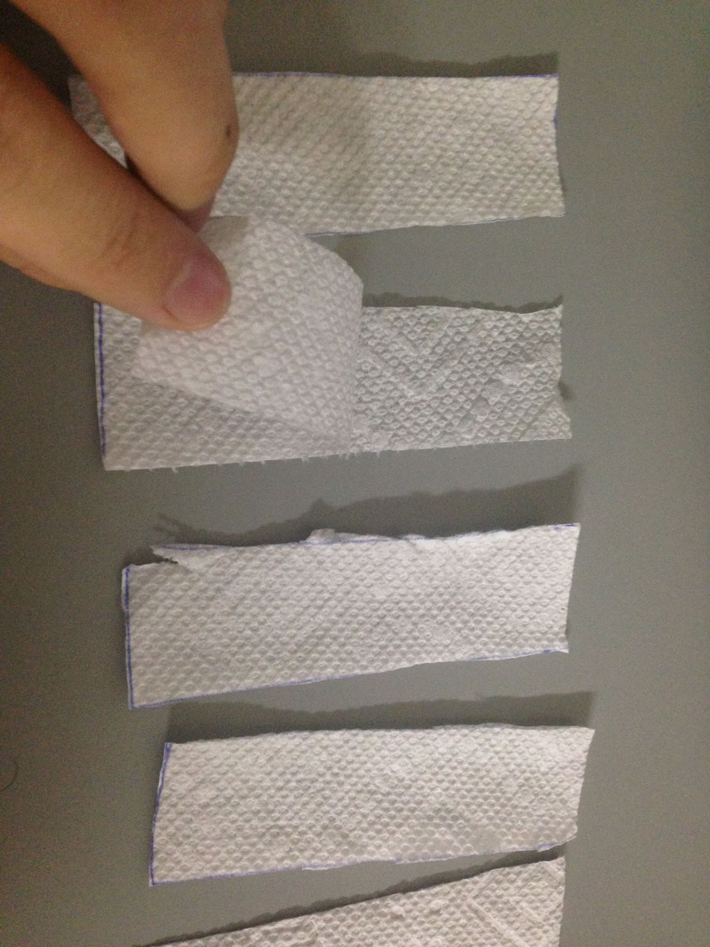
The Kinaesthetic
Tear a sheet of paper into a square, a triangle and a circle.
Place in front of you.
What do you have?

Slide 11

Navigation

Slide 12

Literature/ Literary Fiction
Character-driven fiction
Surrealist/ Magic realism writing
Others

Slide 13
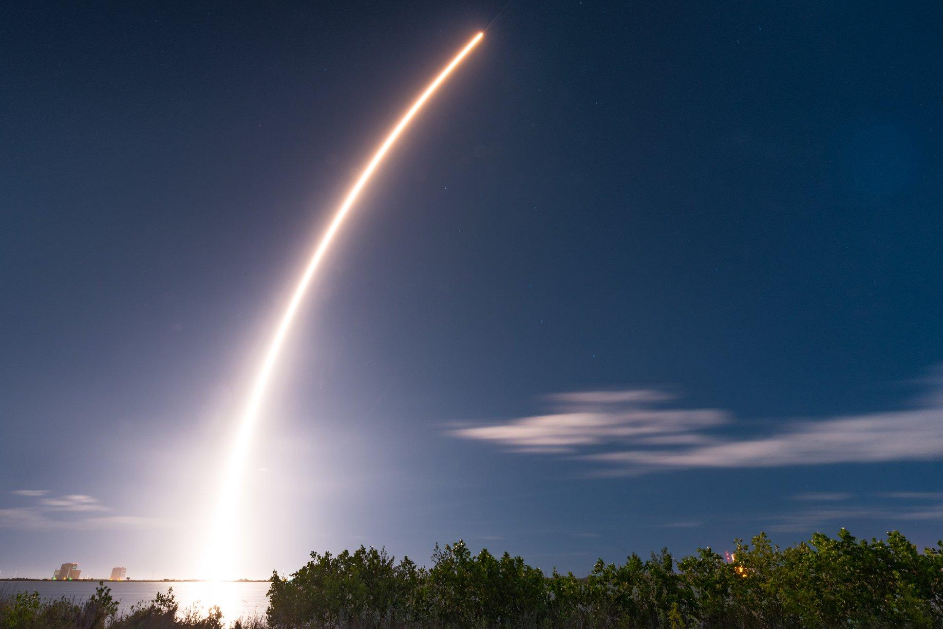
Combining
THE STORY + THE ART

Slide 14

Push boundaries of THE SHORT STORY or Episode

Slide 15
Short Fiction
THANK YOU FOR TAKING PART IN THIS SEMINAR
Please send questions to
info@martinkeaveney.com
APRIL IN PARIS 23 www.martinkeaveney.com 2023

