Slide 1
POETRY - AN INTRODUCTION
APRIL IN PARIS 23
MKCW

Slide 2
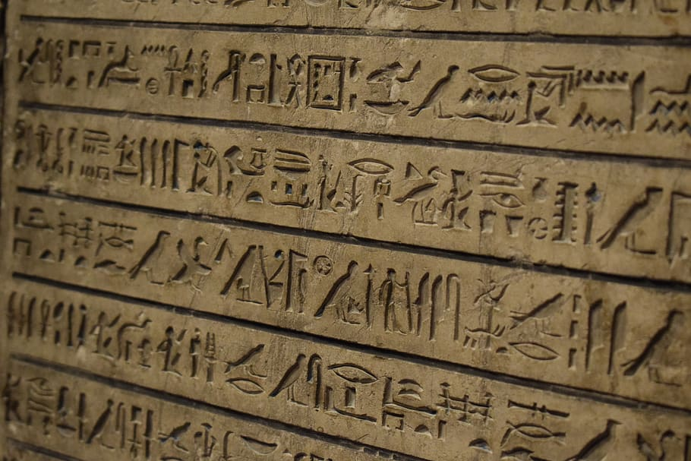
A brief history of language

Slide 3
Poetry the basics
Routledge, 2004
By Jeffrey Wainwright
Wainwright
PppoPetry
Poetry
‘Because there is language, there is poetry’ `(1)e is language there is poetry’ (1)’Becasue
The shape of the poem organize[s] language into a space for pause and […] attention’ (10)
Value of words in a poem

Slide 4
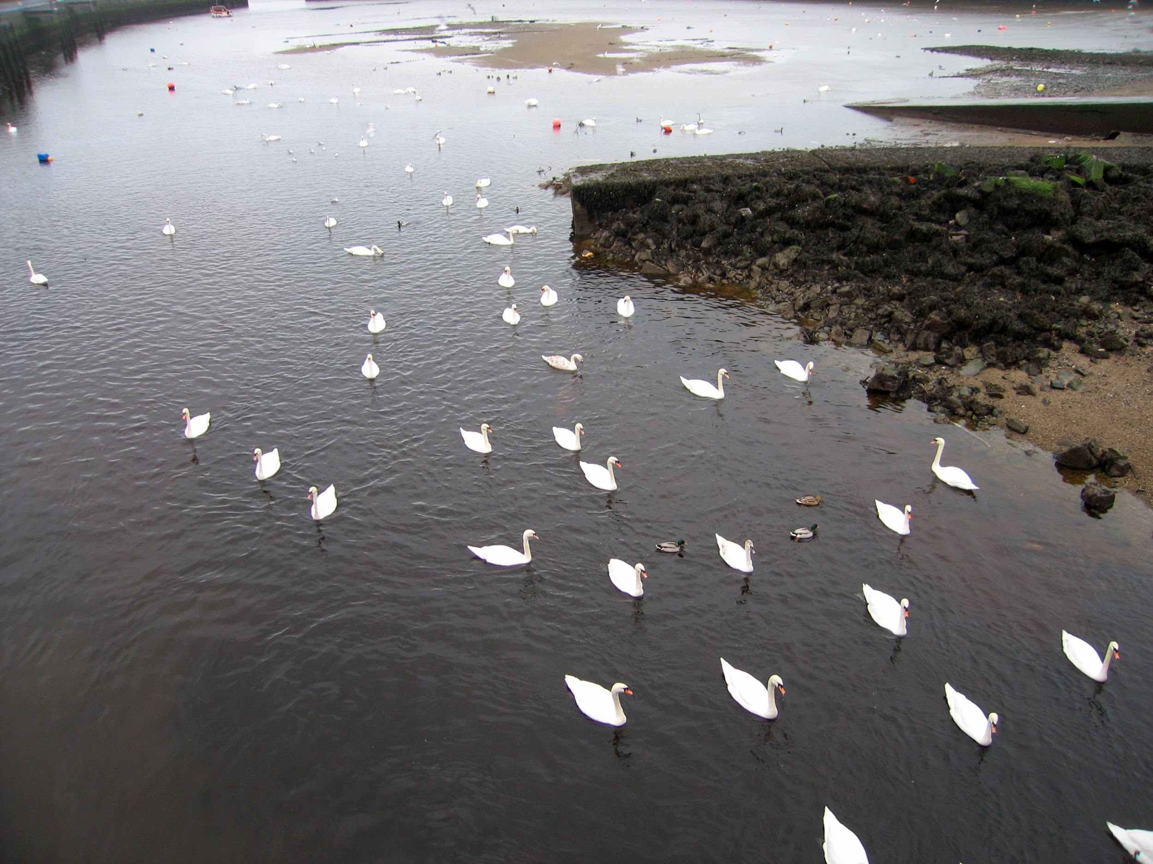
The trees are in their autumn beauty,
The woodland paths are dry,
Under the October twilight the water
Mirrors a still sky;
Upon the brimming water among the stones
Are nine-and-fifty swans

Slide 5

Writing

Slide 6
THANK YOU FOR TAKING PART IN THIS SEMINAR
Please send questions to
info@martinkeaveney.com
APRIL IN PARIS 23 www.martinkeaveney.com 2023

