Slide 1

Long Form Fiction
APRIL IN PARIS 23
MKCW

Slide 2

NOVELS
FILM
3 ACT PLAYS
OPERAS
SAGAS
OTHERS

Slide 3
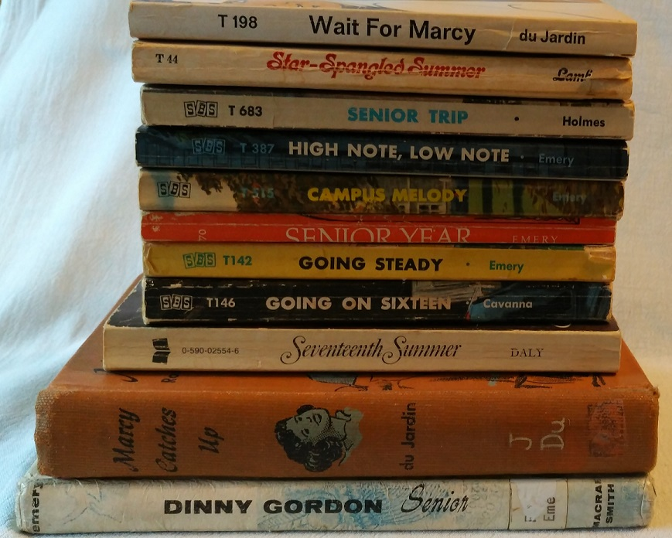
‘In The Theory of the Novel, the novel is considered not as a "closed" (geschlossen) art form but as a mode of thought, predicated upon a discrepancy - between "the conventionality of the objective world and the interiority of the subjective one" (70). This gap is unbridgeable; or rather, the novel is the expression of that gap’ (Bewes 17).
‘The Novel Problematic’
By TIMOTHY BEWES
NOVEL: A Forum on Fiction , SPRING 2011, Vol. 44, No. 1 (SPRING 2011), pp. 17-
19

Slide 4
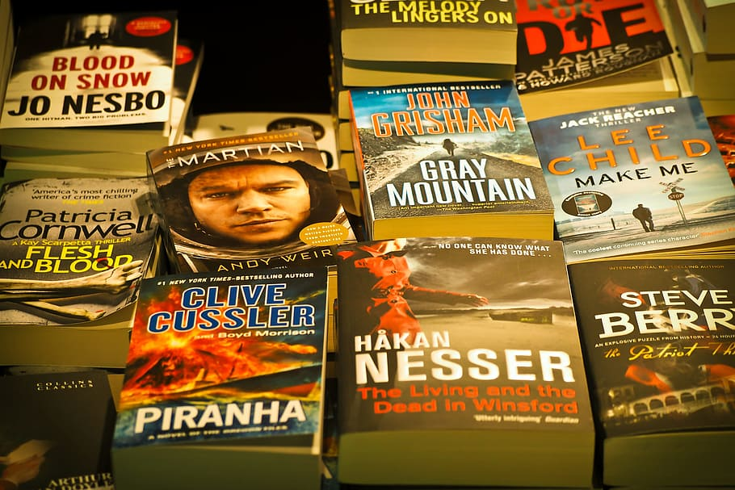
‘Entertainment Novel v ‘Proper Novel’
‘The entertainment novel opens up a problematic, which may be ethical or philosophical, and addresses or deals with it within the work, which is exhausted by it. The entertainment novel reserves all concerns and pre-occupations of the novel for the content of the work; it thereby presupposes an ethical legitimacy to the novel itself and to the activity of the novelist’ (Bewes 17).

Slide 5

Seclusion
Isolation
Conversation
AI
Editing
Finishing

Slide 6
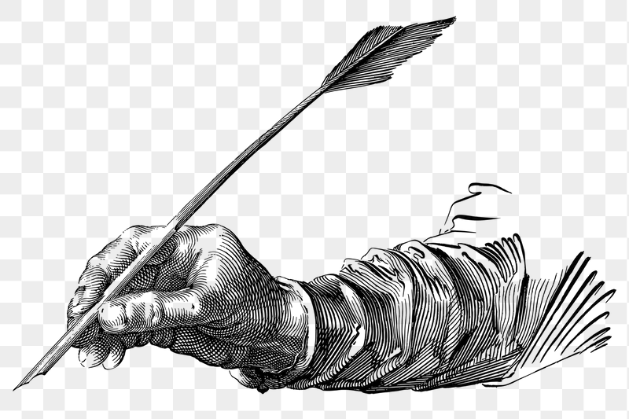
Writing

Slide 7
THANK YOU FOR TAKING PART IN THIS SEMINAR
Please send questions to
info@martinkeaveney.com
APRIL IN PARIS 23 www.martinkeaveney.com 2023

