Slide 1
GEORGE MOORE IN PARIS
MKCW
APRIL IN PARIS

Slide 2
MOORE - A BRIEF INTRO
Born February 24, 1852, Ballyglass, County Mayo, Ireland—died January 21, 1933, London
Moore’s travels
1873 Left Ireland for Paris
1882 Moved to London
1901 Returned to Dublin

Slide 3
MOORE - A BRIEF INTRO
The Untilled Field (1903)
Hail and Farewell trilogy (1911-14)
Ave, 1911; Salve, 1912; Vale, 1914

Slide 4
MOORE IN PARIS
Leaves for Paris, 13 March 1873
Arrives at Hotel Quai Voltaire by the Seine, attended by valet William Molony.
Early use of French was ‘like nothing heard under God’s sky before’ (Frazier 27).
Frazier, Adrian. George Moore 1852-1933, Yale University Press , 2000.

Slide 5
MOORE IN PARIS
25 April 1873 Admitted to Alexandre Cabanel’s (1829-89) private art school
Several attempts to succeed as an Artist through 1870s
Attempts to gain hand of Mary de Ross Rose, an heiress form Co. Limerick (1875)

Slide 6
MOORE IN PARIS
25 April 1878 - Meets group in a favourite cafe Cafe Nouvelle Athene (Rue Pignelle and joins 4,000 other posing as characters form Zola’s L’Assommoir (1877)
Edouard Manet introduces Moore to Zola, but Zolannods and walks on!

Slide 7
MOORE IN PARIS
Tenants not paying rent in Co.Mayo
Moore forced to return
Leaves Paris, last address 61 Rue de Condorcet

Slide 8
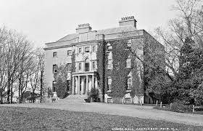
Moore and Place
Moore Hall, 19th century

Slide 9
MOORE AND PLACE
IN THE CLAY
‘In The Clay’ (Untilled Field 1903)
Rodney – Artist and sculptor
Work destroyed by vandals
Reading –
Discussion
Rodney left Ireland to pursue art
Rodney ponders culprits and reflects on life and career

Slide 10
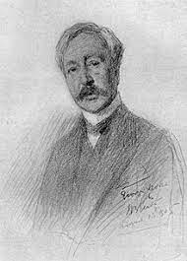
MOORE IN PARIS

Slide 11
THANK YOU FOR TAKING PART IN THIS SEMINAR
Please send questions to
info@martinkeaveney.com
APRIL IN PARIS 23 www.martinkeaveney.com 2023

