Slide 1
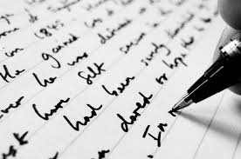
CREATIVE WRITING:ONE DAY COURSE
Dr MARTIN KEAVENEY

Slide 2


Welcome
Introduction

Slide 3
Course Objectives
Writing Craft
Critique
Develop writing practice for a hobby or a career

Slide 4
READING
Reading as a creative writer
Range of texts
Reading practice
Re-reading

Slide 5
Texts for discussion
Readings and links have been/will be supplied.
List
Blake, William. Blake’s Poetry and Designs. WW.Norton, 2008.
Levy, Deborah. ‘Roma’. Granta, 3 May 2017, Online.
https://granta.com/roma-deborah-levy/

Slide 6
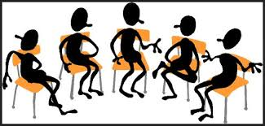
INTRODUCTIONS

Slide 7
Poetry the basics
Routledge, 2004
By Jeffrey Wainwright
Wainwright
PppoPetry
Poetry
‘Because there is language, there is poetry’ `(1)e is language there is poetry’ (1)’Becasue
The shape of the poem organize[s] language into a space for pause and […] attention’ (10)
Value of words in a poem

Slide 8

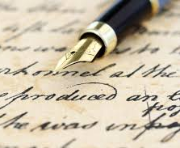
Poetry sample.
‘A Poison Tree.’

Slide 9
Introduce
yourself!

Slide 10
Freewriting
‘Freewriting enables the writer to get past the conventional frame of work because it allows ideas to flow from the mind to the pen.’ (University of Lychburg.edu/drafting a document)
‘Producing writing is not so much like filling a basin or pool once, but rather getting water to keep flowing through finally it runs clear.’ (www.peterelbow.com)

Slide 11

Starting to write

Slide 12
Disclaimer!
Time and Space
Practical Methods
Planning
Starting to write

Slide 13
Time and Space
Writing time management
Isolating blocks of time
Silence
‘Going to sleep’

Slide 14
Practical method
Handwritten v Electronic
Online programs

Slide 15
Planning
Outline v Writing Blind
Character biographies?
Plot-based narrative
Character-based narrative

Slide 16

Starting to write
Turn off Editor
Comic strip approach
Progressive competency
Interview by the page

Slide 17
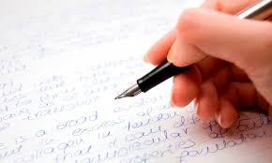
WRITING EXERCISE

Slide 18
Intro to Fiction
Realism
Observation

Slide 19
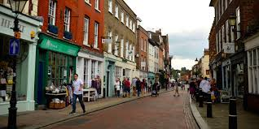
REALISM
‘The main artistic goal of the realist movement was the reliable depiction of daily motives, undertaken via the avoidance of both intricate technical conventions and any appeal to supernatural or exotic subjects.’
Falcato, Ana Christina, ‘Getting to the heart of the matter: Realism and Modernism in the novel’ Revista de Letras, Vol. 55, No. 1 (Janeiro/Junho 2015), pp. 9-24 (11)

Slide 20
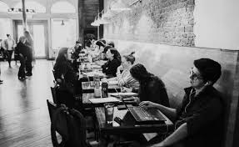
FURTHER DISCUSSION
‘[A] very detailed presentation of individual characters, who are identified by a common, non-typified proper name and to whom are ascribed both reasonably detailed physical characteristics and a deeply developed psychology – all framed, crucially, by a detailed description of the characters’ social environment. As far as specifically literary conventions go, the type of plot characteristic of the novel departed from previous literary structures to the extent that it came to fix previously narrated events as causes of present action.’ (Falcato 12)

Slide 21

THE WRITING LIFE

Slide 22
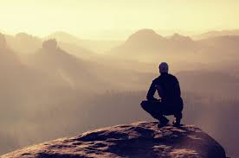
PSYCHOLOGY OF BEING A WRITER
Why write?
Will it be good enough?

Slide 23
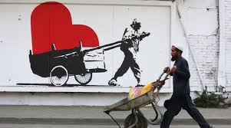
WRITER’S TOOLS
Recognising the role of the literary artist
Recognising ourselves as artists

Slide 24
PSYCHOLOGY OF BEING A WRITER
Consumption of Art (as a literary artist)
Modern visual arts
Contemporary music
Sculpture
Travel
Theatre
Cinema
Reading!

Slide 25

CONSIDERATIONS
Agenda driven material
Commercial driven i. e. advertising
Social issue driven
Politically driven
Considerations when using real life material as source

Slide 26

RAW MATERIAL
‘Write what you know’ - but what do we know?
Can what we know ‘work’ as literature?

Slide 27

WRITER’S TOOLS
Defiance toward externals?
Tell the story, not the [conscious] theme
Practice observation describing a room/scene without action or characters

Slide 28

WRITER’S TOOLS
Observation:
Aural
Visual
Kinaesthetic

Slide 29

WRITING EXERCISE

Slide 30
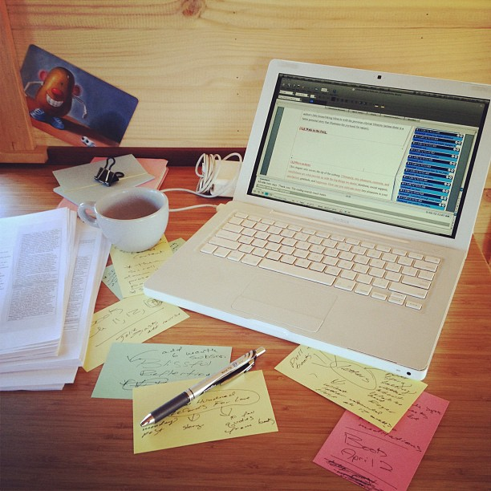
SELF-EDITING

Slide 31
The theories of Editing
Re – Vision
What is a draft?
Respecting the first draft
Rewriting
Editing your work
Separating creator and editor

Slide 32

Modes of revisions
Global revision
Local revision

Slide 33
Practical focus
Plot
Narrative
Characterisation
Dialogue
Descriptemes
Focalisation
Other cuts and additions

Slide 34
Micro-edits
Sentences
Words
Dialogue

Slide 35
Practical Methods
Handwriting second drafts
Using computer and typed versions
Printing hard copy and marking
Making notes through reading
Levels of revision
When work is being improved or being changed

Slide 36

FICTION
https://granta.com/roma-deborah-levy/

Slide 37
Sharing and Critiquing

Slide 38

OPENING THE DOOR…
Sharing your work
Reading for others

Slide 39

SHARING YOUR WORK

Slide 40
Sharing
Selecting readers
Value of ‘Insiders’ and ‘Outsiders’
Writing Groups
Online readers
The waiting game
Live meetings/ Written report

Slide 41




Implementing Feedback
Accepting Comments
Rejecting Comments
Multiple views

Slide 42

READING FOR OTHERS

Slide 43
YES
CRITIQUE: A critique is a written examination and judgment of a situation or of a person's work or ideas. (CED)
NO
TO CRITICISE: If you criticize someone or something, you express your disapproval of them by saying what you think is wrong with them. (CED)
REVIEW:A review is a report in the media in which someone gives their opinion of something such as a new book or film.
Alternative term: RESPONSE

Slide 44


Slide 45
CONSIDER
What is the level of presentation?
How effective is the handling of the material?
What would prevent you from including it in your magazine?

Slide 46
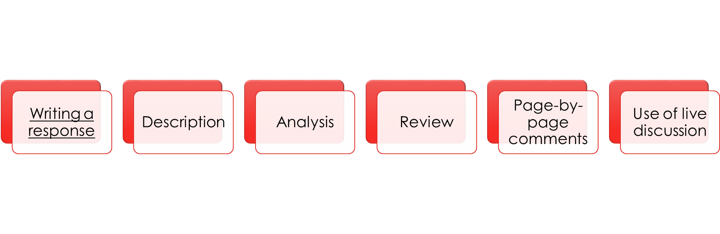

Slide 47

WRITING TIME
To be revealed!

Slide 48

PUBLISHING

Slide 49
Late drafts
Improving or Changing?
The point of release
Font size, Justify, Proofread

Slide 50
Proofreading
Backwards
Read Aloud
Assistive programs

Slide 51
Publishers/Editors guidelines
Name on file
Type of file
Fonts/Images
Submission windows

Slide 52
Writing a query
Writing a biography of yourself

Slide 53
Capitalism of the industry
Majority of Publishers and Editors in profit mode – who will pay for this?
Non-profit section wants high level literature
Self-marketing: social media/website etc.

Slide 54
The Market
Book?
Magazine?
Print/Online
Traditional v Independent

Slide 55
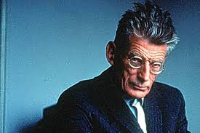
REJECTION
‘Ever tried. Ever failed. No matter. Try again. Fail again. Fail better.’
‘Worstword Ho’, Samuel Beckett, 1983.
Developing register for publications
Being astute with submissions process
Avoid unnecessary rejections

Slide 56
ACCEPTANCE
Proofs
Dealing with editors
Promoting published material
Readings

Slide 57
Congratulations!
Thank you for taking part.
Courses online at www.martinkeaveney.com/courses
info@martinkeaveney.com / 0876007100
www.martinkeaveney.com 2022

