Slide 1
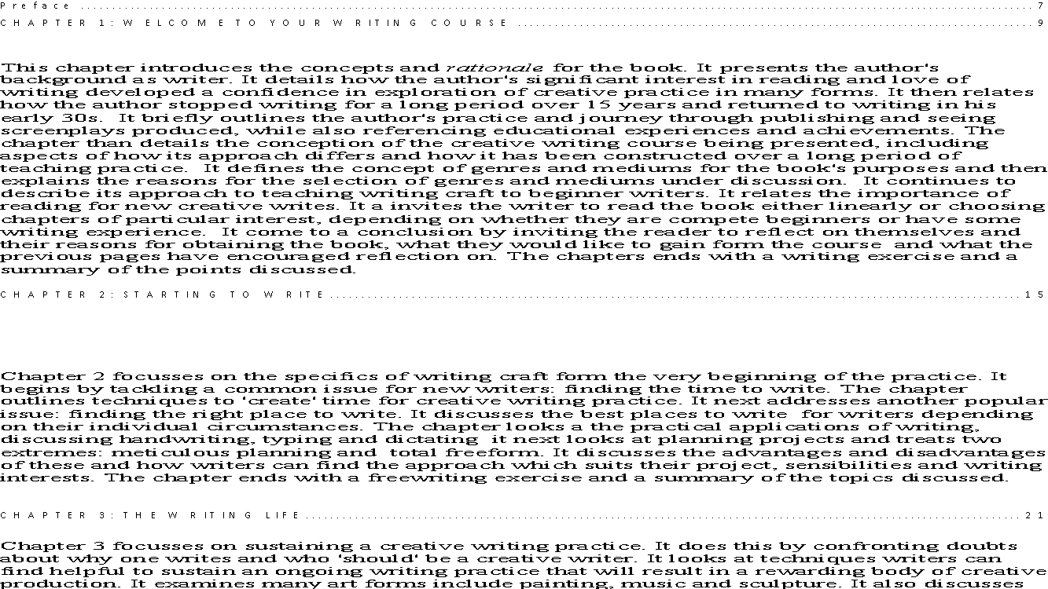
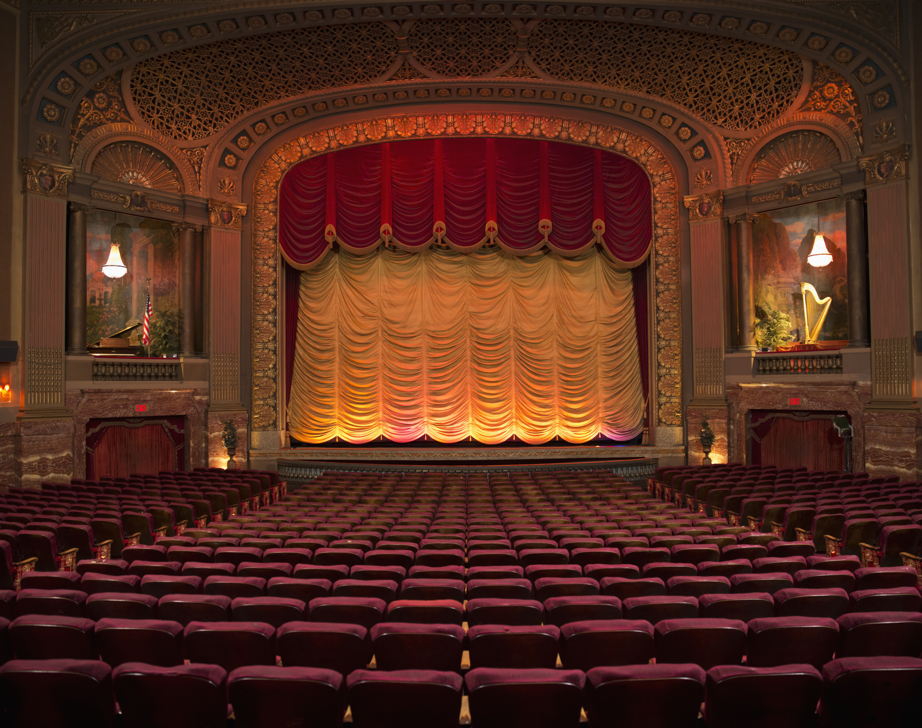
The World on Stage
Specialist Course
MKCW
This Photo by Unknown Author is licensed under CC BY-NC-ND

Slide 2
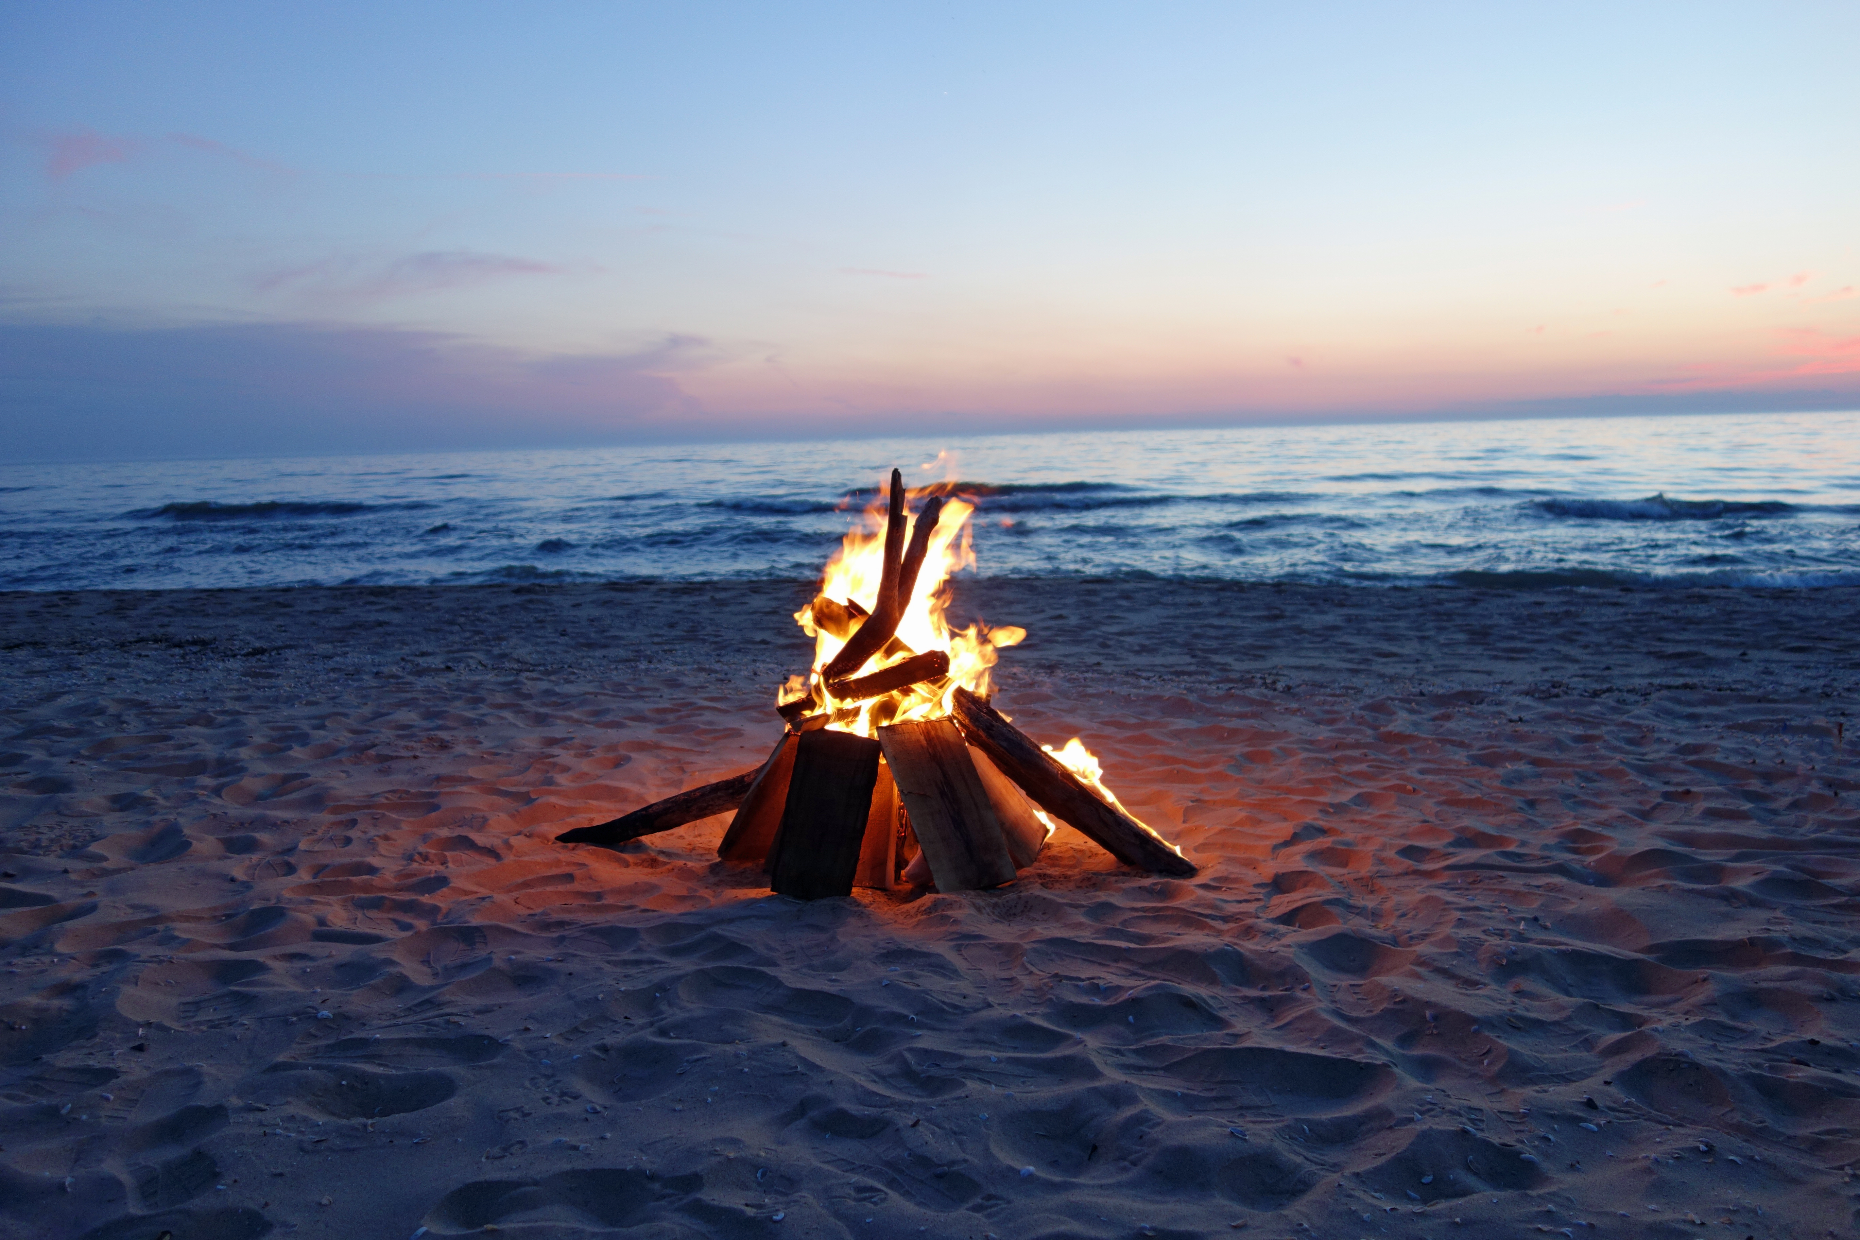
Introduction
Introduction
The Campfire & Language for Drama
Greek Theatre
The Character
Renaissance Theatre
Story on Stage

Slide 3
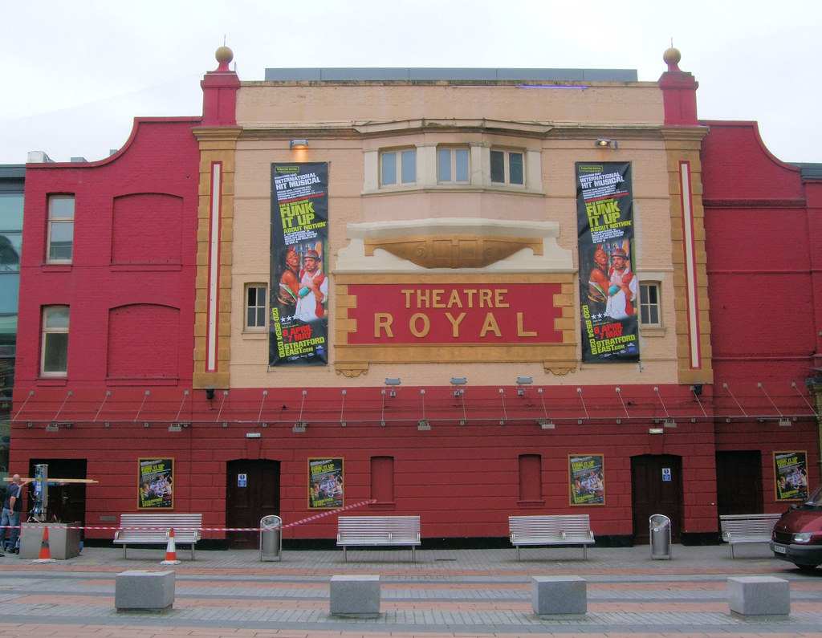
Introduction
Formats
Realism
Modernism
Postmodernism
Submissions
Special Focus
This Photo by Unknown Author is licensed under CC BY

Slide 4

Introduction
Scripts v Prose
Direct Speech
Sets
Technology

Slide 5
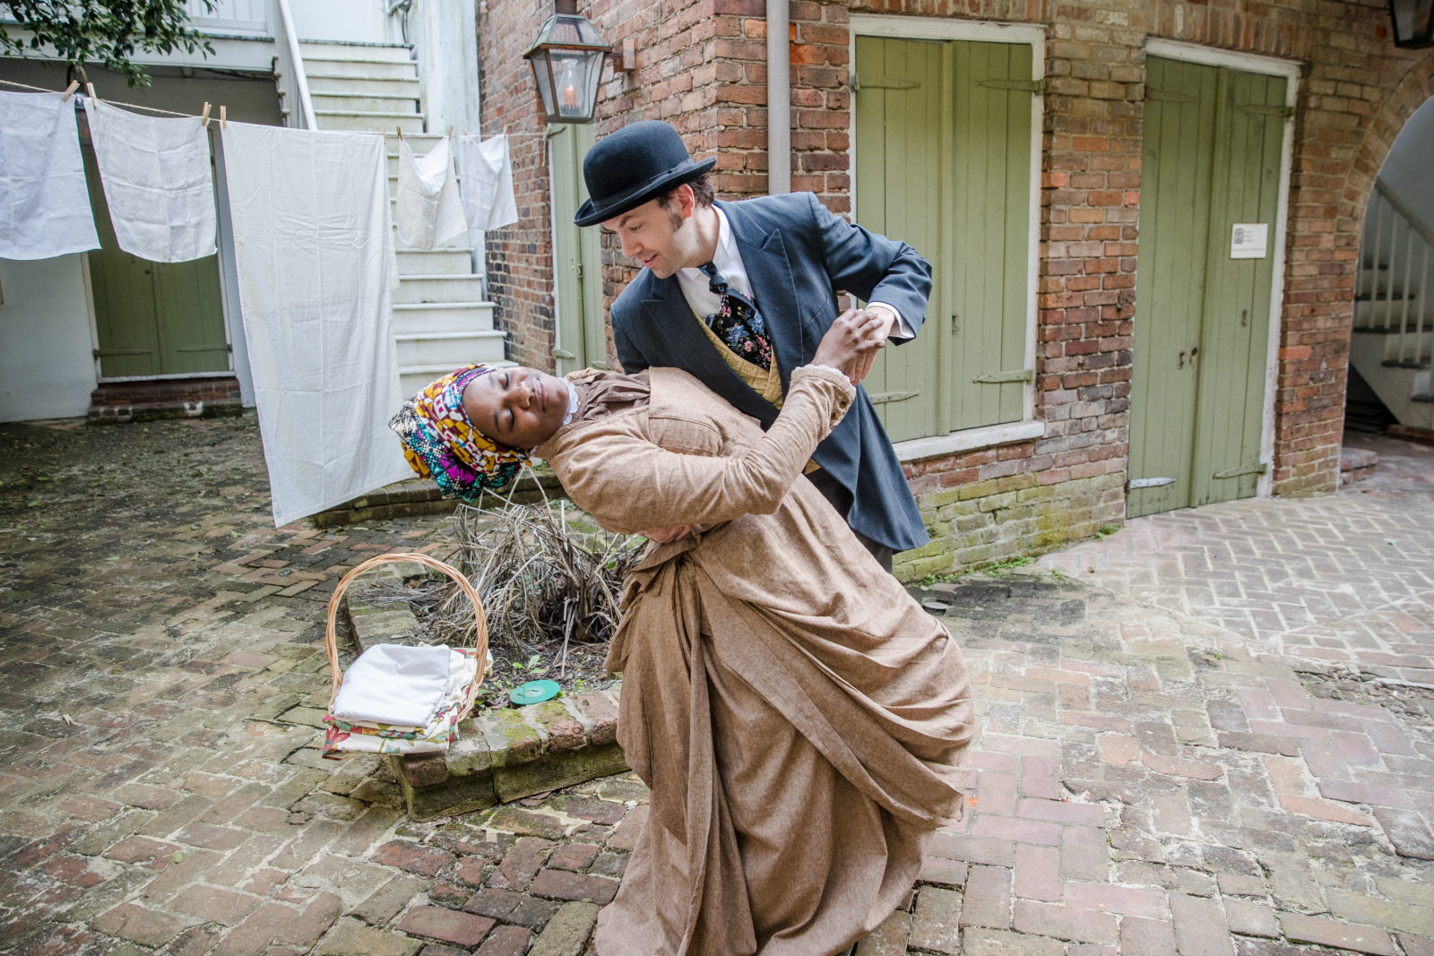
Types of Stagework
Play on Stage
Immersive Theatre
Multi-Media Performances
Technology

Slide 6
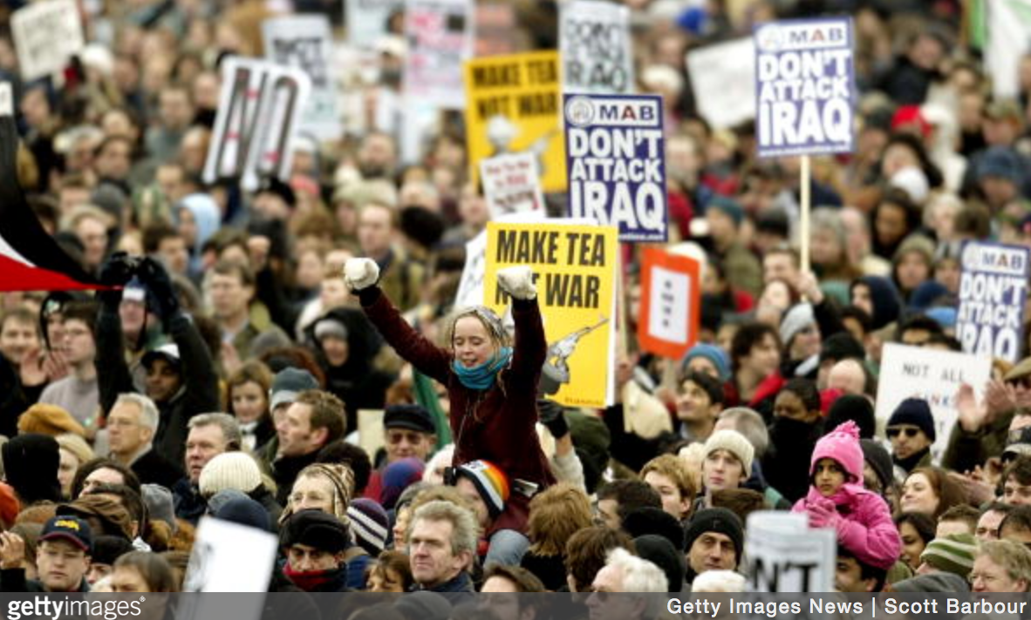
Stage work & Theme
Wide emphasis on Social Theatre
Argument of Story over Theme
Craft v Economics

Slide 7
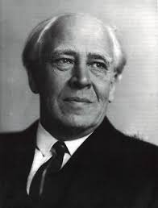
Modern Approaches
Constantin Stanislavski
Bertolt Brecht
Viktor Schlovsky
Mikhail Bakhtin

Slide 8

Voices
Process of Voices before set

Slide 9

Writing

Slide 10
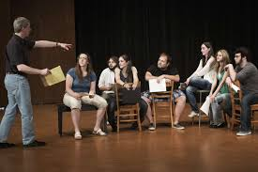
Stage Project
60 Script pages +
500 word synopsis
Any Genre
Submit on Week 12
Editorial response within 3 months

Slide 11

Peer group
Choose slot
Share work
Participate in Workshop
Change slot as needed

Slide 12

Livewrite
7am-9am
Mon-Fri
Excludes hols
Come and go as required

Slide 13
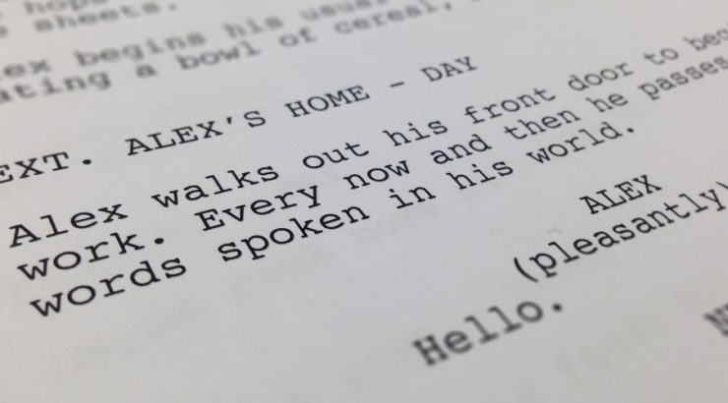
This week
Please write a 10-20 page script based on the writing exercise.
Peer group will be issued shortly.
Next week – Campfires & Language
          www.martinkeaveney.com. 2023

