Slide 1

Children’s Fiction
Special MODULE
AUTUMN 2022 at MKCW

Slide 2

Week 3 - Toddlers/Young Children
Images - Sentences
‘[Campe’s] functional characterization of the Aristotelian pro ommaton or "placing before the eyes" ( Vor- Augen-Stellen) challenges the distinction between the realms of abstraction and intuition, of construction and Anschaulichkeit without short-circuiting the distinction of primary visuality (seeing what is actually visible and present) and imagination - a frequent conflation that is usually based on an invocation of resemblance or of vividness (enargeia)’ (Gross 279).
Gross, Sabine ‘Writing in Images: Introduction’ Monatshefte 102. 3, (Fall 2010), 277-284

Slide 3
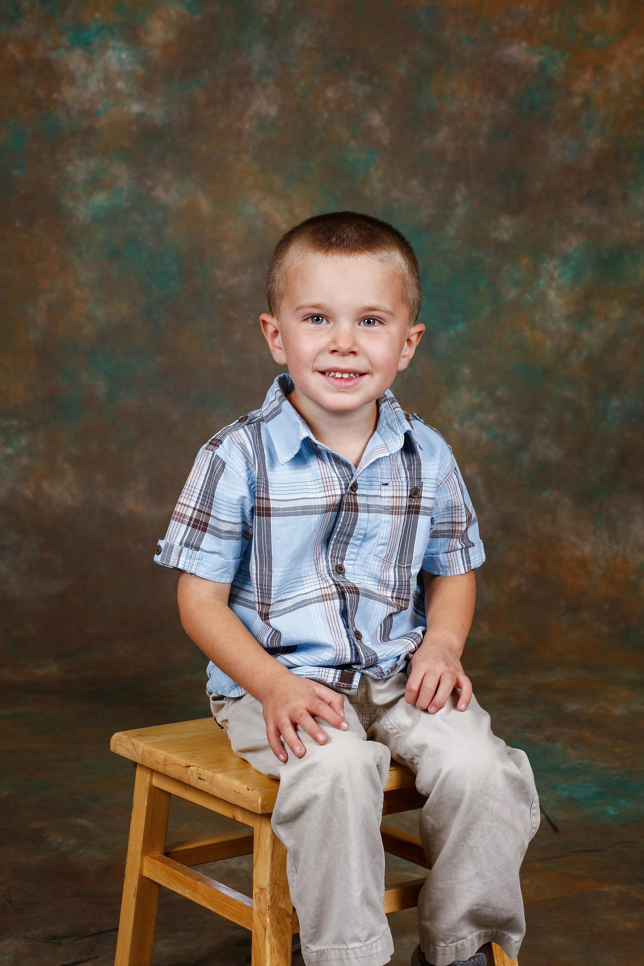
Week 3 - Toddlers/Young Children
Sentences - Story
‘To begin a children's story writing unit, I ask the students to remember what they were like between the ages of five and eight.’ (Wiseman 47)
Wiseman, Nell. ‘A Unit for Writing Children's Stories’ The English Journal, 68. 5 (May, 1979), pp. 47-49

Slide 4
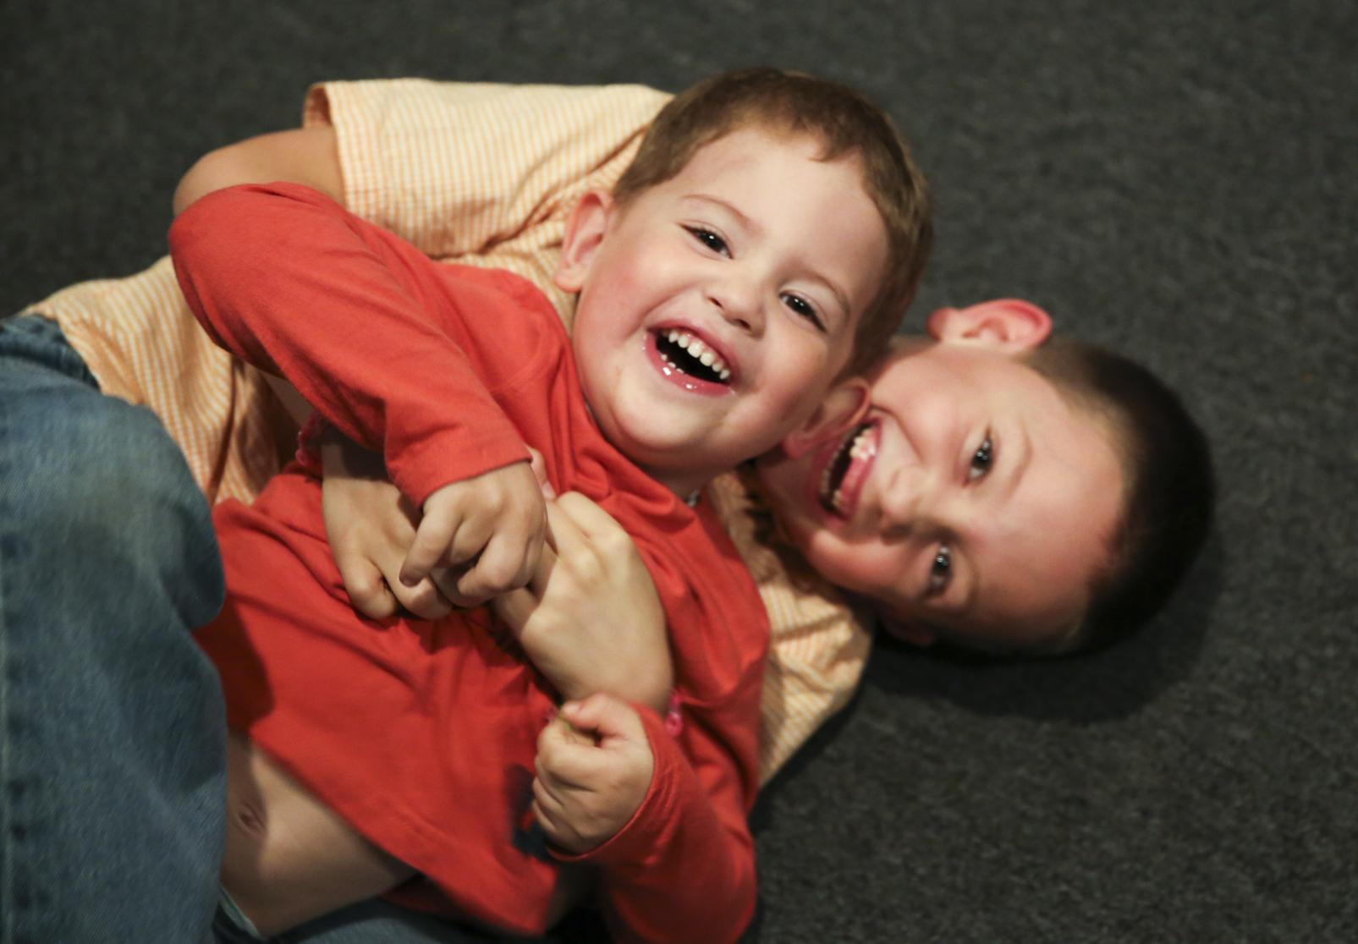
Language
‘Students write many different examples of figures of speech that would appeal to the age.’ (Wiseman 48).

Slide 5
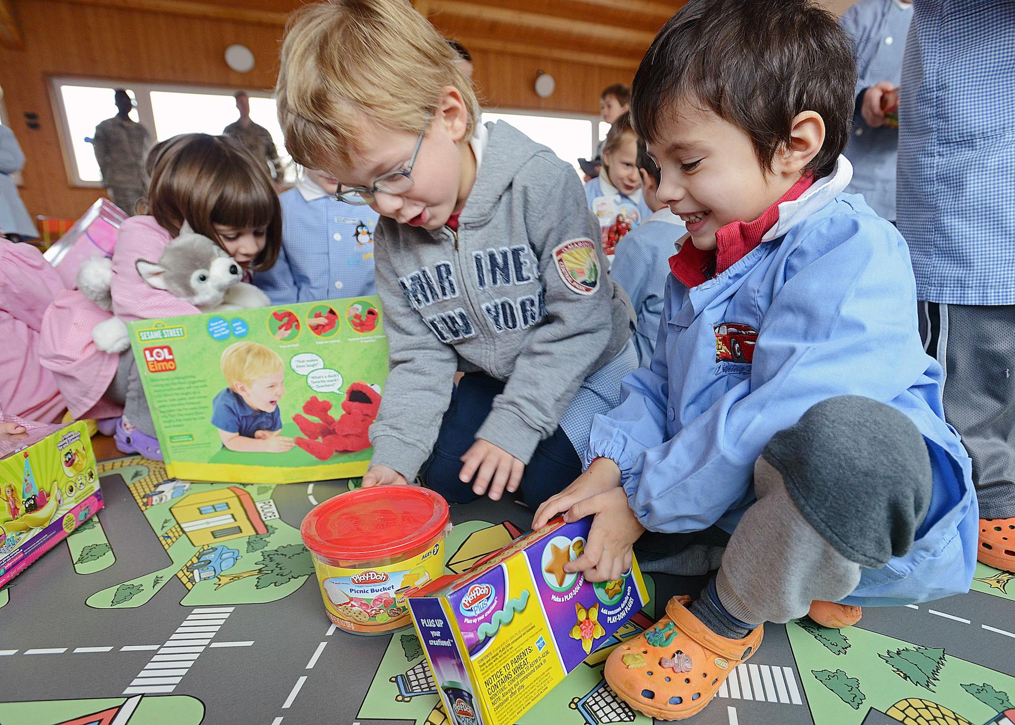
Toddlers/Children
What were you like as a 6-year-old?
What did you love?
What did you hate?

Slide 6
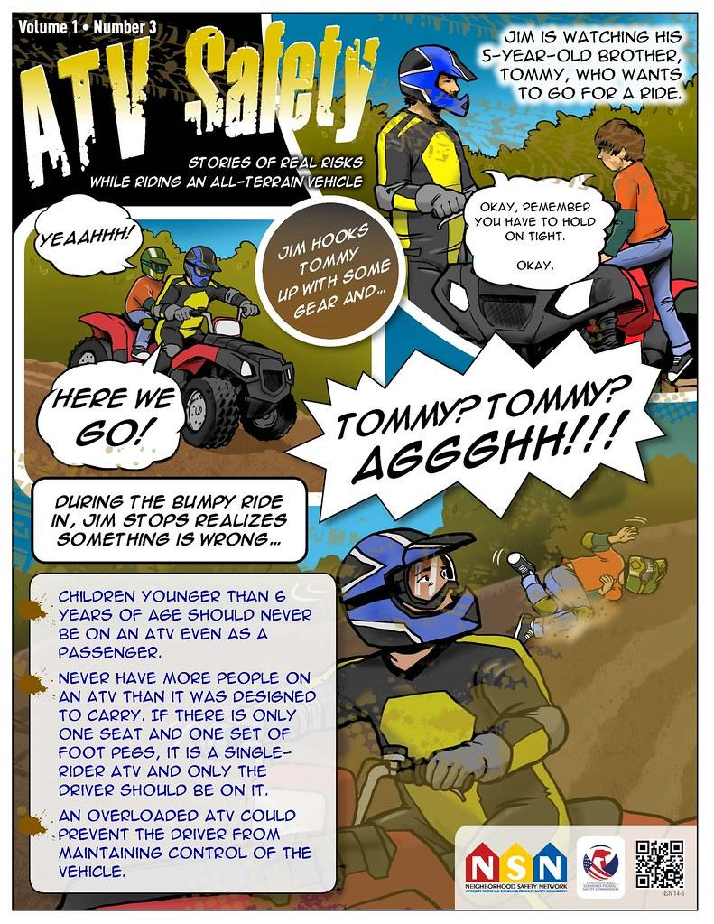
Toddlers/Children
What stories did you like?
Why did you like them?

Slide 7

Toddlers/Children
‘I ask the students what caused them to remember their favorite stories. From their answers come happy endings, good morals, single characters (generally animals), quick conflicts, easy plots and interesting sound words. All of these are important answers because they are a part of so many children's stories’ (Wiseman 47).

Slide 8

Toddlers books
Images & Text

Slide 9
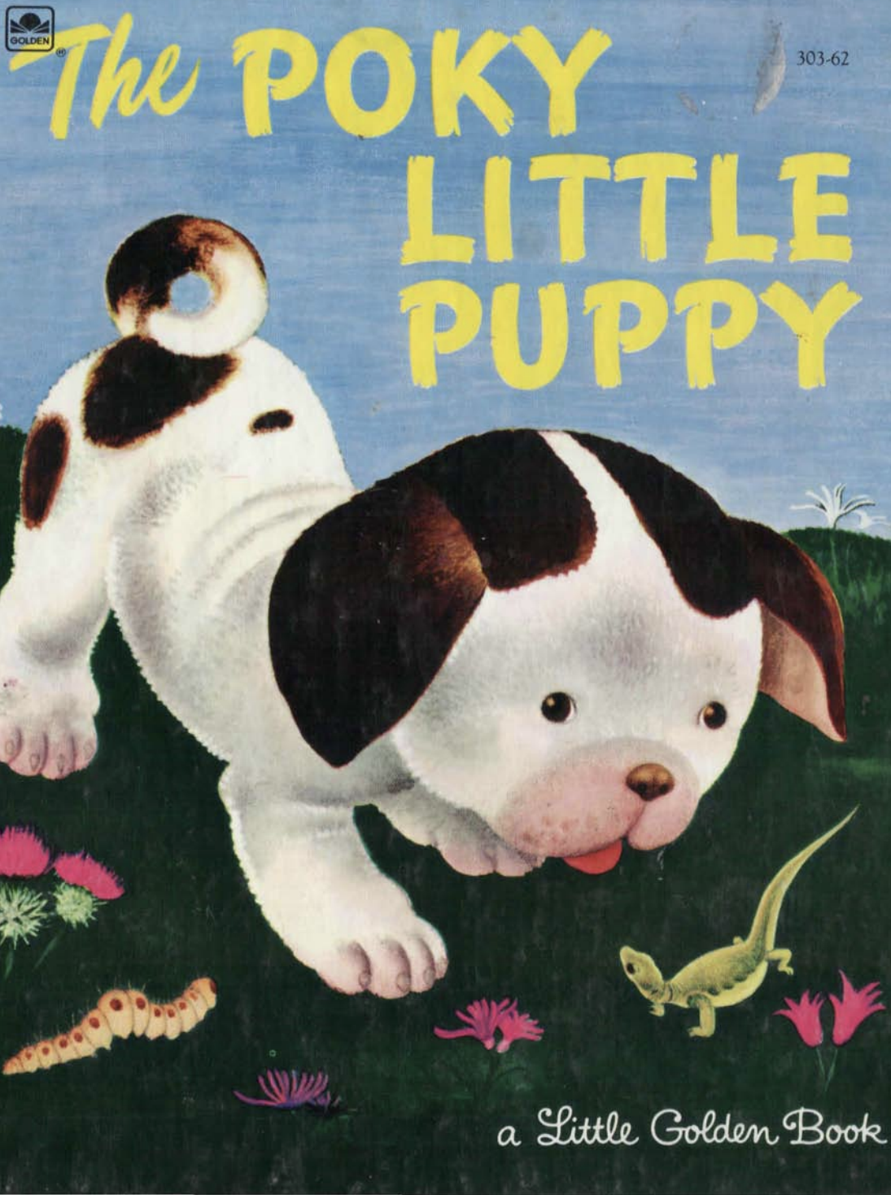
The Poky Little Puppy
by Janette Sebring Lowrey, illustrated by Gustaf Tenngren
Western, 1942.

Slide 10
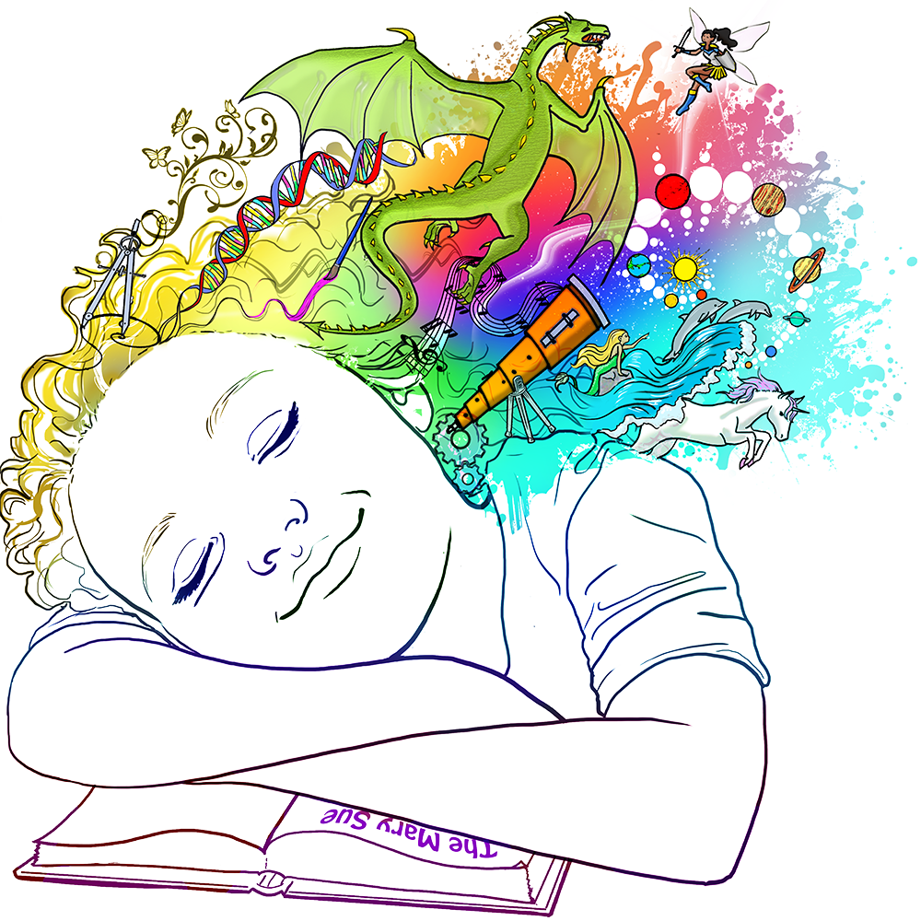
Writing

Slide 11
This week
Please write a 500-word story with images suggested for 4-7 year olds based on the writing exercise.
Next week – New Kids on the Block - 7-11 year olds
          www.martinkeaveney.com. 2022

