Slide 1
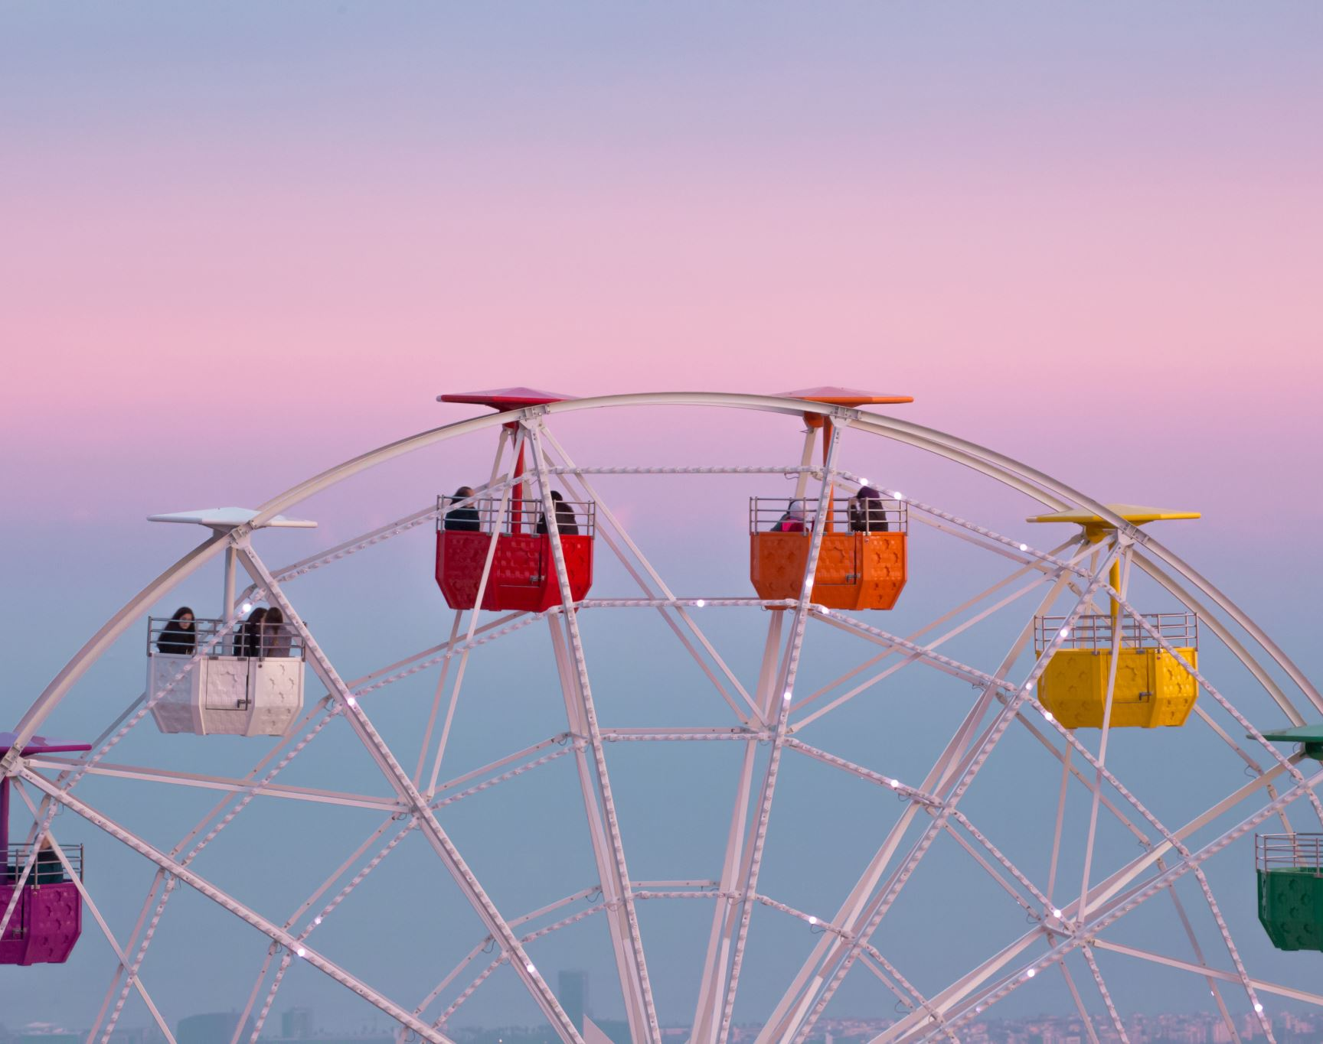
Children’s Fiction
Special MODULE
AUTUMN 2022 at MKCW

Slide 2
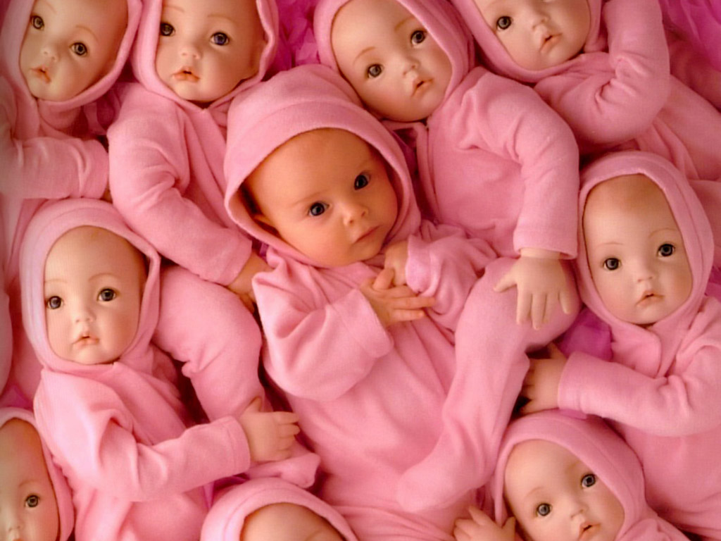
Baby Steps
Images

Slide 3
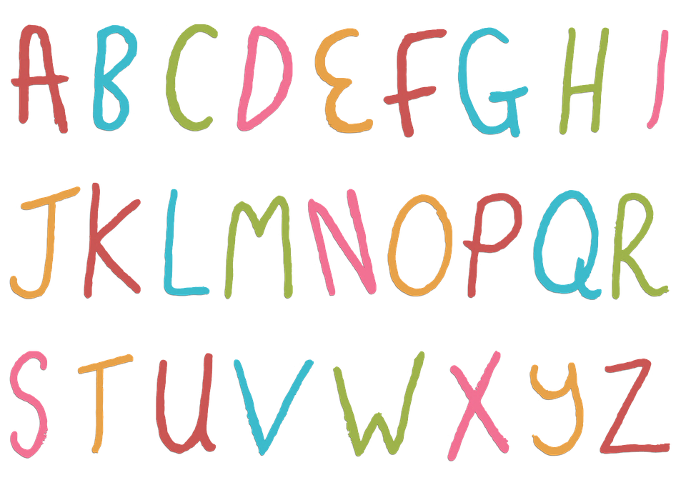
Introduction
Letters

Slide 4
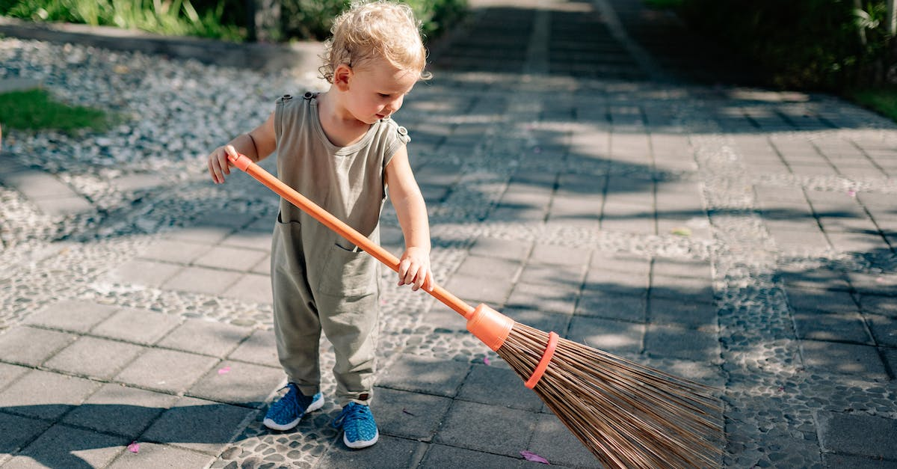
Introduction
Spaces

Slide 5
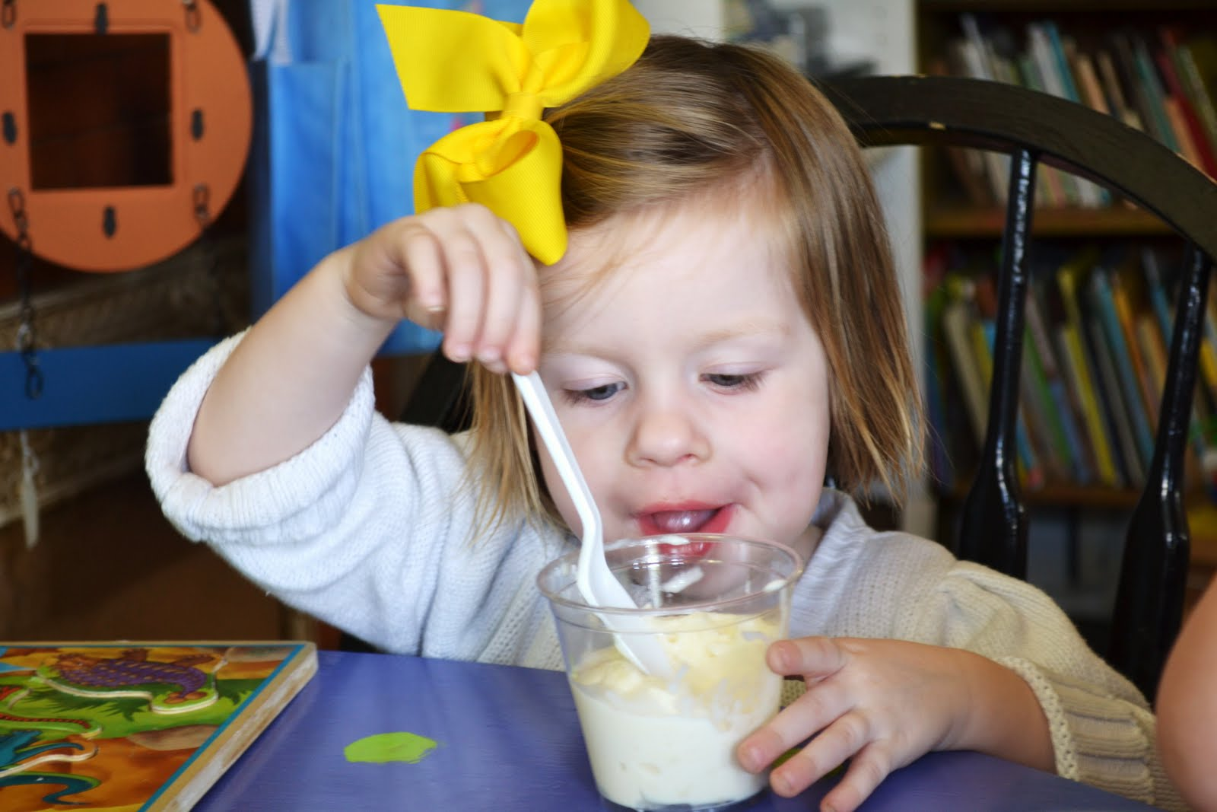
Introduction
Touch

Slide 6
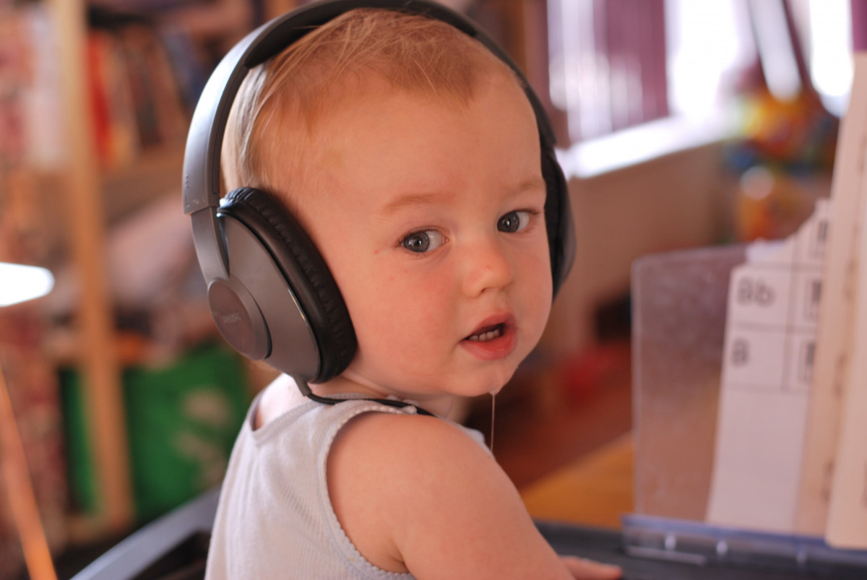
Introduction
Hearing

Slide 7

Introduction
Colours

Slide 8

Baby books
Designing the Picture Book

Slide 9

The Very Hungry Caterpillar

Slide 10
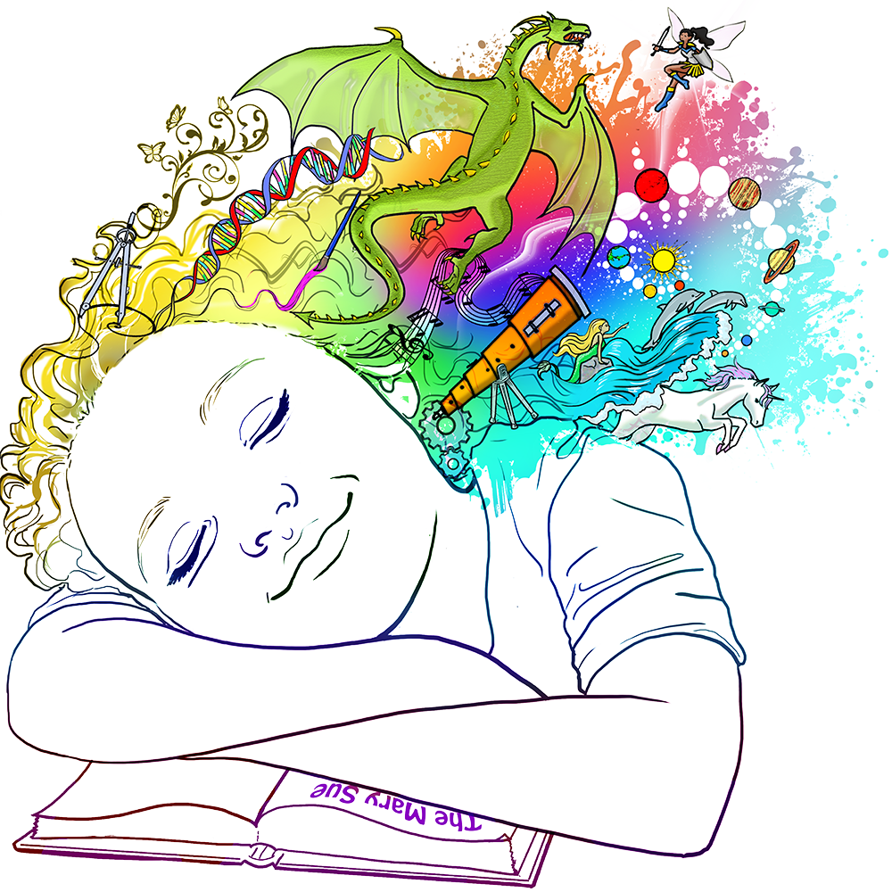
Writing

Slide 11
This week
Please write a 10-page picture book based on the writing exercise.
Next week – Toddlers!
          www.martinkeaveney.com. 2022

