Slide 1

Children’s Fiction
Special MODULE
AUTUMN 2022 at MKCW

Slide 2
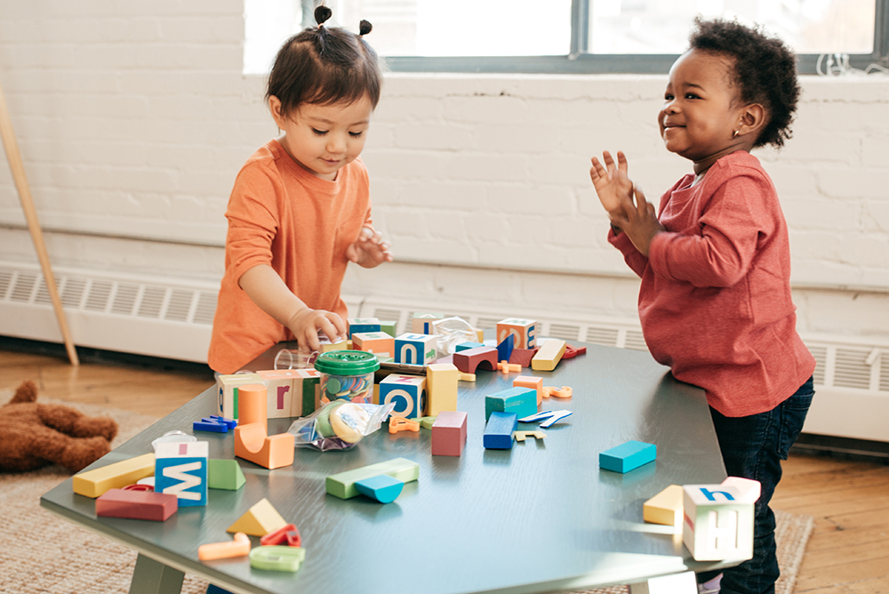
Introduction
Introduction
Baby Steps
Toddlers

Slide 3
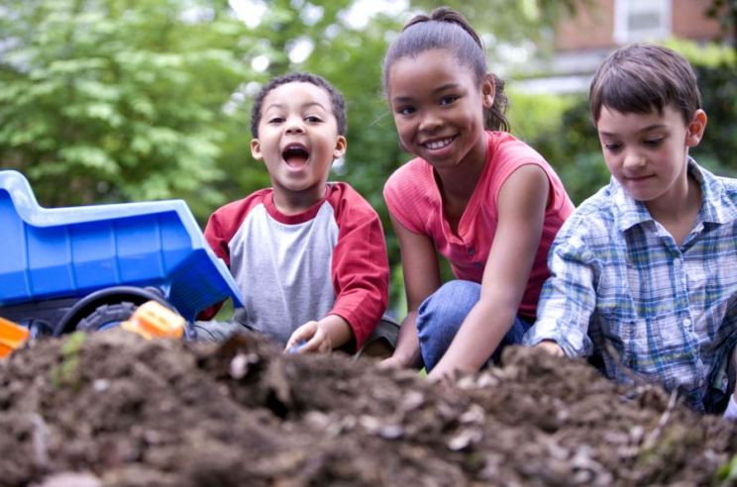
Introduction
Words and Image
Sentences
A story

Slide 4

Introduction
Still a child (?) – Teenage Fiction
Getting serious - YA

Slide 5
Differences?
‘Writing for children is little different from writing for adults. All children, aged two to aged seventy, like a story. People have always liked stories and listened to them. Probably they always will. Tell a story when you write. Children demand that even more than adults. Don't do a character sketch. Don't write an essay. Don't argue. Even if you do all these things, make it a story with beginning, middle, and end.’ (Wood 208)
Wood, James Playsted ‘Writing for Children’ The Georgia Review 12,. 2 (SUMMER - 1958), pp. 208- 214

Slide 6
Child as Reader
‘Don't talk down to children. Don't condescend. Children are serious and have a dignity of their own. They dislike condescension as much as you do and react to it by avoidance. Don't be cute. Baby-talk may please the mother and express her delight but it seldom pleases the child. When you write for children, talk straight. Don't be "literary." The niceties of rhetoric are lost on children. They don't know that alliteration is alliteration and won't be impressed by learned allusions. Neither is anybody else, incidentally.’ (Wood 209).

Slide 7
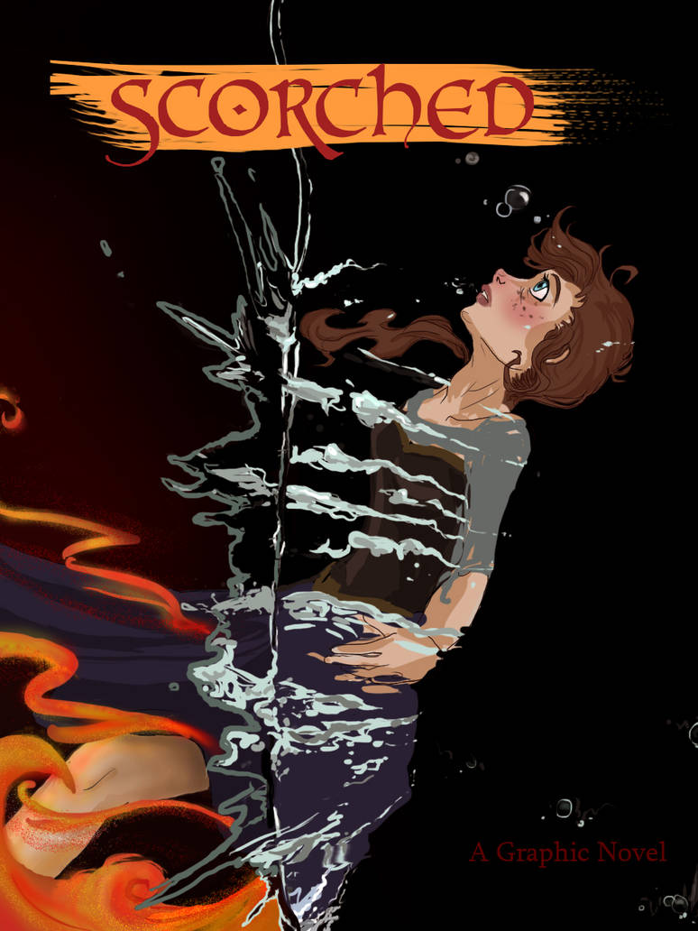
Why write for the Young?
Perspective
Freedom
Publishing
Use of graphics

Slide 8

Advantages
In high demand
Wide range from 0-18+
Evolving society
Historical periods always popular
Potential for adaptation

Slide 9

Challenges
Child writers not Children
Varied levels of cognition
Moral questions

Slide 10

Writing

Slide 11
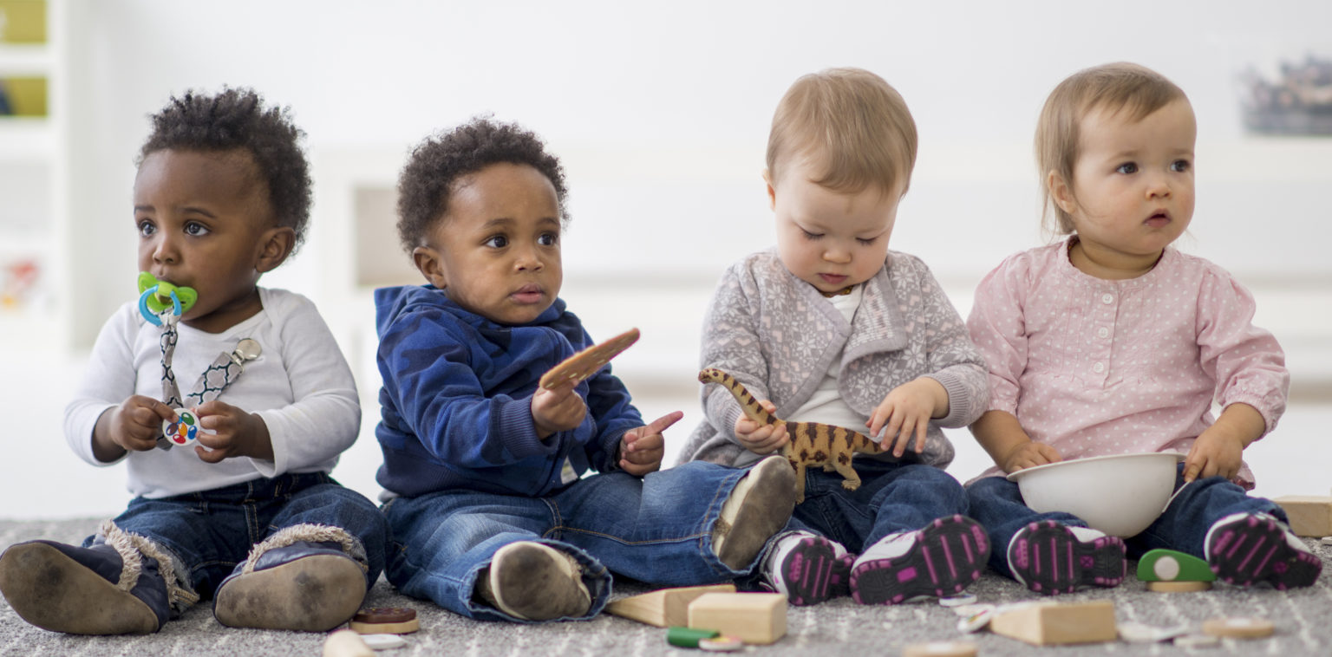
This week
Please write a 500-word story based on the writing exercise.
Peer group will be issued shortly.
Next week – Baby Steps
          www.martinkeaveney.com. 2022

