Slide 1
MKCW
SCREENWRITING: INTRODUCTION
WEEK 2: CHARACTER

Slide 2

OUTLINE
Character
Story
Scriptwriting
Rewrites
Formatting
Production

Slide 3

CHARACTER
Approaches
Meeting Your Character
Writing Exercise
Writing for this week

Slide 4
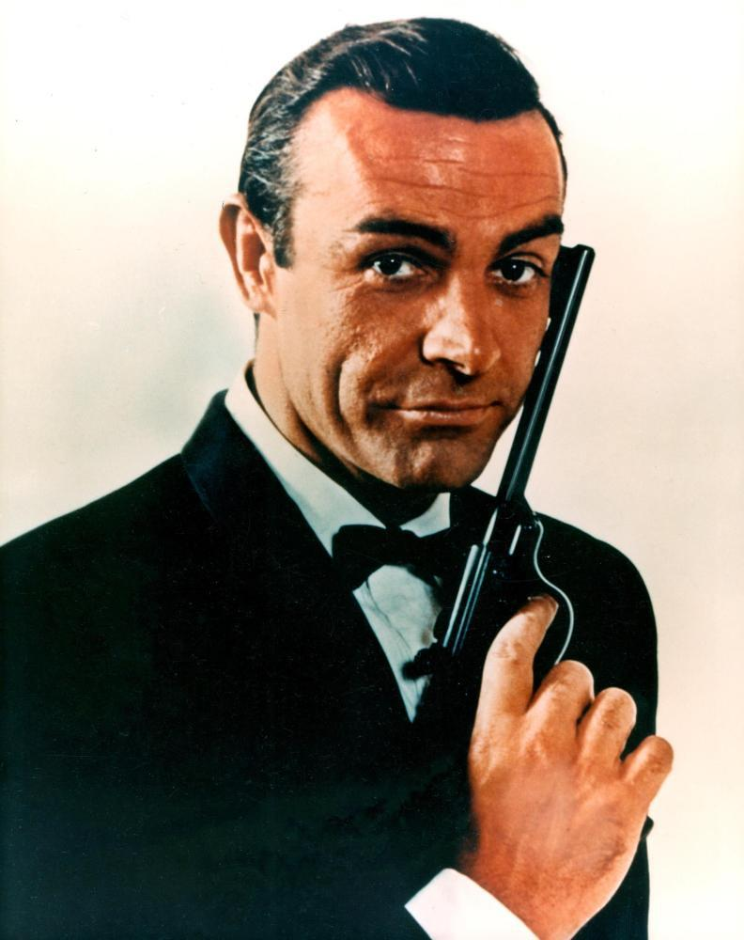
Approaches
Genre Characters
James Bond
Carrie Bradshaw
Harry Potter

Slide 5
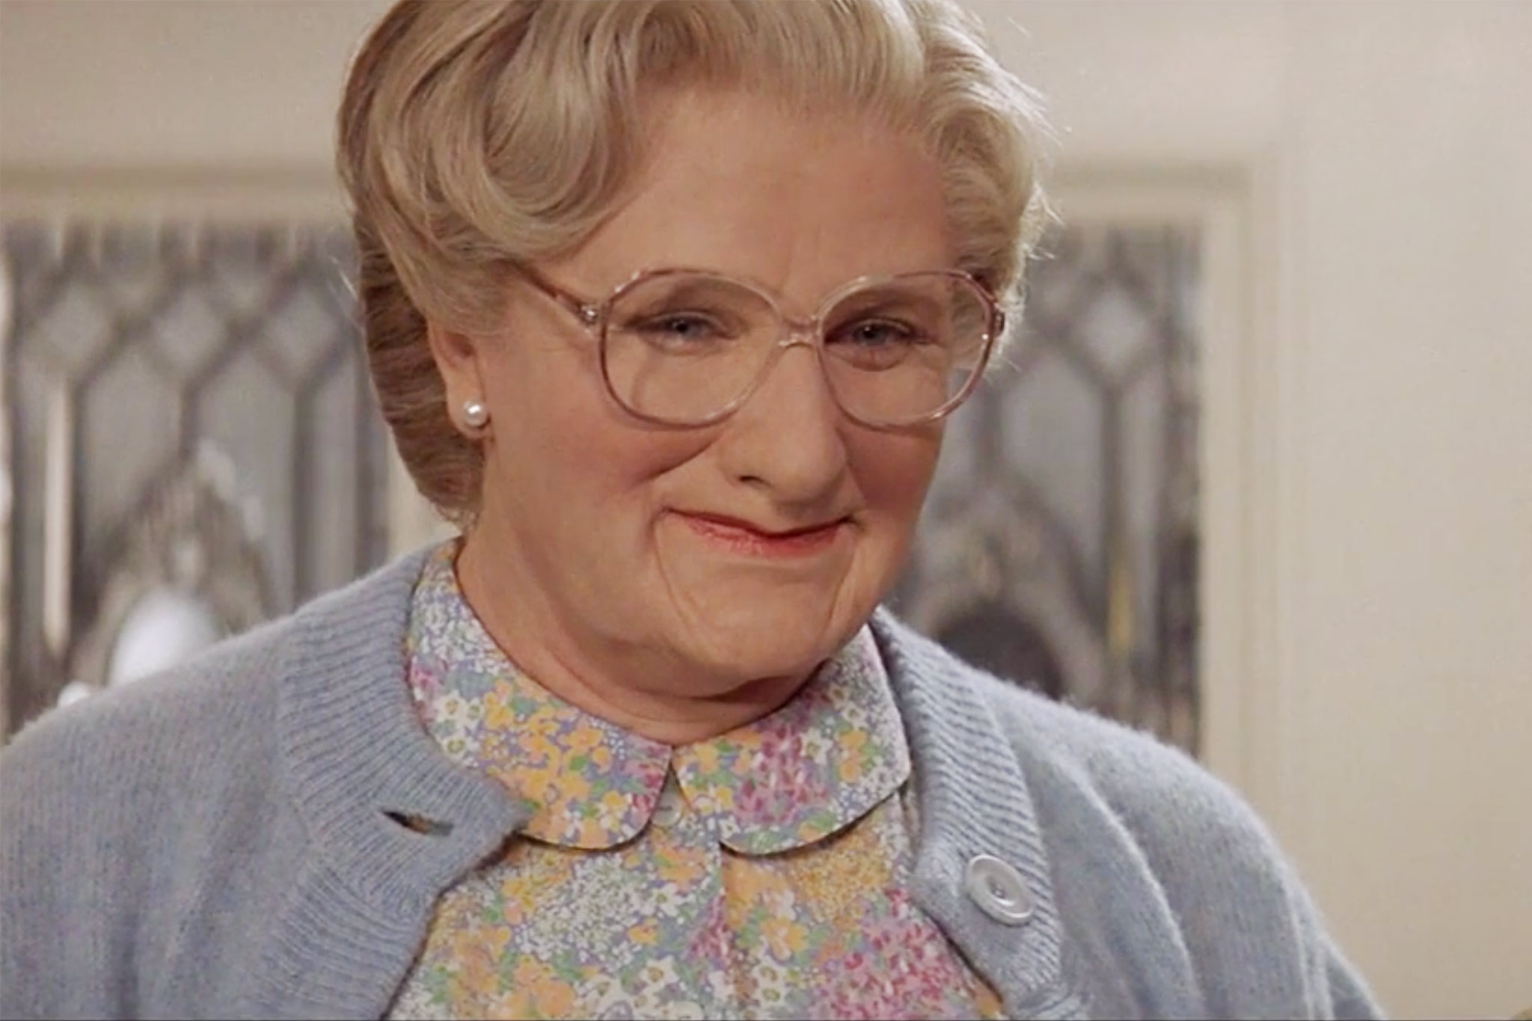
Approaches
Complex Characters
Walter White
Mrs Doubtfire
Peggy Olsen

Slide 6
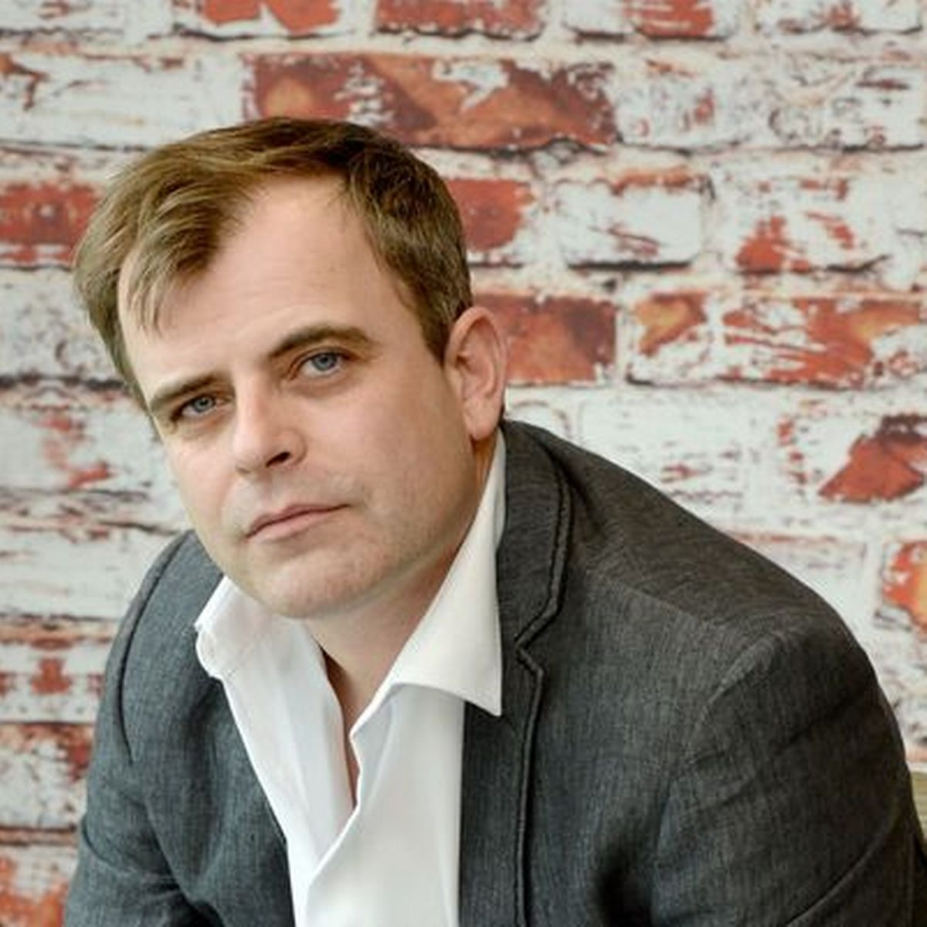
Character Arcs in Projects
Flawed – Perfect – The Karate Kid
Flawed – Flawed – Steve McDonald
Perfect – Perfect – James Bond
Perfect – Flawed – Kevin Arnold
Failed – Perfect – Cool Hand Luke
Perfect – Failed – Walter White

Slide 7
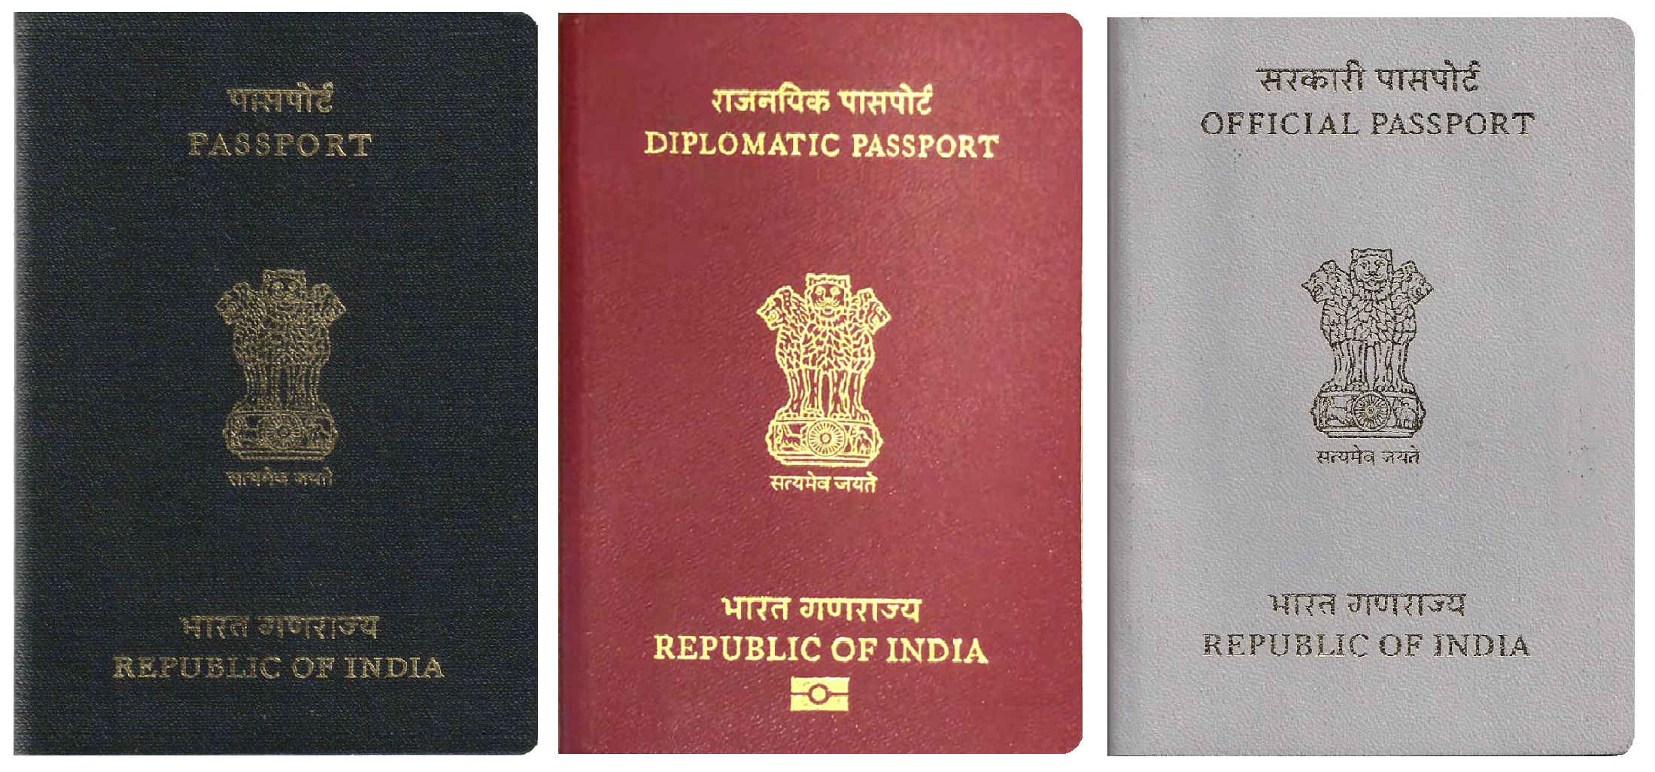
Meeting your character
Genre Characters (Fully formed)
Date of birth?
Education?
Work?
Family?

Slide 8

Meeting your character
Known associates?
Religion?
Convictions?
Finances?
Politics?

Slide 9
Meeting your character
Non-genre Characters (Partly formed)
Allow character to explain itself to you.
Answer questions later.

Slide 10
LISTEN, LISTEN, LISTEN!
What voice comes into your head?
Crystallise it on the page.

Slide 11
EXERCISE 1
Fill Sheet

Slide 12
EXERCISE 2
Now, choose a DIFFERENT CHARACTER
Spend 3 minutes waiting.
The listen to the character talking directly to you. Write everything they say for 3 minutes.

Slide 13
THIS WEEK:
Write a 500 word monologue of your character as they describe the most significant moment in their life.
Next week: Story

