Slide 1
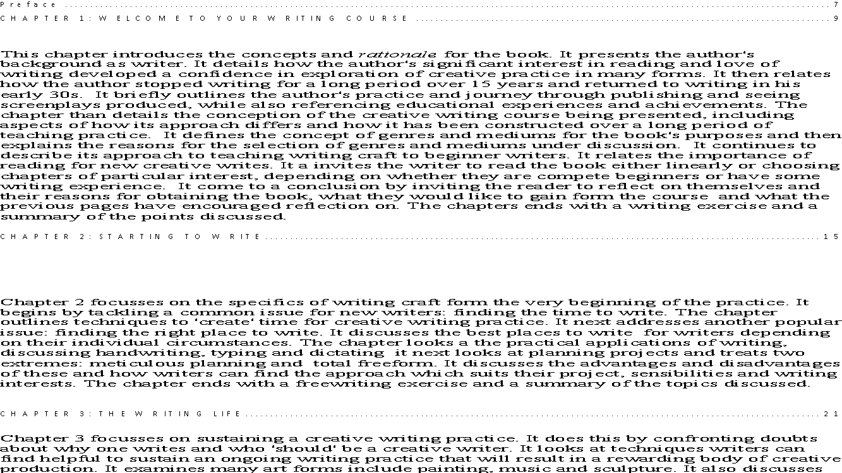

The World on Screen
Specialist Course
MKCW
This Photo by Unknown Author is licensed under CC BY-NC-ND

Slide 2
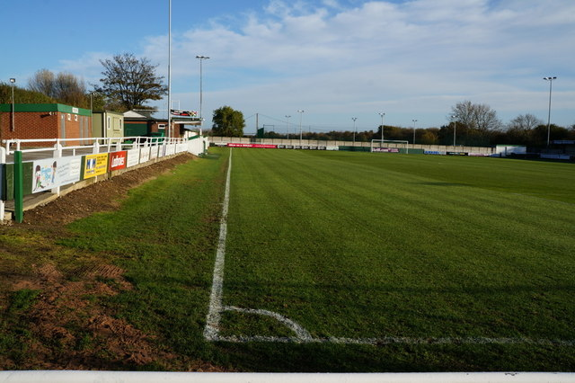
Introduction
Introduction
Visual Writing
Character

Slide 3
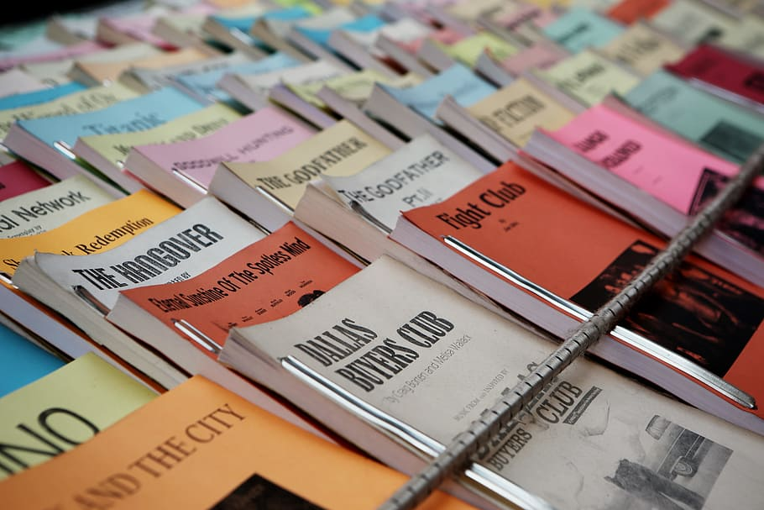
Introduction
The Story
Adaptations
Scriptwriting
Rewrites

Slide 4

Introduction
Treatments
Formatting
Productions & Funding
Pitching
Submission
Special Focus

Slide 5
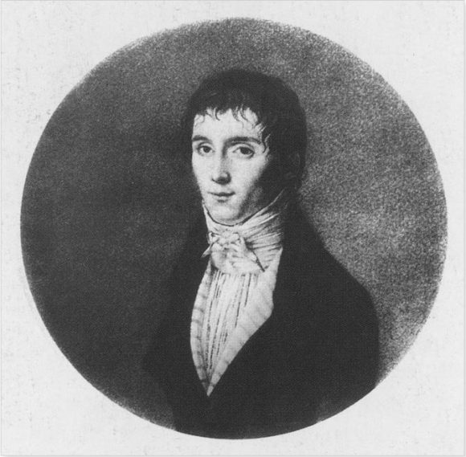
Portrait
Joseph Nicéphore Niépce (1765–1833)

Slide 6
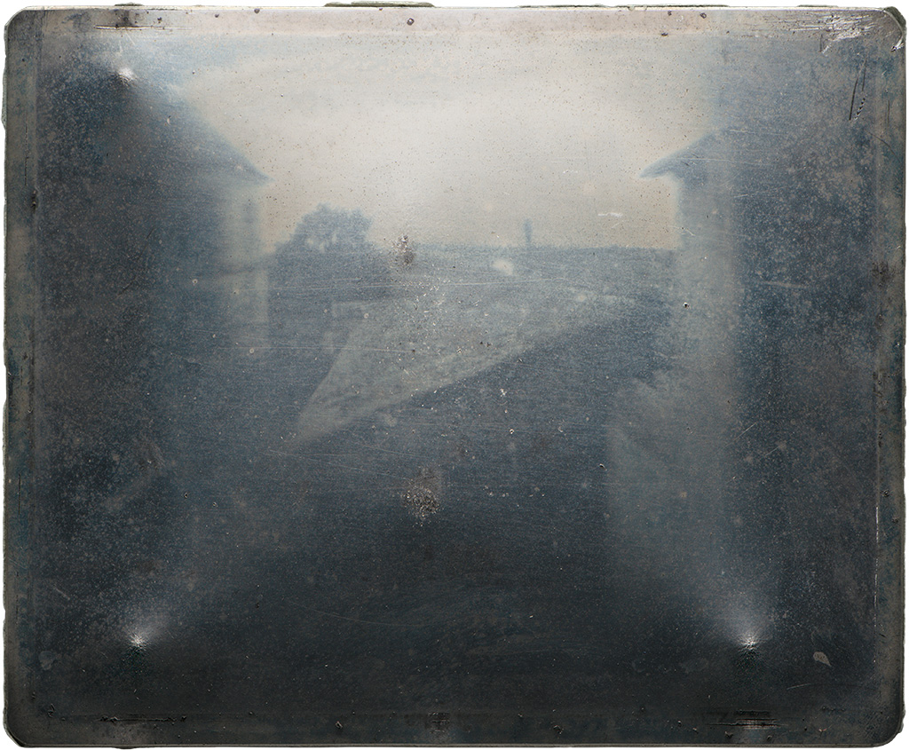
Photos
'point de vue,' 1827

Slide 7
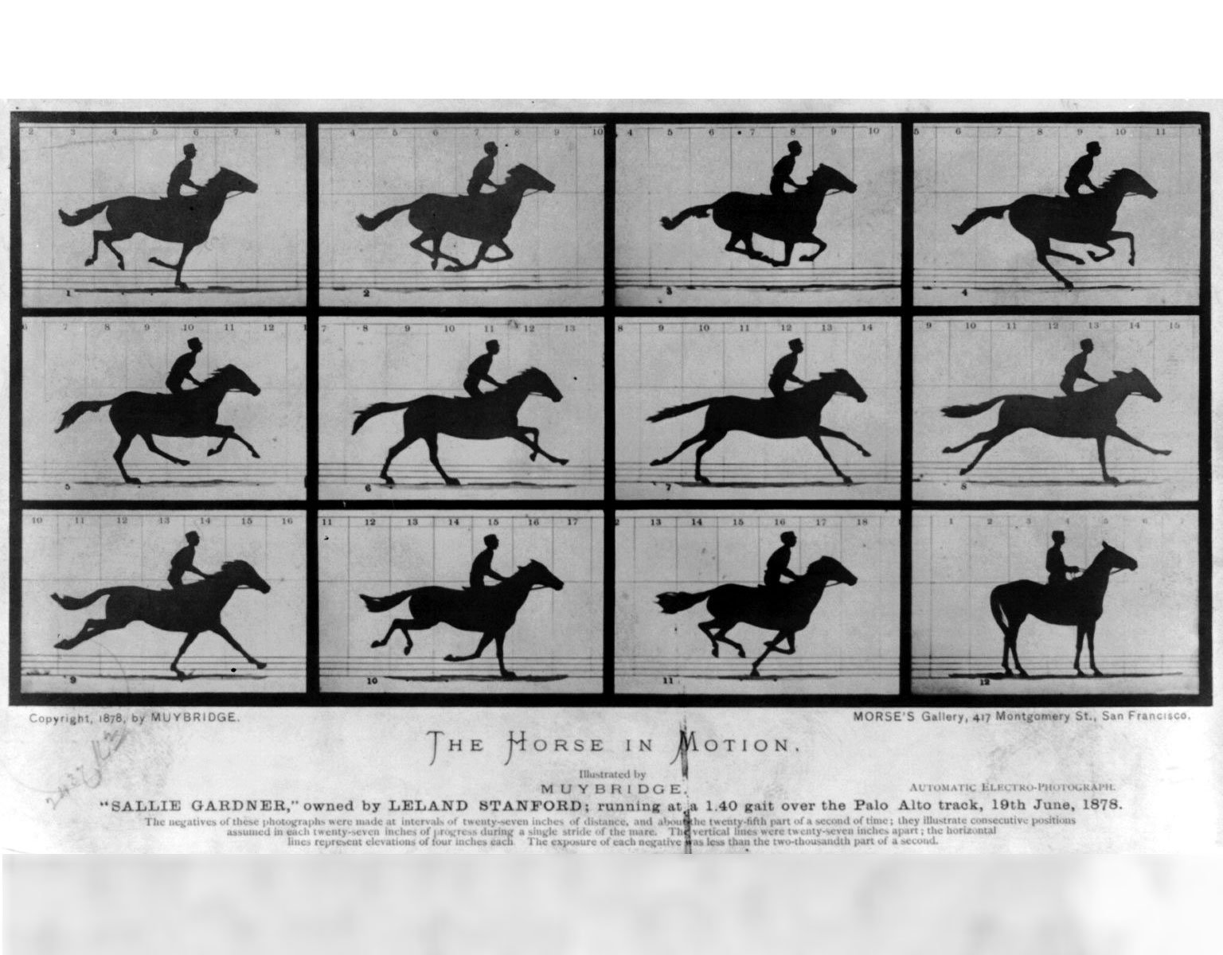
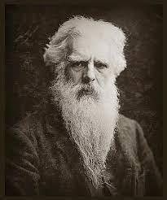
Moving Pictures
Eadweard Muybridge, original name Edward James Muggeridge, (born April 9, 1830, Kingston upon Thames, Surrey, England—died May 8, 1904, Kingston upon Thames)

Slide 8
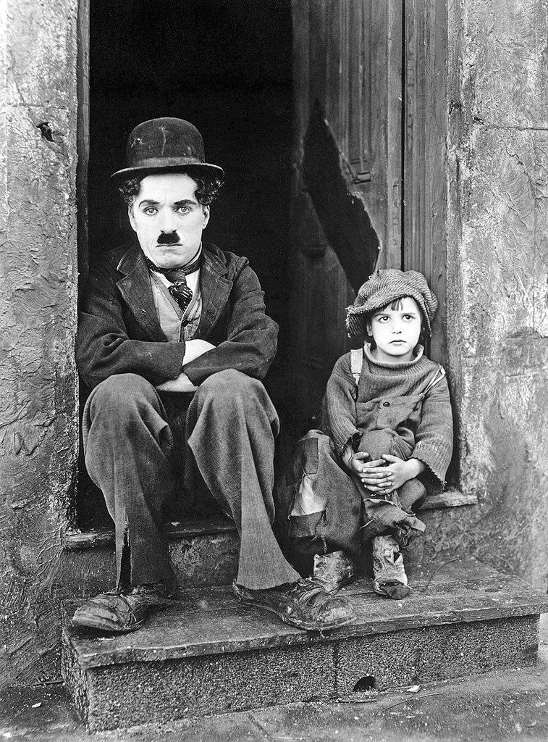
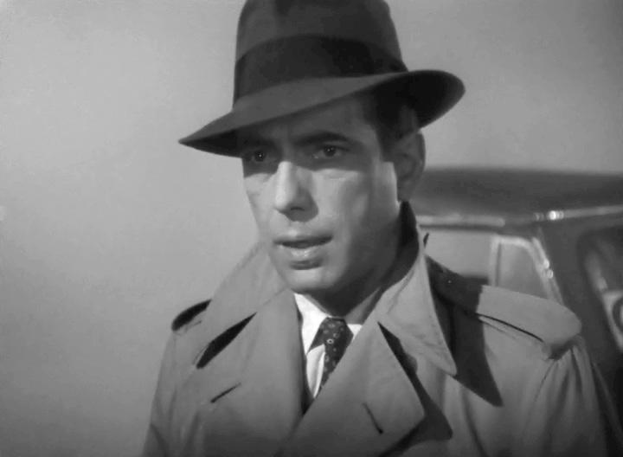
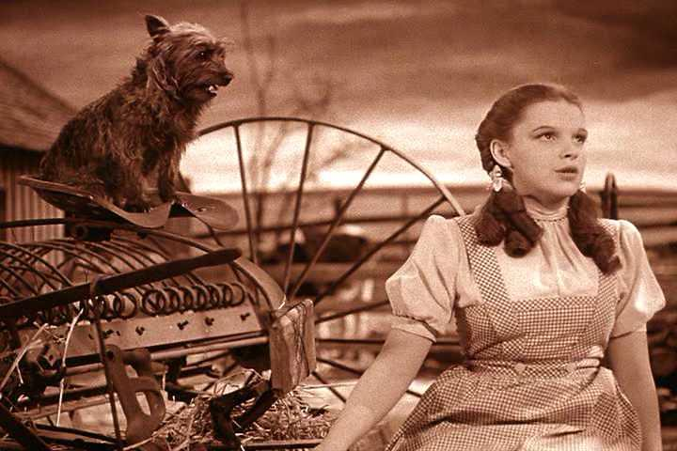
Silent Movies - Talkies

Slide 9
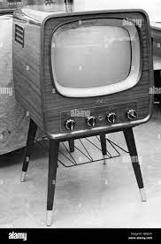
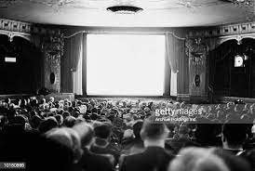
TV v Film
Biskind Peter, Easy Riders, Raging Bulls
Bloomsbury Publishing PLC; 1st Paperback Printing UK edition (27 Sept. 1999)

Slide 10
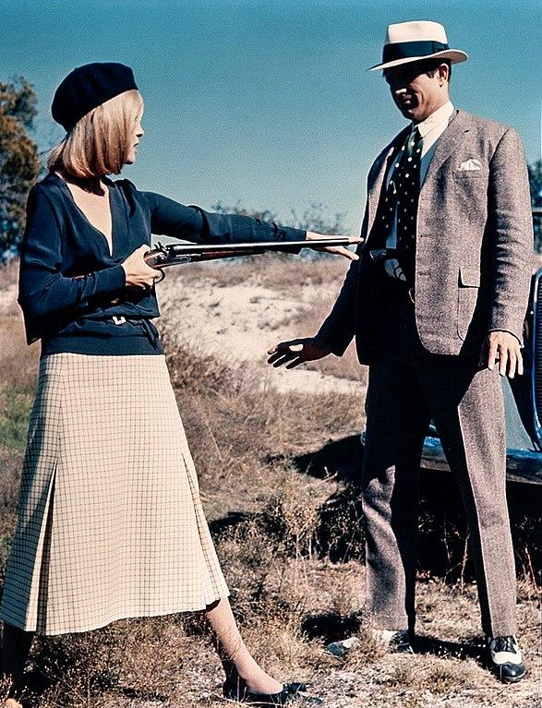
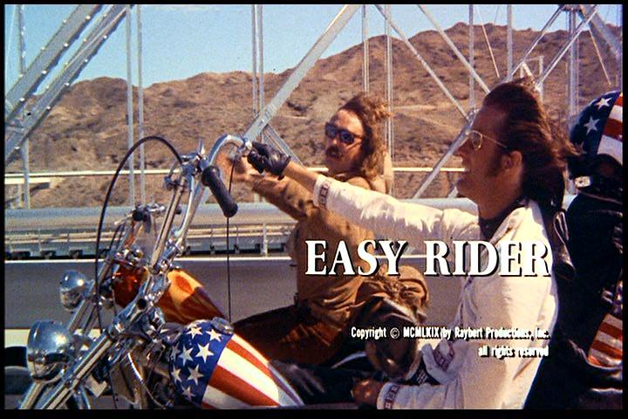

Slide 11
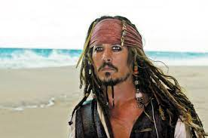
Collapse of Cinema
l

Slide 12
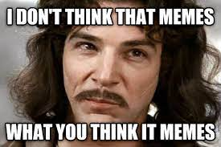
Internet Age

Slide 13

Screen Project
25 Script pages + 1,000 treatment
Any Genre
Submit on Week 12
Editorial response within 3 months

Slide 14

Peer group
Choose slot
Share work
Participate in Workshop
Change slot as needed

Slide 15

Livewrite
7am-9am
Mon-Fri
Excludes hols
Come and go as required

Slide 16

Writing

Slide 17
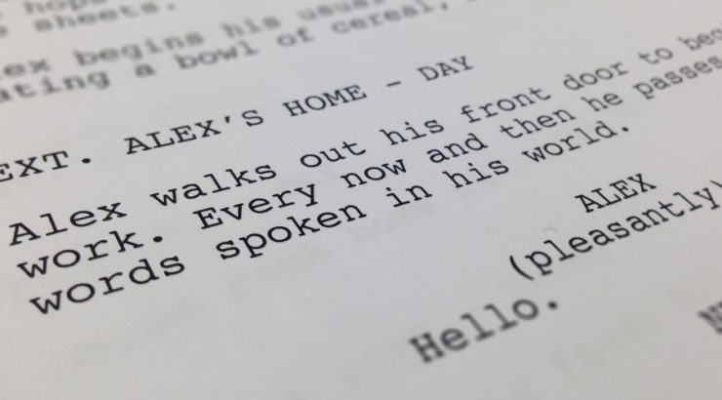
This week
Please write a 10-20 page script based on the writing exercise.
Peer group will be issued shortly.
Next week – The Character
          www.martinkeaveney.com. 2023

