Slide 1
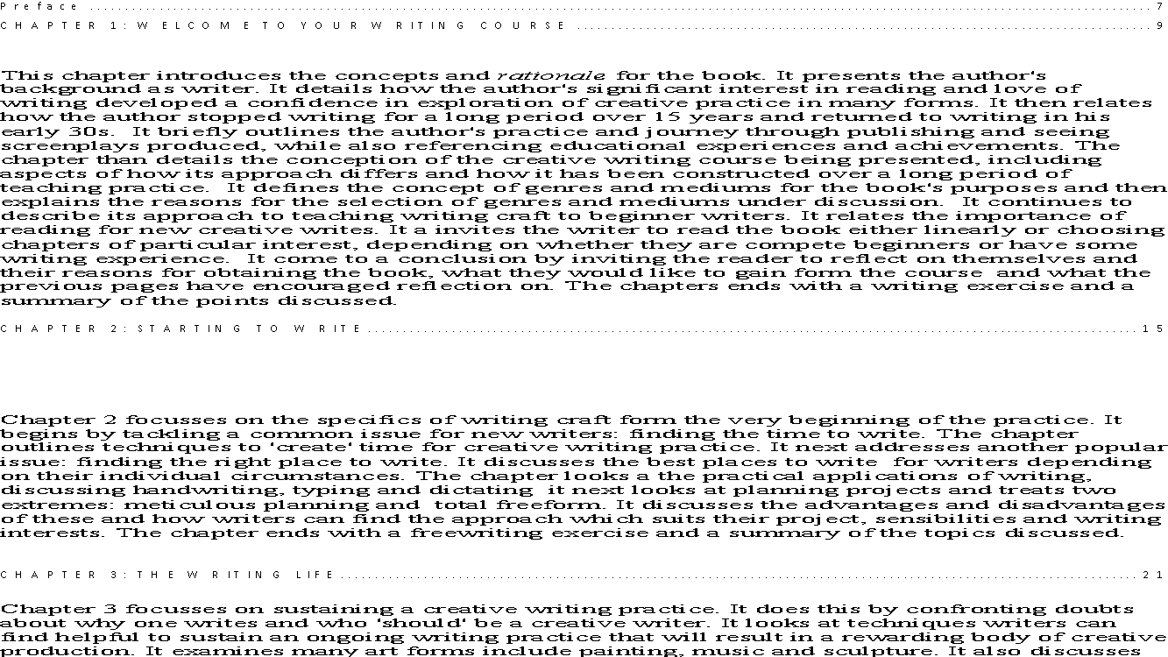
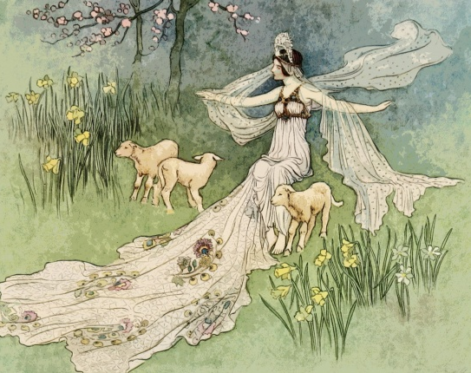
Wonder World
Specialist Course
MKCW
This Photo by Unknown Author is licensed under CC BY-NC-ND

Slide 2
The Fairy Tale
Metamorphosis is central to the fairy tale, which shows us figures endless their shapes, crossing borders, and undergoing change. Not surprisingly, s traffic in transformation also seek to change listeners and readers in unconventional ways (Tatar 55).
Why Fairy Tales Matter: The Performative and the Transformative
Tatar, Maria
Western Folklore , Winter 2010, Vol. 69, No. 1 (Winter 2010), pp. 55-64

Slide 3
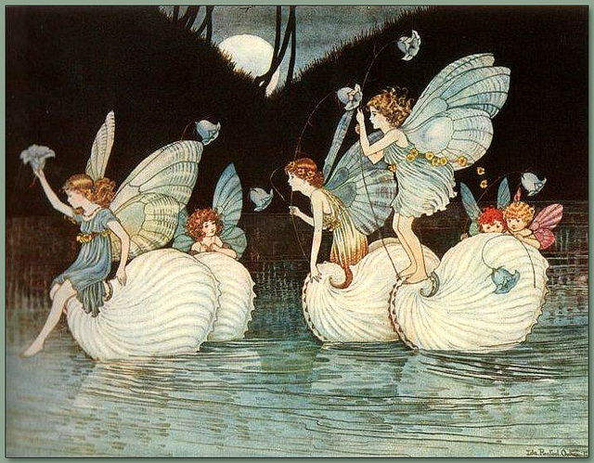
Aspects
In the enchanted world of fairy tale, anything can happens and what happens is often so startling, magical, and unreal that it produces a jolt. Shape-shifting, as Marina Warner has pointed out is one of the defining features of fairy tales, and it happens in ways that contradict the laws of nature’ (Tatar 56).

Slide 4
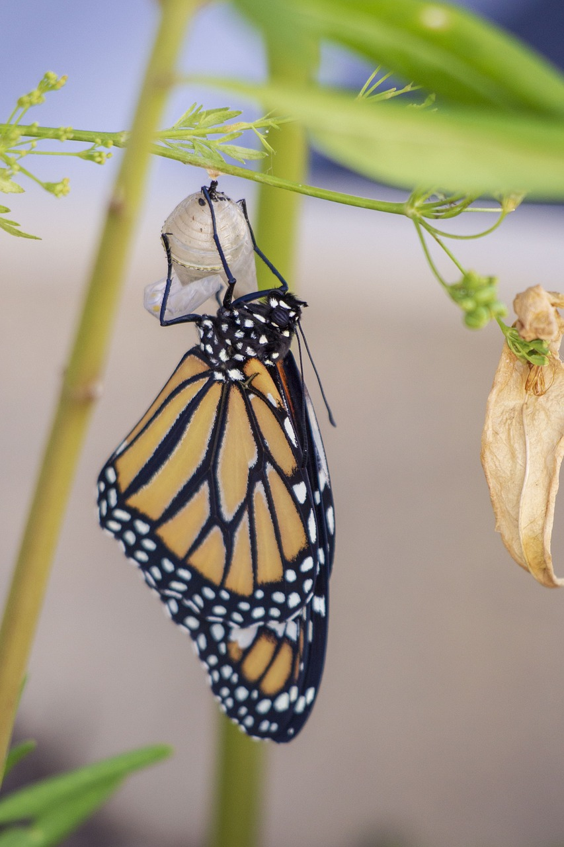
Transformation & Fairy Tale
Transformation is at the heart of magical practices, as Ted Hughes has described the momentum behind metamorphosis as passion that "combusts or levitates mutates into an experience of the supernatural" (Hughes1999:ix-x). The outburst of passion is rarely silent, and words invariably accompany and express the rage, desire and fear that work together with language to produce transformative effects’ (Tatar 60).

Slide 5
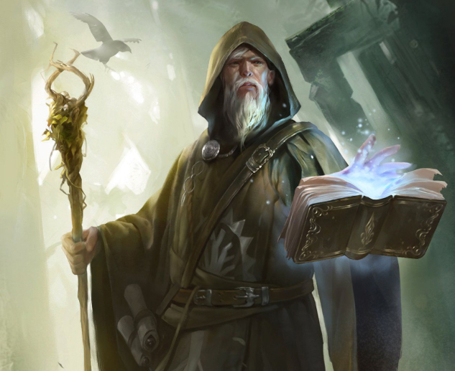
Magical Thinking
The curses, spells, and charms of fairy tales are far removed from what Austin describes as the performative, for they have the unprecedented power to create real physical change, not just the power to perform rituals that produce a change in legal or official status or to persuade, support, or discourage. It may be true that we talk about language as having somatic effects (words can "wound" or have the power to "assault" us), but, in fact, it is only in fairy tales that they are endowed with the capacity to produce real physical change.’

Slide 6
Basic Principles
Shapeshifting
Transformation
Magical Thinking
Word Power

Slide 7
Challenges of Fantasy Writing
The child reading a book, by learning about the magic art of the Great Humbug, can begin to move from the childhood condition of lacking the words needed to name, describe, and define what affects us. Fairy tales help children move from that disempowered state to a condition that may not be emancipation but that marks the beginnings of some form of agency (Tatar 63).

Slide 8
The Children of Lir
THE CHILDREN OF LIR
King Lir of Ireland had four young children who were cared for tenderly
at first by their stepmother, the new queen; but there came a time
when she grew jealous of the love their father had for them, and resolved
that she would stand for it no longer. Sometimes there was murder in her
heart, but she could not bear the thought of that wickedness, and she
resolved at last to choose another way to rid herself of them.
One day she took them to drive in her chariot:—Finola, who was
eight years old, with her three younger brothers,—Aodh, Fiacre, and little
Conn, still a baby. They were beautiful children, the legend says, with skins
as white and soft as swans’ feathers, and with large blue eyes and very
sweet voices. Reaching a lake, she told them that they might bathe in the
clear water; but so soon as they were in it she struck them with a fairy
wand,—for she was of the race of the Druids, who had magical power,—
and she turned them into four beautiful snow-white swans.

Slide 9
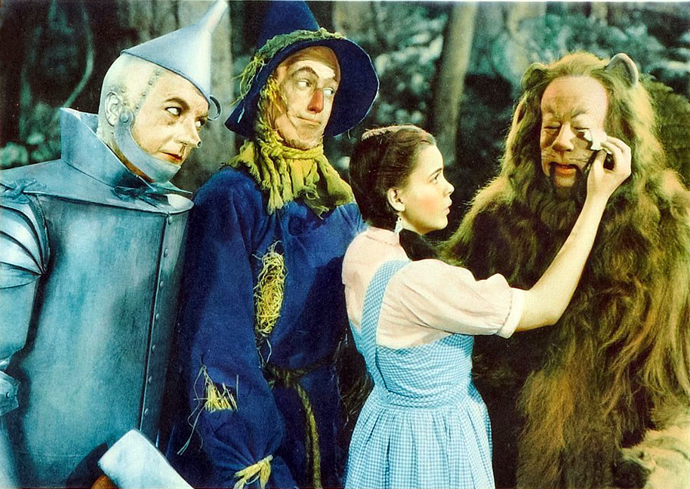
The Wizard of Oz
Baum, Frank, 1900.

Slide 10
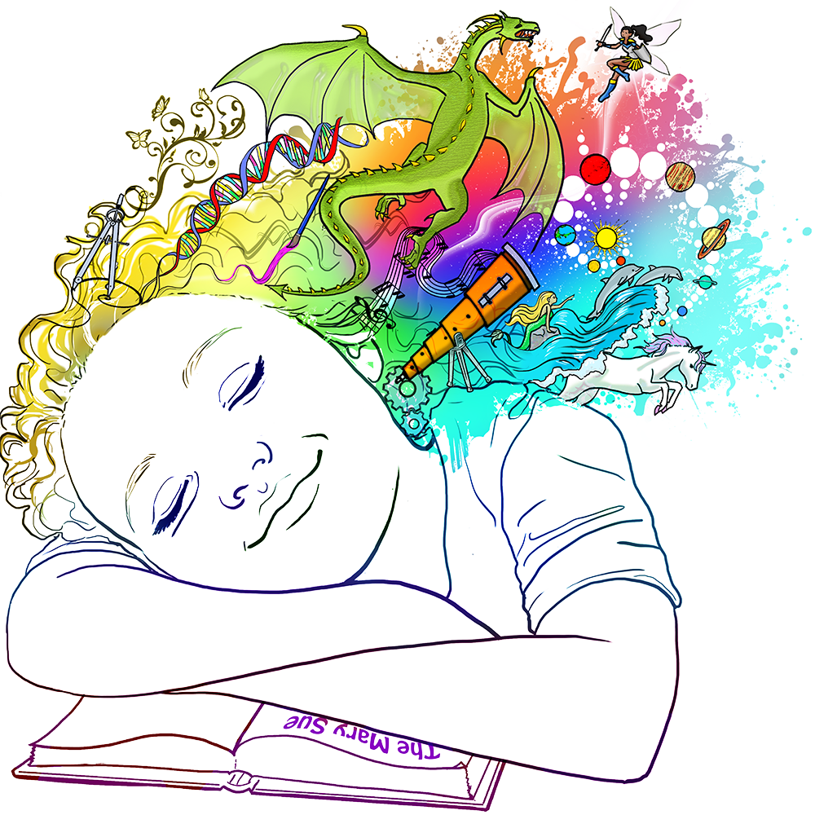
Writing

Slide 11
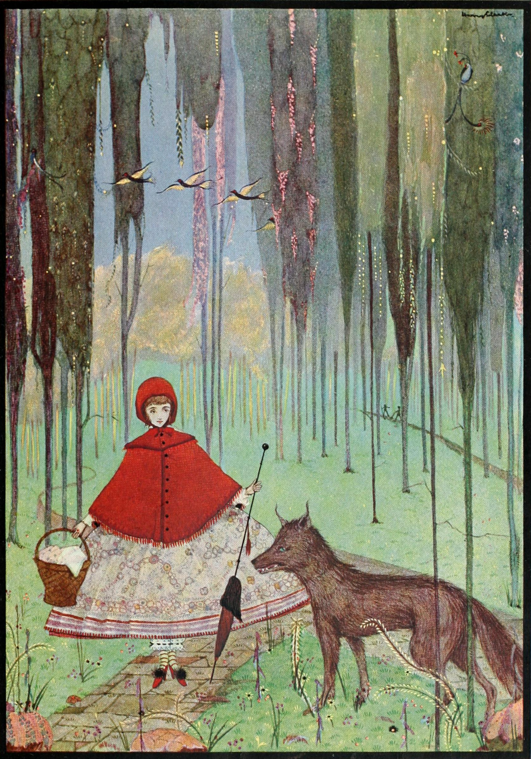
This week
Please write a 1000-word fairy tale based on the writing exercise.
Next week – World-Building
          www.martinkeaveney.com. 2023

