Slide 1
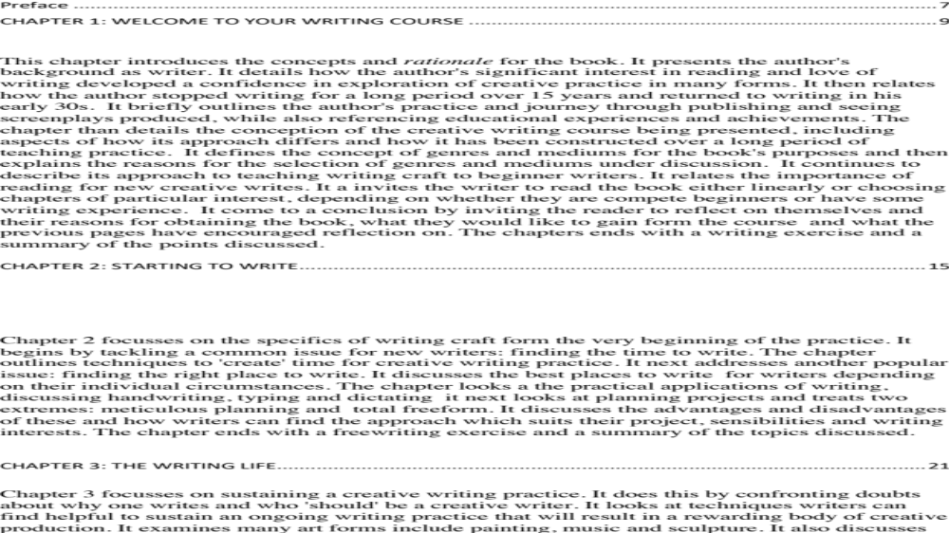
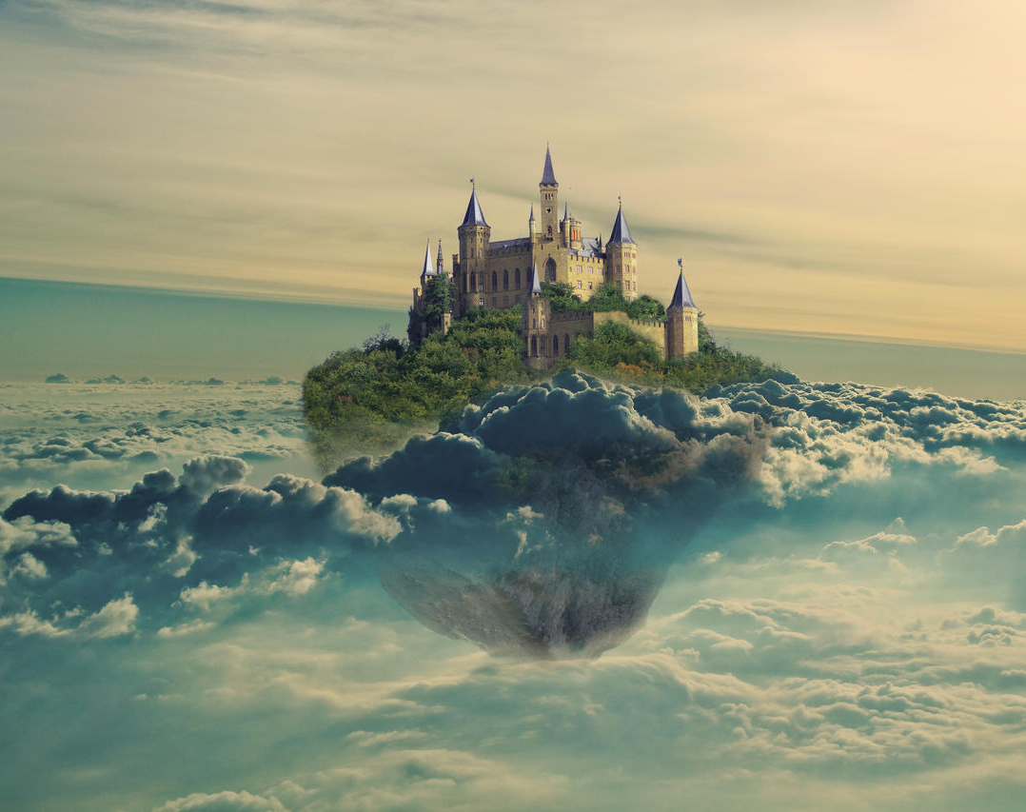
Wonder World
Specialist Course
MKCW
This Photo by Unknown Author is licensed under CC BY-NC-ND

Slide 2
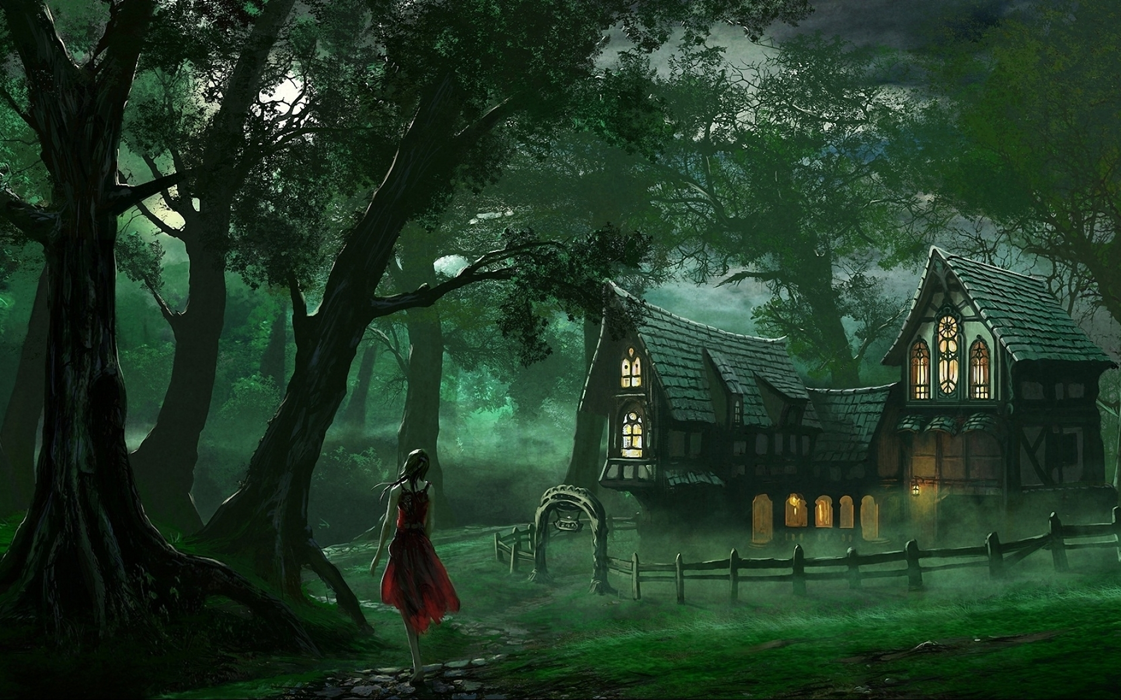
Introduction
Introduction
The Fairy Tale
World Building

Slide 3

Introduction
Alternative History
The World to Come
Publishing
A story

Slide 4
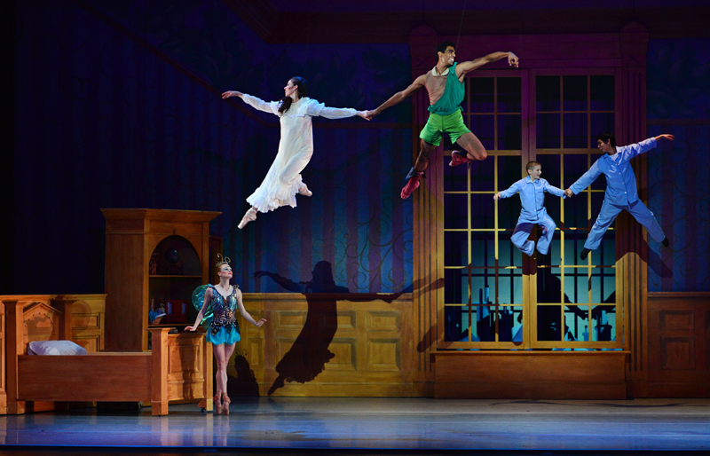
Introduction
Fantasy in Live Performance
Fantasy on Screen

Slide 5
What is the Fantastic?
‘By going past reality, by plunging through and beyond it, fantasy can offer an interesting, at times disturbing, perspective. ‘ (Baker 437).
Why We Need Dragons: The Progressive Potential of Fantasy Author(s): Daniel Baker
Source: Journal of the Fantastic in the Arts , 2012, Vol. 23, No. 3 (86) (2012), pp. 437- 459

Slide 6
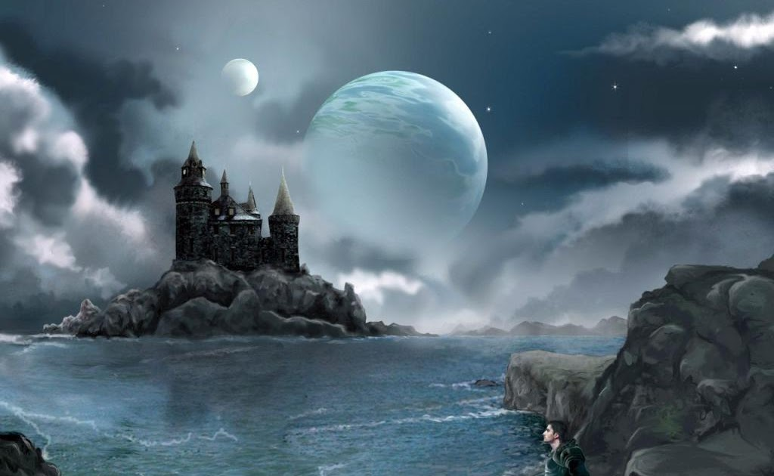
Why write Fantasy?
‘Progressive fantasy can use the genre's ubiquitous temporal dislocations to expose how history informs the present and the future, rupturing reality to re-imagine the then for the benefit of the now and the nows yet to pass’ (Baker 440).

Slide 7
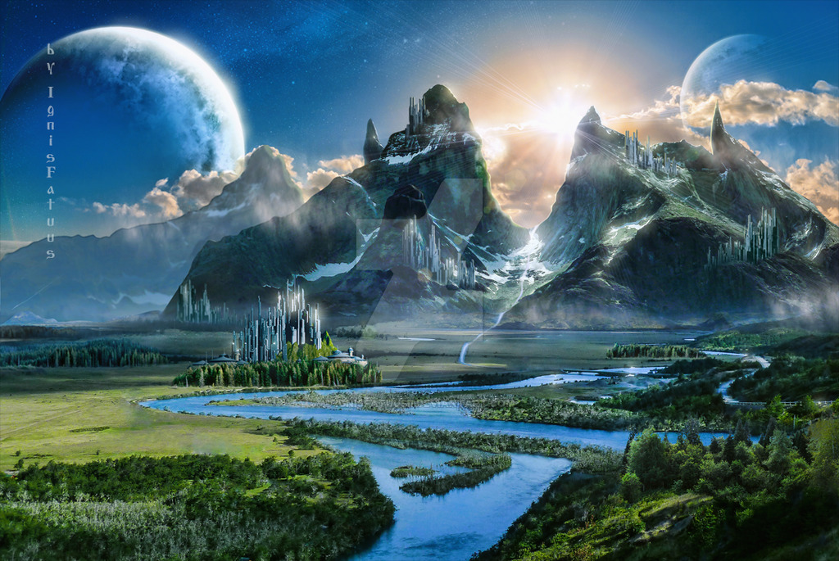
Basic Principles
The World
The Angle
Publishing
Use of graphics

Slide 8
Challenges of Fantasy Writing
‘Plausibility’
Characters
Language
Originality

Slide 9
Fantasy Project
Max. 10,000 words
Any area of Fantasy
Submit on Week 8
Editorial response within 5 months

Slide 10

Peer group
Choose slot
Share work
Participate in Workshop
Change slot as needed

Slide 11

Writing

Slide 12
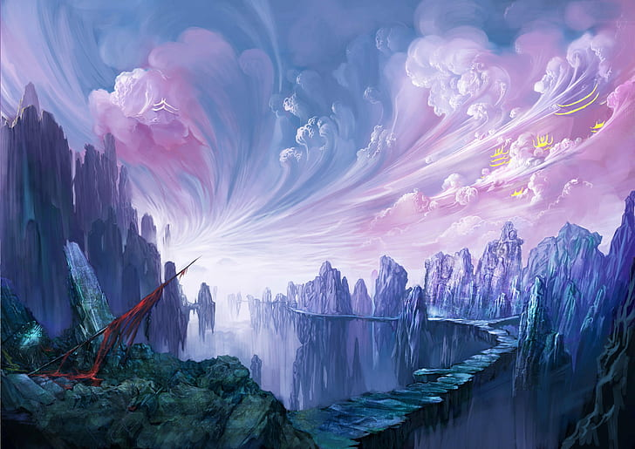
This week
Please write a 1000-word story based on the writing exercise.
Peer group will be issued shortly.
Next week – The Fairy Tale
          www.martinkeaveney.com. 2023

