Slide 1
Writing for Well-Being
Dr Martin Keaveney
Offaly & Laois Libraries - Winter 2022
Session 3 - Fiction & Formats

Slide 2

FICTION & FORMATS
Finishing work - improving or changing
Proofreading
Sample Query

Slide 3

FICTION & FORMATS
Publishers
Agents
Submission Windows
Traditional & Independent

Slide 4

LANGUAGE & COMMUNICATION
Business of Writing
Being Astute with Submissions
Readings
Proofs

Slide 5
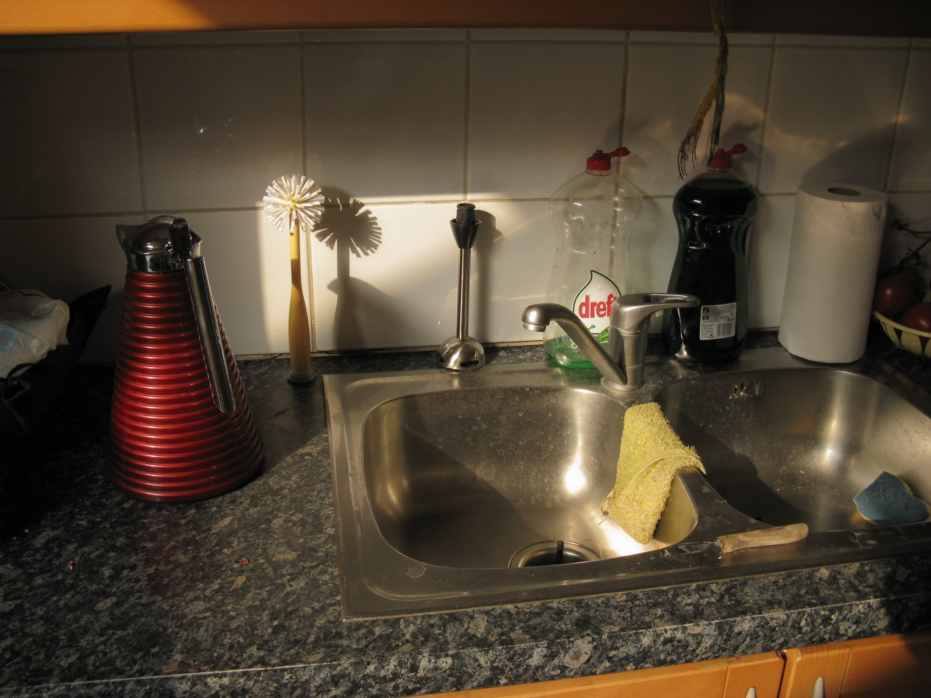
INTRODUCTION TO FICTION
Rise of Realism
Time & Space
Observations
Characters

Slide 6
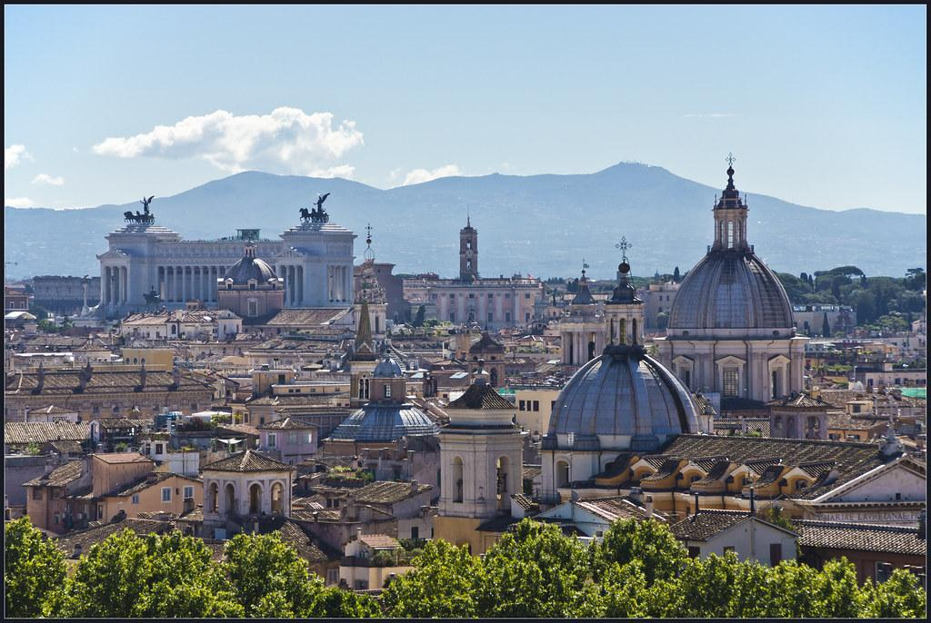
ROMA
https://granta.com/roma-deborah-levy/

Slide 7

WRITING EXERCISE

Slide 8
CREATIVE WRITING AS THERAPY
‘Many writers describe their will to write as springing from a complex mixture of intellectual concerns and activities that support their fascination with language, their desire to investigate or understand thought, their commitment to self-knowledge (spiced by general or even unrelenting human curiosity), their drive to communicate (particularly for the introverts among us) or to develop a speaking platform (particularly for the dispossessed). (Bishop et al. 178)
Bishop, Wendy, et al. ‘Therapy (and Therapeutic)’ Keywords in Creative Writing
Utah State University Press, 2006.

Slide 9

CREATIVE WRITING AS THERAPY
‘Writing, it would appear, helps set the house (of the psyche) in order, even if only temporarily. It helps humans create temporary order out of a bewildering array of lived experience, it’s a speculative tool for spiritual investigation, and it’s a lens that focuses the flame of catharsis.’ (Bishop et al 181)

Slide 10

WRITING EXERCISE

Slide 11
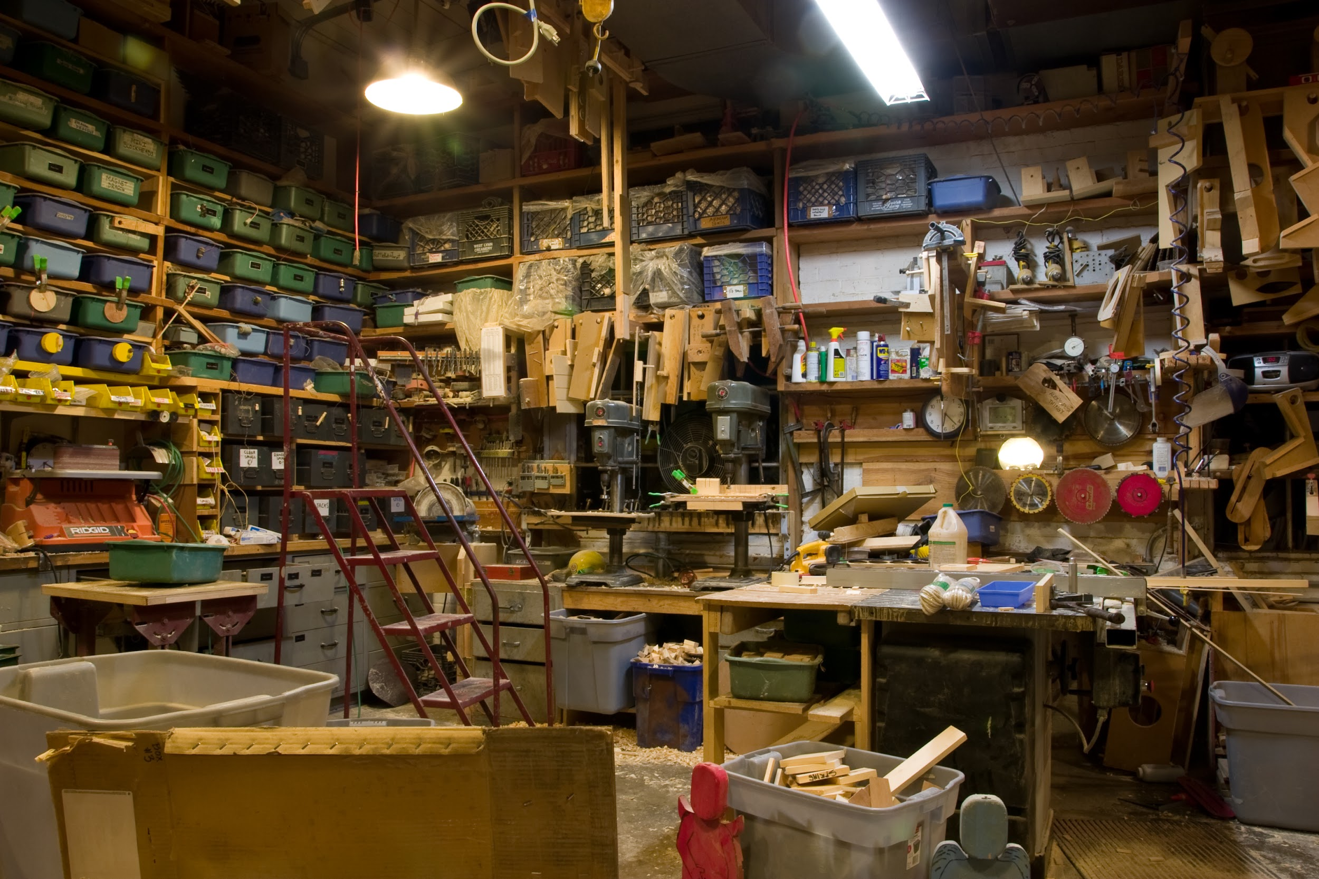
WORKSHOP

Slide 12
THIS WEEK
Please write a short fiction piece of 500 words. Send to your peer group and to info@martinkeaveney.com.
Good luck!
NEXT WEEK:
Plays & Film
www.martinkeaveney.com 2022

