Slide 1
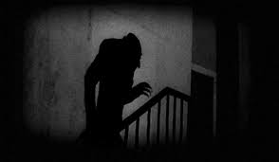
CREATIVE WRITING: INTRODUCTION
Dr MARTIN KEAVENEY
Week 6
The World of Shadows

Slide 2
WEEK 6
Genre – Horror
Craft – Polishing and Submissions

Slide 3
Late drafts
Improving or Changing?
The point of release
Font size, Justify, Proofread

Slide 4
Proofreading
Backwards
Read Aloud
Assistive programs

Slide 5
Publishers/Editors guidelines
Name on file
Type of file
Fonts/Images
Submission windows

Slide 6
Writing a query
Writing a biography of yourself

Slide 7
Capitalism of the industry
Majority of Publishers and Editors in profit mode – who will pay for this?
Non-profit section wants high level literature
Self-marketing: social media/website etc.

Slide 8
The Market
Book?
Magazine?
Print/Online
Traditional v Independent

Slide 9
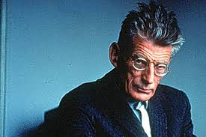
REJECTION
‘Ever tried. Ever failed. No matter. Try again. Fail again. Fail better.’
‘Worstword Ho’, Samuel Beckett, 1983.
Developing register for publications
Being astute with submissions process
Avoid unnecessary rejections

Slide 10
ACCEPTANCE
Proofs
Dealing with editors
Promoting published material
Readings

Slide 11
WHAT IS HORROR?
‘Carroll (1990) defines art-horror as creating an emotional state wherein, essentially, some nonordinary physical state of agitation is caused by the thought of a monster, . . . which thought also includes the recognition that the monster is threatening and impure. . . . Monsters, here, are identified as any being not now believed to exist ac-cording to reigning scientific knowledge’ (Dickson 116).
‘According to Carroll's (1990) definition of art-horror, the text must contain a monster who is "threatening" (p. 43) and that monster must produce "disgust or repulsion" in the reader’ (Dickson 116).
Dickson, Randi. ‘Horror: To Gratify, Not Edify’. Pleasure and the Language Arts (November 1998), pp.115-122.

Slide 12
WHAT IS HORROR?
‘[…]the main character suspects the presence of something unnatural and threatening, and spends a good part of the story attempting to discover what it is’ (Dickson 118)
‘[…]the great lure of horror fiction comes from a combination of awe and curiosity about what is unnatural and repulsive, as well as interest in the narrative structure that is set up by the questions posed at the beginning of the story, the commonly described experience of "reading to find out what will happen." Will the character(s) discover who the monster is? Will they be able to convince the authorities? Will they confront the monster or will he be left to wander the world, popping up who knows where? (Dickson 118)

Slide 13
Narration
Embellishment of theme
Conclusion

Slide 14
FINAL PROJECT
In any genre covered
Up to 2,000 words
May be submitted and revised in later workshops
Brief one-to-one advice available at end of workshops
Submit/Read draft in final session
Feedback/advice how to proceed provided via email within 3 months

Slide 15
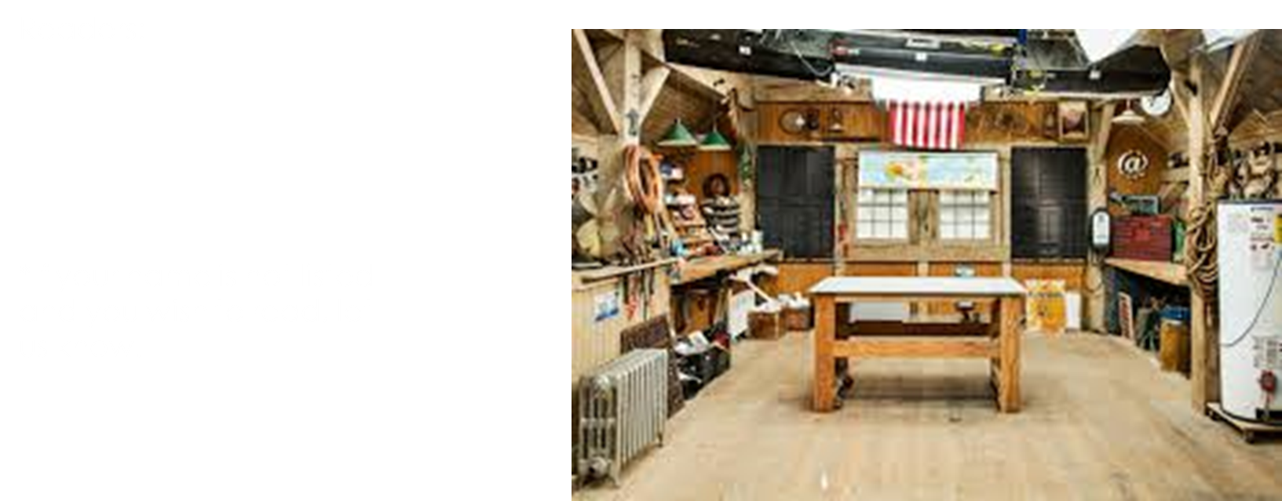
WORKSHOP

Slide 16
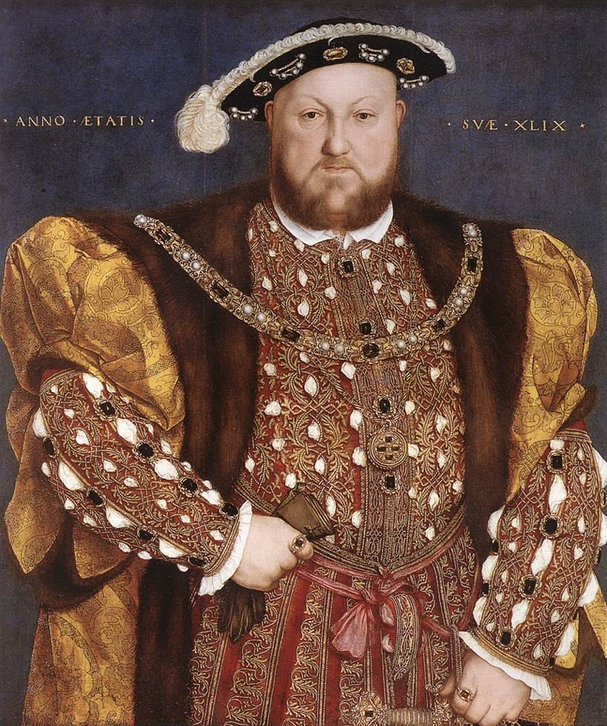

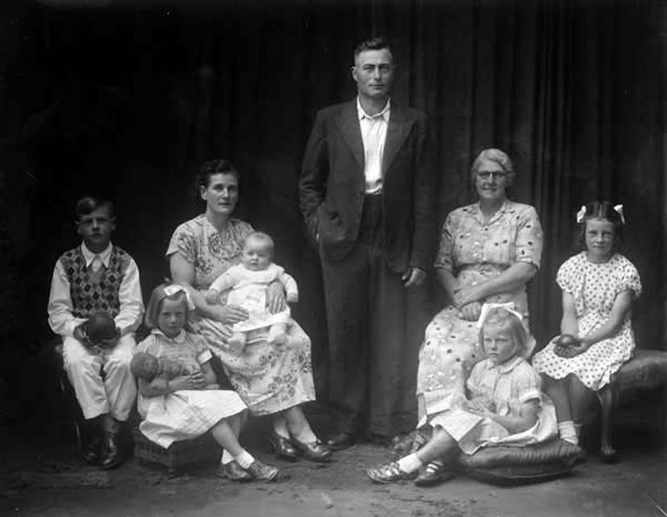
Creative Writing: Intermediate
Historical Fiction - Nonfiction - Memoir - Childrens /YA - Fantasy - Comedy
November 22nd 2022 at 8pm.

Slide 17
CONGRATULATIONS!
Keep writing!
Keep reading!
Maintain links with class
Publish your work!
Let us know of any launches/readings!
Thanks for taking the course, sharing your work and providing feedback to your class!
www.martinkeaveney.com 2022

