Slide 1
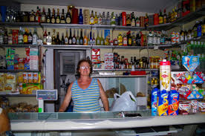
CREATIVE WRITING: INTRODUCTION - VIDEO
MKCW
DR MARTIN KEAVENEY
Session 2:
Real World

Slide 2

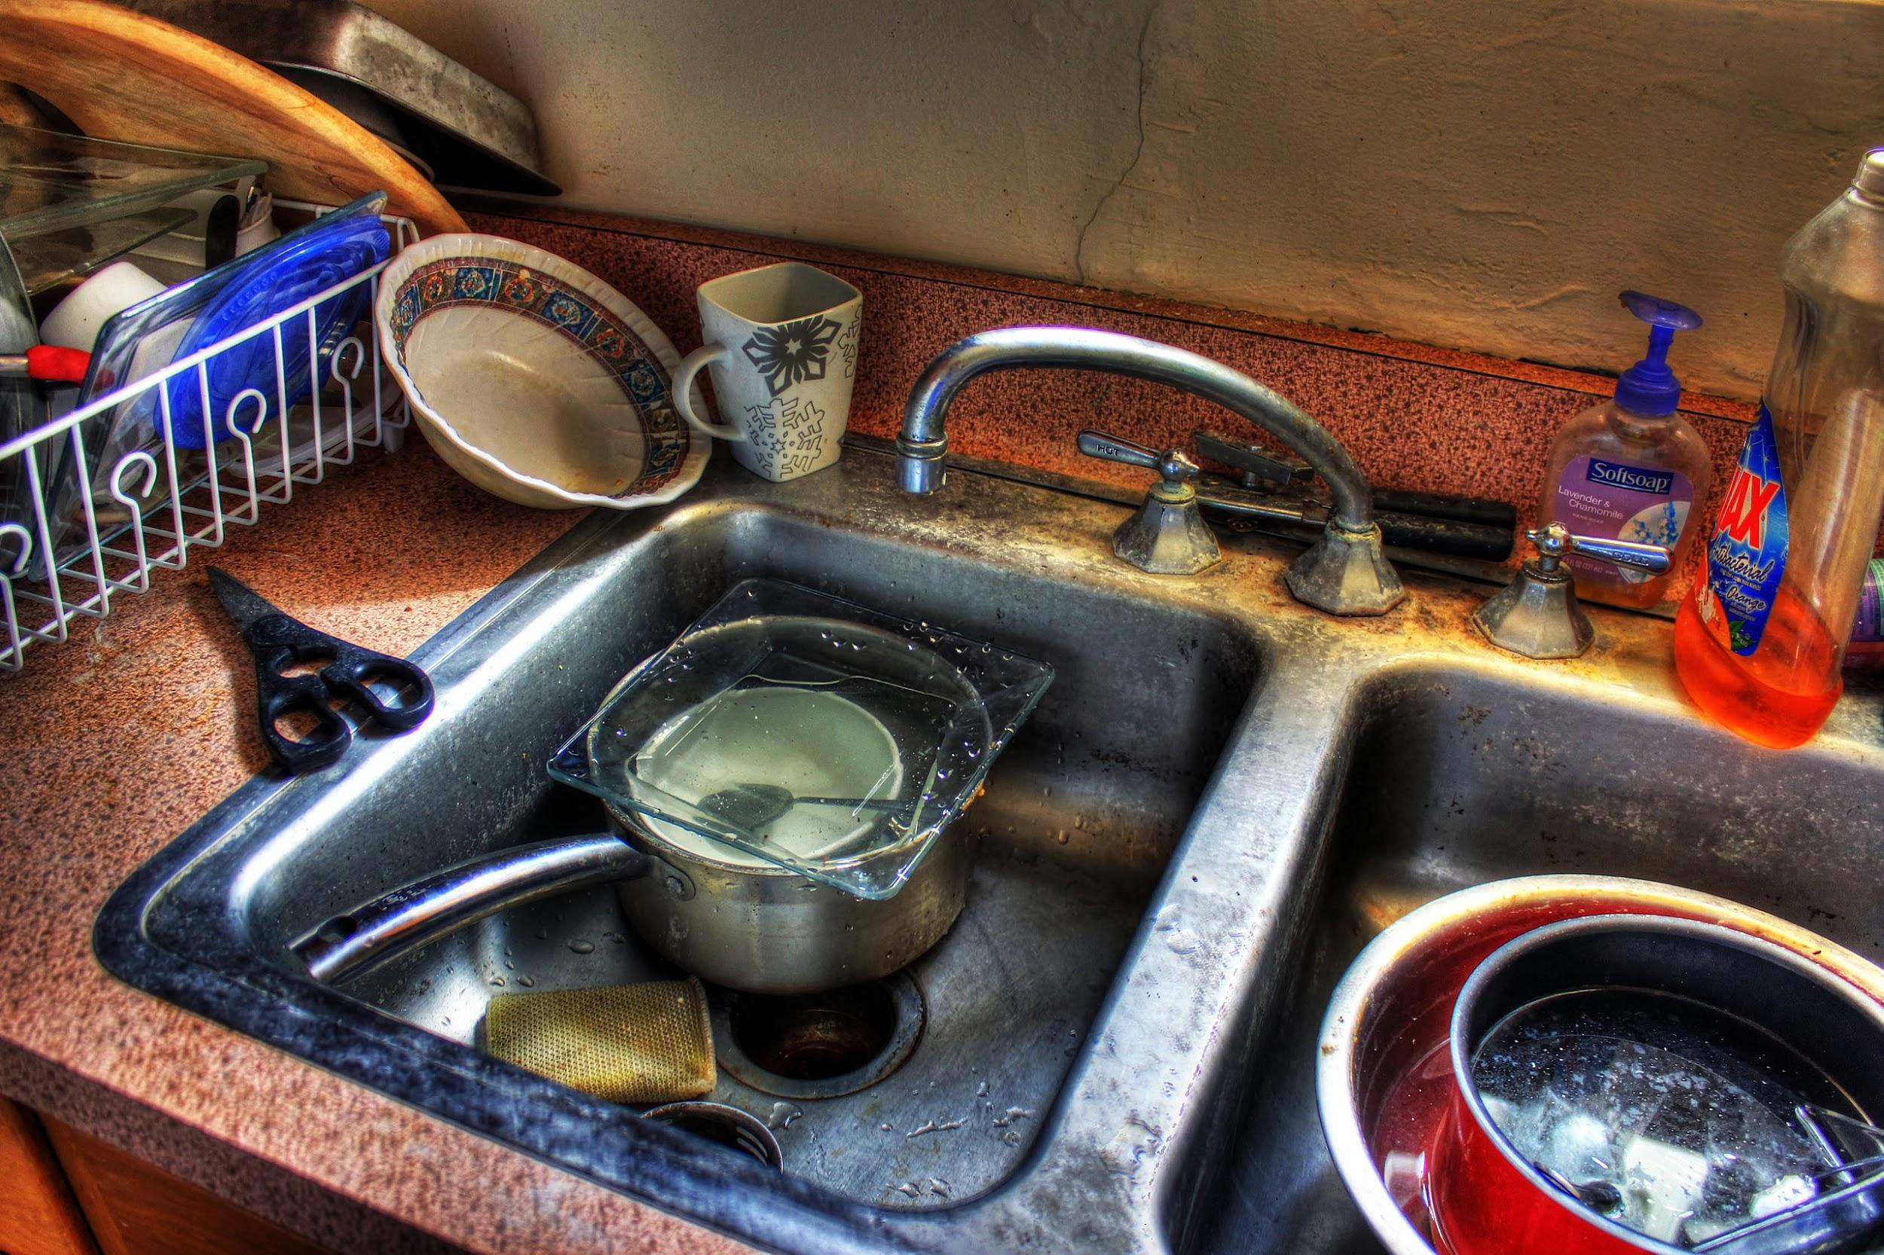
Craft – Starting to write
Genre – Real World

Slide 3
Disclaimer!
Time and Space
Practical Methods
Planning
Starting to write

Slide 4
Time and Space
Writing time management
Isolating blocks of time
Silence
‘Going to sleep’

Slide 5
Practical method
Handwritten v Electronic
Online programs

Slide 6
Planning
Outline v Writing Blind
Character biographies?
Plot-based narrative
Character-based narrative

Slide 7
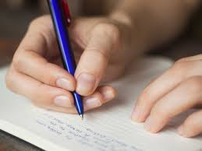
Starting to write
Turn off Editor
Comic strip approach
Progressive competency
Interview by the page

Slide 8
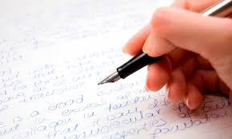
WRITING EXERCISE

Slide 9
Genre
‘Real World’
Observation

Slide 10
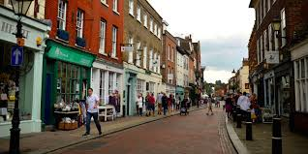
REALISM
‘The main artistic goal of the realist movement was the reliable depiction of daily motives, undertaken via the avoidance of both intricate technical conventions and any appeal to supernatural or exotic subjects.’
Falcato, Ana Christina, ‘Getting to the heart of the matter: Realism and Modernism in the novel’ Revista de Letras, Vol. 55, No. 1 (Janeiro/Junho 2015), pp. 9-24 (11)

Slide 11
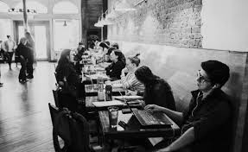
FURTHER DISCUSSION
‘[A] very detailed presentation of individual characters, who are identified by a common, non-typified proper name and to whom are ascribed both reasonably detailed physical characteristics and a deeply developed psychology – all framed, crucially, by a detailed description of the characters’ social environment. As far as specifically literary conventions go, the type of plot characteristic of the novel departed from previous literary structures to the extent that it came to fix previously narrated events as causes of present action.’ (Falcato 12)
Roma
By Deborah Levy
https://granta.com/roma-deborah-levy/

Slide 12

WORKSHOP

Slide 13
FINAL PROJECT
Optional
2000 words
In any genre/medium
Developed from weekly assignments or elsewhere
Submit on Final Week
Option to read on Final Session
Extended editorial response with advice on how to proceed within three months
Short individual consultations available later in course

Slide 14
HOMEWORK
Please write approximately 500 words of fiction set in the ‘Real World’ as we discussed. Parameters of the world should be as we live every day – pigs cannot fly, for example.
Please email to peer group and info@martinkeaveney.com by agreed deadline. Please also read sci-fi story to be sent on shortly.

Slide 15
Class 3 :
Strange World
Read Sci-fi story
Submit piece written in ‘Real World’
www.martinkeaveney.com 2022

