Slide 1
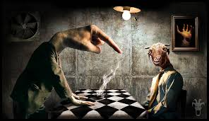
CREATIVE WRITING: INTRODUCTION
GALWAY ARTS CENTRE REMOTE COURSE
MARTIN KEAVENEY
Week 3
Strange World

Slide 2
TODAY
Craft : The Writing Life
Genre: Sci-fi

Slide 3
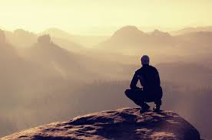
PSYCHOLOGY OF BEING A WRITER
Why write?
Will it be good enough?

Slide 4
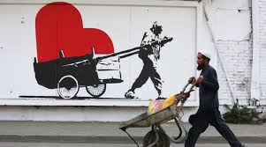
WRITER’S TOOLS
Recognising the role of the literary artist
Recognising ourselves as artists

Slide 5
PSYCHOLOGY OF BEING A WRITER
Consumption of Art (as a literary artist)
Modern visual arts
Contemporary music
Sculpture
Travel
Theatre
Cinema
Reading!

Slide 6

CONSIDERATIONS
Agenda driven material
Commercial driven i. e. advertising
Social issue driven
Politically driven
Considerations when using real life material as source

Slide 7

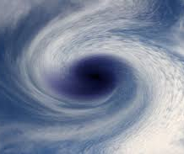
RAW MATERIAL
‘Write what you know’ - but what do we know?
Can what we know ‘work’ as literature?

Slide 8

WRITER’S TOOLS
Defiance toward externals?
Tell the story, not the [conscious] theme
Practice observation describing a room/scene without action or characters

Slide 9
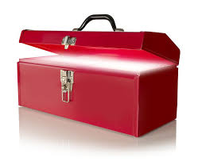
WRITER’S TOOLS
Observation:
Aural
Visual
Kinaesthetic

Slide 10
SCIENCE FICTION
If ever there was in the history of a literary genre one day when it can be said to have begun, it is May Day, 1871, for UK SF: "[Bulwer-Lytton's The Coming Race] appeared on May 1st, 1871, the day when Blackwood's of Edinburgh also published Chesney's Battle of Dorking in their magazine, and by an even more extraordinary coincidence the day when Samuel Butler brought the manuscript of Erewhon to Chapman and Hall."' This opens a period in British SF which culminates with the opus of Wells’ (Suvin 148)
Suvin, Darko. ‘Victorian Science Fiction, 1871-85: The Rise of the Alternative History Sub-Genre (Lascience-fiction victorienne, 1871-1885: l'émergence du sous-genre de l'uchronie). Science Fiction Studies, Vol. 10, No. 2, Science Fiction in the Nineteenth Century (Jul., 1983), pp. 148-169.

Slide 11
SCIENCE FICTION
‘In the 1871-85 period three main clusters or sub-genres of SF can be distinguished: the Extraordinary Voyage, the Future War, and the Altemative History’ (Suvin 148)
‘{Science Fiction]developed out of popular adventure novels; that is, it developed out of stories that substantially shaped the modern reader’s popular imagination about the non-European world, with its colonial imaginations about exotic cultures, dangerous wilderness, and European scientific-technical progress confronting primitive traditional backwardness’ (Shwartz 224).
Schwartz, Matthias. ‘How Nauchnaia Fantastika Was Made: The Debates about the Genre of Science Fiction from NEP to High Stalinism’ Slavic Review 72. 2 (Summer 2013), 224-246.

Slide 12
SCIENCE FICTION
‘"Fascist revolt," wrote Gisela von Wysocki in an essay on Leni Riefenstahl, "promised vagabondage in infinite and eternal spaces, in new eras. Life itself seemed new. One is at home and at the same time on another planet."' In spite of, and parallel to, the discourse of the archaic and von Wysocki , National Socialism wanted to be perceived as a future-oriented movement that would be able to realize German hopes to unite a conglomerate of politically contradictory ideas and social myths to shape a German future’ (Strzelczyk 543)
Strzelczyk, Florentine. ‘Motors and Machines, Robots and Rockets: Harry Piel and Sci-Fi Film in the Third Reich. German Studies Review, Vol. 27, No. 3 (Oct., 2004), pp. 543-561

Slide 13
Sci-fi reading
Use of premise
Suspension of disbelief
Rea-Unreal

Slide 14
FINAL PROJECT
In any genre covered
Up to 2,000 words
May be submitted and revised in later workshops (Weeks 5-7)
Brief one-to-one advice available at end of workshops (Weeks 6-7)
Submit/Read draft in final session
Feedback/advice how to proceed provided via email before September

Slide 15

WRITING EXERCISE

Slide 16

WORKSHOP

Slide 17
For Week 4:
Read assigned peer work
Submit a story to peer group written within a world [or space] with a level of physical parameters of your choosing. Please also email story to info@martinkeaveney.com
Max. 500 words - by usual deadline

Slide 18
LIVE CLASS & PODCAST
Join Zoom Meeting
https://us02web.zoom.us/j/88681034009
Meeting ID: 886 8103 4009
Podcast:
https://www.dropbox.com/s/mw9mjhcb3n89qoh/Week%203.mp3?dl=0

