Slide 1

CREATIVE WRITING:
SINGLE PROJECT
GALWAY ARTS CENTRE REMOTE: MARTIN KEAVENEY CREATIVE WRITING
WEEK 6: THE ROLE OF THE READER

Slide 2

THE READER AND THE WRITER
‘Except for a small corps of highly trained writers, most persons could get into written form few if any of the complicated and nuanced meanings they regularly convey orally’ ( Ong 10)
‘{T] he persons to whom the writer addresses himself normally is not present at all’ (Ong 10)
ONG, WALTER J. ‘THE WRITER'S AUDIENCE IS ALWAYS A FICTION’PMLA , JAN.,90. 1 (JAN., 1975), 9-21

Slide 3
THE READER AND THE WRITER
‘The problem is not simply what to say but also whom to say it to’ (Ong 11)
‘[…], the writer must construct in his [or her] imagination , clearly or vaguely, an audience cast in some sort of role – entertainment seekers, reflective sharers of experience […] inhabitants of a lost and remembered worls or prepubertal latency […] and so on’ (11).
ONG, WALTER J. ‘THE WRITER'S AUDIENCE IS ALWAYS A FICTION’PMLA , JAN.,90. 1 (JAN., 1975), 9-21

Slide 4
THE READER AND THE WRITER
‘The problem is not simply what to say but also whom to say it to’ (Ong 11)
‘[…], the writer must construct in his [or her] imagination , clearly or vaguely, an audience cast in some sort of role – entertainment seekers, reflective sharers of experience […] inhabitants of a lost and remembered works or prepubertal latency […] and so on’ (11).
‘A reader has to play the role in which the author has cast him, which seldom coincides with his role’ (11)
ONG, WALTER J. ‘THE WRITER'S AUDIENCE IS ALWAYS A FICTION’PMLA , JAN.,90. 1 (JAN., 1975), 9-21

Slide 5
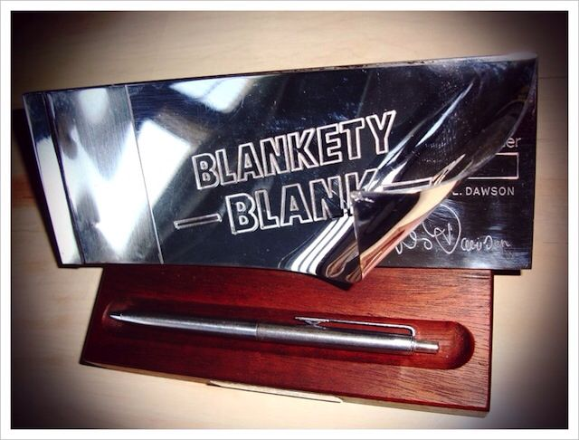
BLANKETY-BLANK CHEQUE BOOK & PEN

Slide 6
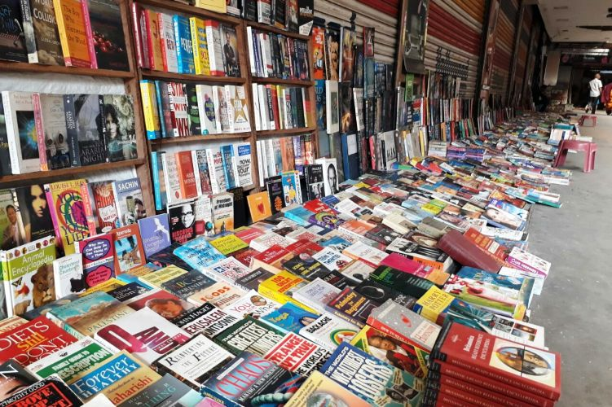
WRITING TO MARKET

Slide 7

CLARITY

Slide 8
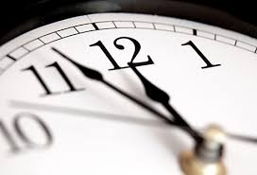
WRITING EXERCISE

Slide 9

WORKSHOP

Slide 10
NEXT WEEK : MOCK BLIND SUBMISSION
Possible Topics
Agents & Publishers List
Query Letter
Sample Draft Chapter
Sample Draft Synopsis
SUBMIT WEEKLY WRITING BY USUAL DEADLINE!!

Slide 11
LIVE CLASS
Now log in here for your live Video Conference class:
Join Zoom Meeting
https://us02web.zoom.us/j/83982245448

