Slide 1
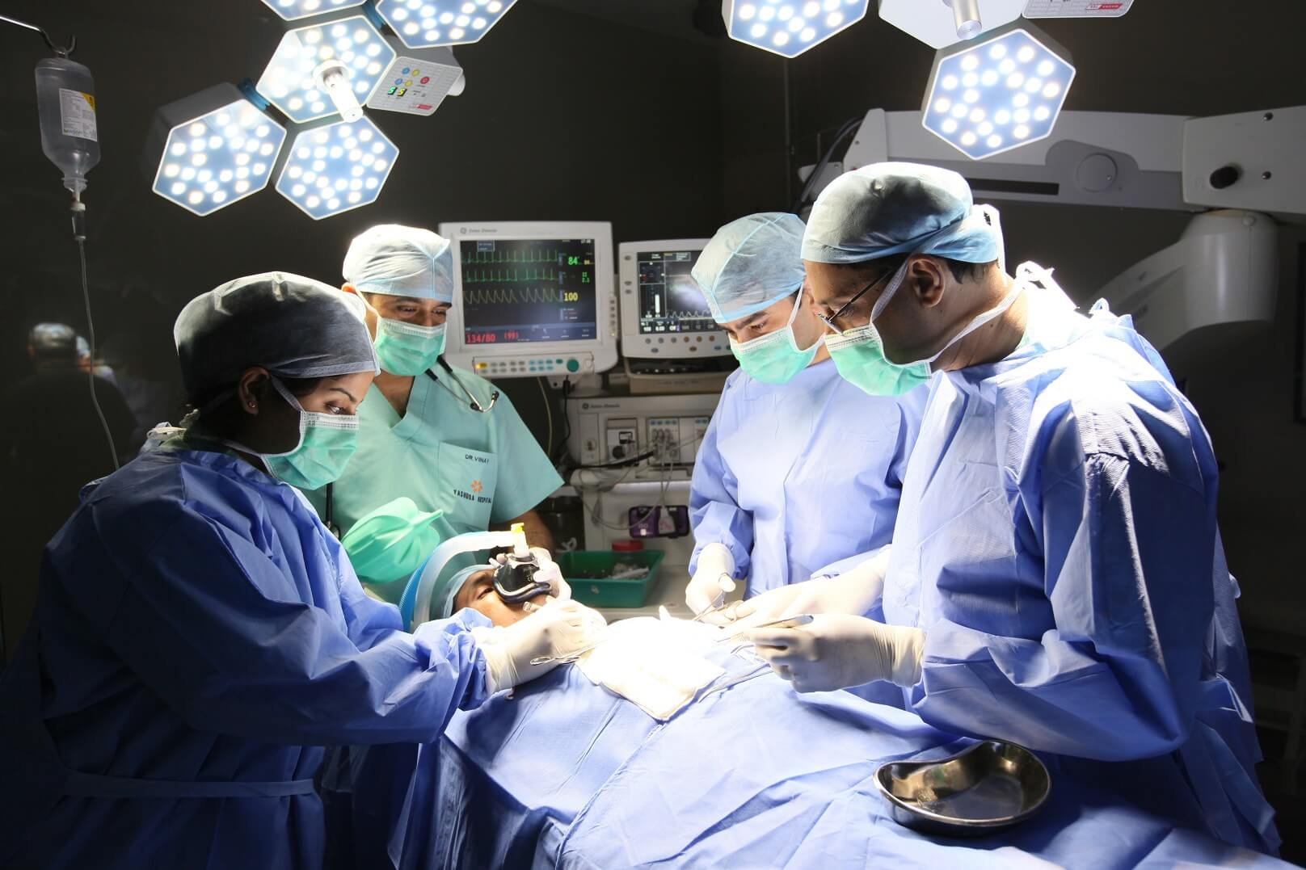
CREATIVE WRITING:
SINGLE PROJECT
GALWAY ARTS CENTRE REMOTE: MARTIN KEAVENEY CREATIVE WRITING
WEEK 5: MAJOR SURGERY

Slide 2


MAJOR SURGERY
LINEAR CHANGES

Slide 3

MAJOR SURGERY – DO NOT BREAK
‘THE ULTIMATE AIM FOR THE STORY WRITER IS […]
THE UNCONSCIOUS INTEGRATION OF FORM AND
SUBSTANCE IN THE SERVICE OF THEME’ (SHOEN 115)
Shoen, Barbara. Writing Fiction: Freedom through Constraint: Going beyond "You Don't Need to Know Anything" Author(s): Barbara Schoen Source: Improving College and and University Teaching 31. 3. (Summer, 1983)115-120.

Slide 4

MAJOR SURGERY – WHEN TO KILL
‘FICTION, LIKE ANY ART, IS FOCUSED TO A PURPOSE BY
THE ARTIST. […] AS LONG AS [WRITERS] WRITE TOTALLY
FROM LIFE , [THEY] ARE LIKE THE SWIMMER WHO KEEPS ONE
FOOT ON THE BOTTOM FOR SECURITY. THE SWIMMER
DOES NOT EXPERIENCE FREEDOM AND SELF-DIRECTION IN
THE NEW MEDIUM [FICTION] UNTIL [WRITERS]
TRUST […] TO IT WHOLLY’ (SHOEN 119).

Slide 5
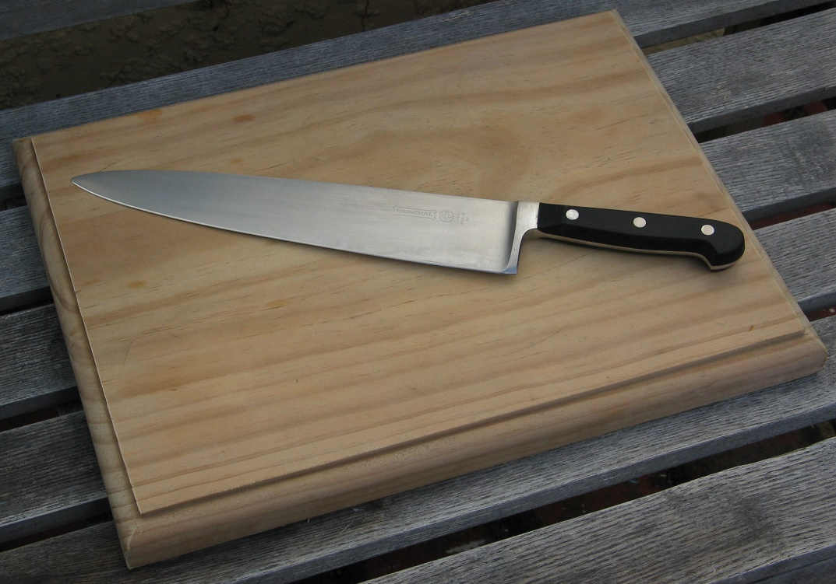
THE CHOPPING BOARD

Slide 6

WRITING EXERCISE

Slide 7

WORKSHOP

Slide 8
NEXT WEEK : THE ROLE OF THE READER
Possible Topics
Blankety-blank Cheque Book & Pen
Writing to Market
Clarity
SUBMIT WEEKLY WRITING BY USUAL DEADLINE!!

Slide 9
Now log in here for your live Video Conference class:
Join Zoom Meeting
https://us02web.zoom.us/j/83982245448
Meeting ID: 839 8224 5448
Now log in here for your live Video Conference class:
Join Zoom Meeting
https://us02web.zoom.us/j/83982245448
Meeting ID: 839 8224 5448
Now log in here for your live Video Conference class:
Join Zoom Meeting
https://us02web.zoom.us/j/83982245448

Slide 10
LOG IN TO CLASS
Now log in here for your live Video Conference class:
Join Zoom Meeting
https://us02web.zoom.us/j/83982245448

