Slide 1

CREATIVE WRITING:
SINGLE PROJECT
GALWAY ARTS CENTRE REMOTE: MARTIN KEAVENEY CREATIVE WRITING
WEEK 4 : CHANGING PERSPECTIVE

Slide 2
WHAT IS PERSPECTIVE?
‘HERE WE ARE CONCERNED WITH THE TRANSFORMATION WHICH THE NOTION OF “PERSON” UNDERGOES IN LITERARY NARRATIVE’
TZVETAN TODOROV, THE POETICS OF PROSE, CORNELL, 1977 (TRA.NS. RICHARD HOWARD)

Slide 3
CHANGING PERSPECTIVE
I WENT TO TOWN
YOU WENT TO TOWN
HE WENT TO TOWN
WE WENT TO TOWN
JOHN WENT TO TOWN, FEELING NERVOUS . [FREE INDIRECT DISCOURSE]

Slide 4
CHANGING PERSPECTIVE
SINGLE NARRATOR ((UN)RELIABLE)
MULTI–PERSON NARRATOR
RETROSPECTIVE
I WENT TO TOWN
I GO TO TOWN
I WILL GO TO TOWN, IT’S GOING TO BE AWFUL… [ANTICIPATORY]

Slide 5
CHANGING PERSPECTIVE
‘Focalization is defined by Genette as a restriction imposed on the information provided by a narrator about his characters.’(729).
‘In the terminology of Mieke Bal, internal and external focalization refer instead to the intra- or extra diagetic locus of the focalizer and have nothing to do with psychological penetration (729).
‘
Edmiston, William F. ‘Focalization and the First –Person Narrator: A Revision of the Theory.’ Poetics Today 10.4 (Winter, 1989) 729-744.

Slide 6

WHERE DO YOU PUT THE CAMERA?

Slide 7

WRITING EXERCISE

Slide 8

WORKSHOP

Slide 9
Dec 17th : MAJOR SURGERY
Possible Topics
Do not break!!
Linear Changes
When to Kill
SUBMIT WRITING BY FRIDAY 29th!!

Slide 10
BANK HOLIDAY!!!!
NO CLASS OCTOBER 25TH NEXT MONDAY - NEXT CLASS NOVEMBER 1ST

Slide 11
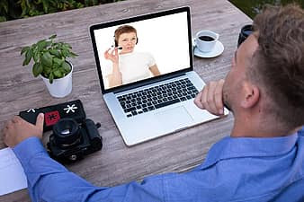
NOW TO CLASS!
Now log in here for your live Video Conference class:
Join Zoom Meeting
https://us02web.zoom.us/j/83982245448
Meeting ID: 839 8224 5448

