Slide 1
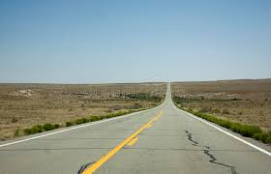
CREATIVE WRITING:
SINGLE PROJECT
MKCW : DR MARTIN KEAVENEY
WEEK 2 :LONG FORM FICTION

Slide 2

WRITING LONG FORM
NOVELS
FILM
3 ACT PLAYS
OPERAS
SAGAS
OTHERS

Slide 3
WRITING LONG FORM
‘In The Theory of the Novel, the novel is considered not as a "closed" (geschlossen) art form but as a mode of thought, predicated upon a discrepancy - between "the conventionality of the objective world and the interiority of the subjective one" (70). This gap is unbridgeable; or rather, the novel is the expression of that gap’ (Bewes 17).
‘The Novel Problematic’
By TIMOTHY BEWES
NOVEL: A Forum on Fiction , SPRING 2011, Vol. 44, No. 1 (SPRING 2011), pp. 17-
19

Slide 4
WRITING LONG FORM
‘Entertainment Novel v ‘Proper Novel’
‘The entertainment novel opens up a problematic, which may be ethical or philosophical, and addresses or deals with it within the work, which is exhausted by it. The entertainment novel reserves all concerns and pre-occupations of the novel for the content of the work; it thereby presupposes an ethical legitimacy to the novel itself and to the activity of the novelist’ (Bewes 17).

Slide 5
WRITING LONG FORM
‘Entertainment Novel v ‘Proper Novel’
‘The novel "excludes completeness," [Georg Lukacs] writes, but "only so far as content is concerned" (73). "In contrast to other genres whose existence resides within the finished form," the novel "appears as something in process of becoming" (72-73). The world of the novel is one in which an instantiation of the problematic is impossible, for the problem that defines the novel is that of instantiation itself. In the novel, unlike other forms, representation (of ideas, characters, or viewpoints) is not a technical problem but an ethical one’ (Bewes 17).

Slide 6
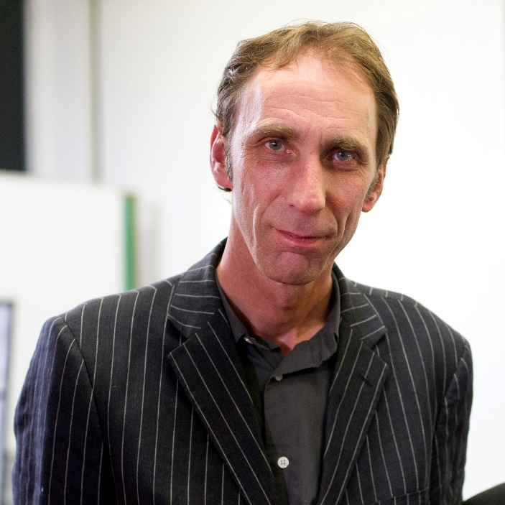
MEDIA
HTTPS://WWW.YOUTUBE.COM/WATCH?V=S2MO5HLWCSG&T=182S

Slide 7

WRITING EXERCISE

Slide 8

WORKSHOP

Slide 9
NEXT WEEK : WRITING OUT OF RYTHYM
Possible Topics
Starting at the end
Cutting
Adding
SUBMIT WEEKLY WRITING BY USUAL DEADLINE!!

Slide 10

NOW TO CLASS!
Now log in here for your Video Conference class:
Join Zoom Meeting

