Slide 1

CREATIVE WRITING:
SINGLE PROJECT
GALWAY ARTS CENTRE REMOTE: MARTIN KEAVENEY CREATIVE WRITING
WEEK 1 :INTRODUCTION

Slide 2

INTRODUCTION

Slide 3
SINGLE PROJECT
WRITING CRAFT
YOUR PROJECT
YOUR SPACE

Slide 4
FORMAT
SHORT DISCUSSION ON WRITING CRAFT
OPTIONAL GROUP WRITING EXERCISE
WORKSHOP

Slide 5
INTRODUCTION
Long and short form works
Collaboration
Weekly Submission
Peer Reviews

Slide 6
WEEK 2: LONG FORM FICTION
Possible topics
Planning
Writing
Editing
Publishing

Slide 7
WEEK 3: WRITING OUT OF RYTHYM
Possible Topics
Starting at the end
Cutting
Adding

Slide 8
WEEK 4: CHANGING PERSPECTIVE
Possible Topics
1st, 2nd, 3rd Person Approaches

Slide 9
WEEK 5: MAJOR SURGERY
Possible Topics
When to kill

Slide 10
WEEK 6: THE ROLE OF THE READER
Possible Topics
Where to leave blanks

Slide 11
WEEK 7: MOCK BLIND SUBMISSION
Possible Topics
Preparing a proposal

Slide 12
WEEK 8: MARKETING
Possible Topics
Websites & Social Media

Slide 13
WEEK 9: SPECIAL FOCUS
Possible Topics
Class Projects
Suggested topics

Slide 14
WEEK 10: SPECIAL FOCUS
Possible Topics
Class Projects
Suggested topics

Slide 15
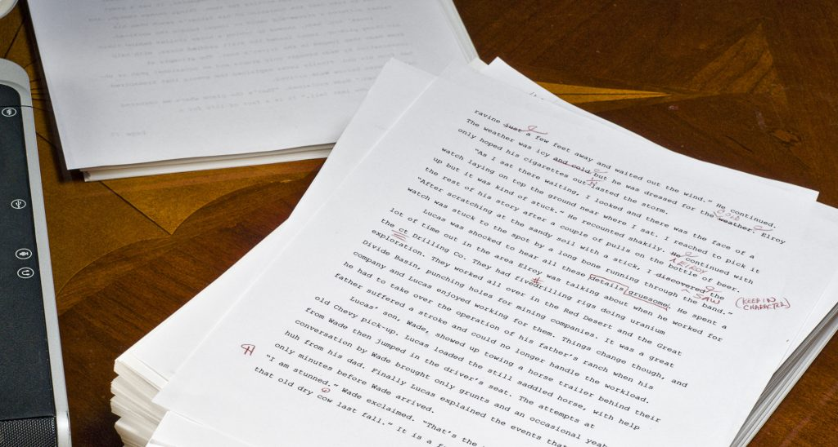
WEEK 11: FINAL PROJECT DISCUSSIONS
Final Projects

Slide 16
WEEK 12: FINAL PROJECT DISCUSSIONS
Final Projects
Conclusion
Revised Single Project Submission Date TBA

Slide 17

WRITING EXERCISE

Slide 18

WRITERS’ PROJECTS

Slide 19

FOR DISCUSSION…
Ruscha, Ed. ‘Pay Nothing Until April’. Tate Modern, 2003.

Slide 20
FINAL PROJECT
Submissions up to:
Novel excerpt 10,000 words plus 500 word synopsis
3 Chapters/Selected stories (10,000 words)
1,000 lines of poetry plus 500 word synopsis of a poetry collection
Feature film treatment 1,000 words plus
25 pages of screenplay
60 pages of stageplay
Enquire for other project types
1-to-1 consultations available
on Weeks 9,10 & 11 (5-10 mins)
Submit draft on Week 12:
Final Revised Manuscript:
TBA
Editorial Response: TBA

Slide 21
THIS WEEK’S SUBMISSION
Submit an excerpt or a piece from your Main Project or another
piece of writing you’d like to workshop to you peer group by the usual deadline and also to info@martinkeaveney.com.
THIS COURSE DEADLINE:
MIDNIGHT ON TUESDAY
Peer-Review:
Peer Groups to be forwarded shortly.

Slide 22
NEXT WEEK : WEEK 2 – LONG FORM FICTION
Suggested topics relating to writing Long Form Fiction are welcome (Length of discussion will be determined by number of pieces for workshop – further material in video)
Please try to read the other work by your peers and don’t forget to submit your work!
Prepare some brief verbal comments for your peers’ work and also on this weeks’ samples.

Slide 23
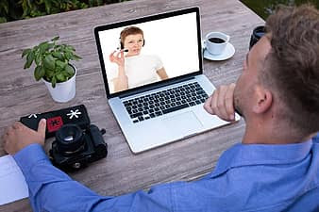
NOW TO CLASS!
Log in here for your Live Video Conference class:
Join Zoom Meeting
https://us02web.zoom.us/j/83982245448
Meeting ID: 839 8224 5448

