Slide 1
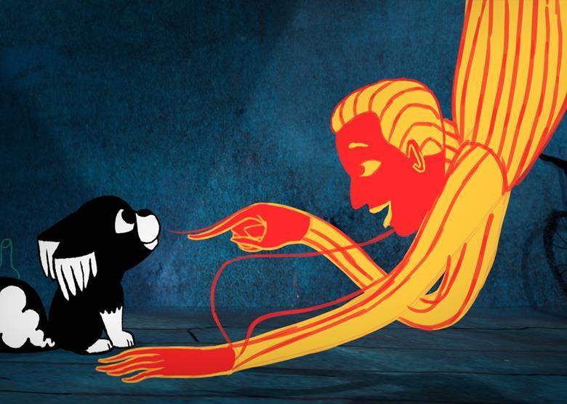
CREATIVE WRITING: INTERMEDIATE
REMOTE WITH GALWAY ARTS CENTRE
MARTIN KEAVENEY
Week 6
Wonder World

Slide 2


Genre: Fantasy
Craft: Review

Slide 3
Fantasy
What is Fantasy? What is Fantastic Literature?
‘[A] generous approach to the genre includes any work that contains
magic or other elements that cannot be understood by the rules of reality. It also includes largely realistic works set in imagined variations on certain historical periods, the medieval era in particular’ (Burcher et al. 227)
‘The best fantasy fiction features a wonderful blend of action, strong characters, and detailed, atmospheric settings. Classical themes such as honor, love, war, revenge, responsibility, otherness, obsession, and loyalty are explored in fantasy tales. Subjects such as bigotry,
greed, religious extremism, politics, abuse, and addiction can be examined in fantasy contexts without offending cultural sensitivities. Fantasy is a chameleon, taking in elements of
historical, romance, crime, and adventure fiction, often inthe pages of the same book’ Burcher et al. 227)
Core Collections in Genre Studies: Fantasy Fiction 101
Author(s): Charlotte Burcher, Neil Hollands, Andrew Smith, Barry Trott and Jessica
Zellers

Slide 4
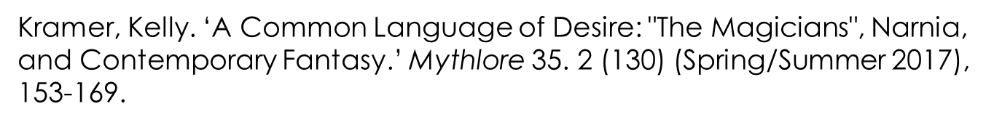
Fantasy
Examples of Fantasy Fiction
Attebery surveyed a large group of university professors as to which works were "quintessential fantasy" and came up with the titles Dracula, The Worm Ouroboros, Alice in Wonderland, Ursula le Guin's Earthsea series, and,at the top of the list, The Lord of the Rings (14). (Kramer 156)

Slide 5
Fantasy
Urban Fantasy
The beginnings of urban fantasy have been assigned to various points in time and connected to different originators. In his entry in The Encyclopedia of Fantasy (1997), John Clute traces the history of urban fantasy from the edifices of Horace Walpole's The Castle of Otranto (1764) to contemporary urban fantasists. To him, the mid-19th century writers Charles
Dickens and Eugène Sue are literary progenitors, but he refrains from giving a specific date for when the genre began. Alexander C. Irvine proposes an even longer heritage for the fantastic city, tracing its roots "in Utopian and quest literature all the way back to the Ur of Gilgamesh" (202). Helen Young similarly acknowledges a long history for one sort of urban fantasy, back to Plato’s Republic and Thomas More's Utopia (1516) (141) (Ekman 153).
Ekman, Stefan ‘Urban Fantasy: A Literature of the Unseen’
Journal of the Fantastic in the Arts 27. 3 (2016), pp. 452-
469.

Slide 6
Fantasy
Further Discussion
.
Traditionally, the genre of fantasy has been understood as stemming from Medieval Romance and fairy tales, and, even further back, from myths and legends of the ancients. ‘ (Kramer 153)
First, in terms of the content, it is "the impossible," something that could never happen in the real world (14). Next, fantasy also requires comic structure, in the classical sense of comedy: Attebery writes, "Death, despair, horror, and betrayal may enter into a fantasy, but they must not be the final word" (15). Finally, fantasy must aim to evoke the response of wonder within readers (16). (Attebery qtd in Kramer 156)

Slide 7
Fantasy
Building the world
Projecting a plot
Unusual Approach
Happy Endings(?)
Others

Slide 8
This week’s reading
Northern Lights
Wonder World
Character
Plot

Slide 9
To be revealed!

Slide 10
Review
Practice
Writing
Revising
Sharing
Publishing

Slide 11

WORKSHOP

Slide 12
WORKSHOP
This week:
Write a piece of fantasy in prose. Use the class exercise, if you wish. Aim for up to 2,000 words. Share with Peer Group. You may also choose to work on Final Project.
Prepare some brief verbal comments for your peers’ work and also on this weeks’ reading.

Slide 13
NEXT WEEK
This week’s slides will be emailed
Reading for next week will be emailed
Read the other work in your peer group and read the extract.
Write your piece(s)!
Any questions – email info@martinkeaveney.com

Slide 14
LIVE CLASS & PODCAST
Join Zoom Meeting
https://us02web.zoom.us/j/87905445113
Meeting ID: 879 0544 5113
Podcast:
https://www.dropbox.com/s/47rpdqvujpommjy/Inter%20Week%206.mp3?dl=0

