Slide 1
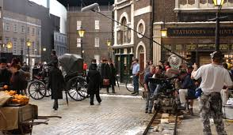
CREATIVE WRITING: INTRODUCTION
GALWAY ARTS CENTRE
MARTIN KEAVENEY
Week 8
The World on Screen

Slide 2
Week 8:
Medium of Screen
Final Readings
Course Conclusion

Slide 3


Screen v Stage
Early films
Rise of Montage
TV/Film

Slide 4
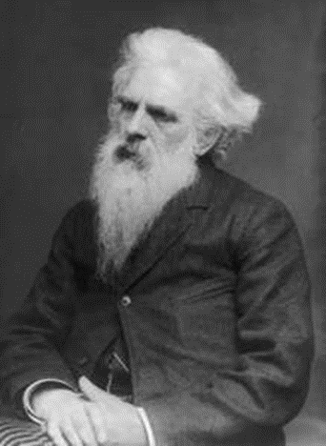
EADWEARD MUYBRIDGE
born April 9, 1830, Kingston upon Thames, Surrey, Eng.—died May 8, 1904, Kingston upon Thames)

Slide 5
Processes of scriptwriting
Outline approach
Writing approach
Shortest way round
Photographic writing
Three act structure
Combinations

Slide 6
Conventions
INT. – KITCHEN – DAY
John, 40s, eats breakfast.
Mary, 30s, enters in dressing gown.
  MARY
  Is that the last of them?
  JOHN
  No, there’ s another fifty boxes in the cat litter tray…
Characters defined only through dialogue and action.
Minimise all other text.

Slide 7
Submissions
Short pieces
Production companies
Agents
Collaboration

Slide 8

THIS WEEK’S WRITING

Slide 9
CLASS FEEDBACK
Class rep
In class feedback
Testimonials

Slide 10
FINAL PROJECTS
Those who submit Final Projects will receive feedback and advice on
how to proceed in via email.
Any revisions must be submitted before 5pm on Friday 23rd December.

Slide 11
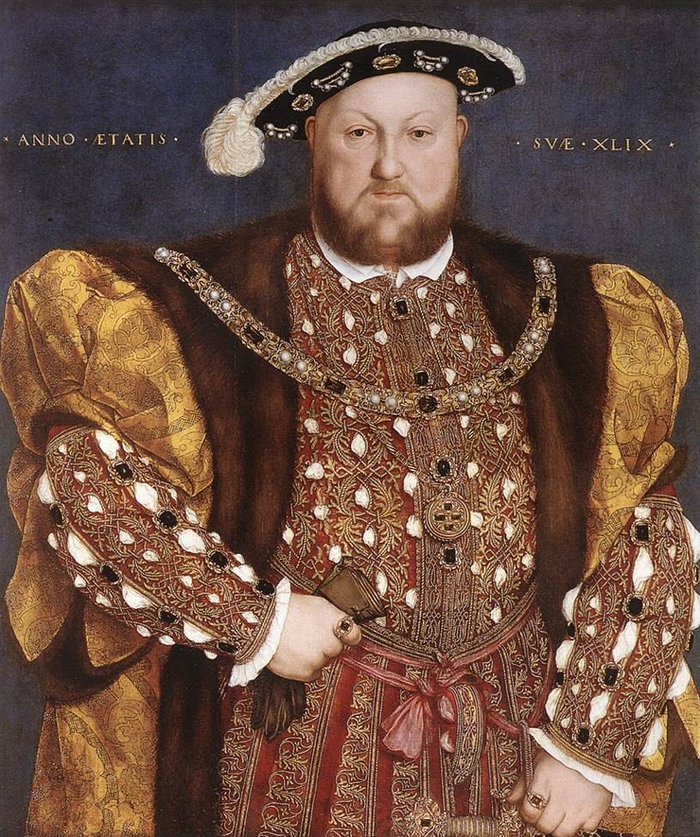
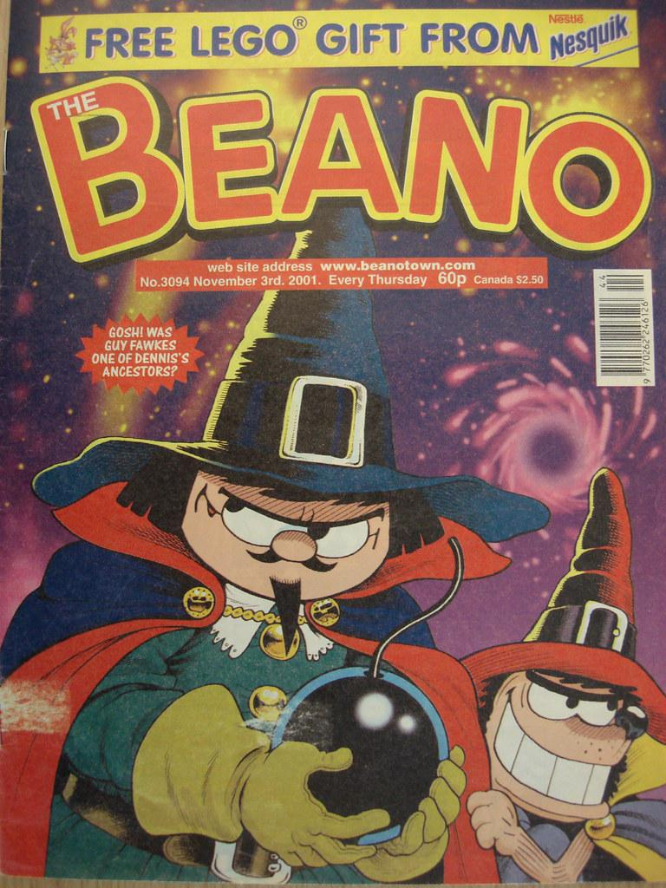

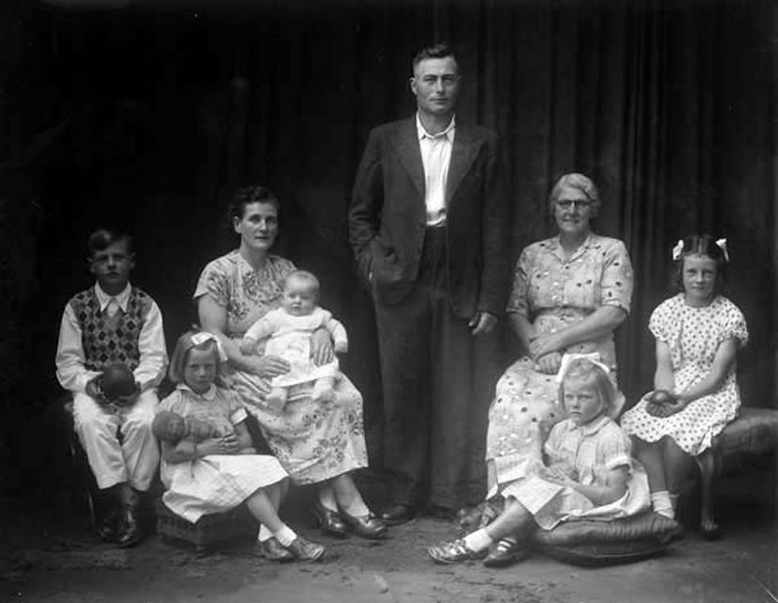
ENJOYED THIS COURSE?
INTERMEDIATE STARTS WEDNESDAY 2nd FEBRUARY 2022 - SAME TIMES
Historical Fiction - Nonfiction - Memoir - Comics - Childrens /YA - Fantasy - Radio - Comedy
Book here

Slide 12

FINAL READINGS

Slide 13
CONGRATULATIONS!!
Keep writing!
Keep reading!
Maintain links with class
Publish your work!
Let us know of any launches/readings!
Thanks for taking the course, sharing your work and providing feedback to your class!
www.martinkeaveney.com 2021

Slide 14
LIVE CLASS & PODCAST
Join Zoom Meeting
https://us02web.zoom.us/j/88681034009
Meeting ID: 886 8103 4009
Podcast
https://www.dropbox.com/s/hzov1qlzpoz3qa8/Week%208.mp3?dl=0

