Slide 1
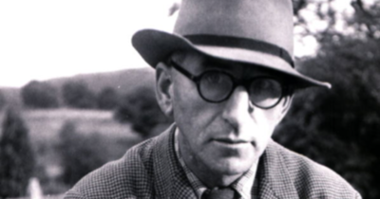
IRISH LITERATURE
From Yeats to McKeon
Dr Martin Keaveney
Week 4 Patrick Kavanagh

Slide 2


PATRICK KAVANAGH
‘Address to an Old Wooden Gate’ (1929)
Thank You, Thank You (1963)

Slide 3
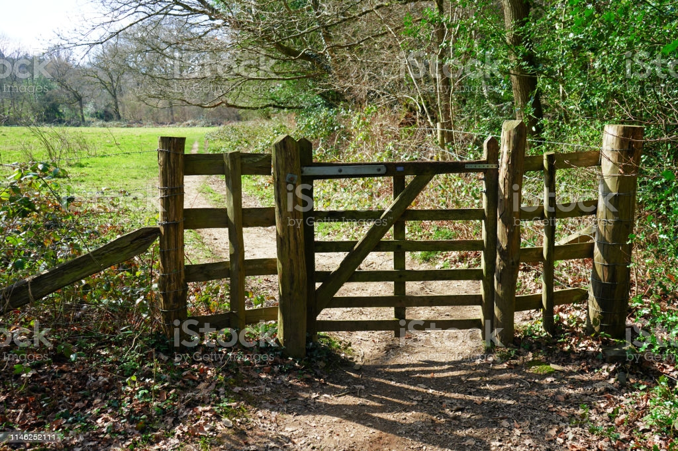
‘ADDRESS TO AN OLD WOODEN GATE’
Dundalk Democrat, 2 February 1929.

Slide 4
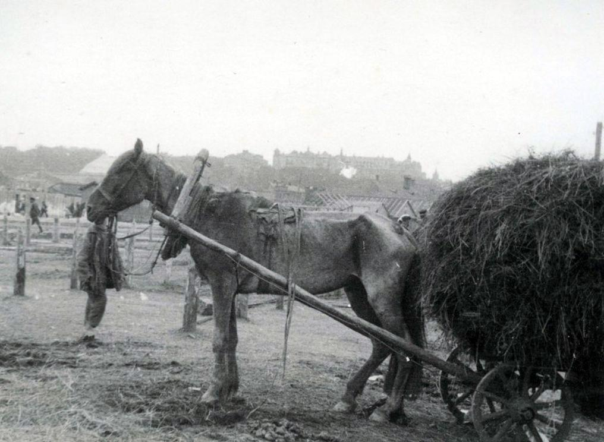
THE GREAT HUNGER
Partial publication as ‘The Old Peasant’ , Horizon, 1942.
Full version Cuala Press, 1942.
This Photo by Unknown Author is licensed under CC BY-SA

Slide 5
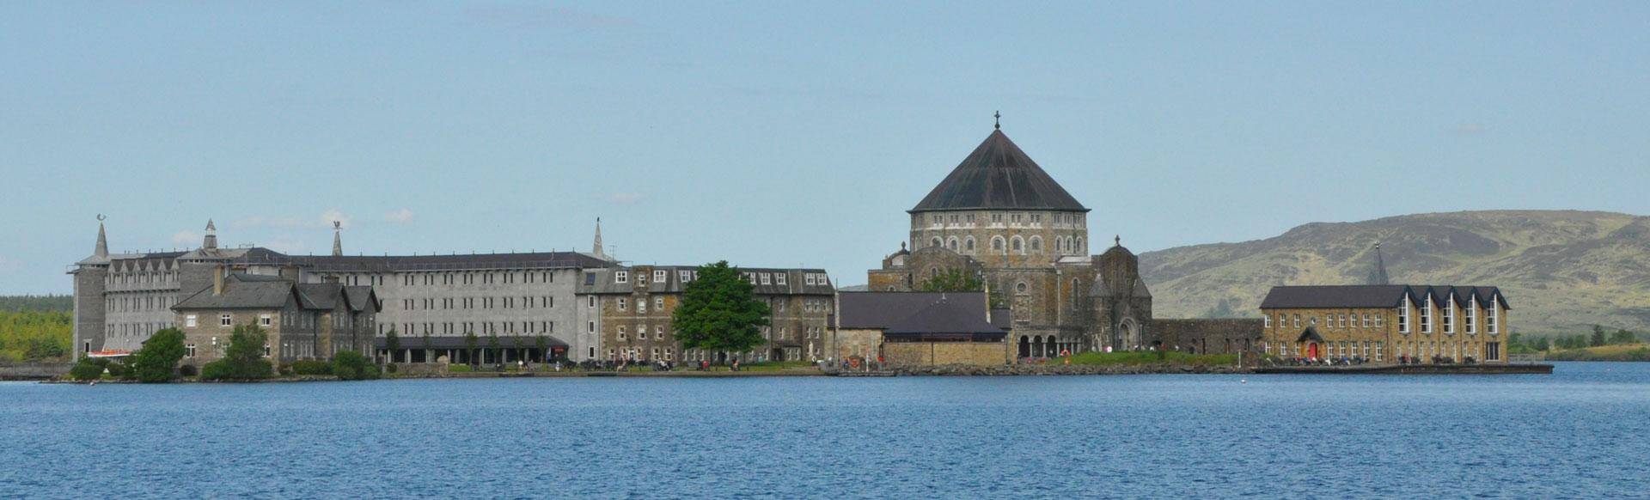
LOUGH DERG
November Haggard, 1971.

Slide 6
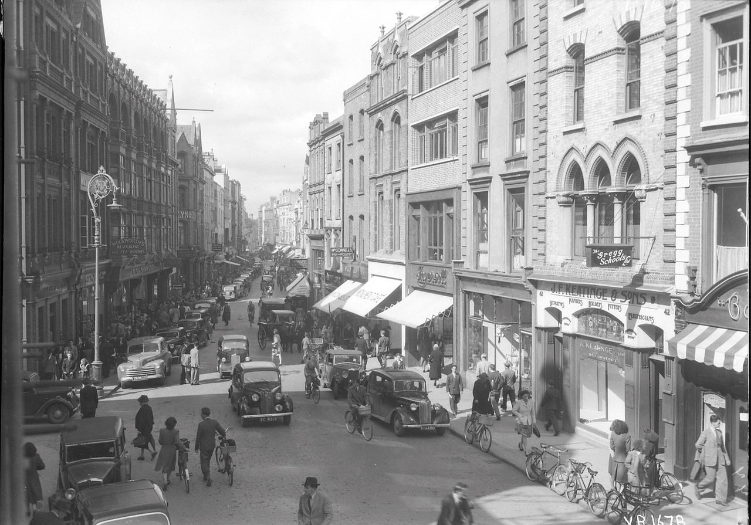
‘THANK YOU, THANK YOU’
Arena (Spring 1963)
This Photo by Unknown Author is licensed under CC BY-SA

Slide 7
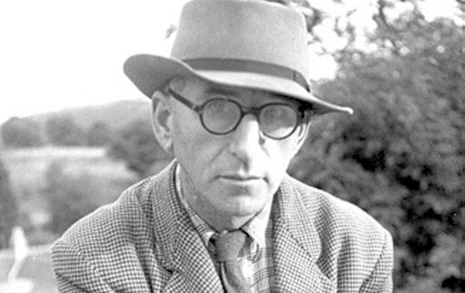
PATRICK KAVANAGH
’
Born on 21 October 1904 Inniskeen,
Co. Monaghan
Died Dublin, 30 November 1967

Slide 8
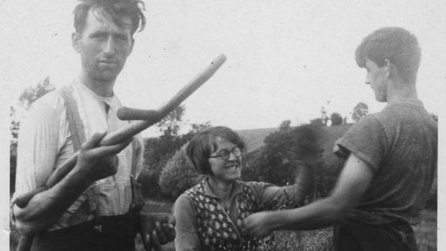
LIFE & TIMES
Father James a cobbler, bought farm in 1910
Young Patrick removed frrom school at 13 to serve as cobbler-cum-farmer
Worked on farm until 35
First published in 1929
Published Ploughman and Other Poems (1936)
Notable: ‘Inniskeen Road: July Evening’

Slide 9
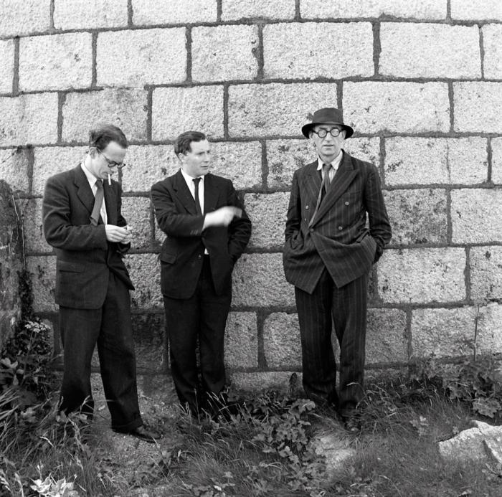
LIFE & TIMES
1937 – commissioned to write autobiography The Green Fool
The Green Fool withdrawn in 1939 due to libel action by Oliver St. John Gogarty
1939 – Moves to Dublin permanently
1942 The Great Hunger

Slide 10
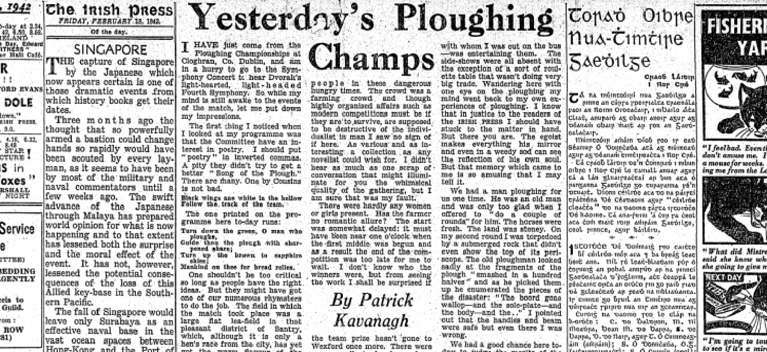
LIFE & TIMES
1942-1944 Columnist The Irish Press
1946-1949 Film Critic The Standard
1948 Tarry Flynn (Novel)
1949 ‘The Paddiad’
‘From 1950 onward, he demanded that writing should reveal the personality rather than the nationality of the writer (Quinn, Oxford DNB)
‘Irishness is a form of Anti-Art ‘ (X , 1961)

Slide 11
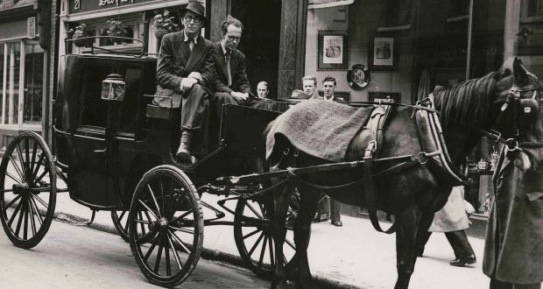
LIFE & TIMES
1949-1951 – Diarist with Envoy
1952 Co-editor Kavanagh’s Weekly
1954 – Loses Libel action against The Leader
1955- Diagnosed with lung cancer. Lung removed.
1960 Come Dance with Kitty Stobling

Slide 12
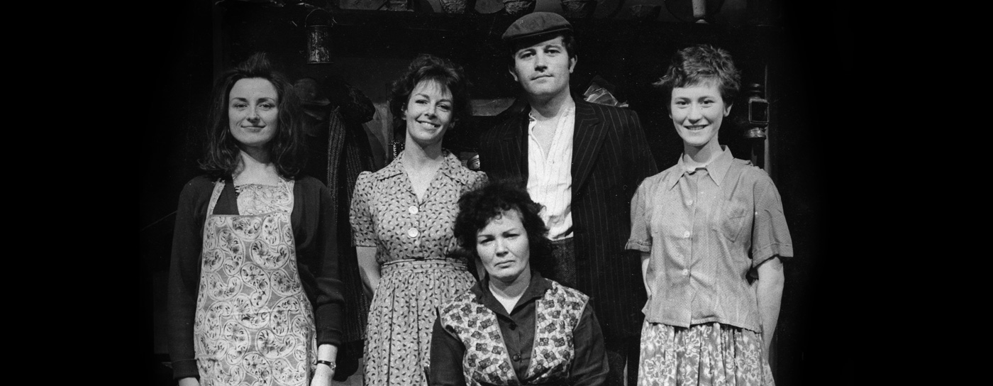
LIFE & TIMES
1955- Extra-Mural Lectureship UCD
1958-1963 Columnist Farmer’s Journal
1963-1967 Columnist RTE Guide
1963 Collected Poems
1966 Adaptation of Tarry Flynn at The Abbey Theatre

Slide 13
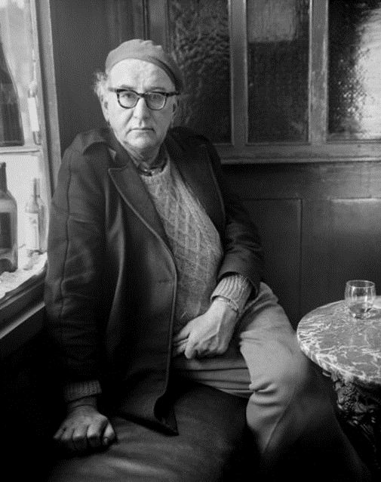
LIFE & TIMES
April 1967 – Marries Katherine Barry Maloney
November 1967 Dies of pneumonia in Merrion Nursing Home, Dublin.
Buried in Inniskeen.
‘His message to Irish poets was to de-nationalize and 'try to be more human’. (Quinn Oxford DNB)

Slide 14

MEDIA
https://www.youtube.com/watch?v=pLISXyxKf7k

Slide 15
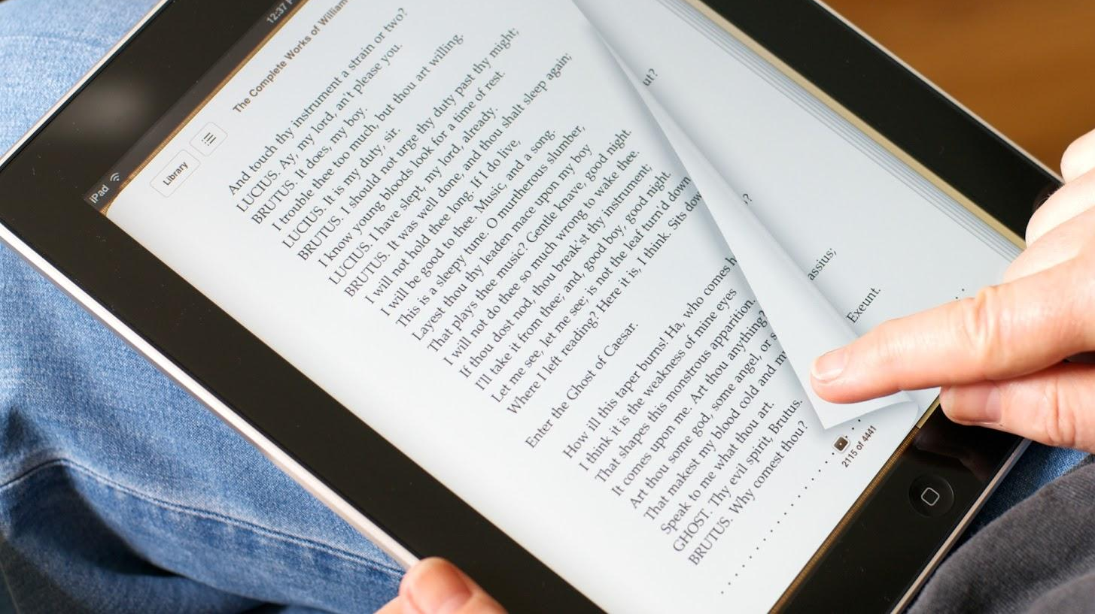
READING
This Photo by Unknown Author is licensed under CC BY-SA-NC

Slide 16
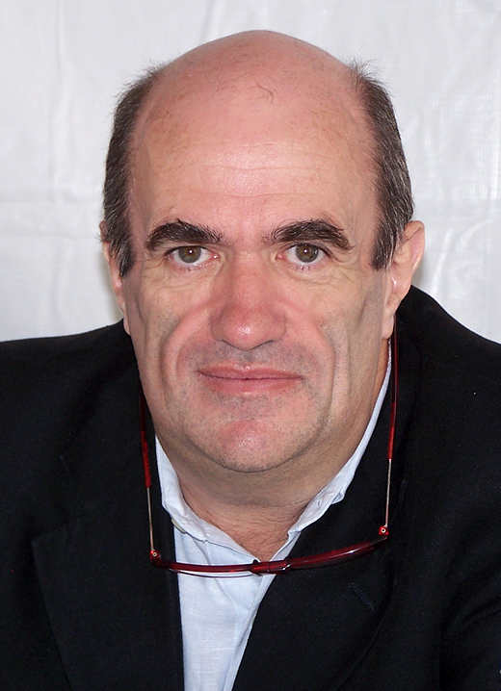
NEXT WEEK
Colm Toibin
]

Slide 17
LIVE SESSION
Log in: https://nuigalway-ie.zoom.us/my/mkeaveney

